Slide 1
IMPACT OF LOW PENETRANCE VARIANTS ON BREAST CANCER MORBIDITY AND PROGNOSIS
M. Ustinova, L. Kalniņa, M. Nakzawa-Miklaševiča, Z. Daneberga,
E. Miklaševičs, J. Gardovskis
Institute of Oncology, Riga, Latvia
The National Research Programme «Biomedicine for Public Health»
25.05.2016.

Slide 2
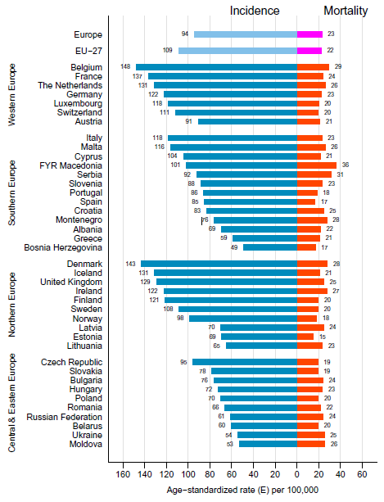
BREAST CANCER
Leading cancer site
The main cause of cancer related death

Slide 3
BREAST CANCER
Leading cancer site
The main cause of cancer related death

Slide 4
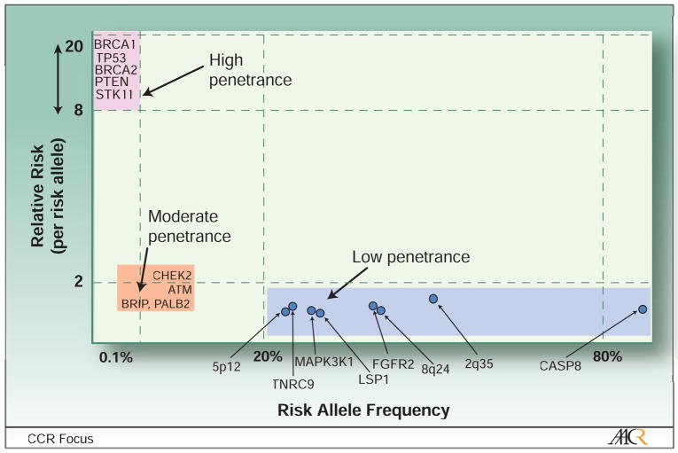
GENETIC ALTERATIONS ASSOCIATED WITH BREAST CANCER
(Garcia-Closas and Chanock 2008)

Slide 5
GENETIC ALTERATIONS ASSOCIATED WITH BREAST CANCER
75
(Garcia-Closas and Chanock 2008)

Slide 6
THE AIM OF THE STUDY
To determine the impact of four low-penetrance variants on breast cancer morbidity and prognosis in population of Latvia.

Slide 7
LOW-PENETRANCE ALLELIC VARIANTS
Allelic variant | Alleles | Localization | MAF
rs9693444 | C/A | Chr8:29509616 RPL17P33 / LINC00589 | 0.32
rs1436904 | T/G | Chr18:22824665 CHST9 intron | 0.40
rs616488 | A/G | Chr1:10488802 PEX14 intron | 0.33
rs204247 | A/G | Chr6:13830502 RANBP9 | 0.43

Slide 8
STUDY GROUPS
PATIENT GROUP
2,214 European descent breast cancer patients with no proven founder variants c.181T>G, c.4035delA and c.5266dupC in the BRCA1 gene and/or positive family history of disease
CONTROL GROUP
861 European descent voluntary women without any oncologic illnesses detected at the time of application

Slide 9
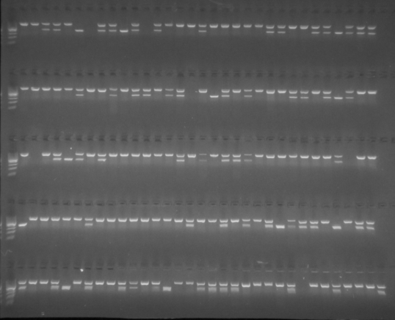
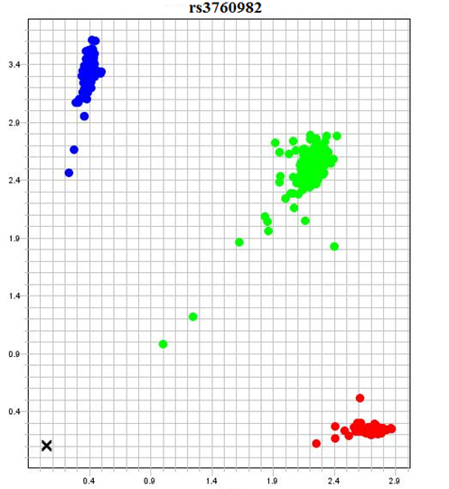
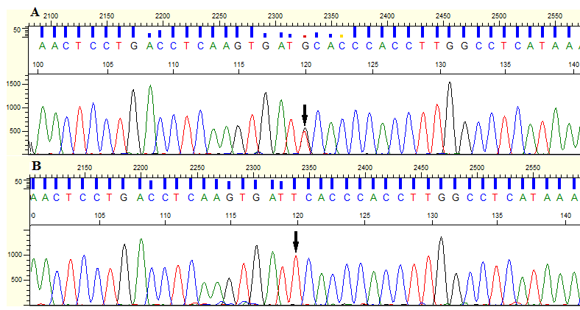
METHODS
RFLP
TaqMan probes
DNA isolation from peripheral blood leukocytes
Genotyping: RFLP and TaqMan probes
Verification of methods by Sanger sequencing
Data collection
Sanger sequencing

Slide 10
Results

Slide 11
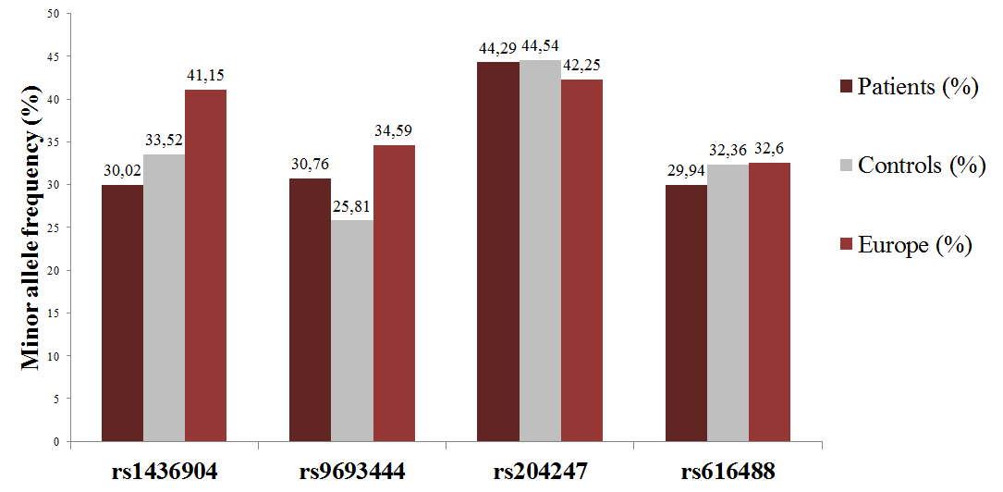
MINOR ALLELE FREQUENCIES

Slide 12
rs1436904
48.6% breast cancer patients 47.1% controls.
Heterozygotes OR = 0.79; 95% CI = 0.63 – 1.00.
Homozygotes OR = 0.62; 95% CI = 0.45 – 0.87.
p = 0.008
Protective effect

Slide 13
rs9693444
52.4% breast cancer patients 44.2% controls.
Heterozygotes OR = 1.39; 95% CI = 1.11 – 1.75.
Homozygotes OR = 1.44; 95% CI = 0.98 – 2.13.
p = 0.005
Increased breast cancer risk

Slide 14
rs204247
31.59% of breast cancer patients and 24.89% of control women.
Heterozygotes OR = 0.88 95% CI = 0.68 – 1.14
Homozygotes OR = 1.04 95% CI = 0.75 – 1.45
p = 0.423
No statistically significant effect

Slide 15
rs616488
49.96% of breast cancer patients and 46.74% control women.
Heterozygotes OR = 0.86; 95% CI = 0.68 – 1.09
Homozygotes OR = 0.84; 95% CI = 0.57-1.25
p = 0.367
No statistically significant effect

Slide 16
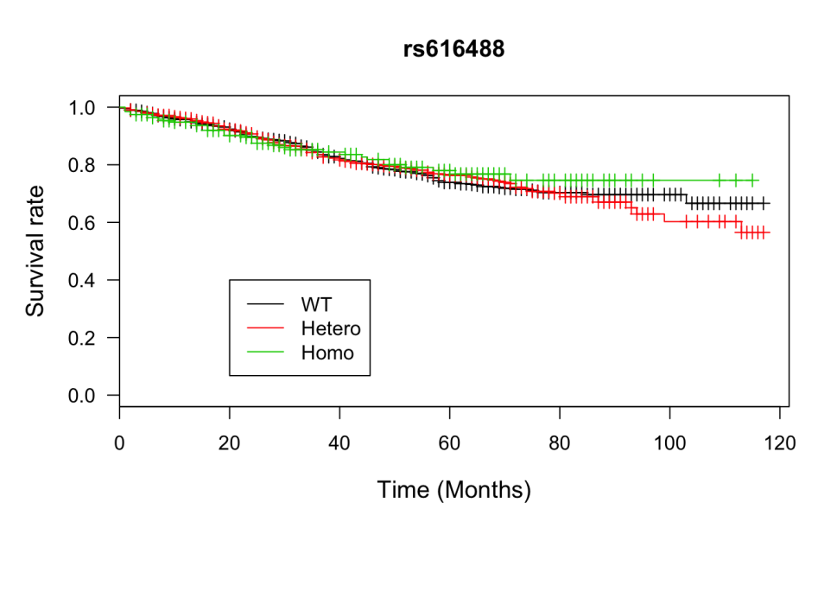
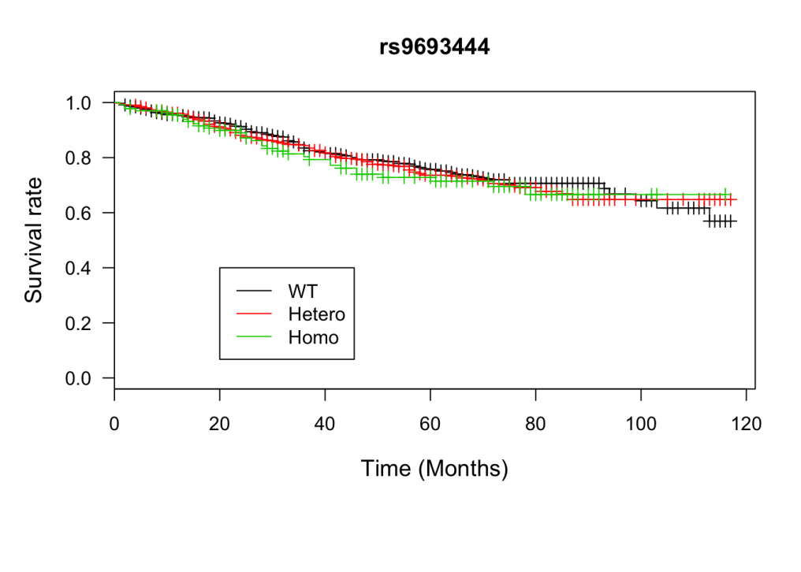
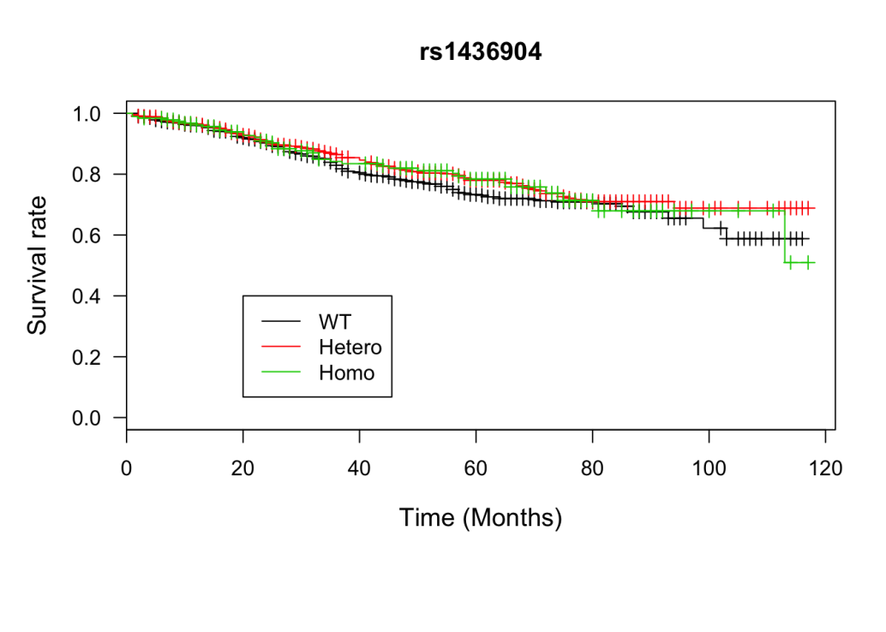
SURVIVAL DATA

Slide 17
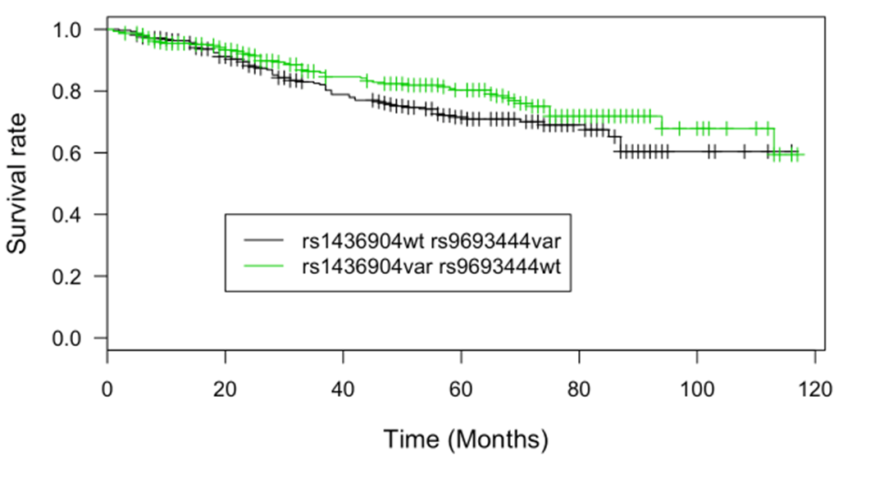
SURVIVAL DATA

Slide 18
SURVIVAL DATA
OR = 0.54; 95% CI = 0.39 – 0.73; p<0.001

Slide 19
CONCLUSIONS
Rs9693444 proved association with increased breast cancer risk.
Rs1436904 has a protective effect.
Rs616488 and rs204247 has no impact on breast cancer risk in given population.
Rs9693444 and rs1436904 are potential prognostic and predictive markers of breast cancer.

Slide 20
Thank you!

