Slide 1
Exploiting genome biology to understand immune response in health and disease
Sergey Belikov

Slide 2
I'm gonna make you an offer…

Slide 3
Braga et al. Hum. Mol. Genet. 2016

Slide 5
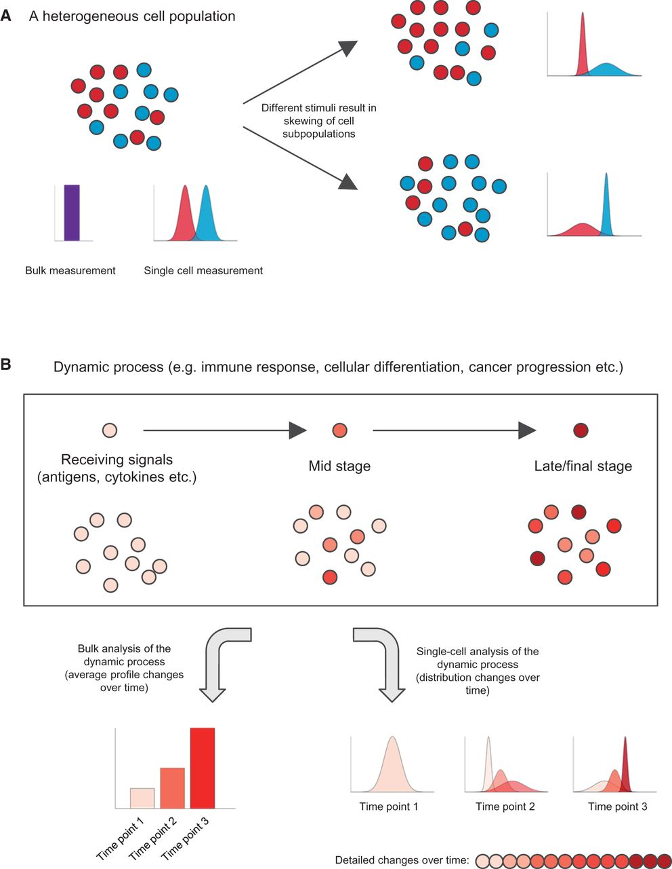
Single-cell assays retain cellular heterogeneity info that is lost by bulk genomic approaches.
Bulk Single-cell
Bulk analysis Single-cell analysis
Braga et al. Hum. Mol. Genet. 2016

Slide 6
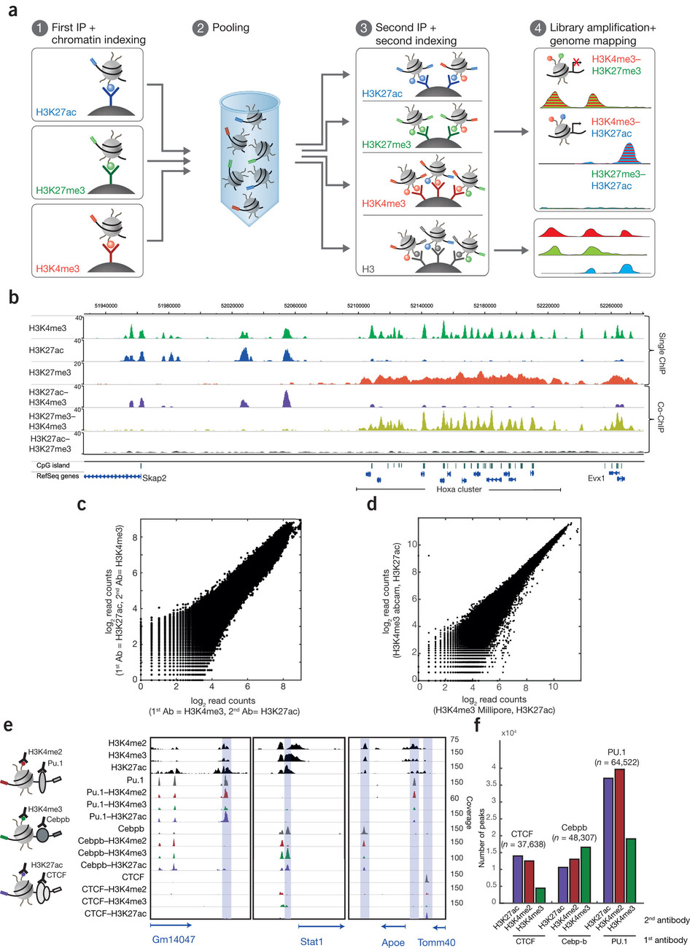
Combinatorial indexed ChIP
to characterize co-occurrence of histone modifications and trx factor binding
1. Cells are crosslinked
2. Chromatin is sheared and
3. immobilized on specific antibody-coated magnetic beads.
4. Chromatin is indexed by ligation of sequencing adaptors.
5. Chromatin is released from the beads and pooled together with other samples in a single tube.
6. The chromatin pool is subjected to a second chromatin IP step.
7. RNA and proteins are degraded and DNA is reverse crosslinked.
8. ChIPed DNA is purified.
9. DNA is amplified by PCR.
10. Sequencing of Co-ChIP libraries
Active
Poised
co-ChIP

Slide 7
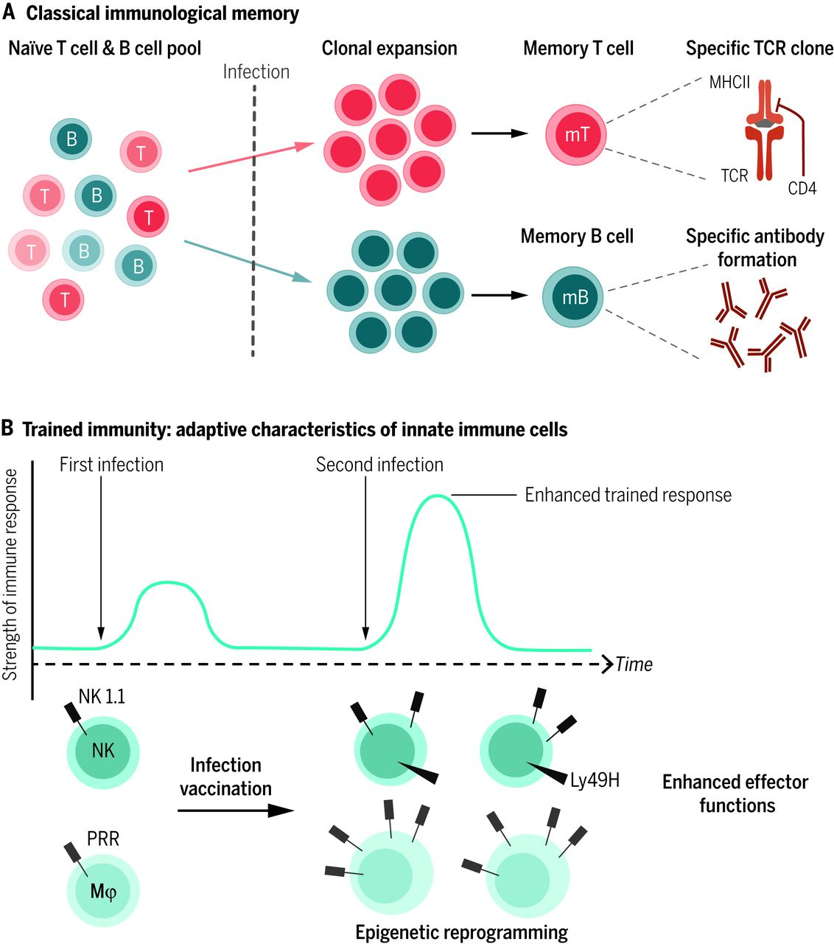
Adaptive immunological memory involves gene recombination in B and T lymphocytes.
Confers high specificity and pathogen-specific protection (up to decades).
“Trained immunity” –
innate immune memory that induces enhanced inflammatory and antimicrobial properties in innate immune cells.
Results in an increased nonspecific response to infections and improved survival of the host.
Netea et al., Science, 2016

Slide 8
Initial activation of trx is accompanied by the acquisition of specific chromatin marks.
They are only partially lost after elimination of the stimulus.
The enhanced epigenetic status - H3K4me1 (poised enhancers) results in a stronger response to secondary stimuli upon rechallenge.
X
Netea et al., Science, 2016

Slide 9
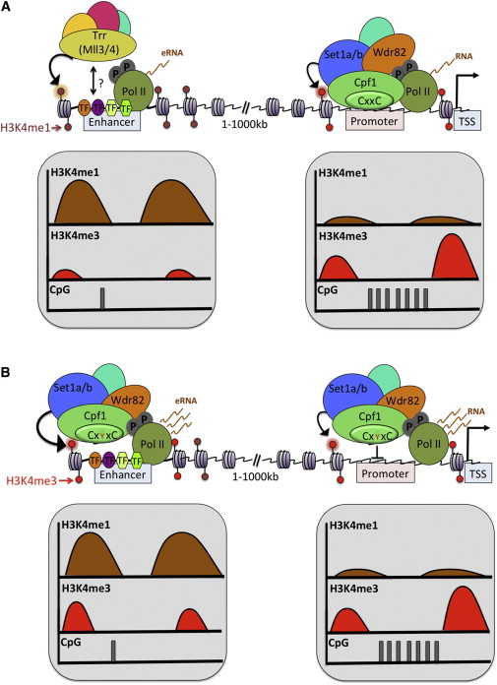
Enhancers and promoters
Enhancer:
-at considerable distance from the promoter,
-can be moved or inverted and still function,
-many TF binding sites
Promoter:
DNA segment that initiates trx of a gene,
located near the trx start sites, upstream
Enhancers are enriched for H3K4me1,
high levels of H3K4me3 predominantly mark promoter...
Buecker & Wysocka, Cell, 2012

Slide 10
H3K4me1 is associated with both active and poised enhancers, while active enhancers are also marked by H3K27 acetylation.
Buecker & Wysocka, Cell, 2012

Slide 11
MPhs acquire repertoires of active enhancers that are instructed by the microenvironmental signals specific to given tissue…
… which affects the regulatory landscape of a cell via the induction of specific trx factors, leading to the expression of genes involved in the unique functional pathways of each tissue-specific cell type

Slide 12
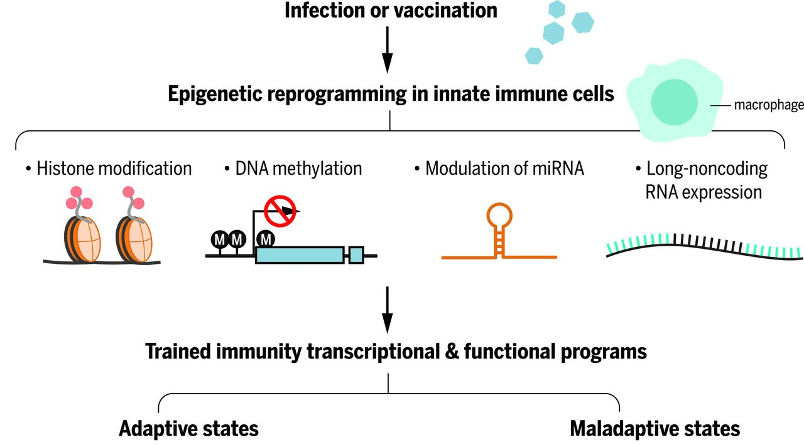
TI leads to adaptive states that protect the host after infections. However, TI may result in maladaptive states such as postsepsis immune paralysis or hyperinflammation -> T2D, Alzheimer’s disease
Netea et al., Science, 2016

Slide 13
Trx memory in the adaptive immune response
When stimulated for the first time naive cells udergo clonal expansion. Once antigen is cleared, 90-95% of the antigen-specific effector cells die and surviving cells form a pool of long-lived memory cells

Slide 14
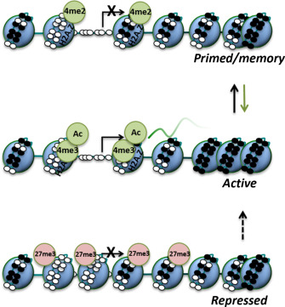
The role of epigenetic regulation in trx memory in the adaptive immune response
Woodworth & Holloway, APCSB, 2016

Slide 15
Inducible chromatin priming and establishment of trx memory in T cells
Primed DHSs maintain regions of active chromatin close to inducible genes and enhancers that regulate immune response by facilitating the induction of regulatory elements of previously activated T cells
Bevington et al., EMBO J , 2016

Slide 16
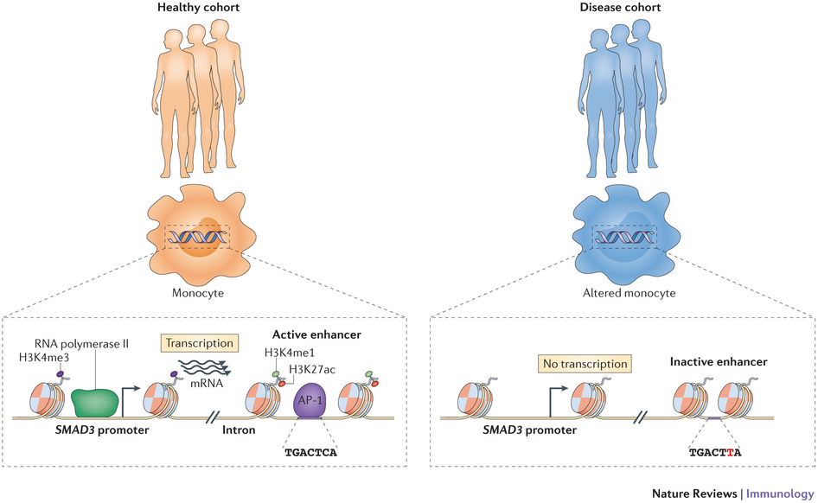
Healthy cohort Disease cohort
Cohort studies to find sources of genetic variation between groups
SNP in AP-1-binding motif (associated with Crohn disease) disrupts AP-1 binding to an enhancer (active in healthy monocytes). The resulting disruption of the chromatin state leads to altered gene trx and provides the mechanism of disease.
Winter et al., Immunology , 2017

Slide 17
Molecular mechanisms to enhance DNA vaccine immunogenicity

Slide 18
Codon optimality
After trx, mRNA can be degraded, stored or used for translation

Slide 19
Codon optimality is a powerful determinant of mRNA stability
Each reporter encodes the same polypeptide sequence but is composed of different codon composition of varying optimality
Radhakrishnan et al., Cell 2016

Slide 20
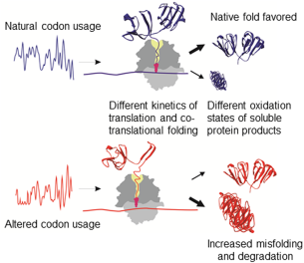
The pace of translation can regulate protein folding which frequently starts co‐translationally.

Slide 21
However...
Codon optimization not always positively correlates with DNA vaccine efficiency
Foreign sequences could provide better adjuvant effect via patter recognition receptors

Slide 22
DNA backbone: Plasmid vector or...
Remove bacterial elements! (inhibit transgene expression)
Minicircle DNA (mvDNA) vectors generally biosynthesized in recombinant bacteria
...by in vivo site-specific recombination; this strategy allows the removal of surplus parental plasmid species and mini-plasmids that result from the recombination process
...have minimalistic backbone
Advantages Disadvantages
A safer and more robust construct Size?
Enabling a higher effective dose
Enhanced T-cell responseg

Slide 23
Choice of promoter
Natural Pol II promoters are week!
Virus-derived promoters: CMV, SV40
However...
... the potency of viral promoters does not necessarily correlate with DNA vaccine efficacy in vivo,
...viral promoters are downregulated by IFN-γ, which is produced as a part of inflammatory reaction triggered by unmethylated CpG sequences present in plasmid backbone (recognized by pattern recognition receptors)

Slide 24
Adjuvants (molecular)
To upregulate To downregulate
Cytokine genes, PRRs, genes coding for signaling proteins (HSP70, IRF)
RNAi: Genes that suppress vaccine action (FoxO3- suppressive regulator of T-cell proliferation)
RNAi: post-trx gene silencing by destruction of specific mRNAs triggered by ds short hairpin RNA structures

Slide 25
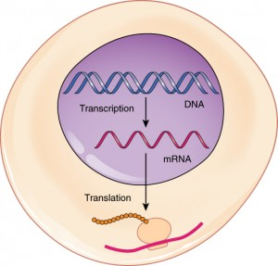
mRNA vaccines
Ex vivo transfection of dendritic cells
Self-amplifying Non-amplifying (naked)

Slide 26
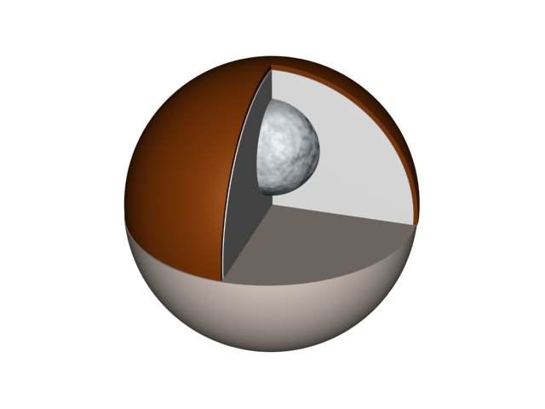
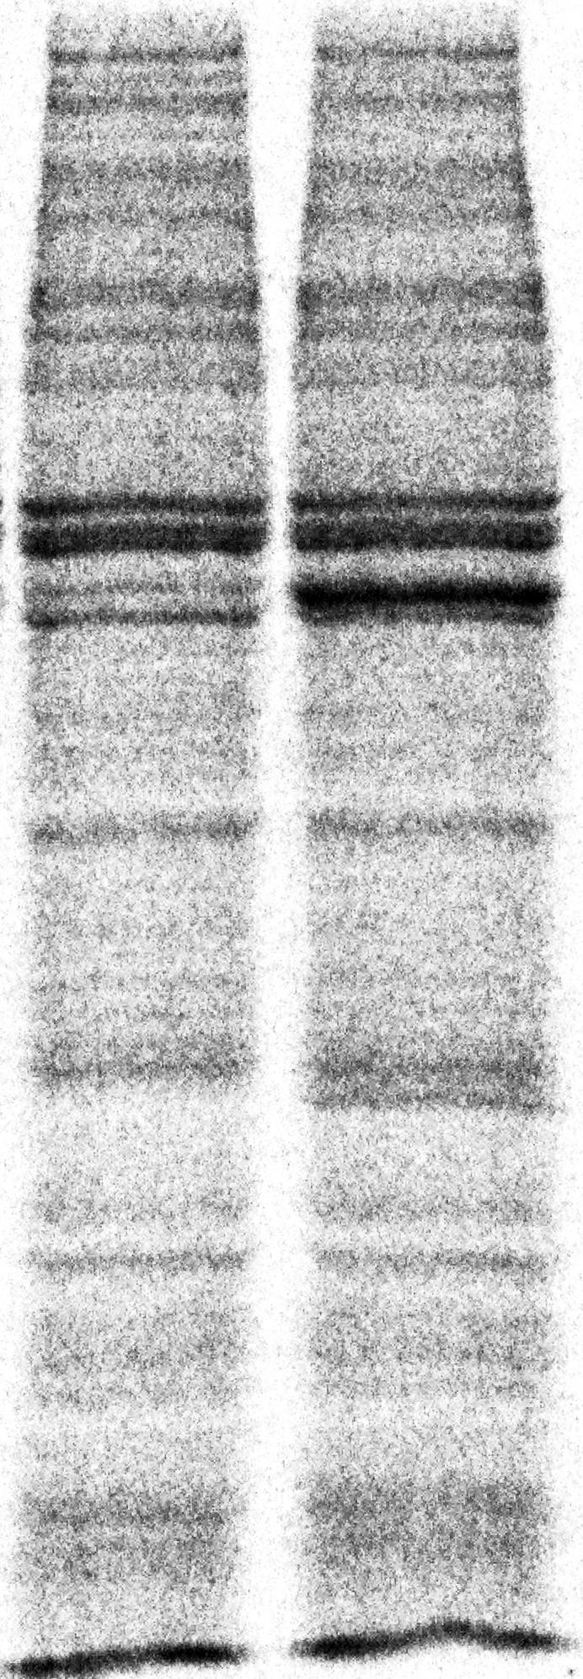
Proteins can be expressed in Xenopus oocytes via injection of synthetic mRNA(s) into oocyte cytoplasm
DNA
GR+ mRNA
FoxA1 injected
-
mRNA
GR
FoxA1
Large size, facilitates microinjection.
mRNA directed translation, up to 1pmol protein

Slide 27
Dendrimer-RNA nanoparticles generate protective
immunity against several pathogens with a single dose
Polyamines (polyethylene imine) condense RNA via inter-action with the phosphate backbone, resulting in compact nanoparticles that protect from nucleases. Amines have pKa = 5-7, this facilitates release of RNA into the cytoplasm.
Chahal et al, PNAS, 2016

Slide 28
Fully synthetic
Single-dose
Adjuvant-free
Nanoparticle vaccine platform.
Vaccines can be formed with multiple antigen-expressing replicons.
After a single immunization vaccines elicit vital T-cell and ab responses and fully protect against lethal exposures to several deadly pathogens

Slide 29
-DCs can be targeted using i.v. administered RNA-lipoplexes (RNA-LPX)
The LPX protects RNA and mediates its efficient uptake and expression of the encoded antigen by DCs and macrophages in various lymphoid compartments
RNA-LPX encoding different antigens induce strong effector and memory T-cell responses (also in three melanoma patients)
RNA-LPX - a universally applicable vaccine class for systemic DCs targeting and induction of both adaptive as well as type-I-IFN-mediated innate immune mechanisms (for cancer immunotherapy)
Kranz et al, Nature, 2016

Slide 30
Get the shot!
DNA vaccine

