Slide 1
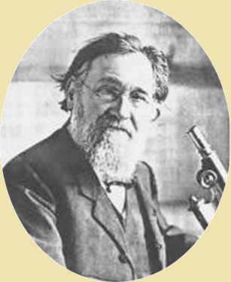
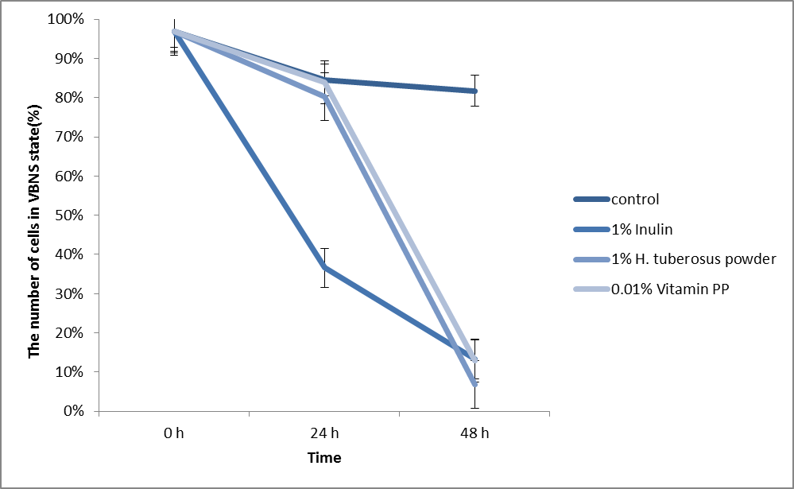
Detection and resuscitation of viable but nonculturable bacteria in vaccines and other biomedical preparations
L.P. Blinkova, Yu.D. Pakhomov, N.N. Skorlupkina
FSBSI “Mechnikov Research Institute for Vaccines and Sera”,
Maliy Kazenniy per. 5a, Moscow, Russia, e-mail: labpitsred@yandex.ru
Background. Problem of viable but nonculturable (VBNC) cells and their resuscitation into active state is very important for industrial biomedical preparations. VBNC cells are appeared under stress and have not ability to form colonies. However, dormant nonculturable cells can return to the active proliferation with help different factors (sera, vitamin K etc.). Due to possible presence of VBNC cells in live bacterial vaccines and probiotics or contamination of viral vaccines and other biomedical preparations it is necessary to apply adequate control procedures. The aim of our research was the detection VBNC cells and testing some factors for the resuscitation of active division.
Materials & Methods. We used light microscopy to count bacterial cells and assessed CFU/ml values on nutrient agar. Luminescence microscope was used to determine portions of viable and dead cells after staining with Live/Dead® Baclight™ double staining kit. Numbers of VBNC cells were determined by comparison of total cell counts and portions of viable cells [Blinkova L.P. et al 2014, Pakhomov Yu.D. et al, 2016]. Statistical analysis was conducted using Fisher-Student t-criteria for p value ≤0.05. Detection of VBNC bacteria was conducted for probiotic preparations of E. coli (Colibacterin – CB), Lactobacillus (Lactobacterin – LB), Bifidobacterium (Bifidumbacterin - BB). As resuscitation factors of VBNC of different bacteria for example Salmonella enterica Typhimurium we used normal saline, blood substitute, inulin, vitamin PP etc.
Results. Our analysis of native commercial lyophilized probiotics (Russia) showed that from 4% to more than 99% cells were nonculturable in assessed samples. Numbers varied for different bacterial preparations, their storage period and other factors. The normal saline, blood substitute were effective for reversion VBNC cells of probiotics to active state.
In experiment with Salmonella enterica Typhimurium of the resuscitation, which was VBNC for 8 months after exposure to different concentration of inulin or vitamin PP in nutrient broth we observed decrease in number of VBNC bacteria to 7 – 37% compared to 80-90% in controls. Exposure to vitamin PP acid was effective only in concentration 0.01%.
As seen on the figure supplementing culture medium with 1% of inulin led to significant resuscitation of Salmonella cells in 24 hours. With 1% of Helianthus tuberosus and 0.01% of vitamin PP cells returned into active state after 48 hours.
Table 1. Studying of samples probiotic preparations, containing: A – E.coli, B –Lactobacillus and C – Bifidobacterium; with various periods of storage.
(date of analysis – 2013)
A
Characteristics of Colibacterin |  | Biological parameters
Batch codes, expiration date (year) | Type of vessel, number of doses | Total number of cells in Goryaev-Thoma chamber (cells/ml) (I₉₅) p value | Live cells with “Live/Dead” (%) | CFU/ml (I₉₅) p value | VBNC (%)
 |  |  | Total number of live cells/ml with “Live/Dead” (I₉₅) p value
1 | 2 | 3 | 4 | 5 | 6
CB 72-5 1982 | Ampoules, 3 doses | 2.11±0.23×10¹⁰ (1.56÷2.67)×10¹⁰ 3 and 4<0.05 3 and 5<0.05 | 52,2 | 2.89±0.32×10⁷ (2.11÷3.65)×10⁷ 5 and 3<0.05 5 and 4<0.05 | 99.73
 |  |  | 1.1±0.12×10¹⁰ (0.81÷1.39) ×10¹⁰ 4 and 3<0.05 4 and 5<0.05
CB 70-3 2001 | Ampoules, 3 doses | 3.11±0.34×10¹⁰ (2.29÷3.93)×10¹⁰ 3 and 4>0.05 3 and 5<0.05 | 86,7 | 5.55±0.61×10⁹ (4.09÷7.01)×10⁹ 5 and 3<0.05 5 and 4<0.05 | 79.5
 |  |  | 2.7±0.3×10¹⁰ (1.98÷3.42) ×10¹⁰ 4 and 3>0.05 4 and 5<0.05
CB 4-3 2008 | Vials, 5 doses | 1.21±0.13×10¹⁰ (0.89÷1.52)×10¹⁰ 3 and 4>0.05 3 and 5<0.05 | 90,3 | 1.58±0.17×10⁹ (1.17÷1.99)×10⁹ 5 and 3<0.05 7 and 4<0.05 | 85.5
 |  |  | 1.091±0.12×10¹⁰ (0.80÷1.38)×10¹⁰ 4 and 3>0.05 4 and 5<0.05
CB 24-3 2009 | Vials, 5 doses | 1.44±0.15×10¹⁰ (1.08÷1.8)×10¹⁰ 3 and 4>0.05 3 and 5>0.05 | 88,2 | 1±0.11×10¹⁰ (0.74÷1.26)×10¹⁰ 5 and 3>0.05 5 and 4>0.05 | 21.3
 |  |  | 1.27±0.14×10¹⁰ (0,90÷1.58)×10¹⁰ 4 and 3>0.05 4 and 5>0.05
CB 27-3 2009 | Vials, 5 doses | 1.32±0.14×10¹⁰ (0.98÷1.66)×10¹⁰ 3 and 4>0.05 3 and 5>0.05 | 91,3 | 1.16±0.13×10¹⁰ (0.85÷1.47)×10¹⁰ 5 and 3>0.05 5 and 4<0.05 | 4.13
 |  |  | 1.2±0.13×10¹⁰ (0.89÷1.51)×10¹⁰ 4 and 3>0.05 4 and 5<0.05
B
Characteristics of preparation |  | Biological parameters
Codes of batches, expiration date (year) | Type of vessel, number of doses | Total number of cells in Goryaev-Thoma chamber (cells/ml), I₉₅ | live cells with “Live/Dead” (%) | CFU/ml (Incubation time=72h), (I₉₅) | VBNC (%)
 |  |  | total number of live cells/ml with “Live/Dead”, I₉₅
 |  |  | p value
 |  | p value |  | p value
1 | 2 | 3 | 4 | 5 | 6
LB-55 1994 | Ampoules, 5 doses | 3.4±0.37×10⁹ (2.5÷4.3)×10⁹ | 66,5 | 1.0±0.11×10⁷ (0.74÷1.26)×10⁷ | 99.9
 |  |  | 2.3±0.25×10⁹ (1.7÷2.9)×10⁹
 |  |  |  | 5 and 3 <0.05 5 and 4 < 0.05
 |  | 3 and 4 >0.05 3 and 5 < 0.05 | 4 and 3 >0.05 4 and 5 < 0.05
LB-80 2010 | Vials, 5 doses | 3.3±0.3×10⁹ (2.6÷4.02)×10⁹ | 92,04 | 2.1±0.22×10⁹ (1.57÷2.63) ×10⁹ | 92.0
 |  |  | 3.06±0.23×10⁹ (2.5÷3.61)×10⁹
 |  |  |  | 5 and 3 ≥0.05 5 and 4 >0.05
 |  | 3 and 4 >0.05 3 and 5 ≥ 0.05 | 4 and 3 >0.05 4 and 5 > 0.05
LB 93 2013 | Vials, 5 doses | 2.9±0.3×10⁹ (2.18÷3.62)×10⁹ | 99,9 | 1.35±0.15×10⁹ (0.99÷1.71)×10⁹ | 54.4
 |  |  | 2.9±0.3×10⁹ (2.18÷3.62)×10⁹
 |  |  |  | 5 and 3 < 0.05 5 and 4 < 0.05
 |  | 3 and 4>0.05 3 and 5 <0.05 | 4 and 3 >0.05 4 and 5 < 0.05
C
Characteristics of preparation |  | Biological parameters
Codes of batches, expiration date (year) | Type of vessel, number of doses | Total number of cells in Goryaev-Thoma chamber (cells/ml) (I₉₅) p value | live cells with “Live/Dead” (%) | CFU/ml | VBNC (%)
 |  |  | total number of live cells/ml with “Live/Dead” (I₉₅) p value
1 | 2 | 3 | 4 | 5 | 6
BB 44 2012 | Vials, 5 doses | 2.92±0.32×10⁷ (2.15÷3.69)×10⁷ 3 and 4>0.05 3 and 5<0.05 | 70.7 | 1±0.11×10⁷ (0.74÷1.26)×10⁷ 5 and 3<0.05 5 and 4<0.05 | 62,23
 |  |  | 2.06±0.23×10⁷ (1.51÷2.61)×10⁷ 4 and 3>0.05 4 and 5<0.05
BB 56 2013 | Vials, 5 doses | 6.76±0.74×10⁷ (4.98÷8.54)×10⁷ 3 and 4>0.05 3 and 5<0.05 | 95.45 | 2±0.22×10⁸ (1.47÷2.53) 5 and 3<0.05 5 and 4<0.05 | 99,74
 |  |  | 6.45±0.71×10⁷ (4.75÷8.15)×10⁷ 4 and 3>0.05 4 and 5<0.05
Figure. Resuscitation of Salmonella Typhimurium 79 nonculturable
for 8 months in nutrient broth supplemented with 1% of inulin, 1% of
powdered Helianthus tuberosus or 0.01% of vitamin PP.
Table 2. Resuscitation of probiotic bacteria
Microorganism | Supplement |  | Original CFU/ml | CFU/ml with supplement | Original/supplemented CFU/ml, p-value
E. coli M–17 (Colibacterin, Batch. 40–3) | 10 % «Aminopeptidum» |  | 6.2×10⁷ | 4×10⁸ | 6.45 < 0.05
Lactobacillus acidophilus (Acipol Batch. 11) |  |  | 2.2±2.42×10⁵ | 1.1±1.21×10⁶ | 5 <0.05
Bifidobacterium bifidum Bifidumbacterin Batch. 735 | «Aminopeptidum» | 1% | 9×10⁵ | 1.81×10⁶ | 2 < 0.05
 |  | 10% | 9×10⁵ | 2.3×10⁶ | 2.56 < 0.05
Conclusion. Since VBNC cells were detected in bacterial probiotics subjected to lyophilization stress such cells can be identified in bacterial vaccines and can lead to underestimation of their viability, when only the CFU/ml is measured.
Contamination of different biopreparations with VBNC microbial cells, which can return to active state is also possible, and thus it is a hazard for bioproduction without appropriate control technique.

