Slide 1


VACTRAIN
DENDRIMER COMPLEXES AS A PLATFORM FOR GENE DELIVERY
Dr. Volha Dzmitruk, PhD. (dmitruk.olga@gmail.com)
Dr. Dzmitry Shcharbin (shcharbin@gmail.com)
Institute of Biophysics and Cell Engineering of
National Academy of Science of Belarus, Minsk, Belarus
This work was supported by project VACTRAIN within HORIZON 2020 and by project NANOGENE within MSC IRSES of 7th EU FP, co-financed by the Polish Ministry of Science and Higher Education.

Slide 2
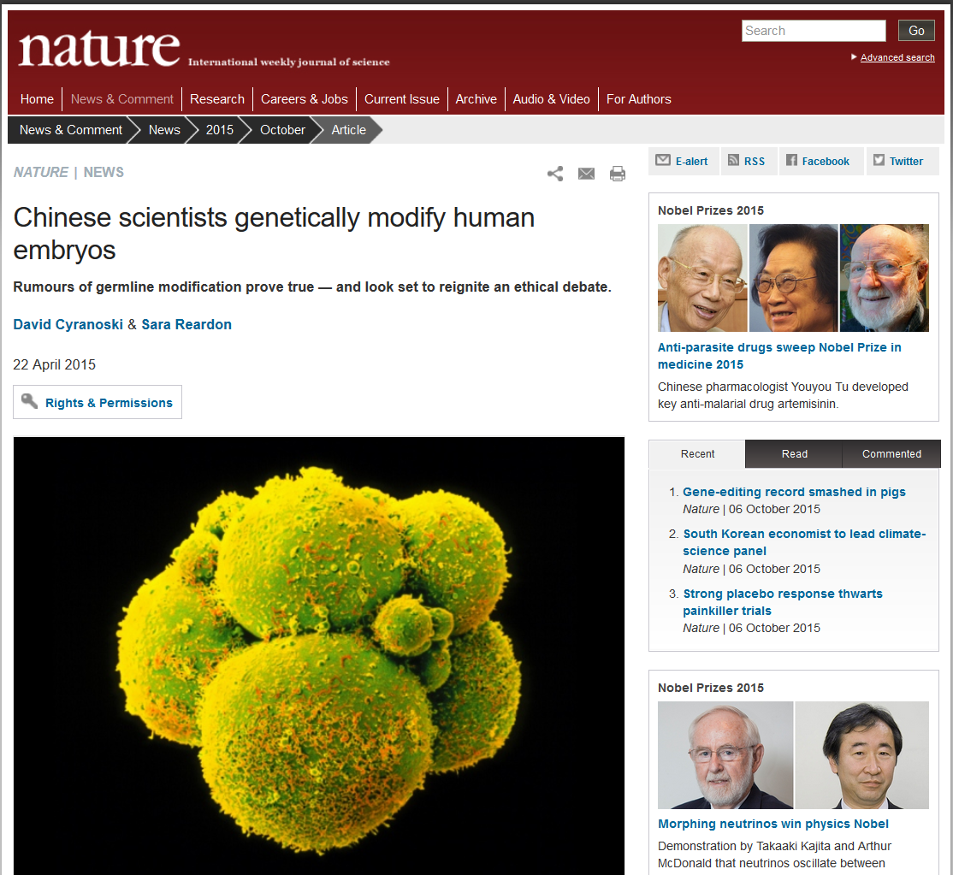

Slide 3
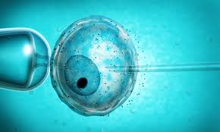
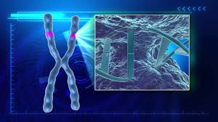
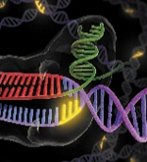
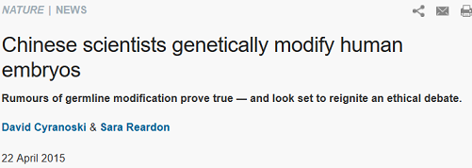
Embryo with fatal
blood disorder
(β-thalassaemia)
Cutting the bad gene by CRISPR/Cas9
The enzyme complex CRISPR/Cas9 (C-Cas9), which binds and splices DNA at specific locations. The complex can be programmed to target a problematic gene, which is then replaced or repaired by another molecule introduced at the same time.

Slide 4
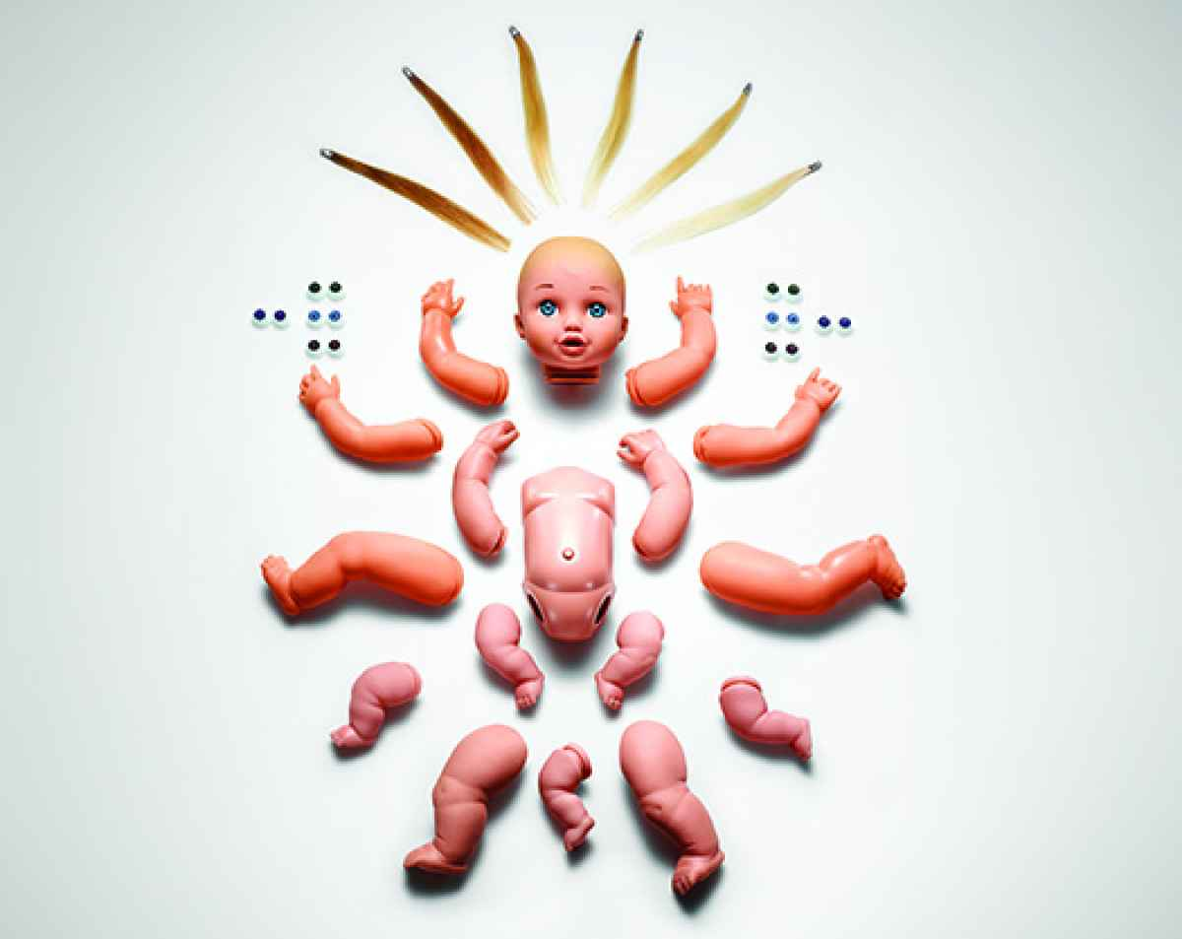
What did they obtain?
Meta-Homo Sapiens = Artificial H. Sapiens

Slide 5
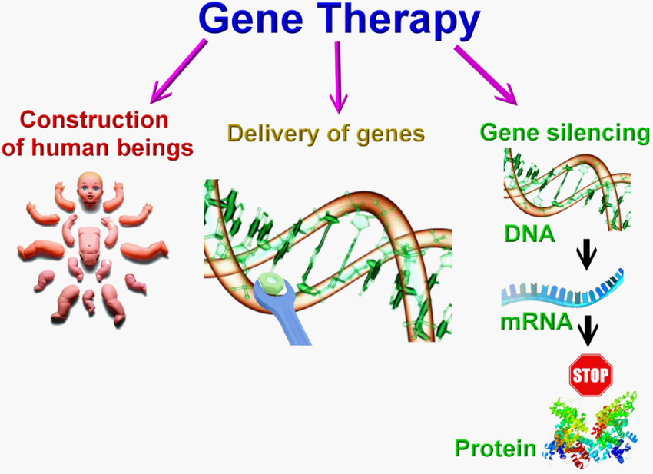
A
B
C

Slide 6
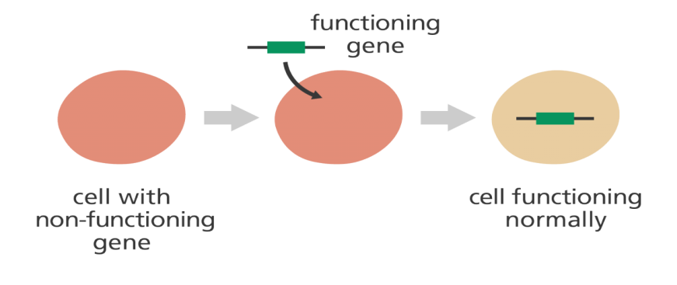
B
Viral systems
Non-viral systems
versus
[ Simply the best !!! ]
More efficient transfection,
Less toxic,
More selective,
Effects in vivo are more pronounced.
Less efficient transfection,
Still more toxic,
Still less selective
Effects in vivo are less pronounced.
Risk of insertional mutagenesis,
Can be immunogenic.
Difficulties for commercial
production
No risk of insert. mutagenesis,
Non-immunogenic.
Easy to produce in

Slide 7
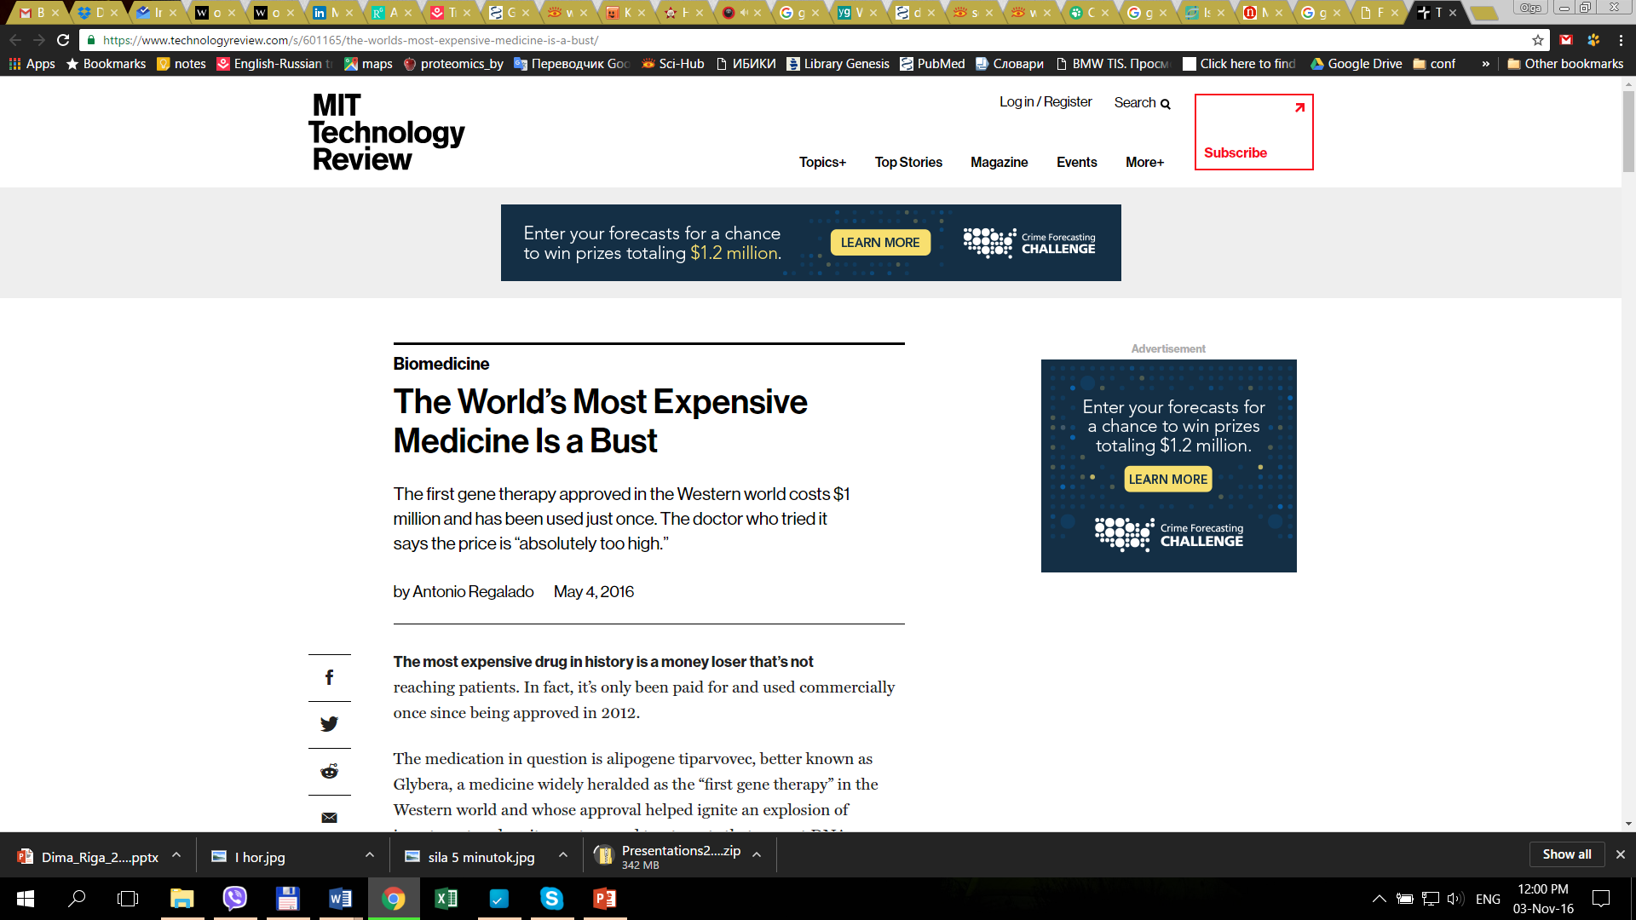
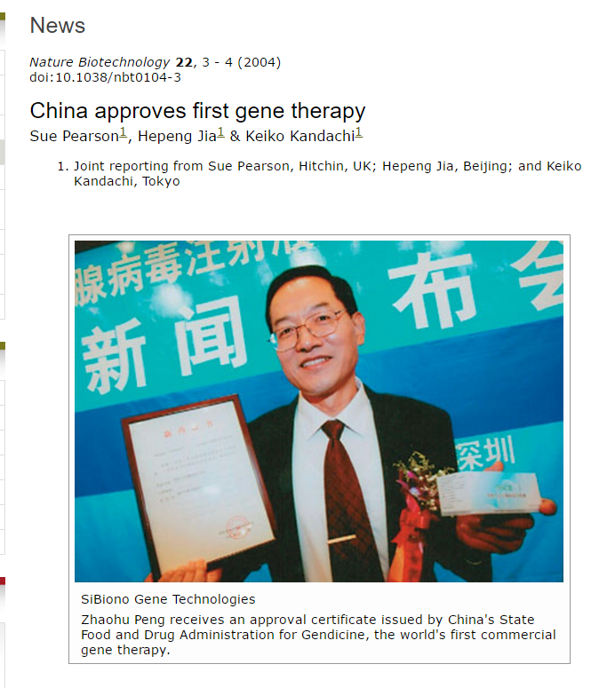
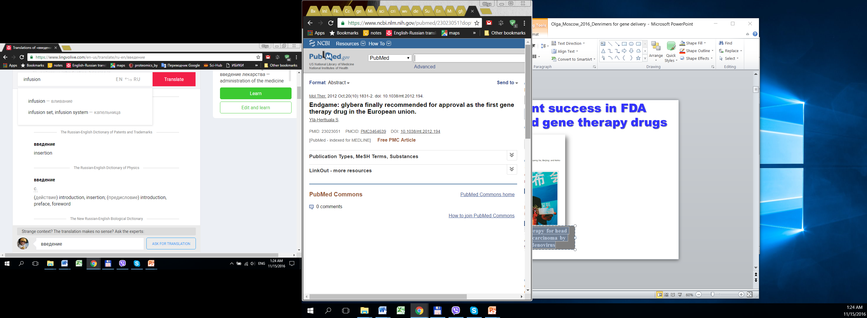
Recent success in FDA Approved gene therapy drugs
Adeno-associated virus -derived vectors for the correction of genetic lipoprotein lipase deficiency
Gendicine - p53 gene therapy for head and neck squamous cell carcinoma by means of recombinant adenovirus
Mostly is not affordable for
the patients (>1 million$ !!!)

Slide 8
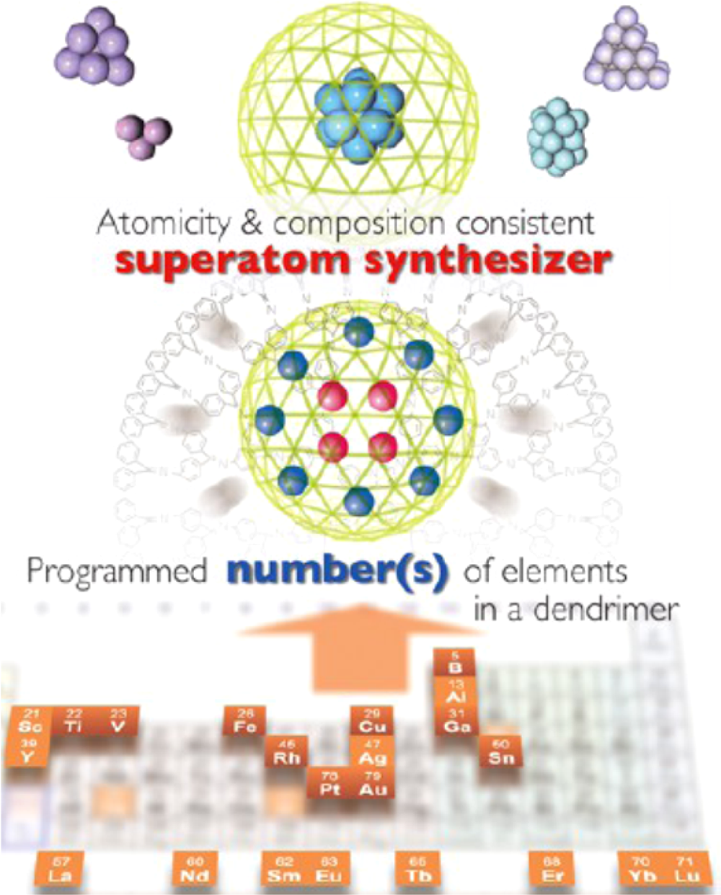
But why we are developing non-viral systems ?
They are like constructor details, so
1) We can tune their efficiency,
2) We can make them bio-available,
3) We can make them self-destroying,
4) We can create complex
constructions,
5) We can modify the routes of
administration.
A Systematic Framework and Nanoperiodic Concept for Unifying Nanoscience: Hard/Soft Nanoelements, Superatoms, Meta-Atoms, New Emerging Properties, Periodic Property Patterns, and Predictive Mendeleev-like Nanoperiodic Tables
Donald A. Tomalia, Shiv N. Khanna,
DOI: 10.1021/acs.chemrev.5b00367. Chem. Rev. XXXX, XXX, XXX−XXX

Slide 9
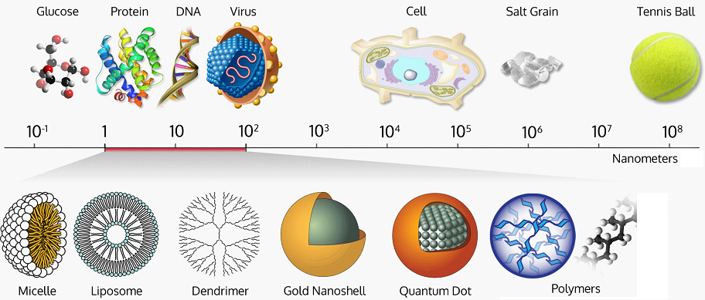
Nanomaterials
From: http://wichlab.com/research/

Slide 10
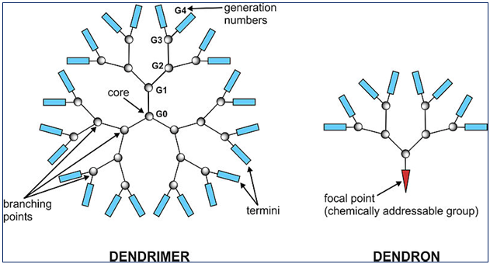
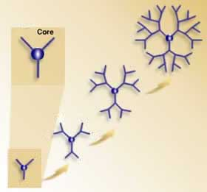
What are dendrimers and
dendrimer constructions?
3G
2G
Spherical shape
Surface active sites (type / number)
Monodispersity
Accurately precise structure
Presence of internal cavities
Structural components
Nanosize from 1nm
1G
Most known types:
1) Polyamidamine (PAMAM)
2) Polypropilenimine
3) Phosporous-contating etc.

Slide 11
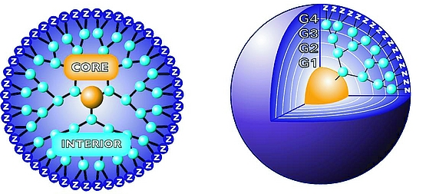
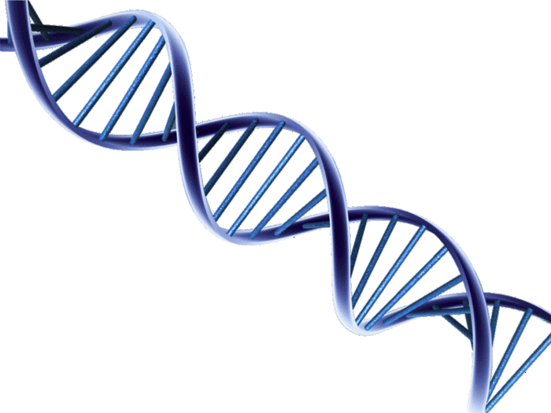
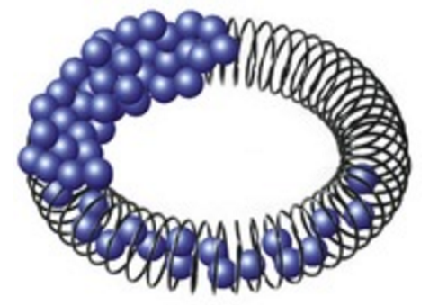
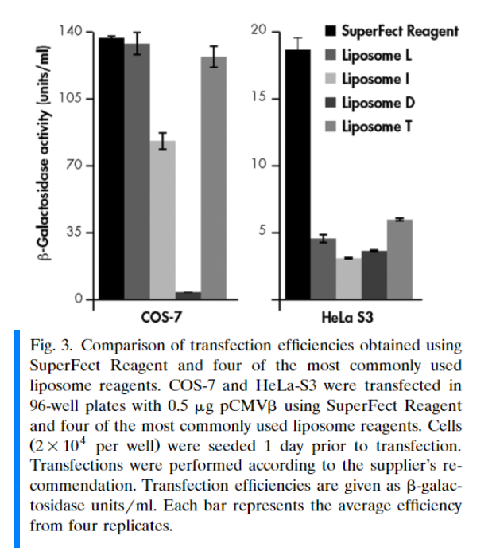
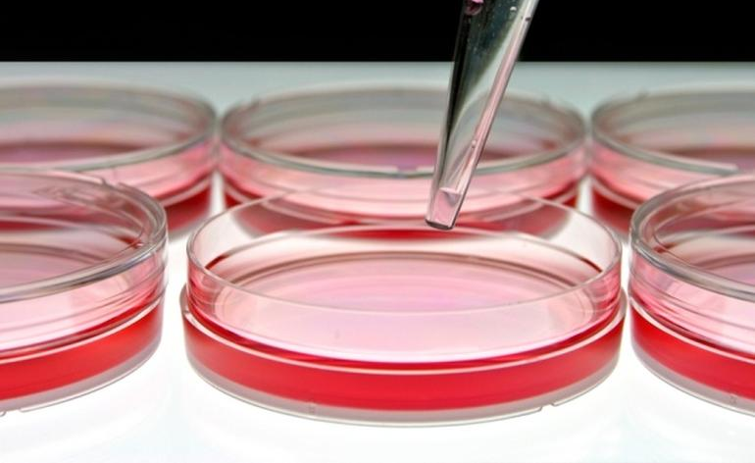
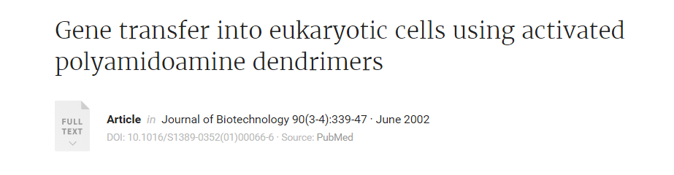
Commercial examples: SuperFect & PolyFect
Activated PAMAM dendrimer
DNA/plasmid
Dendriplex
Notes:
SuperFect is much more effective to transfect cells in the presence of serum and proteins. This parameter provides much closer to in vivo conditions compared to other mostly used transection kits.
Dendriplex condence DNA into compact complex called dendriplex

Slide 12
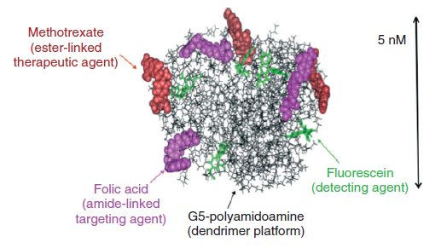
Examples: Anticancer nano-conjugate
- We can create complex constructions

Slide 13
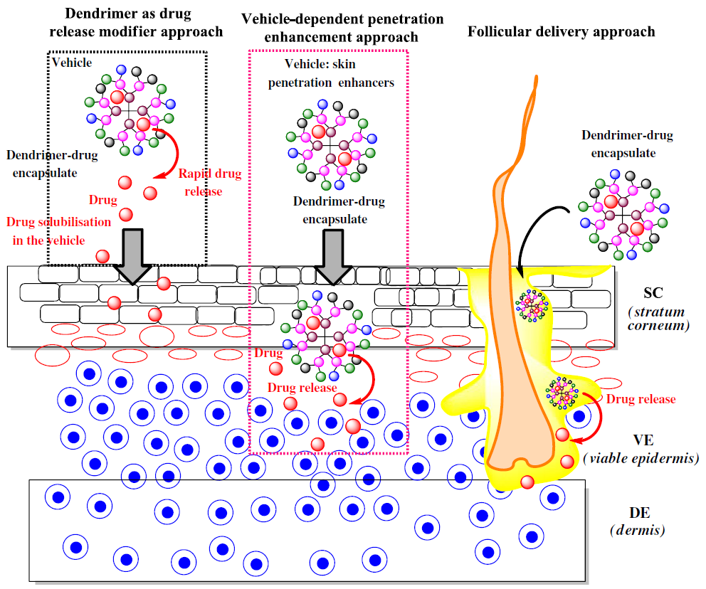
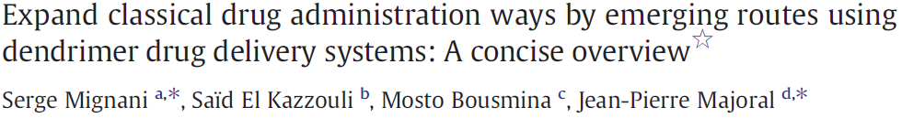
- We can modify the routes of administration

Slide 14
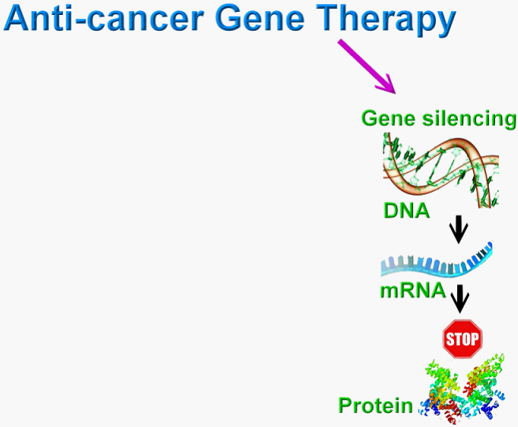
Small RNAs
C

Slide 15
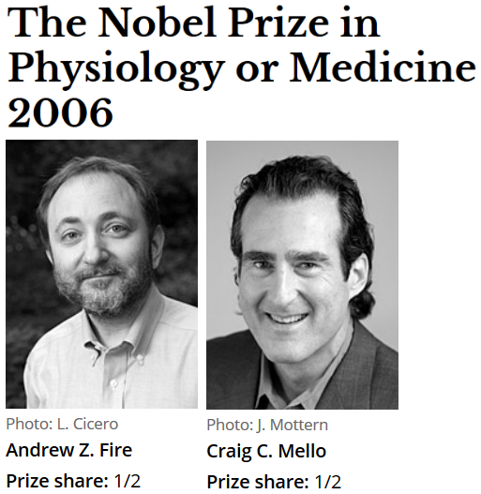
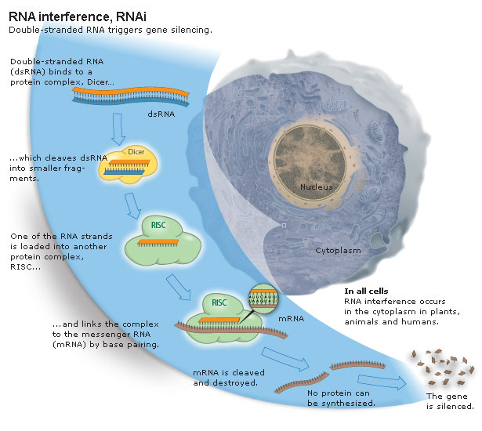

Slide 16
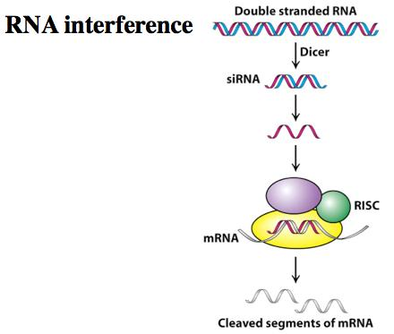
microRNA, siRNA, etc.
RISC complex
is in cytoplasm
Cutting of mRNA
regions which encode
protein expression

Slide 17
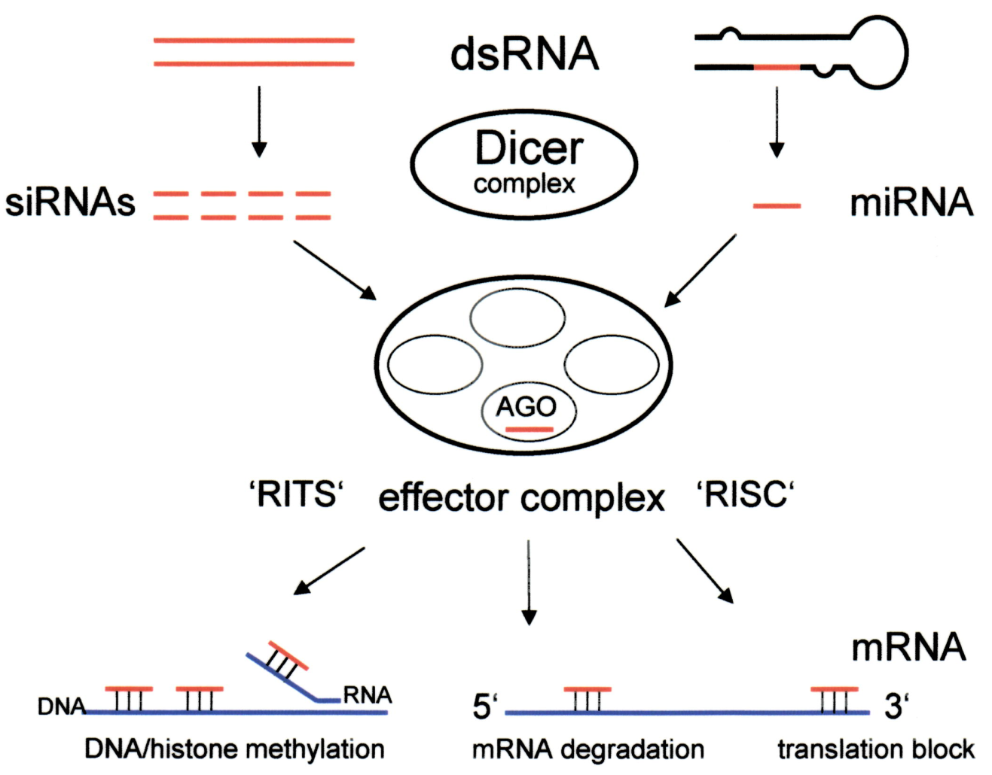
What are we studying?
microRNA,
siRNA
+
non-viral carrier
e.g. dendrimers,
dendronized
Au nanoparticles,
Ru dendrimers, etc.
1) To kill cancer cells
2) To regulate the protein expression in cancer cells

Slide 18
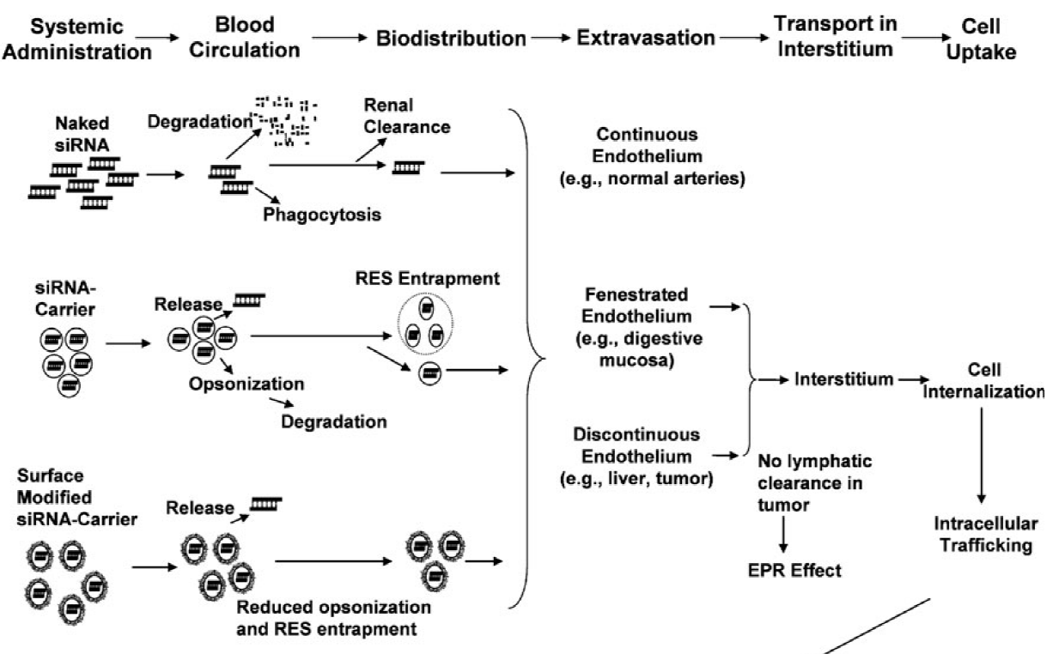
Problems?

Slide 19
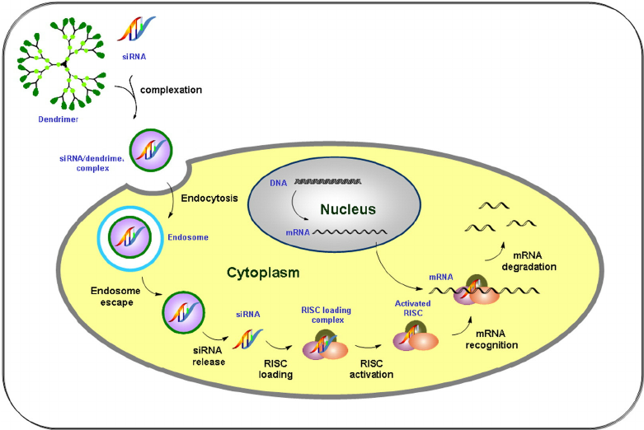
Problems? Intracellular traffic

Slide 20
C. Gene silencing to kill cancer cells or to regulate cell proteins expression
Viral systems
Non-viral systems
versus
[ Simply, the best !!! ]
Less efficient to deliver to cytoplasm,
It is difficult to create viral systems for small RNAs.
Can be immunogenic,
Can penetrate in nucleous,
e.g. risk of insertional mutagenesis.
More efficient to deliver in cytoplasm,
Selectivity in not too important,
Self-degrading,
No risk of insert. mutagenesis,
Non-immunogenic.

Slide 21
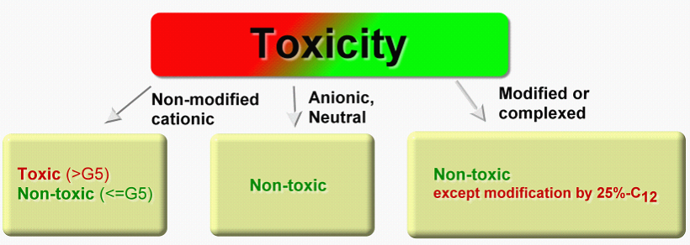
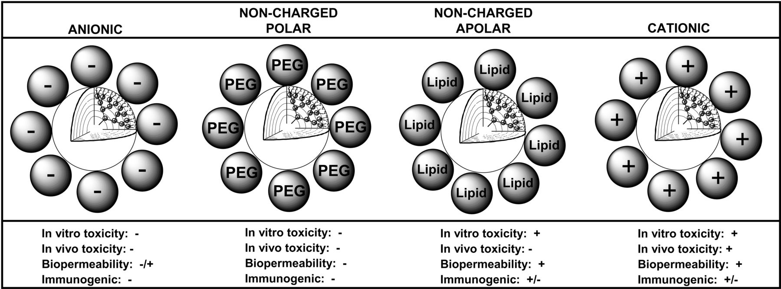
Dendrimers IN VIVO
Dendrimers as multi-purpose nanodevices for oncology drug delivery and diagnostic imaging
D.A. Tomalia,
L.A. Reyna, S. Svenson
Biochemical Society TransactionsFeb 01, 2007,35(1)61-67;

Slide 22
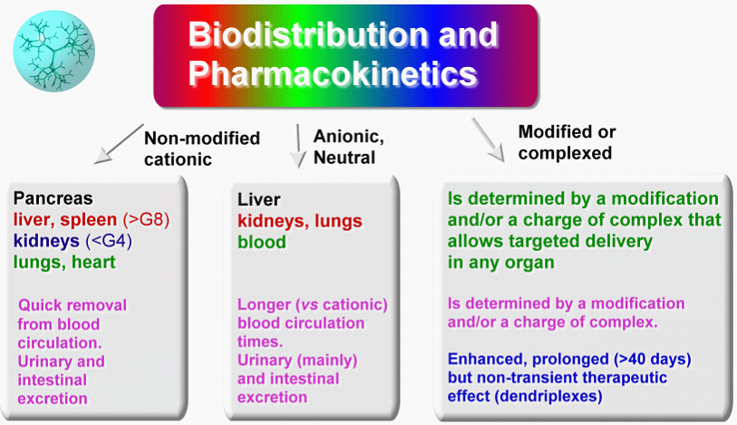
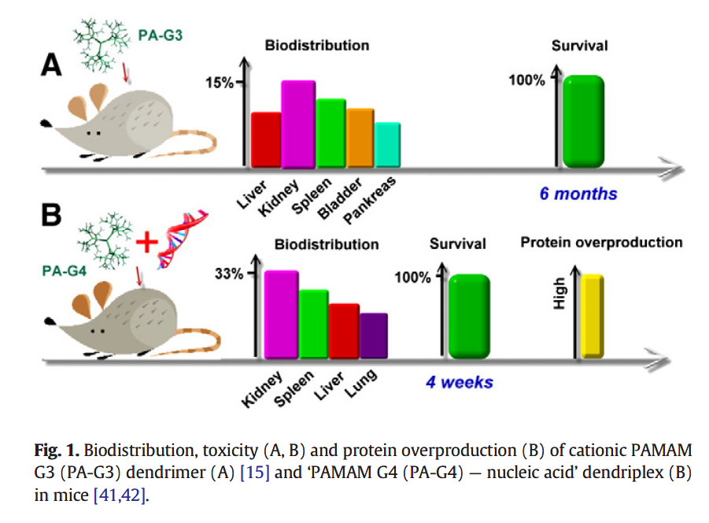
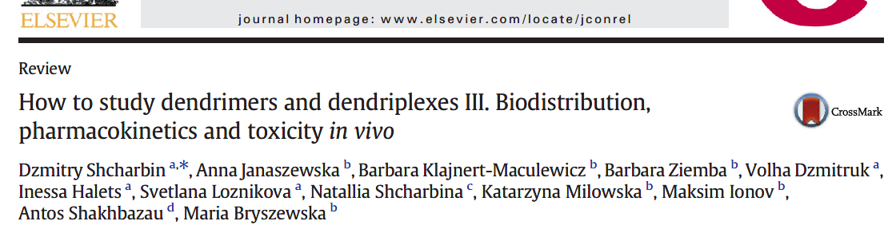
Dendrimers
IN VIVO

Slide 23

Project: EU-Belarus-Russia Network in Nanomaterials-Driven Anti-Cancer Gene Therapy
7 European Union Framework Programme (2013-2016)
Department of General Biophysics, University of Lodz, Lodz, Poland – coordinator,
Departamento de Química Inorgánica, Universidad de Alcalá, Alcalá de Henares, Spain,
Laboratorio de Inmunobiología Molecular, Hospital General Universitario Gregorio Marañón, Madrid, Spain,
Laboratoire de Chimie de Coordination, CNRS, Toulouse, France,
Institute of Chemical Biology and Experimental Medicine of SB of Russian Academy of Sciences, Novosibirsk, Russia,
Institute of Biophysics and Cell Engineering of NASB, Minsk, Belarus

Slide 24
The regulation of apoptosis in cells is realized by the family Bcl-2 proteins. The family of Bcl-2 proteins is differed by pro-apoptotic and anti-apoptotic proteins. The group of apoptosis inhibitors include:
Bcl-2, Bcl-xL, Mcl-xL, Bcl-w, A-1, Boo. For suppression of synthesis of anti-apoptotic proteins the newly discovered mechanism of gene expression – RNA interference - is starting to use
[Poeck H, Besch R, Maihoefer C, Renn M, Tormo D, Morskaya SS, Kirschnek S, Gaffal E, Landsberg J, Hellmuth J, Schmidt A, Anz D, Bscheider M, Schwerd T, Berking C, Bourquin C, Kalinke U, Kremmer E, Kato H, Akira S, Meyers R, Häcker G, Neuenhahn M, Busch D, Ruland J, Rothenfusser S, Prinz M, Hornung V, Endres S, Tüting T, Hartmann G. 5'-Triphosphate-siRNA: turning gene silencing and Rig-I activation against melanoma, Nat Med., 2008, Vol. 14(11), P. 1256-1263; Tiemann K, Höhn B, Ehsani A, Forman SJ, Rossi JJ, Saetrom P. Dual-targeting siRNAs, RNA, 2010, Vol. 16(6), P. 1275-1284].

Slide 25
Uptake of siRNA into HeLa after 3 hours of incubation
by flow cytometry

Slide 26
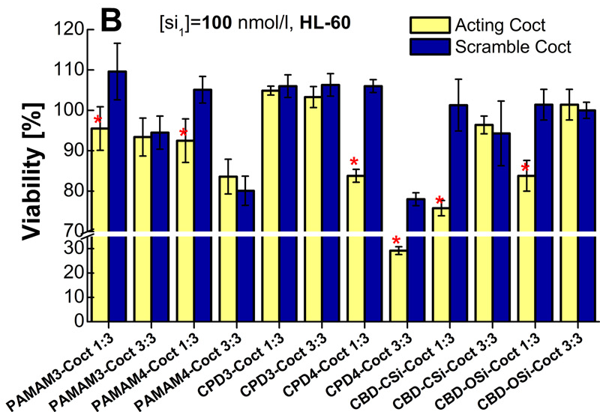
  1) V. Dzmitruk, A. Szulc, D. Shcharbin, A. Janaszewska, N. Shcharbina, J. Lazniewska, D. Novopashina, M. Buyanova, M. Ionov, B. Klajnert-Maculewicz, R. Gómez-Ramirez, S. Mignani, J.-P. Majoral, M.A. Muñoz-Fernández, M. Bryszewska. Anticancer siRNA cocktails as a novel tool to treat cancer cells. Part (B). Efficiency of pharmacological action // International Journal of Pharmaceutics. 2015 Vol. 485. P. 288-294.
  2) M. Ionov, J. Lazniewska, V. Dzmitruk, I. Halets, S. Loznikova, D. Novopashina, E. Apartsin, O. Krasheninina, A. Venyaminova, K. Milowska, O. Nowacka, R. Gomez-Ramirez, F. J. de la Mata, J.-P. Majoral, D. Shcharbin, M. Bryszewska. Anticancer siRNA cocktails as a novel tool to treat cancer cells. Part (A). Mechanisms of interaction // International Journal of Pharmaceutics. 2015. Vol. 485. P. 261-269

Slide 27
VACTRAIN
Thank you for attention
This work was supported by project VACTRAIN within HORIZON 2020 and by project NANOGENE within MSC IRSES of 7th EU FP, co-financed by the Polish Ministry of Science and Higher Education.

