Slide 1
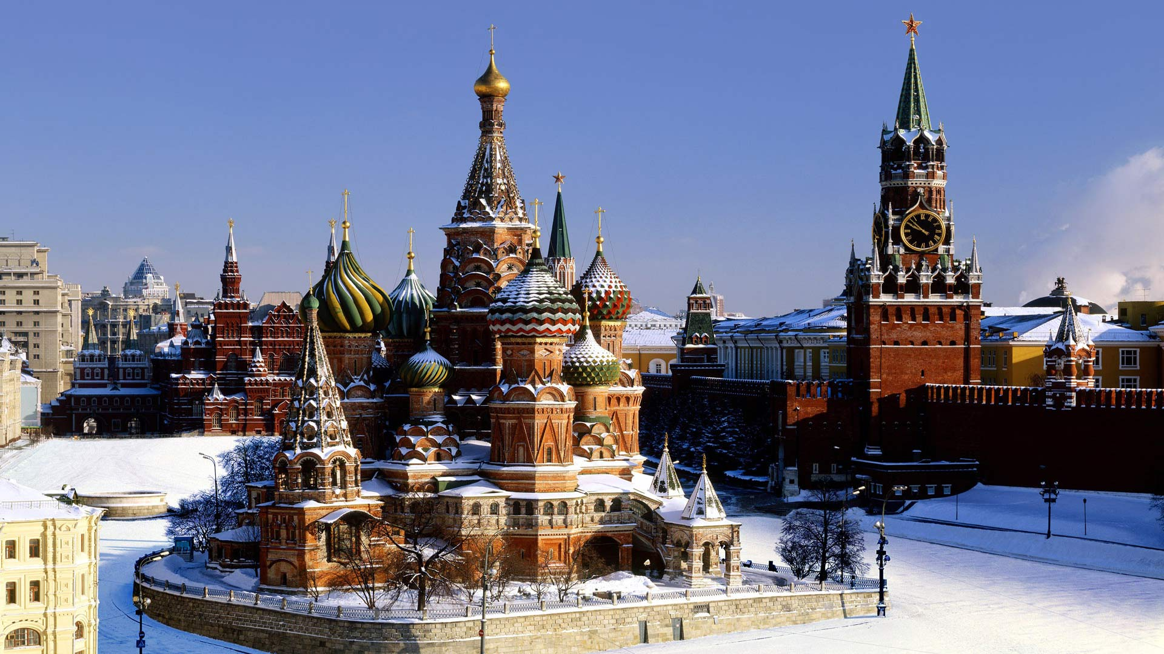

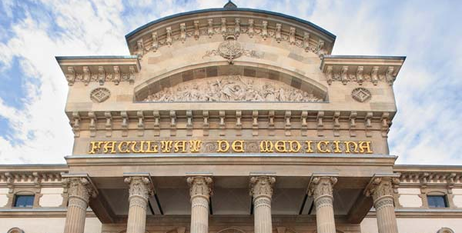

International Conference “Toolkits for DNA vaccine design, an update”
MOSCOW, NOVEMBER 17-20th 2016
PRE-CLINICAL DEVELOPMENT OF RECOMBINANT BCG BASED HIV-TB PEDIATRIC
VACCINE.
LESSONS LEARNED
Joan Joseph et al.
School of Medicine

Slide 2
Agenda
BCG as a vaccine vector.
Introduction to recombinant mycobacterium vaccines.
Evolution of the BCG.HIV model in our lab:
  Improvement of plasmid stability.
  Introduction of fusion proteins as immunogens.
Development of an antibiotic resistance free selection marker for E.coli-Mycobacterial shuttle vectors: p2auxo.
Future vaccine candidates using p2auxo.

Slide 3
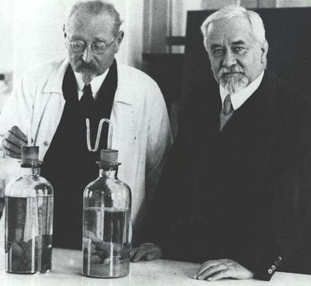
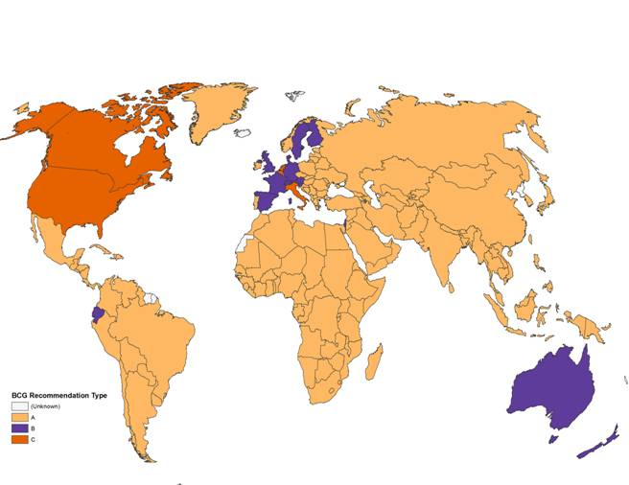
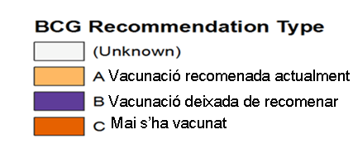
Why BCG is a good vaccine vector?
Long safety record (more than 2 billion doses administered in nearly 100 years)
Cheap mass production.
Strong adjuvant immunopotenciating activity.
Can be administered at birth,
Worldwide distribution network with experience in BCG vaccination.

Slide 4
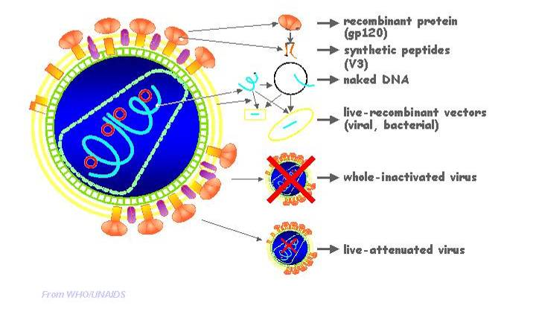
rBCG:HIV: what kind of vaccine is it?
José Esparza MD, PhD
Bill & Melinda Gates Foundation, IAC 2004

Slide 5
rMycobacterium based vaccines:
The generic model
Mycobacterial DNA
Kan ^{r}
Shuttle vector
OriM
Vector: attenuated mycobacterium (BCG)
Shuttle vector
OriE
Plasmid DNA, E.coli-mycobacterial shuttle vector
Heterologous immunogen
Immunogen: Heterologous immunogen to be expressed by the mycobacterium.

Slide 6
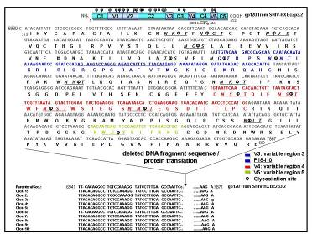
Our first vaccine model: BCG.gp120²⁶¹
ADN BCG Pasteur
Kan ^{r}
BCG.gp120²⁶¹
pMV261-gp120
OriM
BCG : BCG substrain Pasteur
pMV261.gp120
OriE
gp120
Plasmid DNA: pMV261.gp120
Immunogen: Clade B gp120.
Controlled by hsp60 promoter.
gp120
HA
His

Slide 7

Proposed modifications to increase plasmid stability: BCG.gp120²²²
Molecular characterization of heterologous HIV-1gp120 gene expression disruption in Mycobacterium bovis BCG host strain. A critical issue for engineering Mycobacterial based vaccine vectors.
Joan Joseph¹, Raquel Fernández-Lloris¹, Elias Pezzat¹, ², Narcís Saubi ¹, Pere-Joan Cardona³, Beatriz Mothe⁴ and Josep Maria Gatell¹
ADN BCG Pasteur lysA-
ADN BCG Pasteur
Kan ^{r}
pJH222-gp120
BCG.gp120²²²
pMV261-gp120
lysA
pJH222.gp120
OriM
BCG : BCG ΔlysA substrain Pasteur
pMV261.gp120
OriE
gp120
Plasmid DNA: pMV261.gp120
pJH222.gp120
Immunogen: Clade B gp120.
Controlled by hsp60 promoter.
gp120
HA
His
19 kD signal seq
α-Ag

Slide 8
Collaboration with University of Oxford: fusion proteins, HIVA immunogen
ADN BCG Pasteur Δlys A
Kan ^{r}
BCG.HIVA²²²
pJH222-HIVA
LysA
HIVA
OriM
BCG : BCG ΔlysA substrain Pasteur
pJH222gp120
OriE
HIVA
Plasmid DNA: pJH222HIVA
gp120
Immunogen: HIVA.
Controlled by α-Ag promoter.
Pk Tag
p24
p17
19 kD signal seq
multi-CTL epitope region

Slide 9
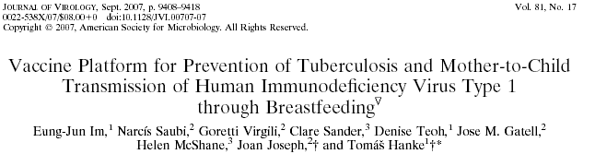

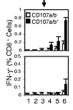
Heterologous prime-boost vaccination programme:
BCG.HIVA²²²
+
MVA.HIVA
IFN-γ by ICS
Challenge with M. tuberculosis

Slide 10
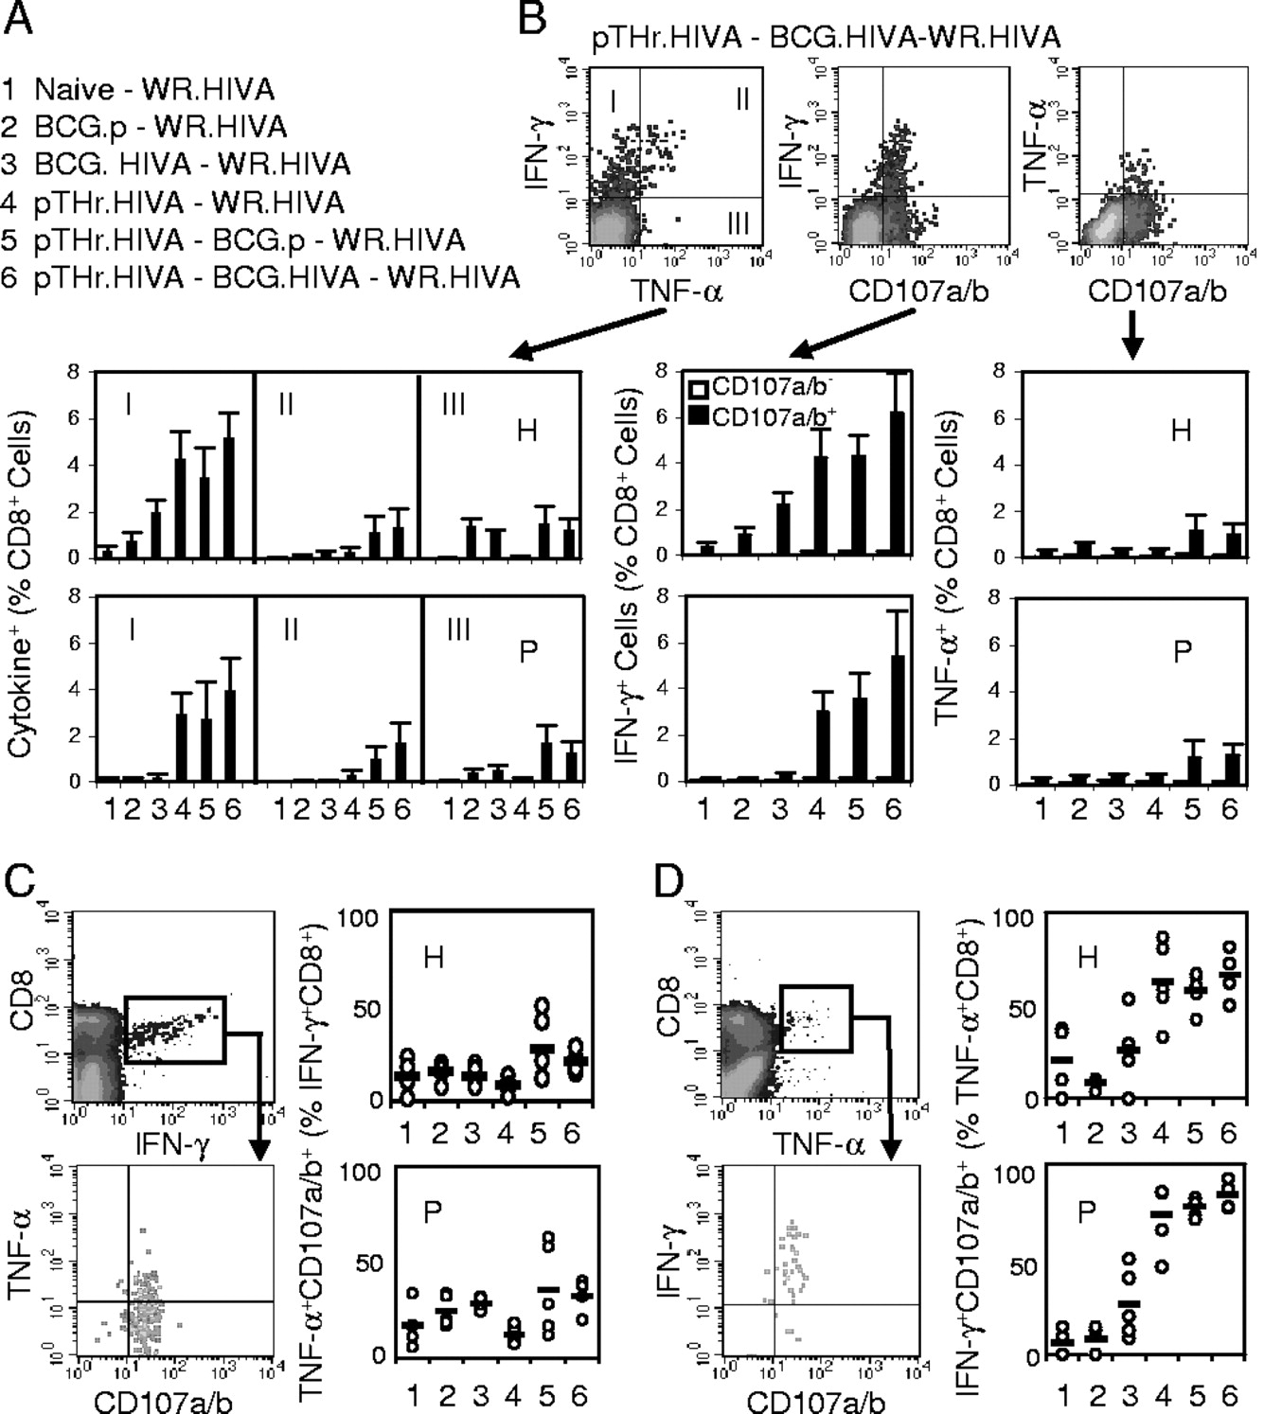
Immunogenicity of the pTHr.HIVA DNA priming-BCG.HIVA boosting regimen for CD8+ T cells.
Eung-Jun Im et al. J. Virol. 2007;81:9408-9418
Notes:
Immunogenicity of the pTHr.HIVA DNA priming-BCG.HIVA boosting regimen for CD8+ T cells. (A) Mice were left unimmunized or primed with 106 CFU of BCG.HIVA or BCG.p or 100 μg of pTHr.HIVA DNA, groups 5 and 6 were given booster doses of 106 CFU of BCG.p or BCG.HIVA, and then all groups were challenged with 4 × 106 PFU of WR.HIVA. (B) The top panels provide examples of dot blots for the analysis of bifunctional CD8+ T cells as generated for group 6 and epitope H. The bottom panels summarize the data obtained for each vaccination group by using the H (top) and P (bottom) epitopes. For the IFN-γ/CD107a/b and TNF-α/CD107a/b analyses, the frequencies of nondegranulating (empty bars) and degranulating (full bars) cells producing cytokine are shown. For the IFN-γ/TNF-α analysis, average frequencies corresponding to dot blot quadrants I, II, and III are plotted. Data are presented as means ± SD (n, 4 to 5 mice). (C and D) Analyses of trifunctional vaccine-elicited T cells. The two left panels indicate the gating. The right panels give the frequencies of trifunctional cells corresponding to the upper right quadrants for individual mice (circles) and groups (bars; values are means for the groups) as obtained with the H (top) and P (bottom) epitopes. Frequencies are expressed as percentages of CD8+ IFN-γ+ (C) and CD8+ TNF-α+ (D) cells.

Slide 11
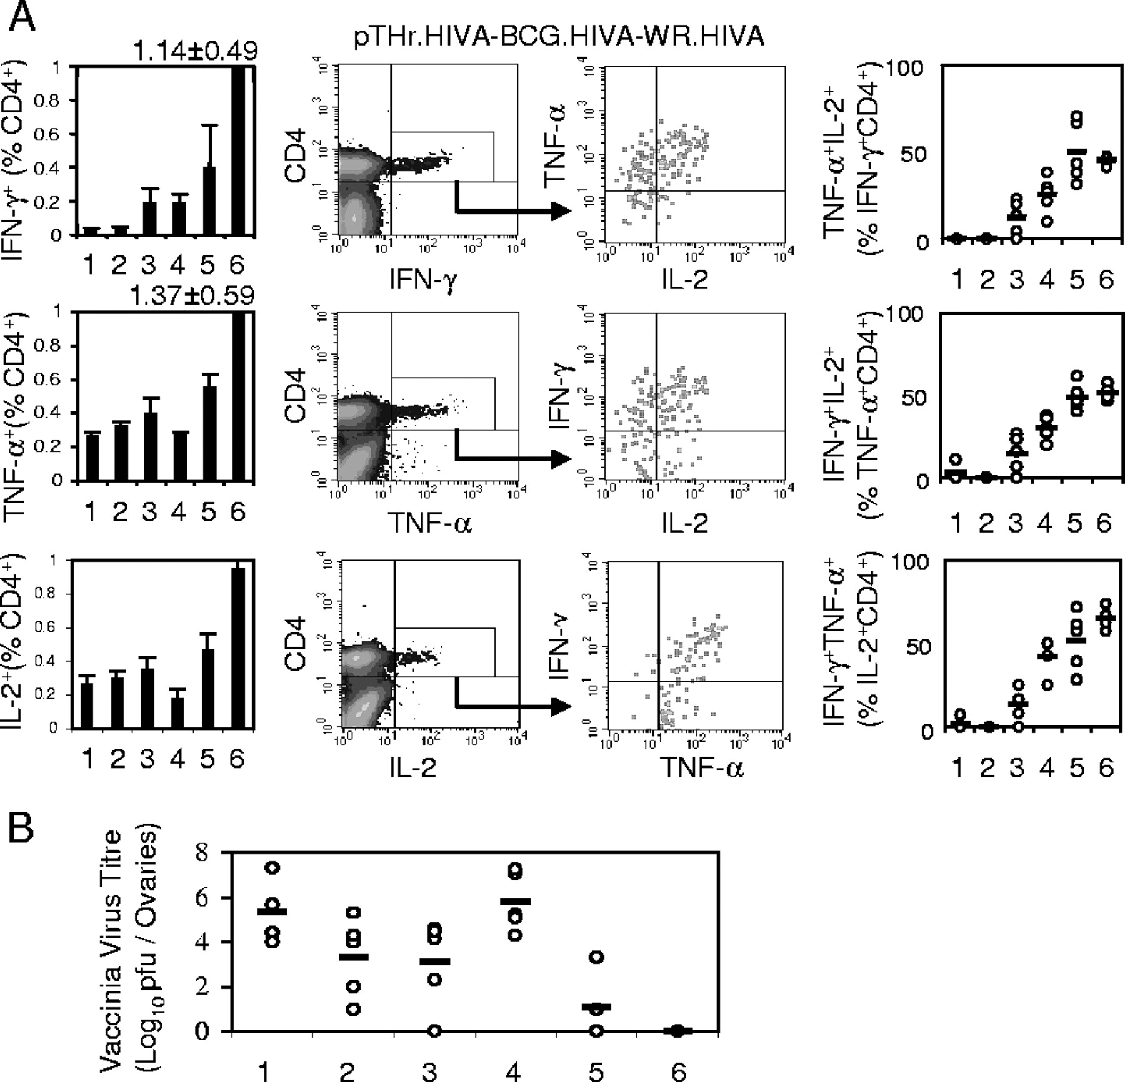
Induction of high-quality HIV-1-specific CD4+ T cells and complete protection against surrogate virus challenge.
Eung-Jun Im et al. J. Virol. 2007;81:9408-9418
Notes:
Induction of high-quality HIV-1-specific CD4+ T cells and complete protection against surrogate virus challenge. The mice and the treatment groups (1 through 6) were the same as those described in the legend to Fig. 4A. (A) The leftmost panels summarize the data obtained for each cytokine and vaccination group. Data are presented as means ± SD (n, 4 to 5 mice). The middle panels demonstrate the gating for IFN-γ-, TNF-α-, and IL-2-producing CD4+ T cells as generated by group 6 for a cocktail of three MHC class II epitopes. The rightmost panels give the upper-right-quadrant data for trifunctional HIV-1-specific CD4+ T cells from individual mice (circles) and groups (bars). Data are presented as means ± SD (n, 4 to 5 mice). (B) Mice were either left naïve (1) or vaccinated with BCG.p (2), BCG.HIVA (3), pTHr.HIVA DNA (4), pTHr.HIVA DNA and BCG.p (5), or pTHr.HIVA and BCG.HIVA (6) and challenged with WR.HIVA. The WR.HIVA loads in ovaries were determined 4 days later. Data for individual mice (circles) and group means (bars; n, 4 to 5 mice) are shown.

Slide 12
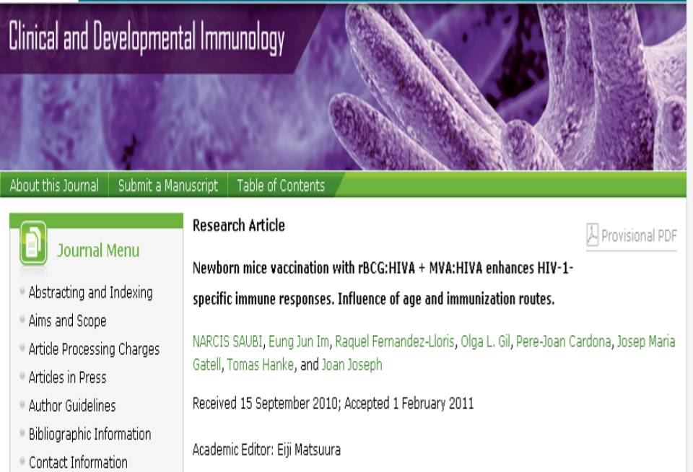
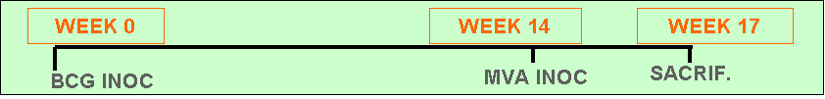
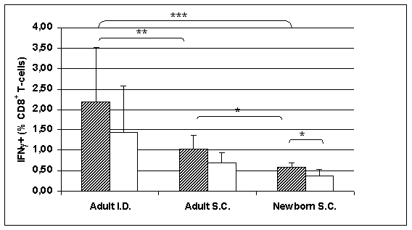
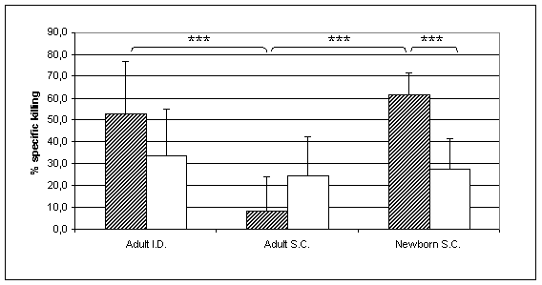
BCG.HIVA²²²
http://www.hindawi.com/journals/cdi/aip/516219/

Slide 13
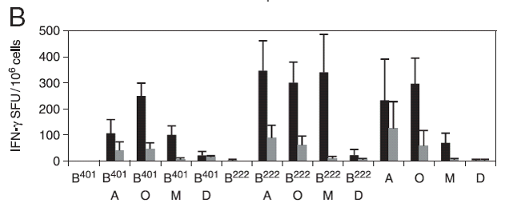
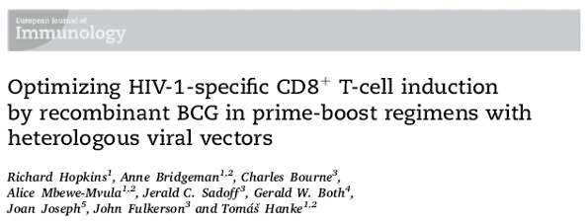
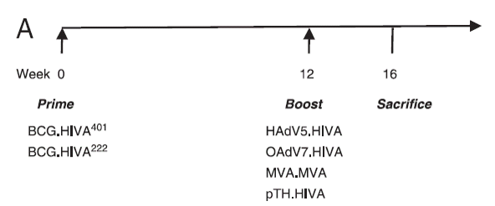
BCG.HIVA²²²
Priming Agents:
BCG.HIVA⁴⁰¹
BCG₁₃₃₁ΔureC::ΩpfoA
BCG.HIVA²²²
BCG Pasteur ΔlysA5
Boosting Agents:
A Human Adenovirus serotype 5 (HAdV5.HIVA)
O Ovine Atadenovirus serotype 7 (OAdV7.HIVA)
M Modified Vaccinia Ankara Strain (MVA.HIVA)
D Plasmid DNA (pTH.HIVA)
Eur. J. Immunol. 2011. 41: 1–11 DOI 10.1002/eji.201141962

Slide 14
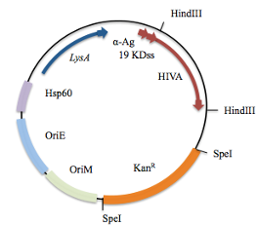
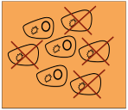
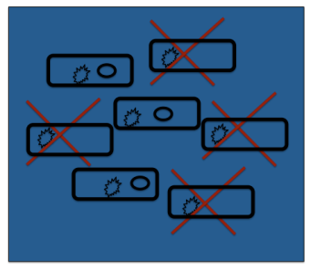
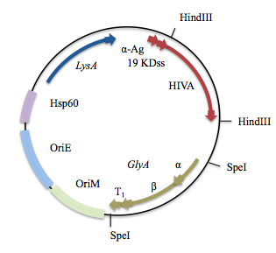
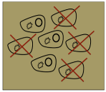
Improvement of the selection system: Substitution of the Kan® by E.coli glycine auxotrophy complementation.
E. Coli
Mycobacterium BCG Lys⁻
pJH222
KANAMYCIN RESISTANCE
LYS AUXOTROPHY COMPLEMENTATION
E. Coli M15ΔGly
Mycobacterium BCG Lys⁻
p2auxo
GLY AUXOTROPHY COMPLEMENTATION
LYS AUXOTROPHY COMPLEMENTATION

Slide 15
Elimination of Kan®: double auxotrophy selection: BCG.HIVA^{2auxo}
glyA
ADN BCG Pasteur
Kan ^{r}
BCG.HIVA^{2auxo}
p2auxo.HIVA
LysA
OriM
BCG : BCG substrain Pasteur. LysA auxotroph.
pJH222HIVA
OriE
p2auxo.HIVA
HIVA
Plasmid DNA: pJH222.HIVA
p2auxo.HIVA
1
2
3
Pk Tag
Immunogen: HIVA.
Controlled by α-Ag promoter.
p24
p17
multi-CTL epitope region

Slide 16
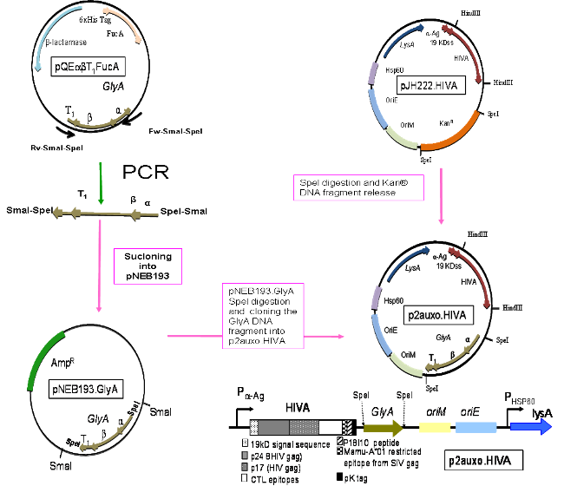
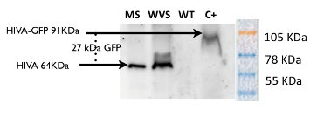
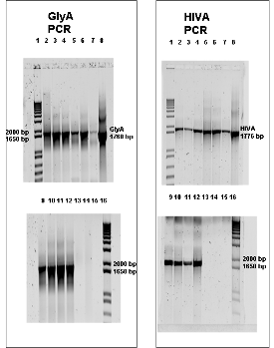
Construction of p2auxo.HIVA and BCG.HIVA^{2auxo}

Slide 17
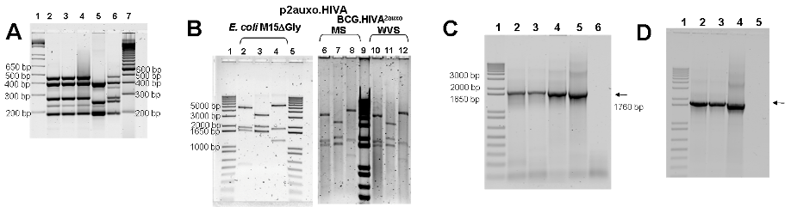
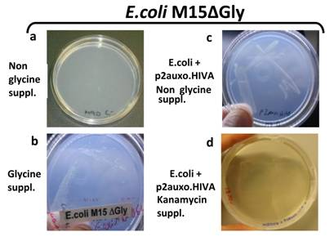
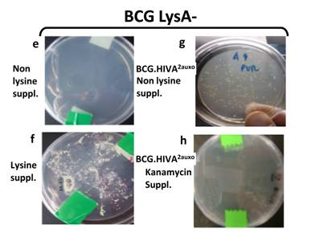
BCG.HIVA^{2auxo} characterization
BCG Pasteur Substrain
HIVA insert stability
p2auxo.HIVA stability pre and post-BCG
glyA insert stability

Slide 18
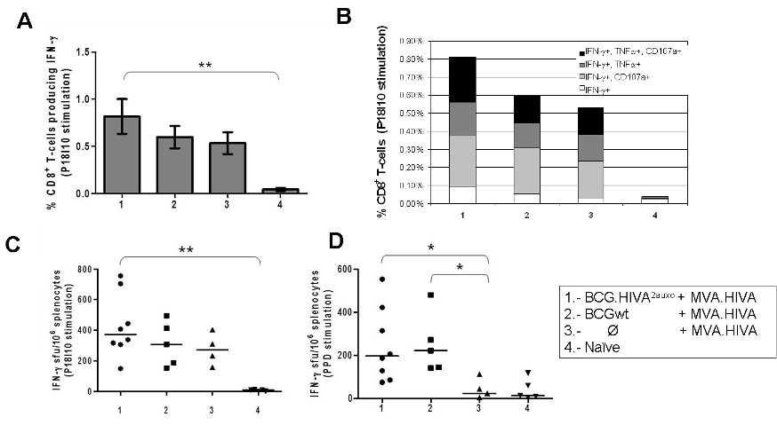
BCG.HIVA^{2auxo} immunogenicity in BALB/c mice
W0
W5
W7
Prime
Boost
Sacrifice
BCG.HIVA^{2auxo}
MVA.HIVA

Slide 19
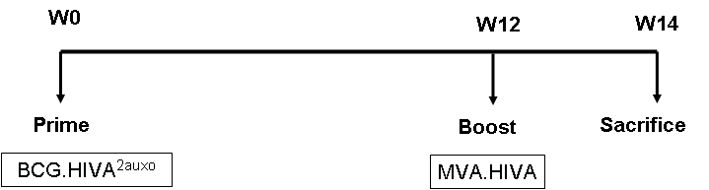
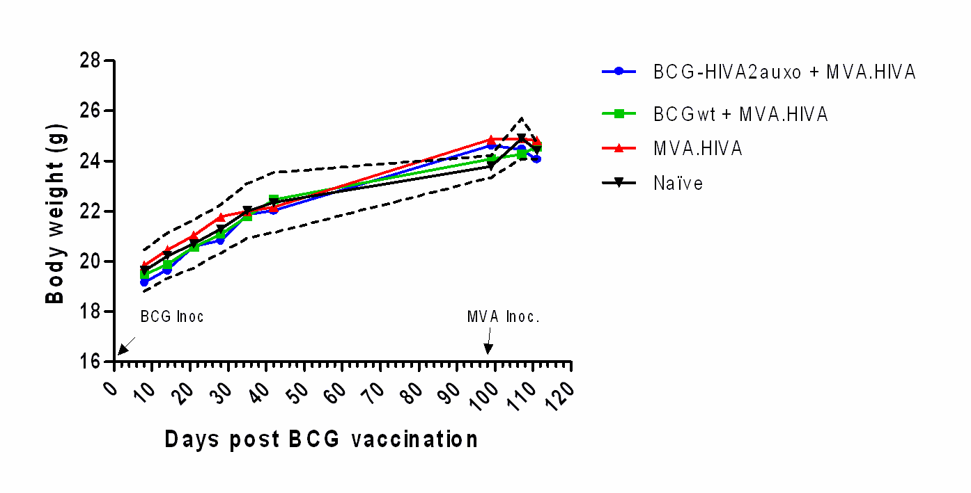
BCG.HIVA^{2auxo} safety in BALB/c mice

Slide 20

p2auxo.HIVA plasmid
EP 12 382 336.1

Slide 21
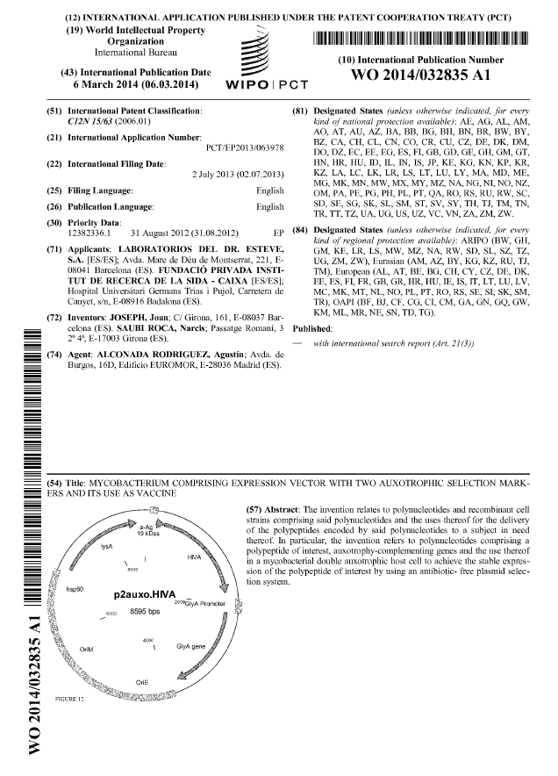
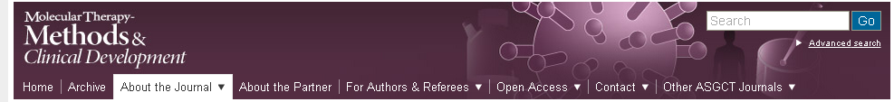
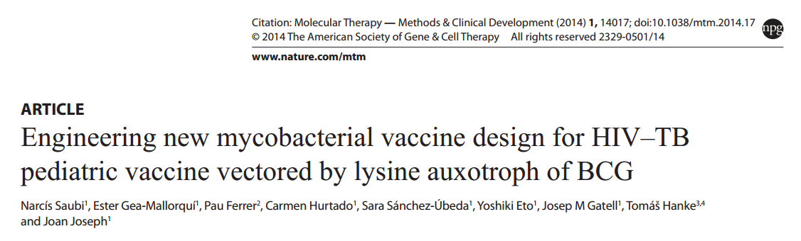
p2auxo.HIVA plasmid

Slide 22
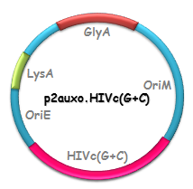


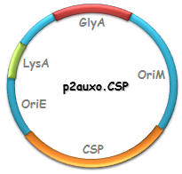


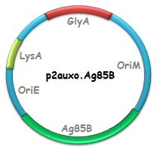
HIVc immunogen
(T. Hanke, Univ. Oxford)
VIH/SIDA
HIVACAT T-cell immunogen
(C. Brander, HIVACAT)
BCG.HIVc(G+C)^{2auxo}
GlyA
Malària
LysA
OriM
p2auxo.HIVA
OriE
PαAg
BCG.CSP^{2auxo}
19kD ss
HIVA
HindIII
Tuberculosi
HindIII
BCG.Ag85B^{2auxo}

Slide 23





About EAVI2020
Financed by the European Commission, the European AIDS Vaccine Initiative (EAVI2020) brings together leading HIV researchers from public organisations and biotech companies from across Europe, Australia, Canada and the USA in a focused effort to develop protective and therapeutic HIV vaccines.
“This project has received funding from the European Union’s Horizon 2020 research and innovation programme under grant agreement No 681137”

Slide 24
Objectives
The Scientific and Technological Objectives of the project can be summarised as:
1. Env immunogens to elicit bNAb.
2. HIV immunogens to elicit broad and effective antiviral cellular responses.
3. Production of vaccine components (adjuvants, vectors, proteins).
4. Advanced Animal Models.
5. Human Experimental Medicine studies.
6. Immunological analysis.
7. B cell repertoire analyses and isolation of neutralising monoclonal antibodies.
8. Generation and selection of a novel and diverse portfolio of promising HIV-1 prophylactic and therapeutic vaccine candidates for further clinical development in the context of the European and Developing Countries Clinical Trials Partnership (EDCTP) and other allied partners.

Slide 25
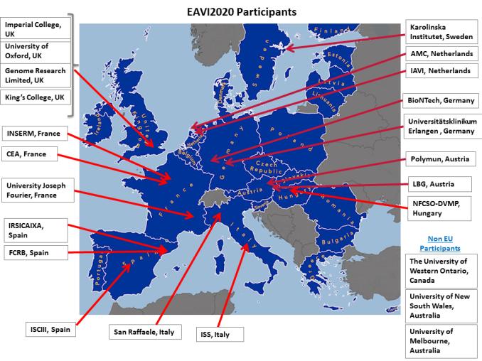
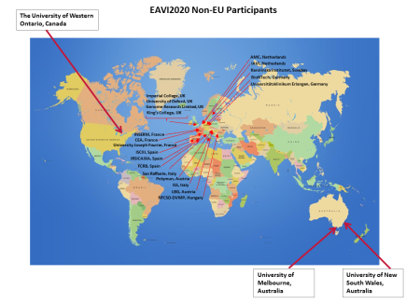
EAVI2020 Partners

Slide 26

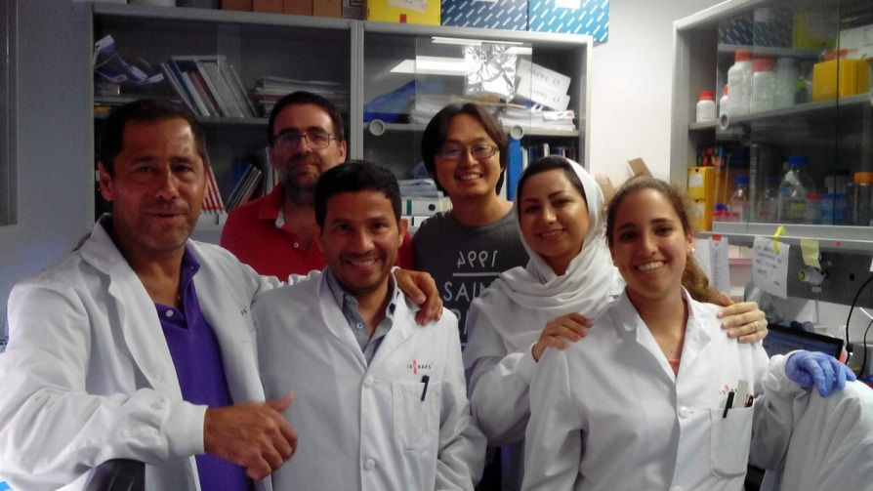







ACKNOWLEDGEMENTS
Dr. Joan Joseph (PI)
Narcis Saubi
Yoshiki Eto
Mitra Ayashari/Mohammad Feizabadi
Núria Guitart
Athina Kilpelainen
Prof. JosepMª Gatell
All researchers and technicians from the AIDS Research Lab.
Dr. Christian Brander
Dr. Bea Mothe
Dr. Alex Olvera
Prof. Tomáš Hanke
Prof. Mohammad Feizabadi
Prof. Carlos Martin

Slide 27
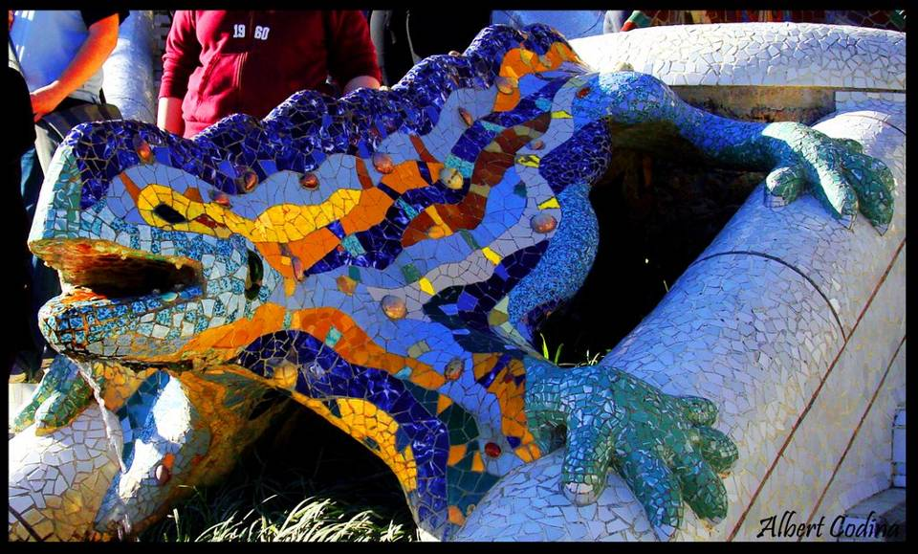
MOLTES GRÀCIES PER LA VOSTRA ATENCIÓ
MUCHAS GRACIAS POR SU ATENCIÓN
THANKS FOR YOUR ATTENTION
با تشکر از توجه شما

