Slide 1
Determination of parameters defining accuracy of widefield FRET measurements of molecular interactions
Laura Hippe, Anita Bērziņa and Mārtiņš Kālis, PhD
A. Kirchenstein Institute of Microbiology and Virology, Riga Stradiņš University, Latvia

Slide 2
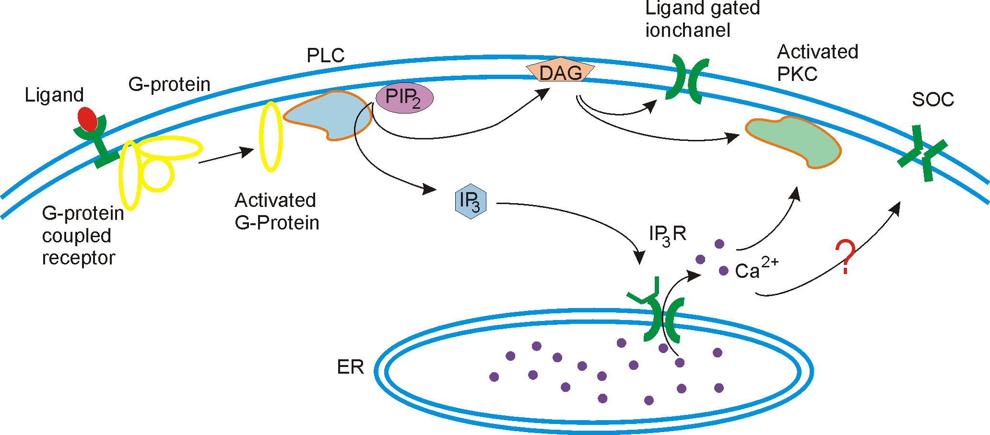
Ca²⁺ release-activated Ca²⁺ channel (CRAC)
CRAC is a selective calcium ion store operated channel (SOC)
SOC activity is dependent on [Ca²⁺]_{ET}.
Ca²⁺ depletion is caused by:
Receptor signals
Biochemical signals
Thapsigargin
Ionomycin
H₂O₂
Gene expression
Secretion
Cell growth

Slide 3
CRAC ion channels
STIM1 (stromal interaction molecule) is located on ER membrane
ORAI1 is located on PM
ER Ca²⁺ store depletion
STIM1-ORAI1 complex formation
Ca²⁺ influx
Prakriya and Lewis 2015

Slide 4
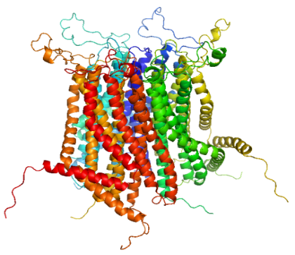
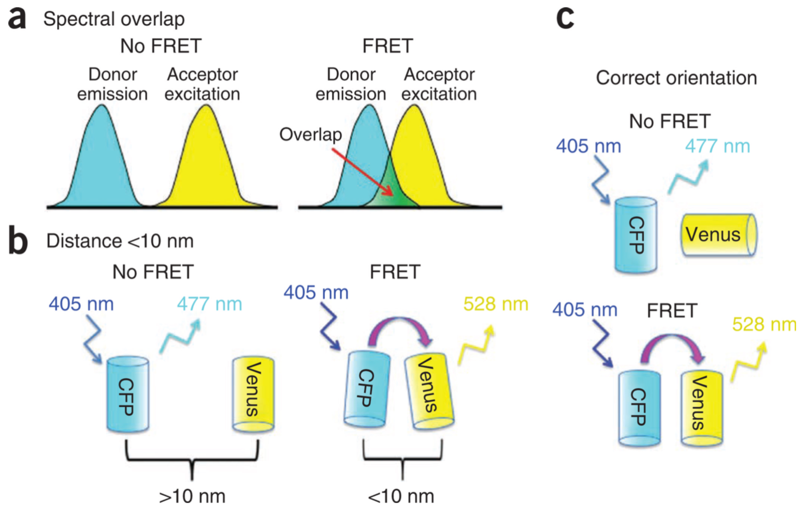
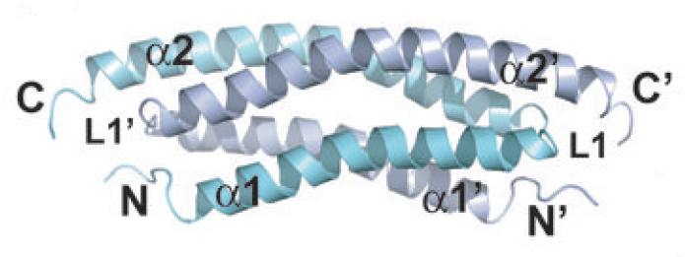
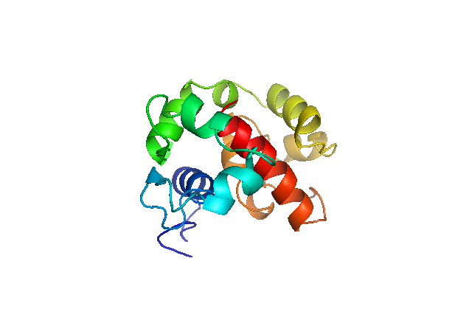
FRET – Förster Resonance Energy Transfer
Used for:
Molecular interaction detection in a cell
Conformational changes
CFP
YFP
STIM1
Brossard et al. 2013
Shindl 2016

Slide 5
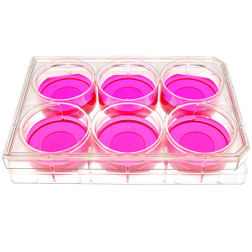
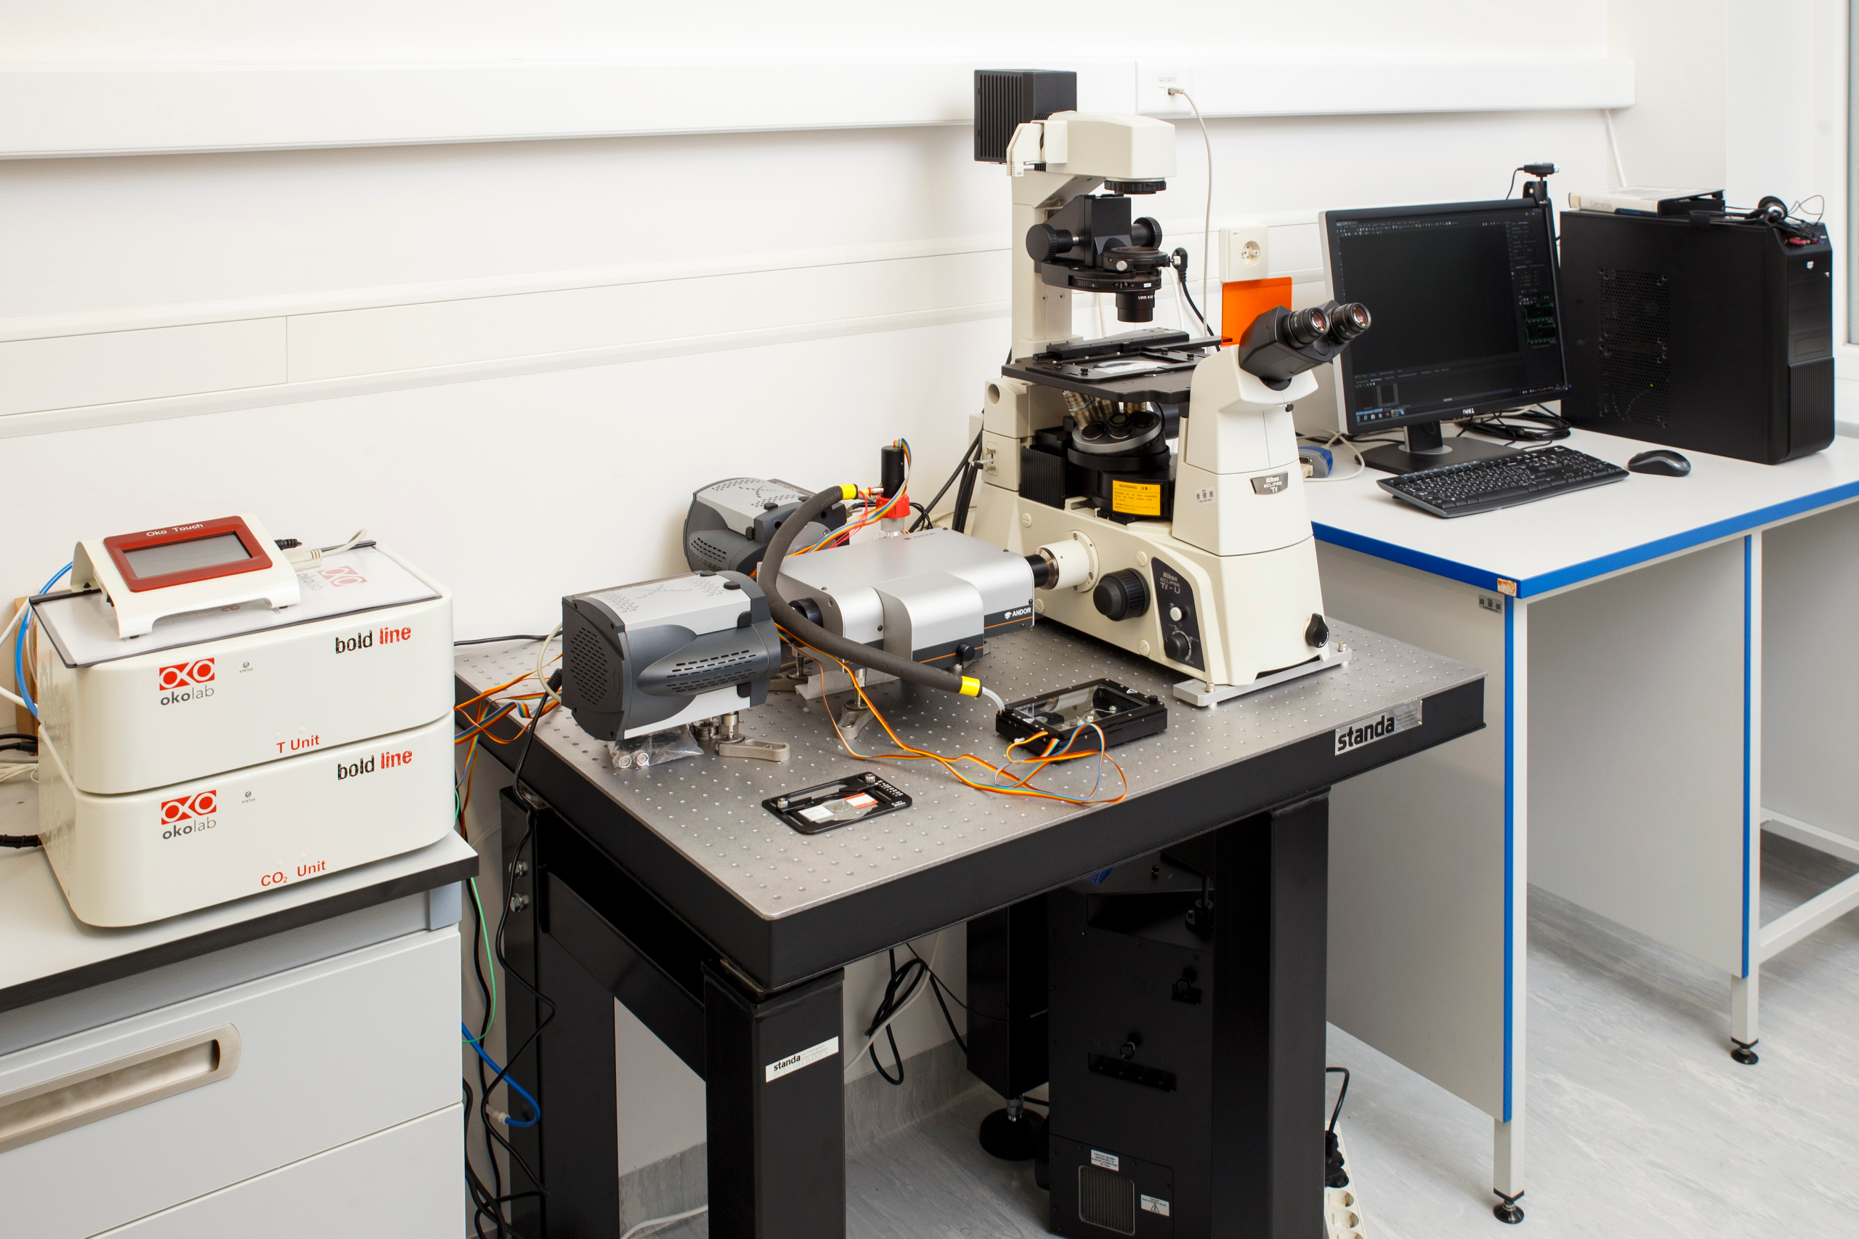
Transfection of HEK 293 cells with DNA constructs

Slide 6
DNA constructs
CFP-YFP
Positive control
CFP + YFP
Negative control
CFP-STIM1 + YFP-ORAI1
Negative control
STIM-CFP + YFP-ORAI1

Slide 7
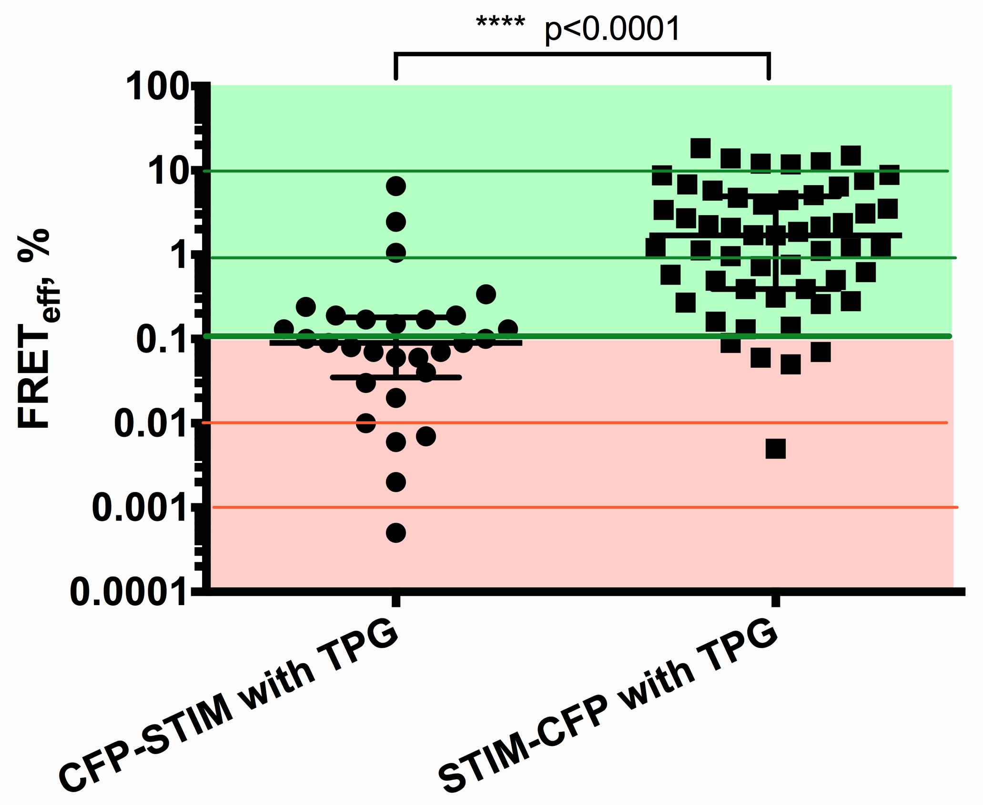
Bleached fluorophores

Slide 8
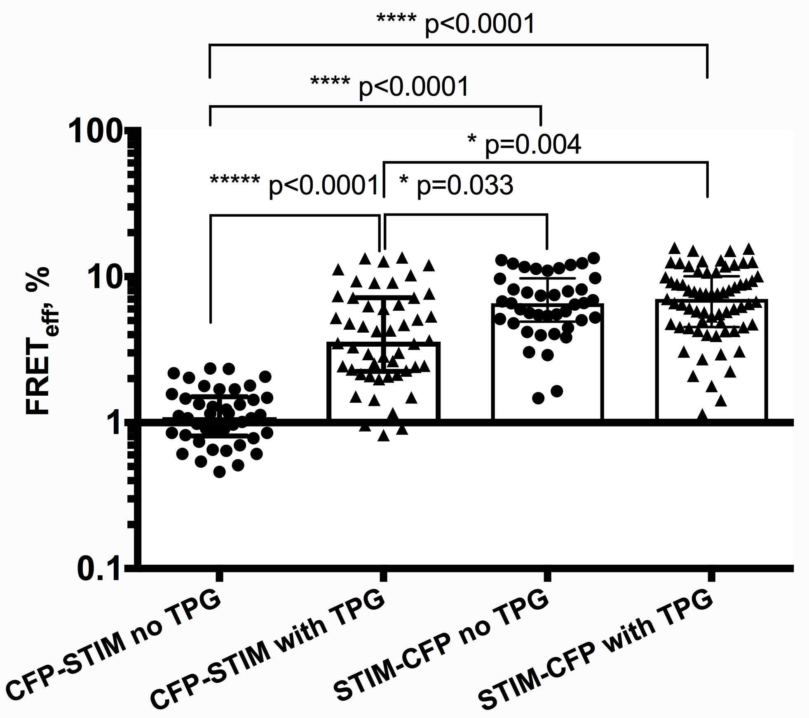
Reduced fluorophore bleaching

Slide 9
FRET measurement quality

Slide 10
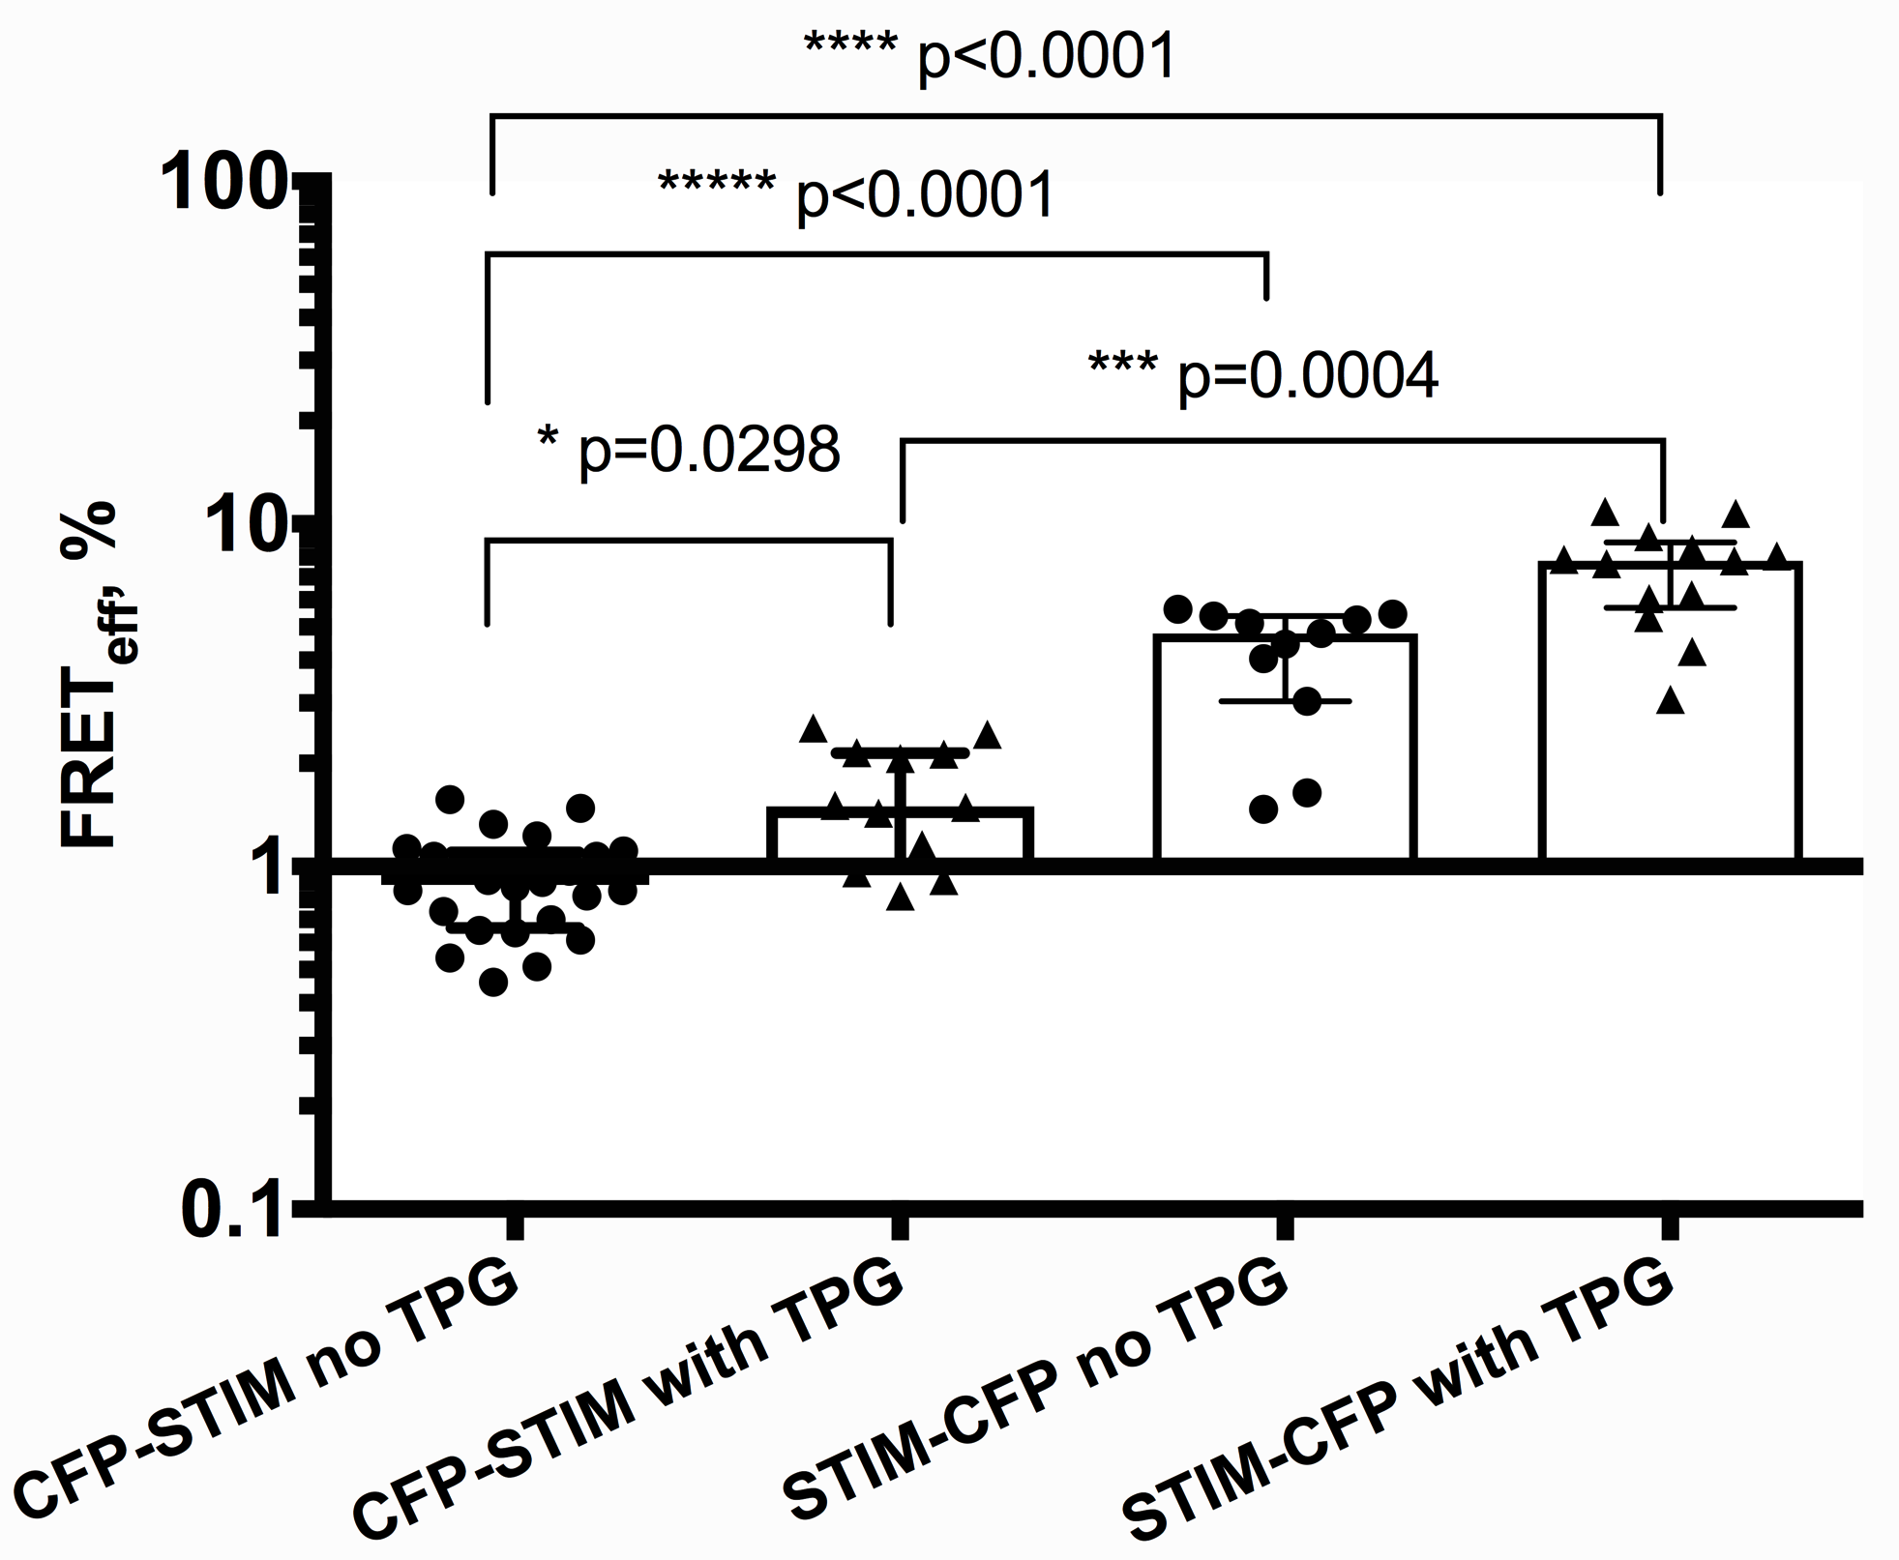
FRET data filtering
Before data filtering
After data filtering

Slide 11
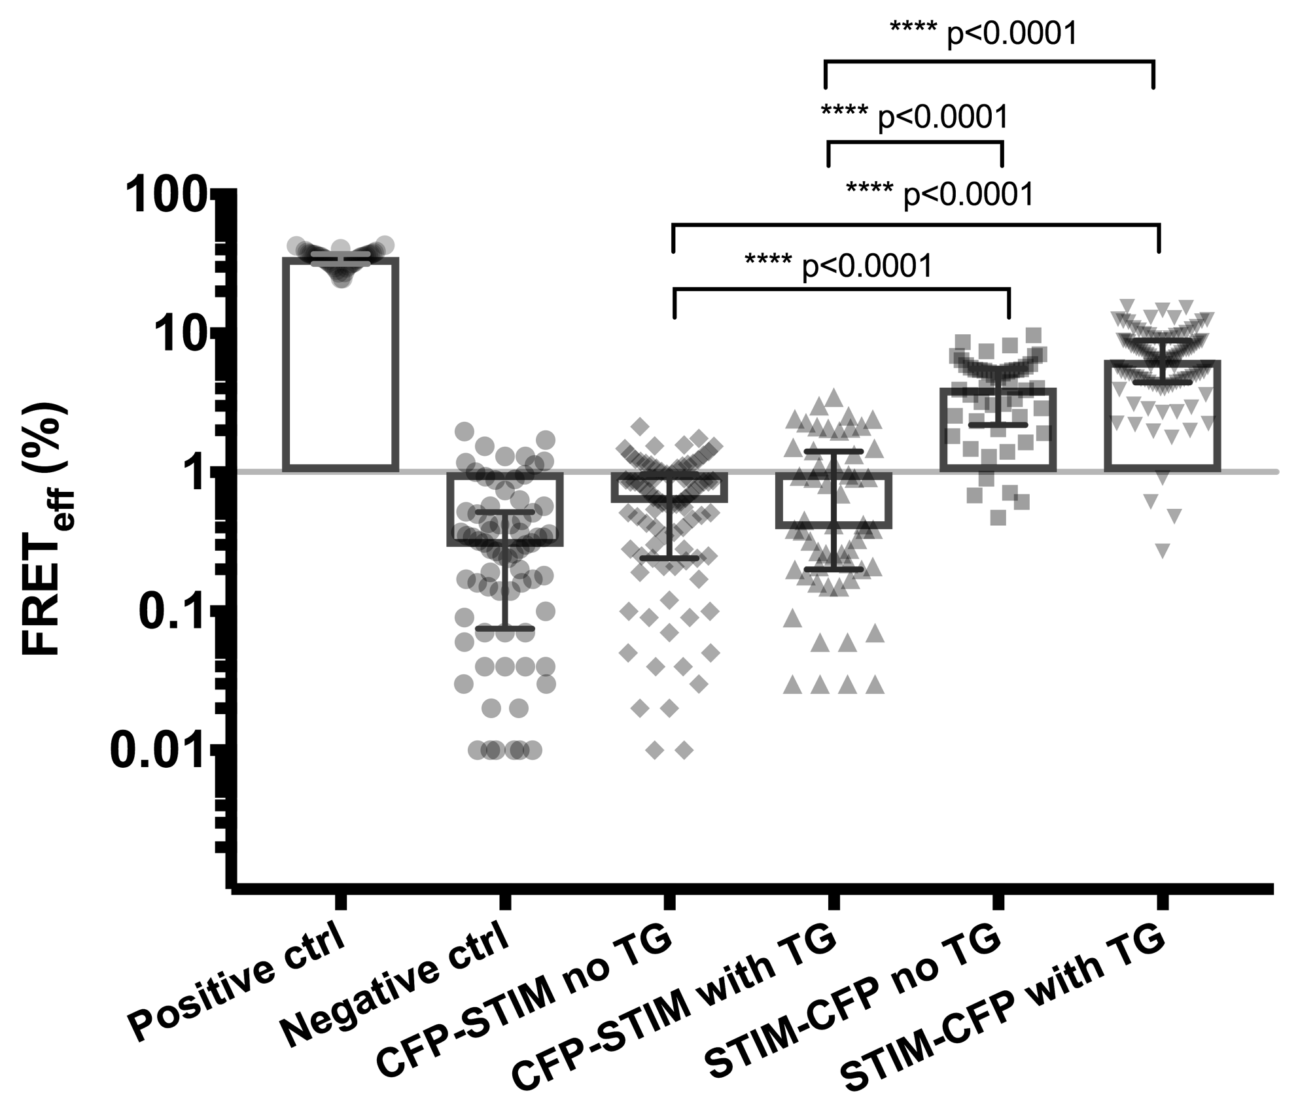
Positive and negative control

Slide 12
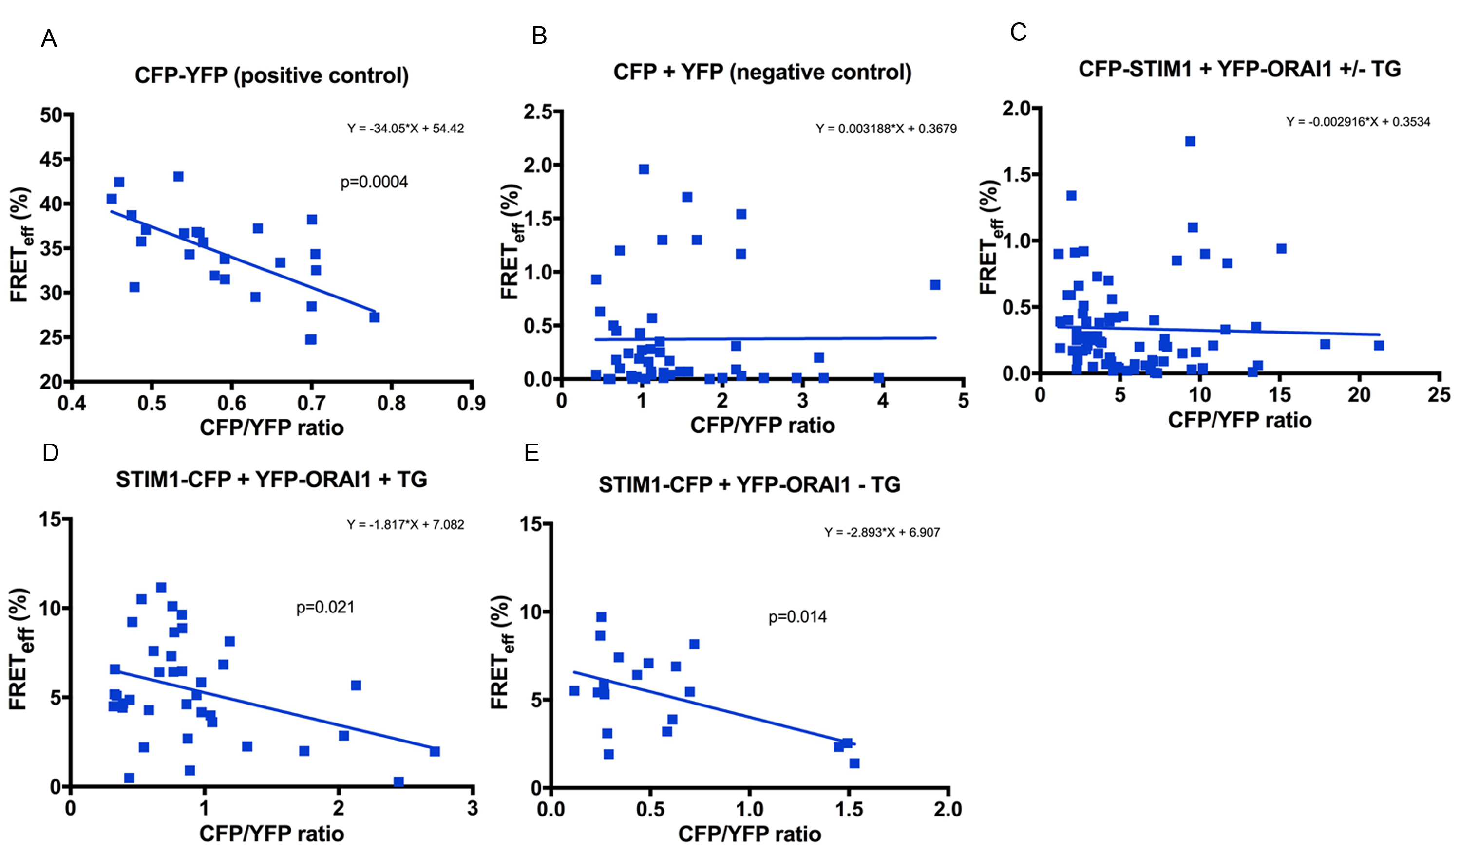
Correlation between CFP/YFP ratio and FRET_{eff}

Slide 13
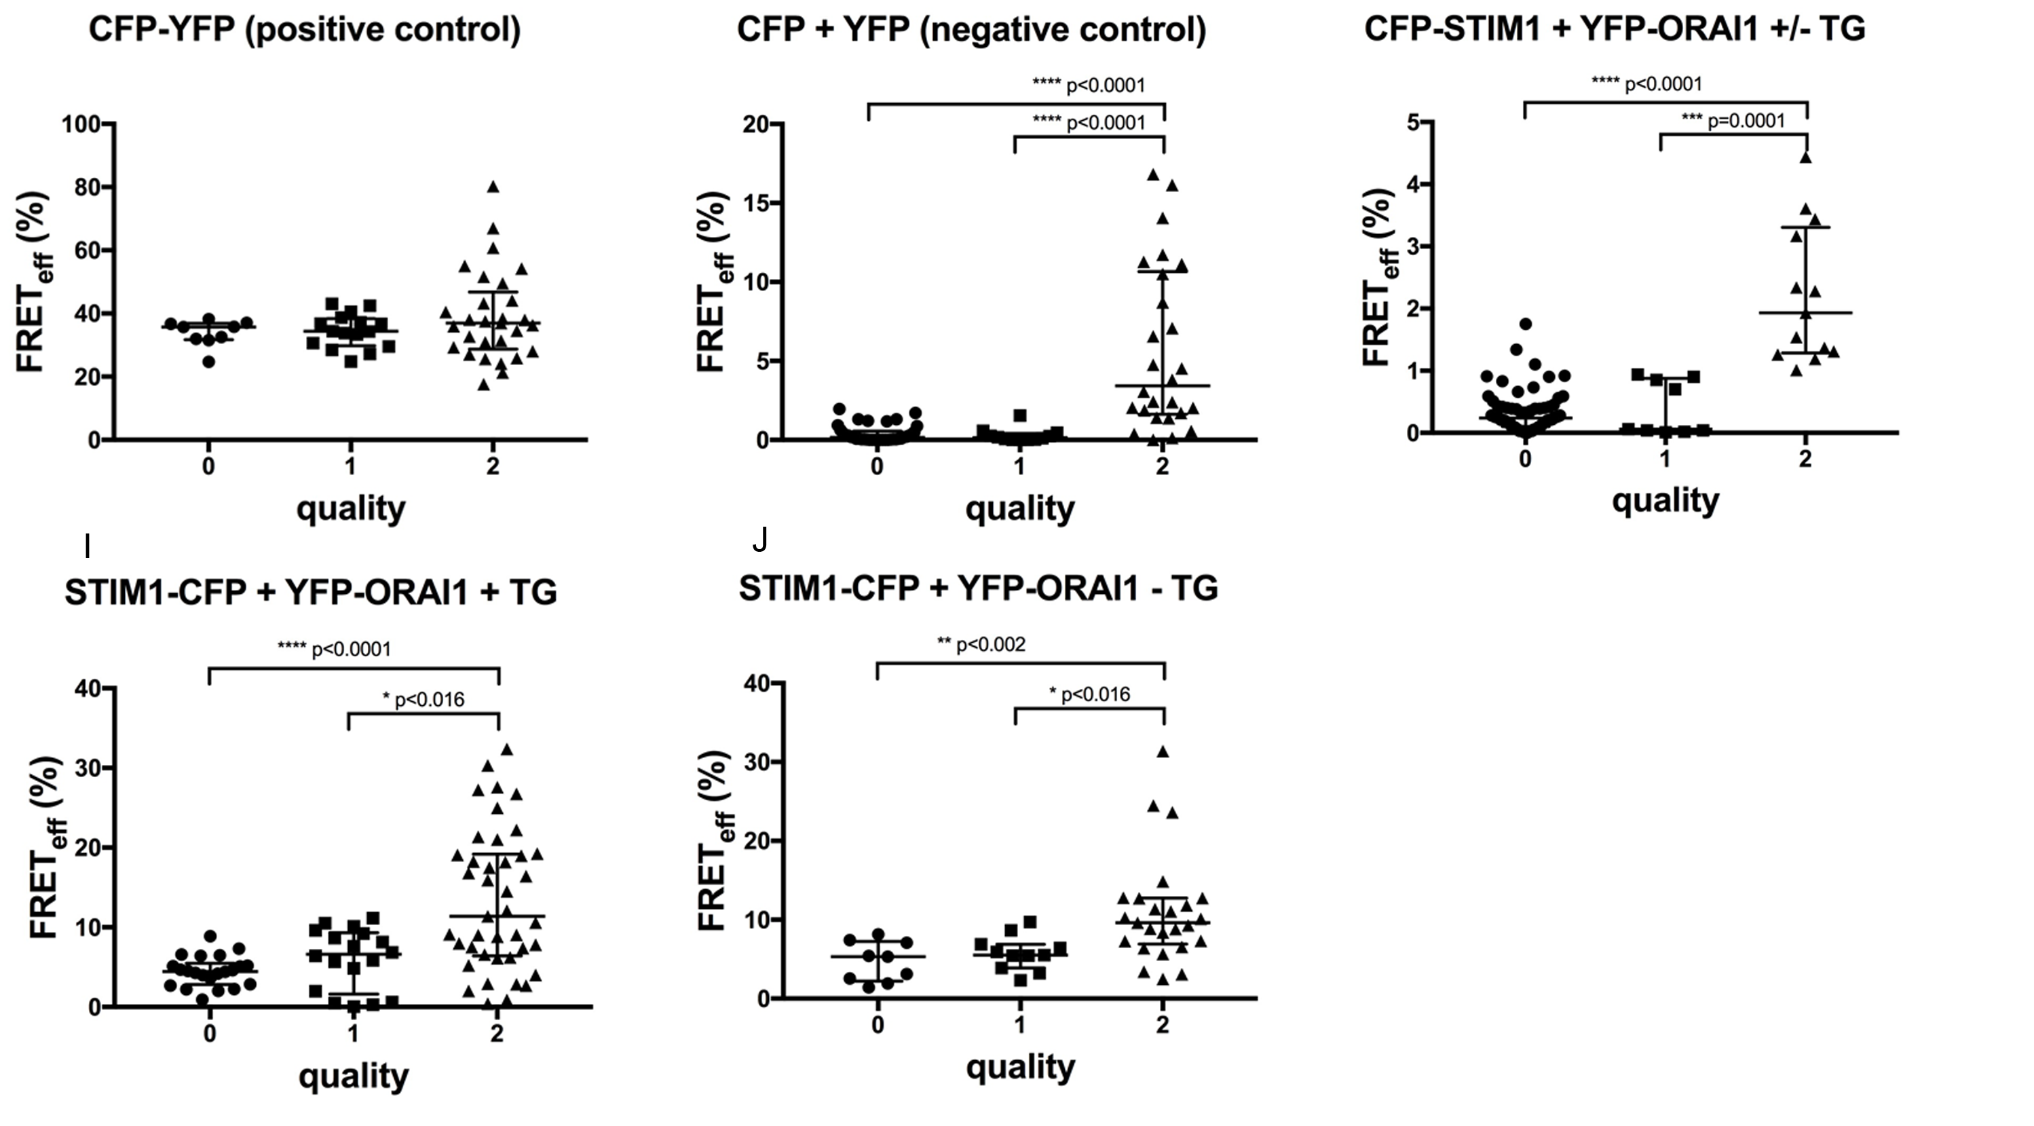
Effect of FRET quality on FRET_{eff} values

Slide 14
Conclusions
1. Optimal conditions for FRET experiments using a wide-field fluorescence microscope require use of ND filters during the preparation of cells for the FRET measurement in order to avoid photobleaching.
2. Donor/acceptor fluorophorescence intensity ratio can considerably influence FRET_{eff} levels. Fluorophore ratio must be taken into account when interpreting FRET results.
3. FRET_{eff} pixel frequencies not conforming to Gaussian distribution cause artifacts of elevated FRET_{eff} values.

Slide 15
Acknowledgements
Hermanis Sorokins
Šimons Svirskis
Maria Issagouliantis
Modra Murovska
Rainer Schindl

