Slide 1
Viral RNA nucleotide content is affected by innate immune system recognition
Alexander N. Lukashev
Chumakov Center for Development of Biologicals and Immunologicals

Slide 2
Codon usage bias
Translational - preference for codons with abundant/optimal tRNA content
Mutational – a function of mean genomic base content
“Selection” – selection pressure directed on nucleic acid sequence

Slide 3
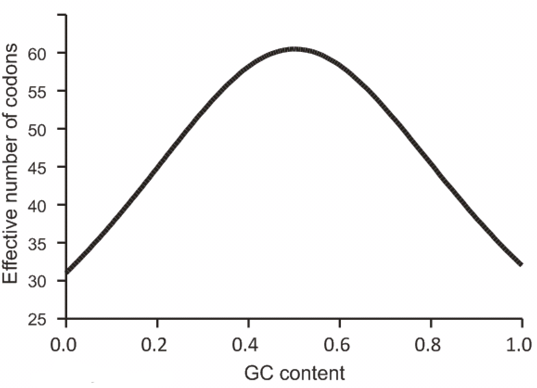
Mutational bias
Due to preference of certain bases in the genome
The exact mechanism is not known
Classically described by
GC (Wright’s) curve
ENC – effective number of
codons
Extreme bias: ENC=20
No bias: ENC=61
Single-stranded viruses have
unlinked base frequencies,
hence the classical GC content
tools are poorly applicable

Slide 4
Disambiguation
GC = total content of G + C in a genome
CpG = C-phosphate-G, a dinucleotide

Slide 5
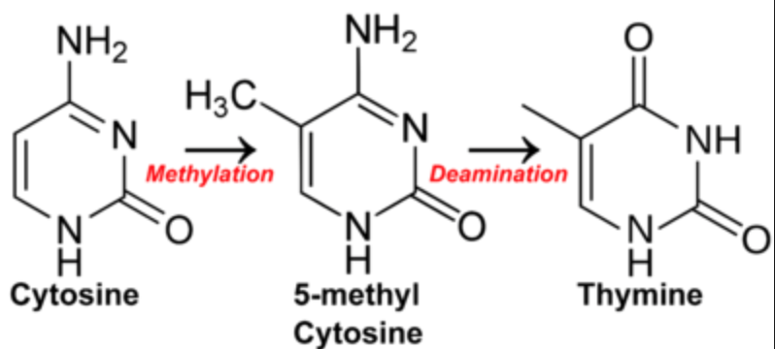
Mutational pressure on dinucleotide usage
In DNA genomes depletion of CpG dinucleotide is provided by deamination of C and mutation into T in CpG context

Slide 6
Translational bias
Due to requirements for certain translation rate
Relative synonymous codon usage of host/parasite
Optimization = use of frequent codons
Rare codons – time for proper folding or ribosome spacing
Studies neglect codon usage in distinct tissues

Slide 7
Selection bias
Generally neglected before 2000
Selection pressure on DNA/RNA sequence

Slide 8
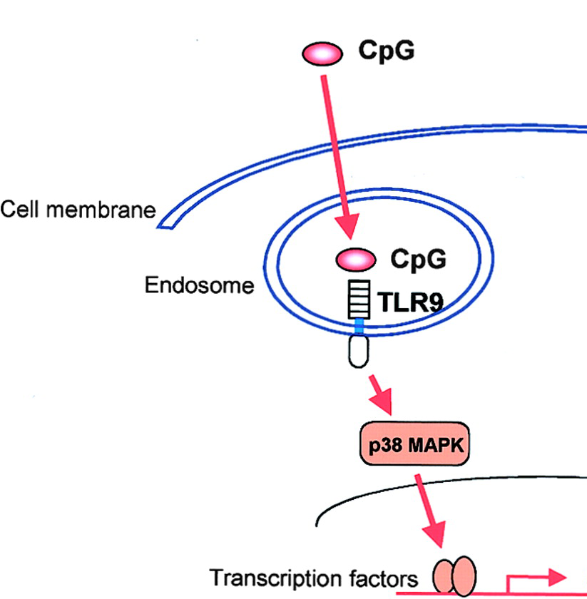
DNA genomes
CpG content in DNA allows
non-self recognition by TLR9
Self = low CpG
Bacterial DNA = high CpG
Mitochondrial DNA = intermediate
Although TLR9 is endosomal,
small DNA viruses avoid CpG

Slide 9
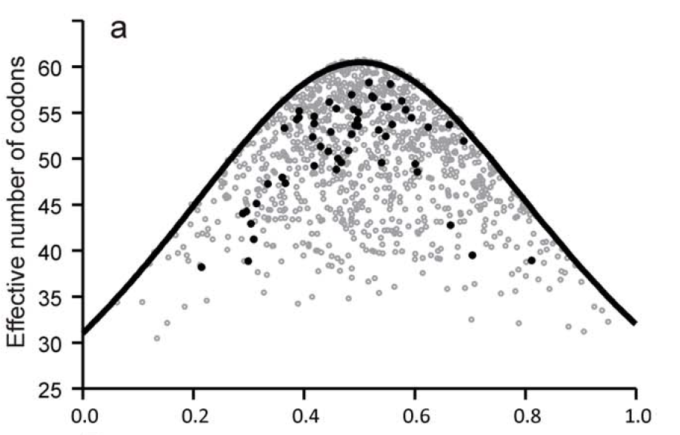
Codon usage in RNA viruses is not explained by Wright’s curve
GC content
Black – real RNA viruses; gray – simulated sequences with
preserved amino acid sequence and and nucleotide content
Belalov and Lukashev, 2013

Slide 10
Tools to investigate pressure sources
Wright’s curve: “What can ENC be at this GC content?”
Shuffling: “What can ENC be at this nt/di-nt content?”
Belalov and Lukashev, 2013

Slide 11
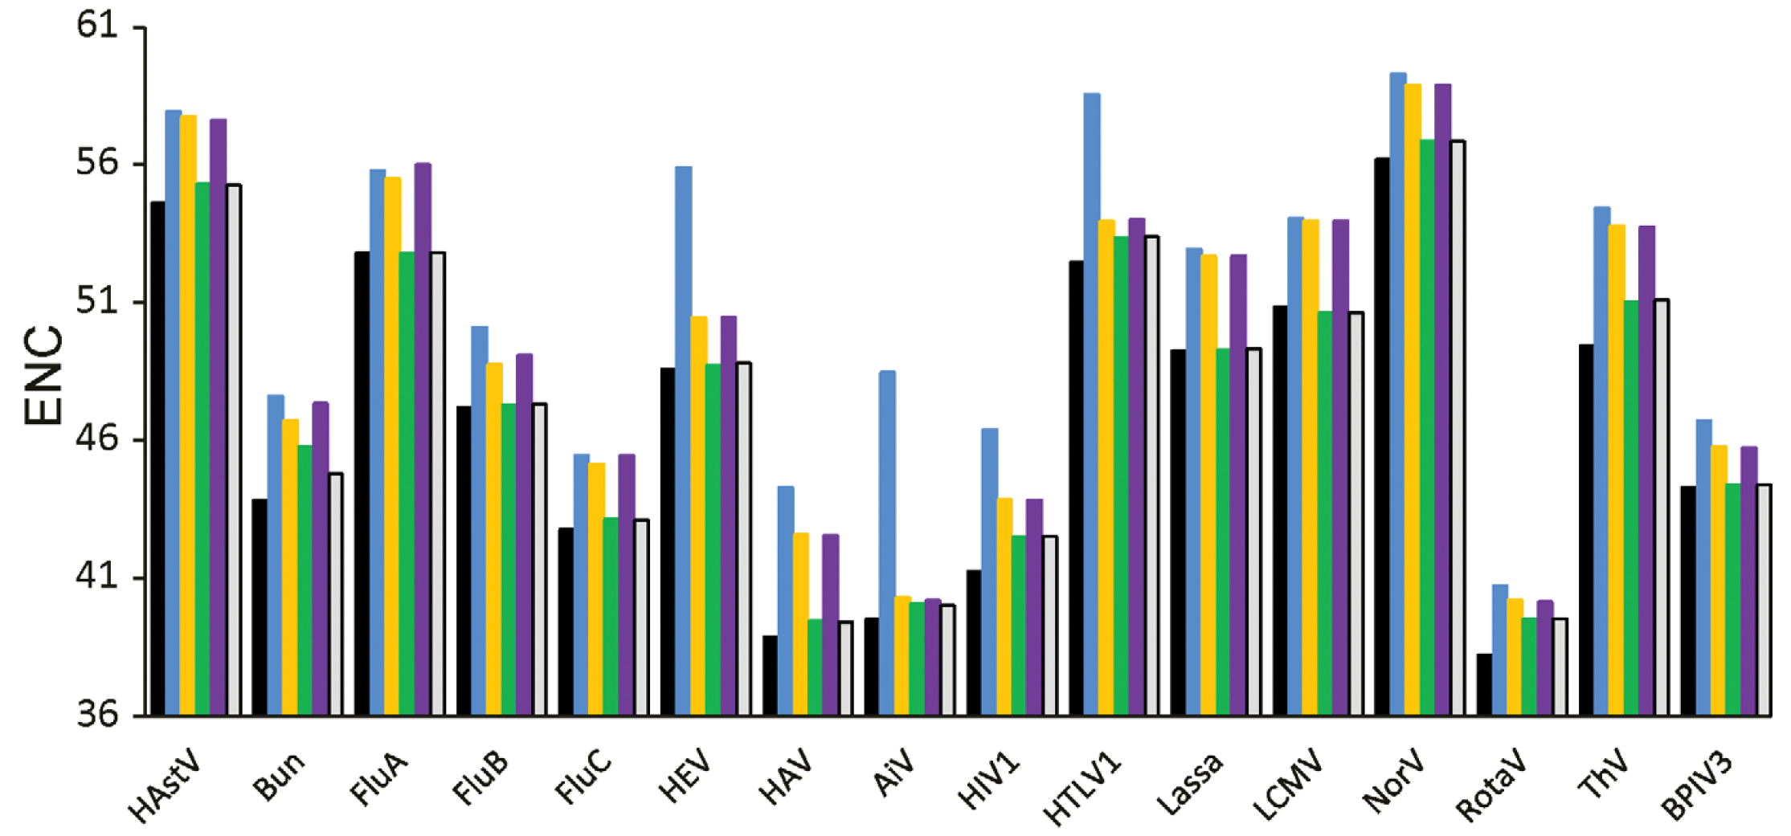
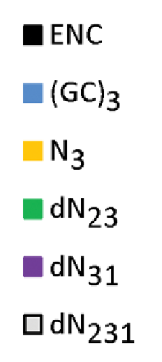
Factors affecting codon usage in RNA viruses
Actual ENC
Belalov and Lukashev, 2013

Slide 12
Factors affecting codon usage in RNA viruses
Actual ENC
In some cases, no nt bias over GC content
Belalov and Lukashev, 2013

Slide 13
Factors affecting codon usage in RNA viruses
Actual ENC
GC content is hugely misleading
Belalov and Lukashev, 2013

Slide 14
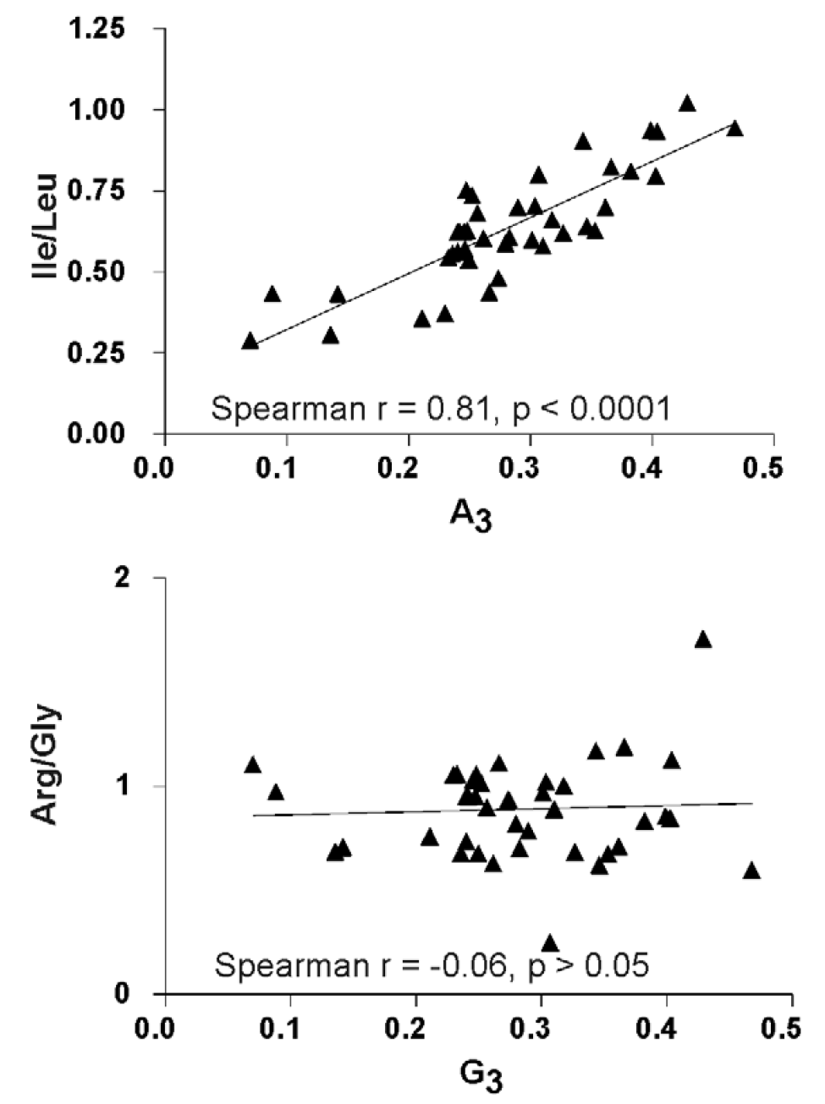
Nucleotide bias affects choice between similar amino acids
Ile:AUH
Leu:CUN,UUR
Arg:CGN, AGR
Gly:GGN
Belalov and Lukashev, 2013

Slide 15
Factors affecting codon usage in RNA viruses
Actual ENC
Nt content may explain all codon usage bias
Belalov and Lukashev, 2013

Slide 16
Factors affecting codon usage in RNA viruses
Actual ENC
Usually dinucleotide shuffling explains all bias
Belalov and Lukashev, 2013

Slide 17
Factors affecting codon usage in RNA viruses
Actual ENC
Additional factors (true codon usage bias) – in few viruses, weak
Belalov and Lukashev, 2013

Slide 18
GC content
Belalov and Lukashev, 2013

Slide 19
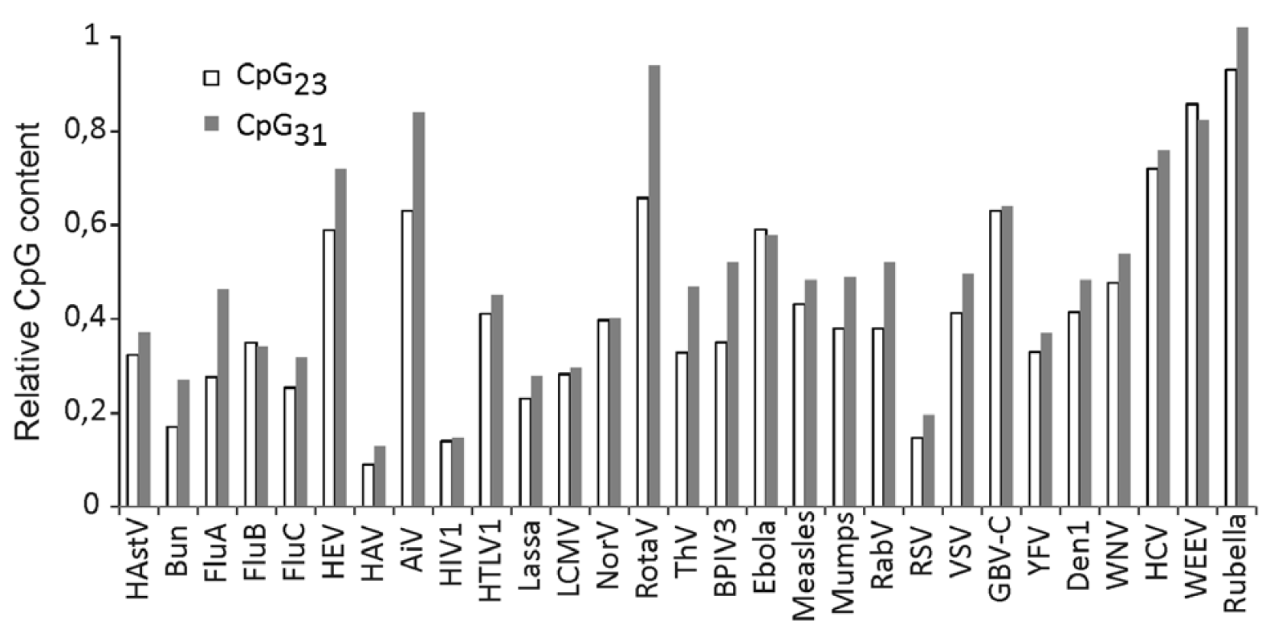
Most of the CpG bias is not codon usage dependent
Belalov and Lukashev, 2013

Slide 20
Avoided dinucleotides:
UpA – target of RNAse L
CpG – reason unknown
Viruses of sister genera may have radically different biases: viral counter-defense mechanisms can suppress recognition

Slide 21
Codon de-optimization became a standard virus attenuation tool

Slide 22
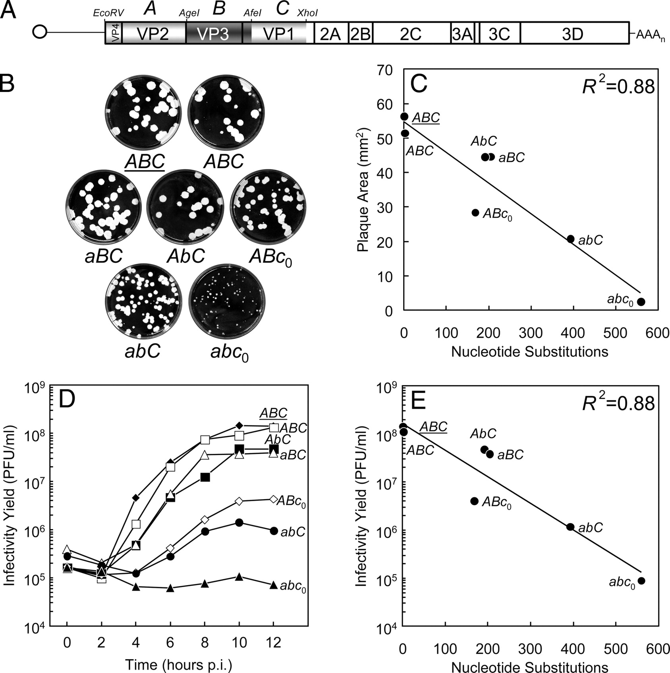
Poliovirus attenuation by codon replacement
Cara C. Burns et al. J. Virol. 2009;83:9957-9969
Notes:
(A) MEF-1 codon replacement constructs aligned with a schematic of the poliovirus genome, with the single open reading frame represented by an open rectangle, flanked by the 5′- and 3′-untranslated regions, represented as lines. Bounding restriction endonuclease sites and locations of codon replacement cassettes (A, EcoRV-AgeI fragment [nt 748 to 1773; 1,026 nt]; B, AgeI-AfeI fragment [nt 1774 to 2610; 837 nt]; and C, AfeI-XhoI fragment [nt 2611 to 3300; 690 nt]) are indicated above the capsid region. Unmodified cassettes are indicated by italicized capital letters. ABC nucleotide sequences completely matched the MEF-1 sequence; ABC had two synonymous substitutions introduced to generate an AgeI site. (B) Plaque morphologies on HeLa cell monolayers (37°C, 60 h, 10-cm plates). Relative amounts of infected cell culture lysates yielding the plaques shown in each dish were as follows: ABC, 1; ABC, 0.1; aBC, 1; AbC, 1; ABc0, 1; abC, 10; and abc0, 4,000. (C) Mean plaque areas as a function of the number of nucleotide substitutions in the capsid region. (D) Growth properties of different virus constructs in single-step growth experiments in HeLa S3 cells (37°C). Single-step growth experiments were performed as described in Materials and Methods, and virus yields were determined by plaque assay. One milliliter of culture contained 2 × 106 HeLa S3 cells. (E) Virus yields (averages for 10-h and 12-h time points) of the single-step growth experiments as a function of the total number of nucleotide substitutions in the capsid region.

Slide 23
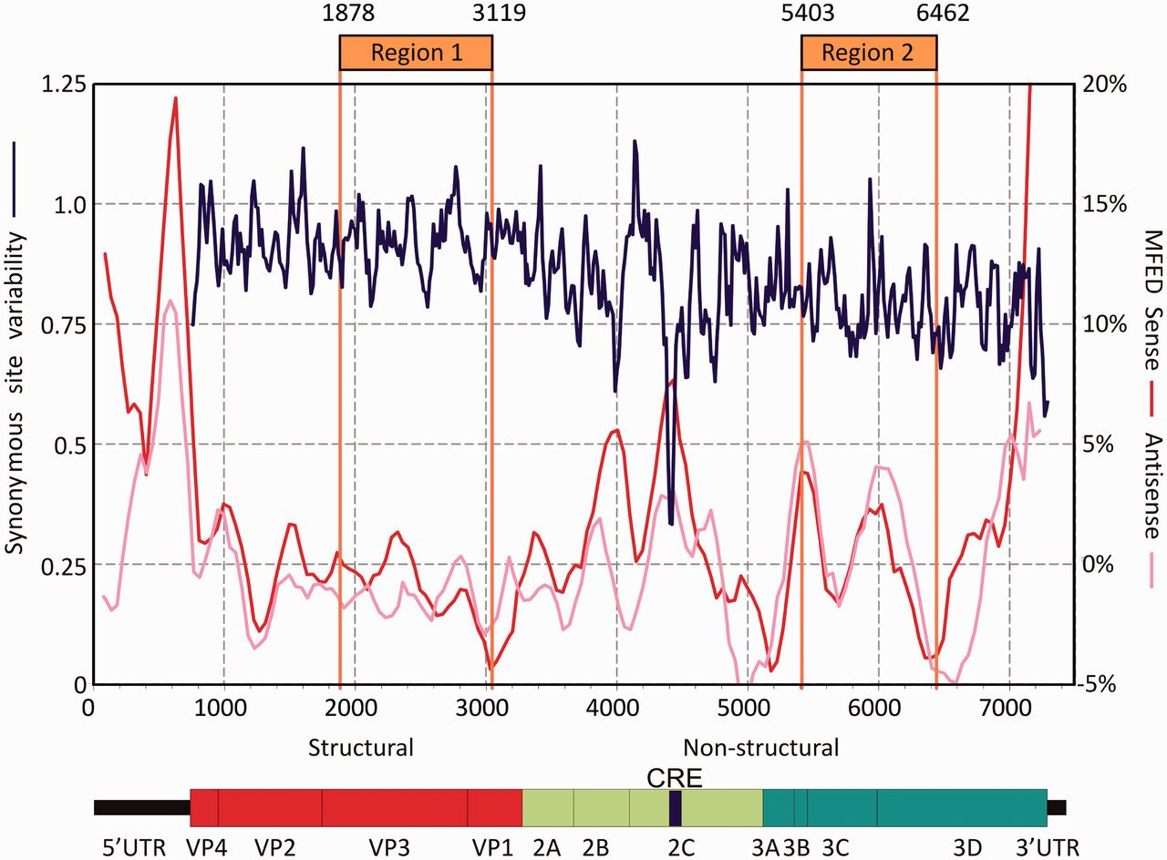
Genome organization of E7 and positions of mutated insert regions.
Nicky J. Atkinson et al. Nucl. Acids Res. 2014;nar.gku075
© The Author(s) 2014. Published by Oxford University Press.
Notes:
Genome organization of E7 and positions of mutated insert regions. Insert positions are compared with genome diagram and a plot of sequence variability within species B enteroviruses at synonymous sites (blue line) and folding energies indicative of RNA secondary structure (red and pink lines). Variability at synonymous sites (left y-axis) was computed at each codon position in alignments, plotted with a window size of 41 codons. MFED values (right y-axis) for sense and antisense RNA sequences were calculated for 200 base fragments, incrementing by 48 bases; values plotted represent mean values of five consecutive fragments. Nucleotide positions were calculated relative to the pT7:E7 cDNA sequence.

Slide 24
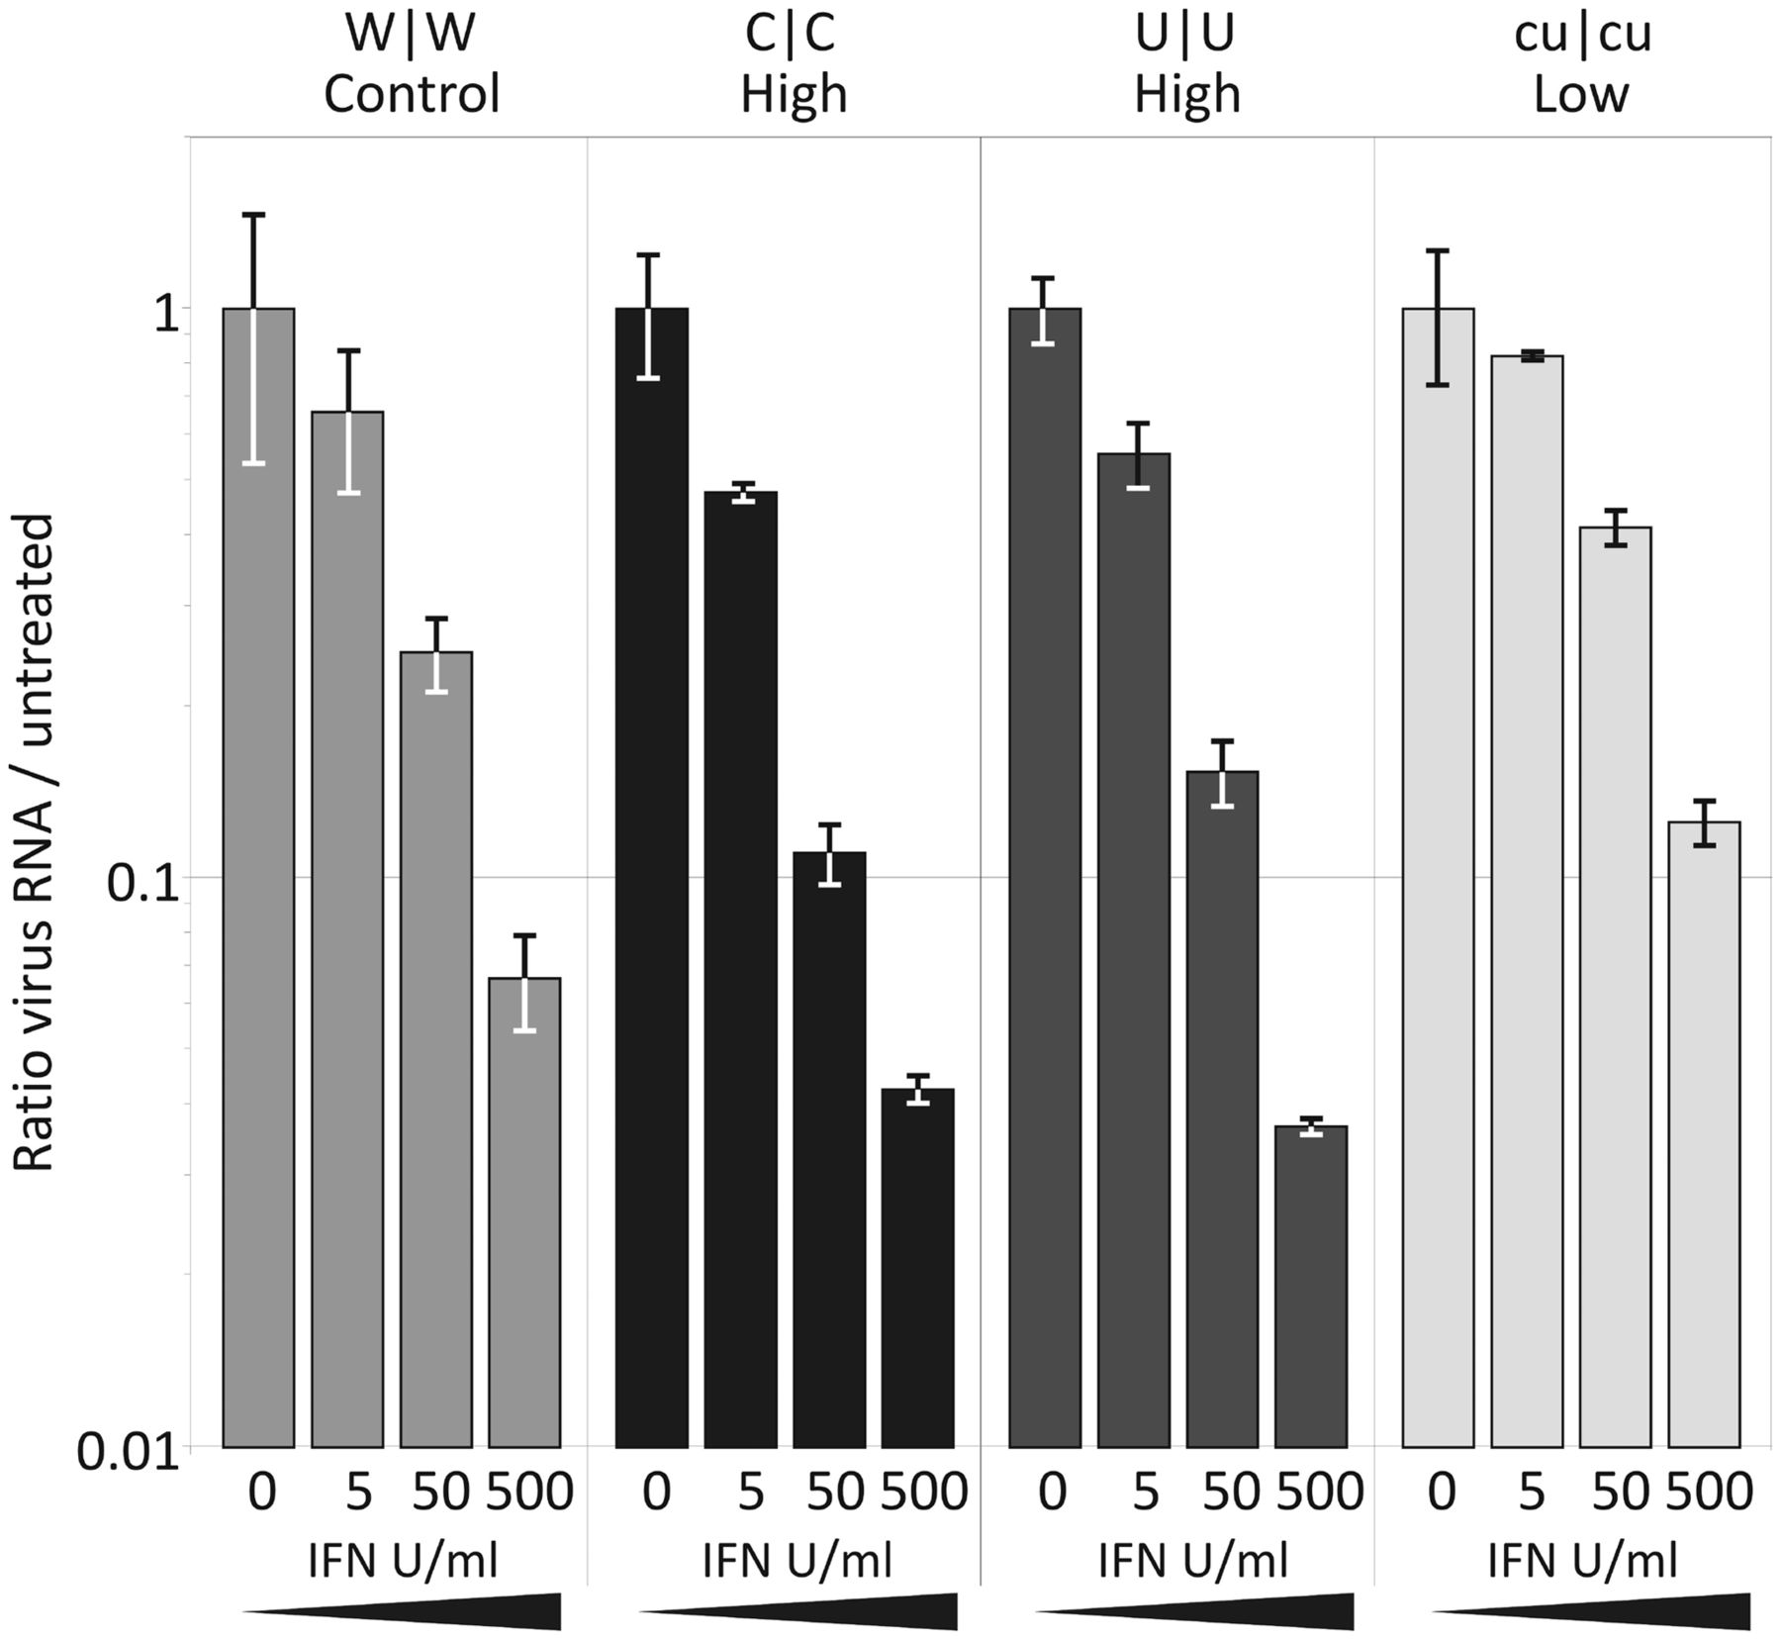
Effect of exogenous IFN-β on viral replication.
Nicky J. Atkinson et al. Nucl. Acids Res. 2014;nar.gku075
© The Author(s) 2014. Published by Oxford University Press.
Notes:
Effect of exogenous IFN-β on viral replication. RD cells were treated with 5, 50 and 500 U/ml human IFN-β, or mock treated, then infected with WT E7, C|C, U|U and cu|cu mutants at an MOI of 1. RNA was isolated after 8 h and viral load determined by qRT-PCR. Results are the mean and standard error of two biological replicates.

Slide 25
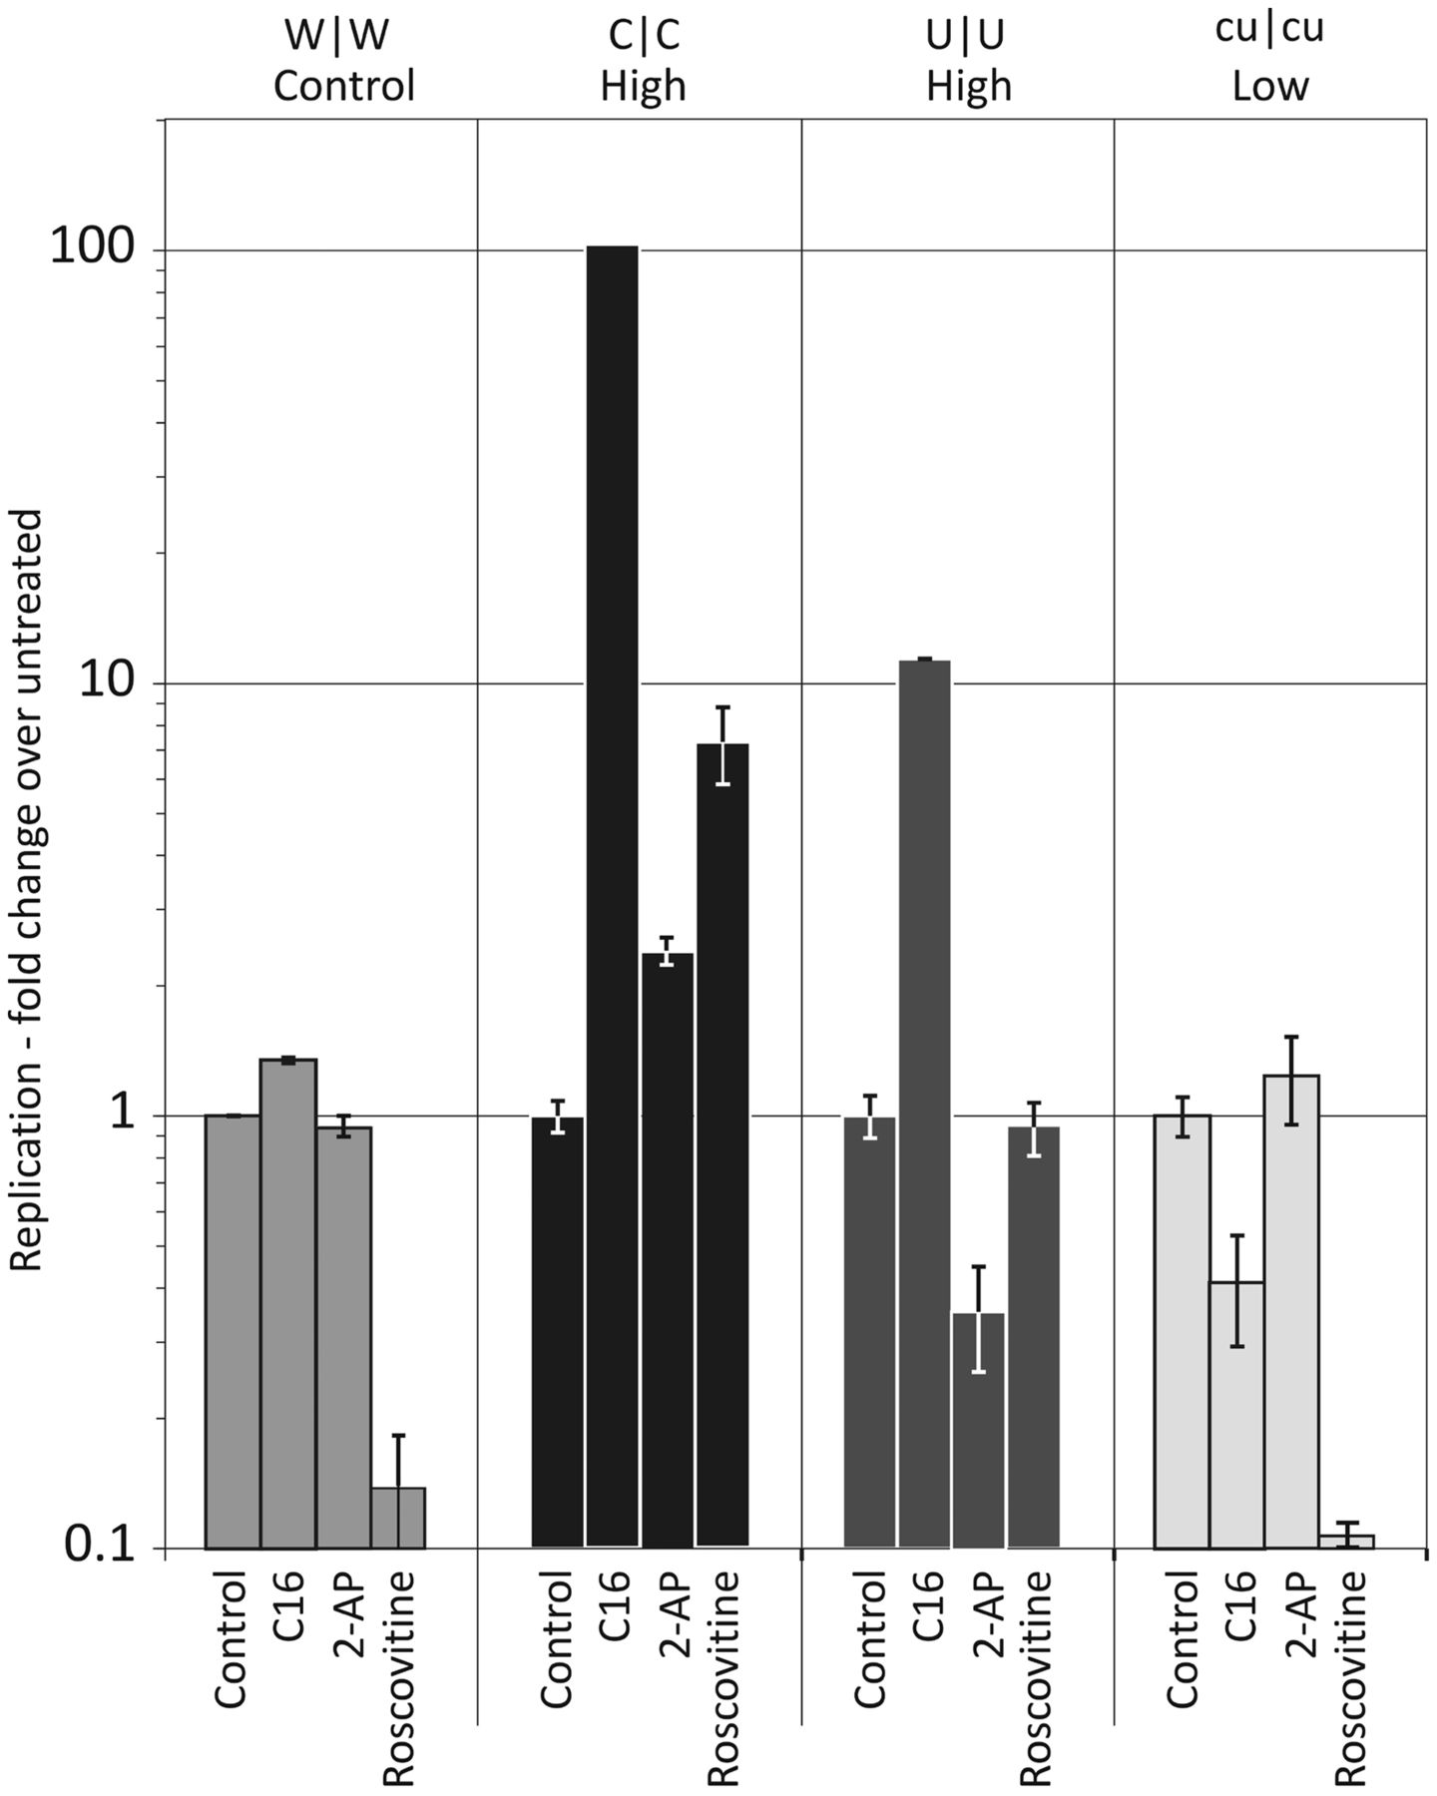
Effect of the kinase inhibitors, C16, 2-AP and Roscovitine on E7 replication.
Nicky J. Atkinson et al. Nucl. Acids Res. 2014;nar.gku075
© The Author(s) 2014. Published by Oxford University Press.
Notes:
Effect of the kinase inhibitors, C16, 2-AP and Roscovitine on E7 replication. Cells were pre-treated for 45 min with 2 μM C16, 5 mM 2-AP or 40 μM Roscovitine and infected with WT virus or CpG-high, UpA-high or CpG/UpA-low mutants at an MOI of 0.1. RNA was isolated at 24 h, and intracellular viral loads were determined by qRT-PCR. Results are shown relative to the replication rate in cells untreated cells (note log scale).

Slide 27
Conclusions
CpG and UpA content in DNA, genomic RNA and mRNA may trigger innate response
“Codon optimization” may have profound effect on translation efficiency and immunogenicity
CpG may be used as a built-in adjuvant in xNA vaccines
CpG sensor/effector remain unknown

Slide 28
Acknowledgements
Ilya Belalov

