Slide 1
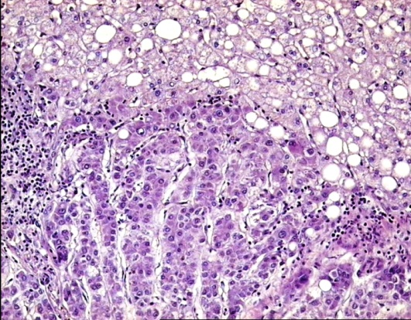
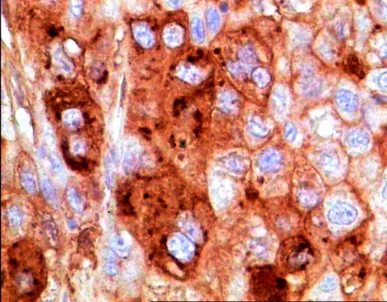
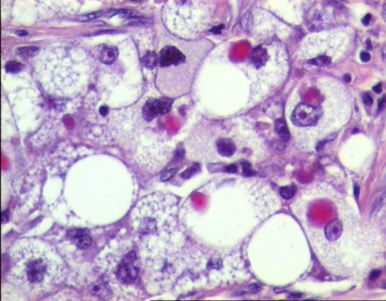
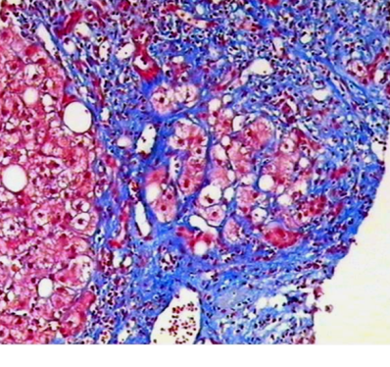
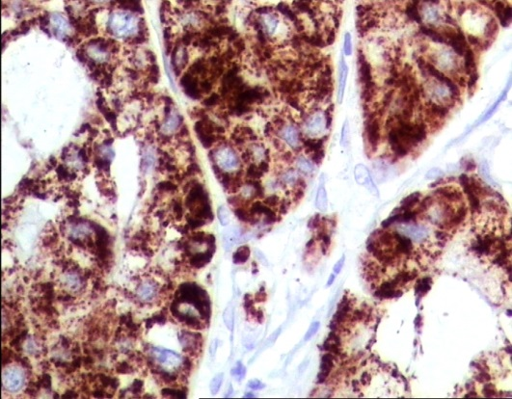
EXPRESSION OF ABERRANT p53 PROTEIN IN PRIMARY AND SECONDARY MALIGNANT LIVER TUMOURS
Mezale D*¹, Strumfa I¹, Balodis D¹, Vanags A², Rumba R²
¹ Department of Pathology, Riga Stradins University, Riga, Latvia
² Department of Surgery, Riga Stradins University, Riga, Latvia

Slide 2
Background
Hepatocellular carcinoma (HCC) is one of the most common malignancies worldwide.
The major risk factors include chronic infections with the hepatitis B or C virus.
Somatic mutations in the p53 tumour suppressor gene TP53 are involved in the molecular pathogenesis of HCC^{[1]}.
1. Harris CC et al.; Oncogene, 26, 2007, 2166 – 2176

Slide 3
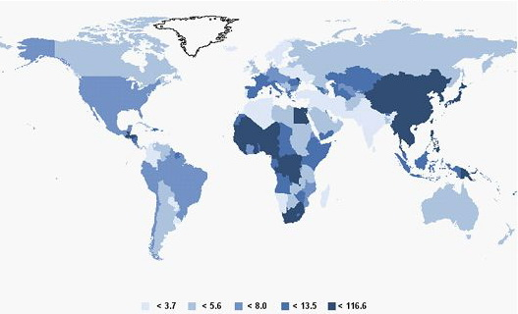
HCC epidemiology
Schweitzer N ,Vogel A, Epidemiology and Risk Factors, Lochan, ISBN 978-953-51-1070-5, Published: April 10, 2013

Slide 4
Background
Hepatocellular carcinoma (HCC) is one of the most common malignancies worldwide.
The major risk factors include chronic infections with the hepatitis B or C virus.
Somatic mutations in the p53 tumour suppressor gene TP53 are involved in the molecular pathogenesis of HCC^{[1]}.
1. Harris CC et al.; Oncogene, 26, 2007, 2166 – 2176

Slide 5
Background (2)
TP53 is frequently mutated or inactivated in different cancer types, including colorectal, pancreatic and gastric cancer^{[2]}.
The success of targeting p53 by anti-cancer vaccination or other means is likely to depend on the frequency of pathological aberrations and availability of a predictive biomarker^{[3]}.
2. Rivlin N et al; Genes Cancer. 2011 Apr; 2(4): 466–474
3. Duffy MJ et al.; Cancer Treat Rev. 40, 10, 2014, 1153 – 60

Slide 6
Aim
To evaluate p53 protein expression in hepatocellular carcinoma and selected representative secondary liver tumours including colorectal, pancreatic and gastric cancer metastases

Slide 7
Materials and methods
In a retrospective study, 67 consecutive, morphologically confirmed cases were included:
hepatocellular carcinoma (35 patients)
liver metastases of colorectal cancer (15 patients)
liver metastases of pancreatic cancer (10 patients)
liver metastases of gastric cancer (7 patients)

Slide 8
Materials and methods (2)
p53 protein expression was evaluated by immunohistochemistry and assessed quantitatively by computer-assisted morphometry as the fraction (%) of positive neoplastic cells.
Only intense nuclear reactivity was considered positive.
Descriptive statistic evaluation was performed, including detection of 95% confidence interval (CI).

Slide 9
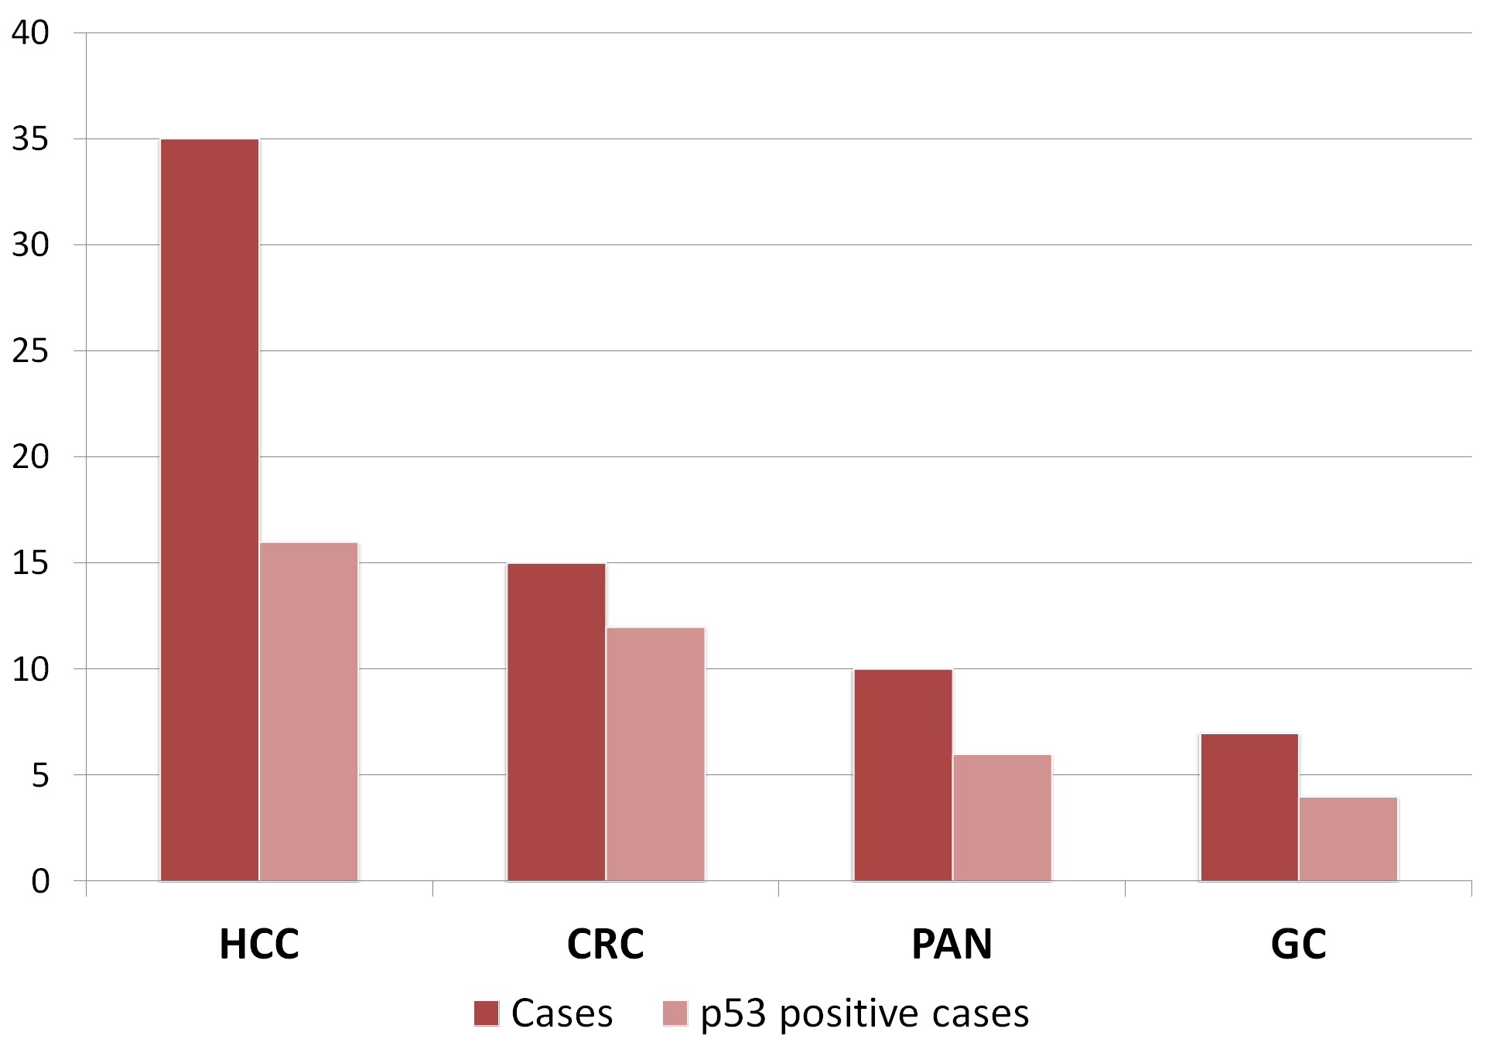
Results
Fig.1. p53 expression in primary and secondary liver tumours
HCC- hepatocellular carcinoma; CRC- colorectal cancer metastases; PAN- pancreatic cancer metastases; GC- gastric cancer metastases

Slide 10
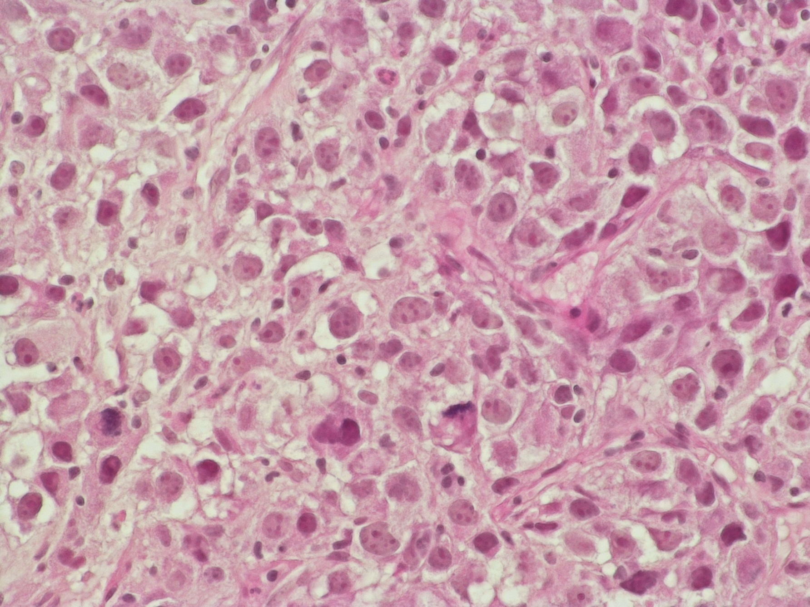
Results (2)
HCC showed p53 expression in 16 (45.7%; CI = 30.5 – 61.8) out of 35 cases, of which 11 (68.6%; CI = 44.4 – 85.8) had only 30.0% or less positive cells.
Fig.2. HCC
Fig.3. p53 expression in HCC
H&E, 400
p53, 400

Slide 11
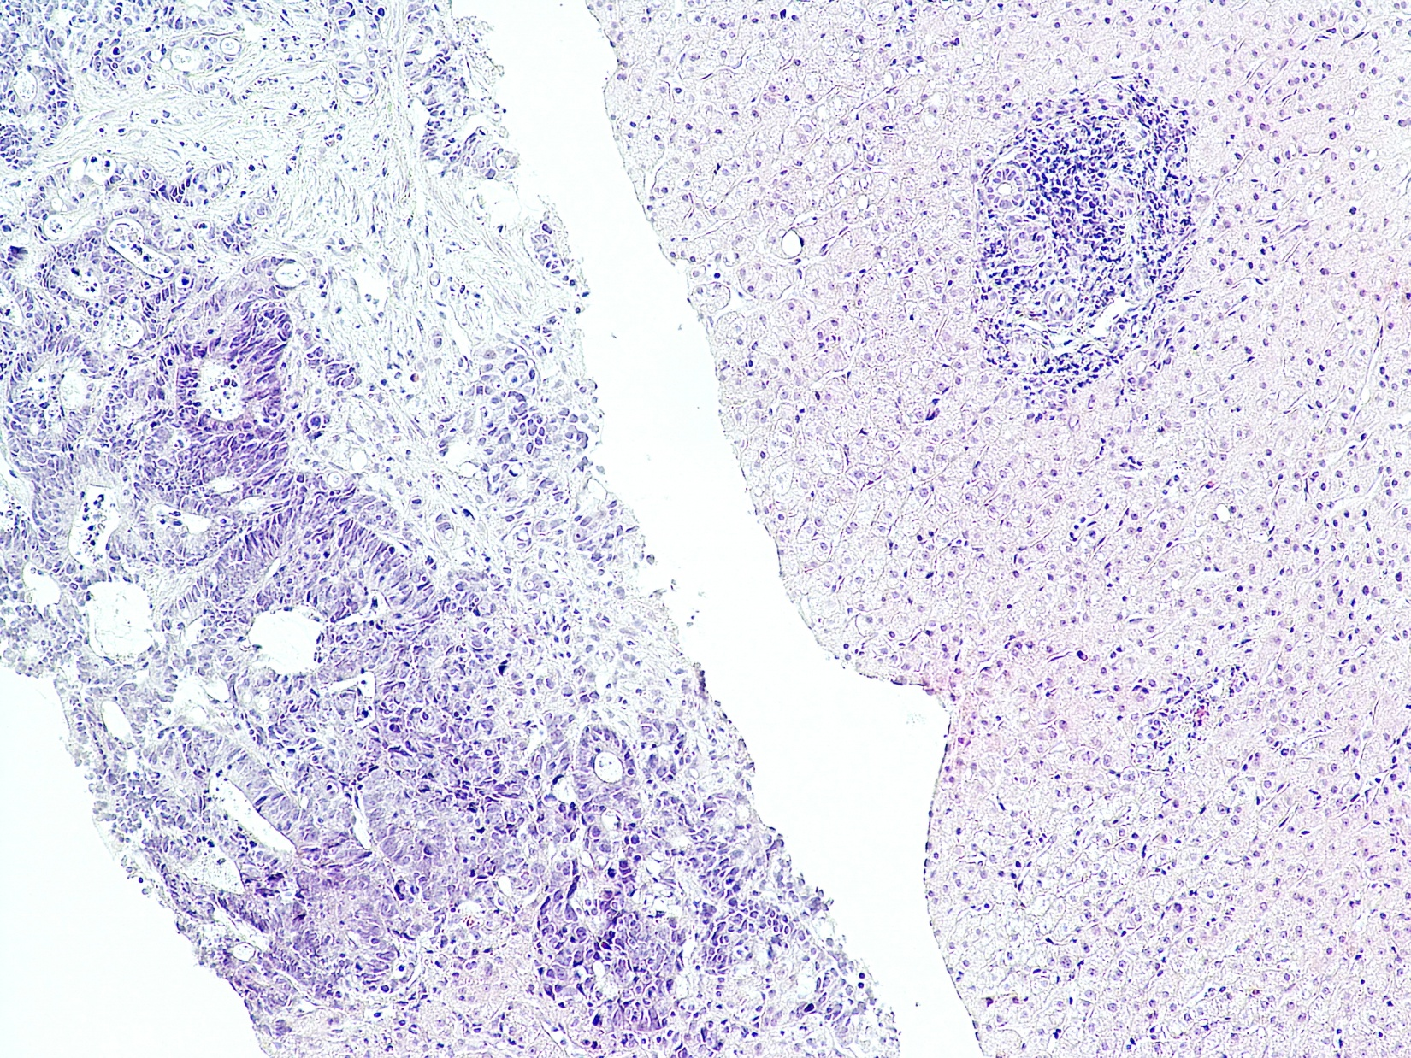
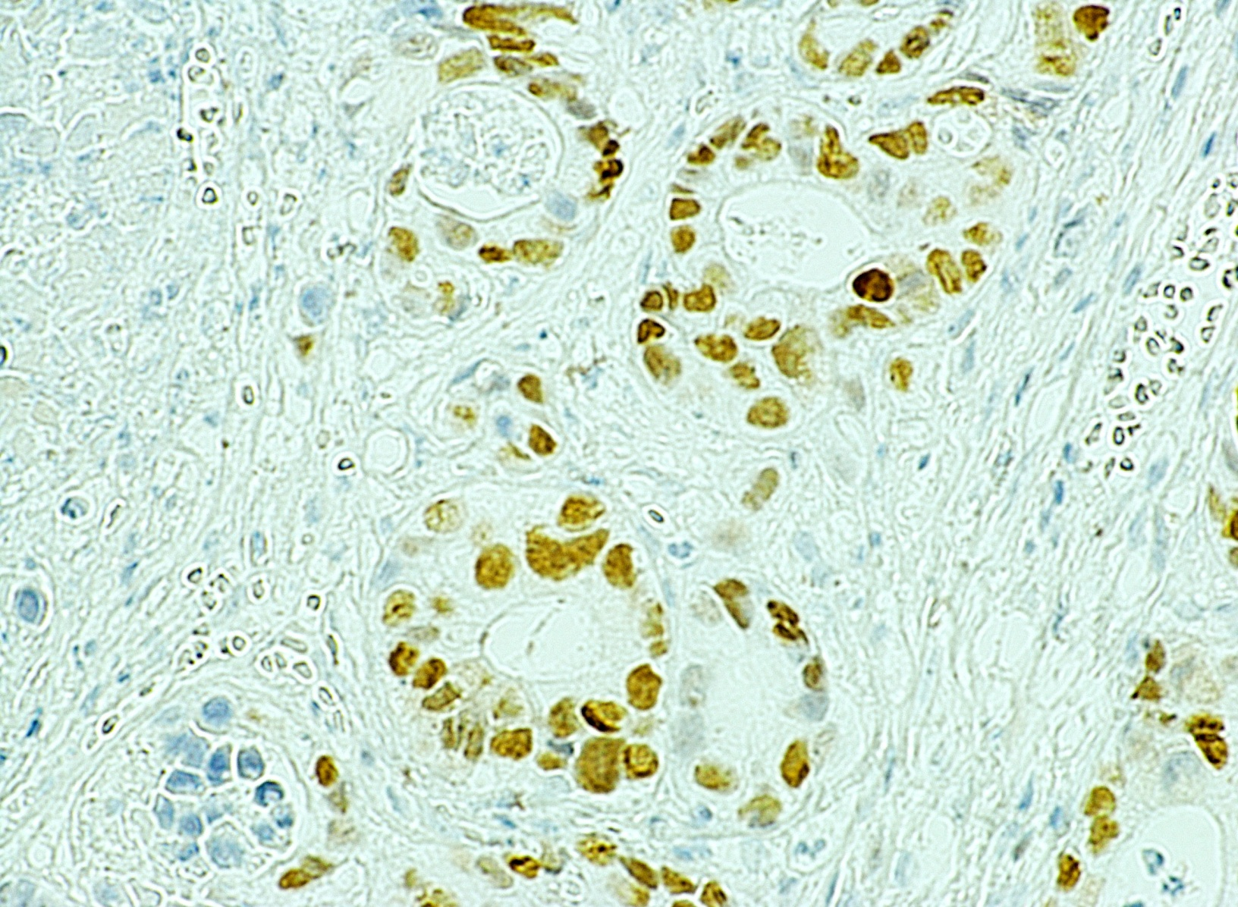
Results (3)
Regarding metastatic colorectal carcinoma, p53 expression was found in 12 (80.0%; CI= 54.8 – 93.0) cases, of which 8 (66.7%; CI = 39.0 – 86.2) had p53 levels higher than 80.0%
Fig.4. Metastatic CRC
Fig.5. p53 expression in CRC
H&E, 100
p53, 400

Slide 12
Results (4)
In pancreatic cancer, p53 expression was observed in 6 (60.0%; CI = 31.3 – 83.2) metastases, characterised by wide variations in the levels of p53 expression (25.0 – 100.0% positive cells).
In metastatic gastric cancer, 4 (57.1%; CI = 25.0 – 84.2) cases showed positive p53 expression. The expression exceeded 20% of neoplastic cells in only 2 (50.0%; CI = 15.0 – 85.0) metastases.

Slide 13
Conclusions
Expression of p53 in HCC is limited both by frequency and by extent.
There was a statistically insignificant trend to more frequent and widespread p53 expression in colorectal cancer.
Regarding gastric and pancreatic carcinomas, combined treatment should be considered again as expression of aberrant p53 protein was limited both by frequency and by extent.

Slide 14
Thank you for your attention!

