Slide 1
Immunogenicity of poliovirus non-structural proteins during natural poliovirus infection. Maria Prostova¹, Maria Yakovenko¹, Tatyana Eremeeva¹, Olga Baykova¹, Anatoly Gmyl¹. Chumakov Institute of Poliomyelitis and Viral Encephalitides 2016 Moscow, Russia

Slide 2
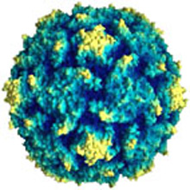
OriL
CRE
OriR
VP4
3B (VPg)
VP2
VP3
VP1
2A
2B
2C
3A
3C
3D
VPg
IRES
A_{n}
Structural proteins
(capsid )
Non-Structural proteins
(poliovirus RdRp and others)
Success of anti-polio vaccination
(attenuated or inactivated vaccine)
is based on production of
neutralizing antibodies
Nothing is known about the role of non-structural proteins in forming of adaptive immunity

Slide 3
OriL
CRE
OriR
VP4
3B (VPg)
VP2
VP3
VP1
2A
2B
2C
3A
3C
3D
VPg
IRES
A_{n}
Structural proteins
(capsid )
Non-Structural proteins
(poliovirus RdRp and others)
Success of anti-polio vaccination
(attenuated or inactivated vaccine)
is based on production of
neutralizing antibodies
Nothing is known about the role of non-structural proteins in forming of adaptive immunity

Slide 4
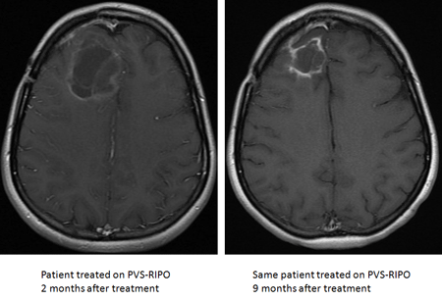
How Does PVS-RIPO work (poliovirus based anti-glioma therapy)? PVS-RIPO is infused directly into a patients’ tumor (e.g. in the brain). This assures that the maximal amount of virus is delivered directly to the tumor. Once inside the tumor, PVSs-RIPO infects and kills tumor cells. Although this tumor cell killing alone may have tumor-fighting results, the likely key to therapy with PVS-RIPO is its ability to recruit the patients’ immune response against the cancer. There are many events following PVS-RIPO infusion into the tumor that can contribute to such an outcome. Unraveling why and how the immune system attacks tumors that were infused with PVS-RIPO is a major research goal in the Gromeier Laboratory.
https://www.cancer.duke.edu/btc/modules/Research3/index.php?id=41

Slide 5
How Does PVS-RIPO work (poliovirus based anti-glioma therapy)? PVS-RIPO is infused directly into a patients’ tumor (e.g. in the brain). This assures that the maximal amount of virus is delivered directly to the tumor. Once inside the tumor, PVSs-RIPO infects and kills tumor cells. Although this tumor cell killing alone may have tumor-fighting results, the likely key to therapy with PVS-RIPO is its ability to recruit the patients’ immune response against the cancer. There are many events following PVS-RIPO infusion into the tumor that can contribute to such an outcome. Unraveling why and how the immune system attacks tumors that were infused with PVS-RIPO is a major research goal in the Gromeier Laboratory.
Not about neutralizing antibodies
https://www.cancer.duke.edu/btc/modules/Research3/index.php?id=41

Slide 6
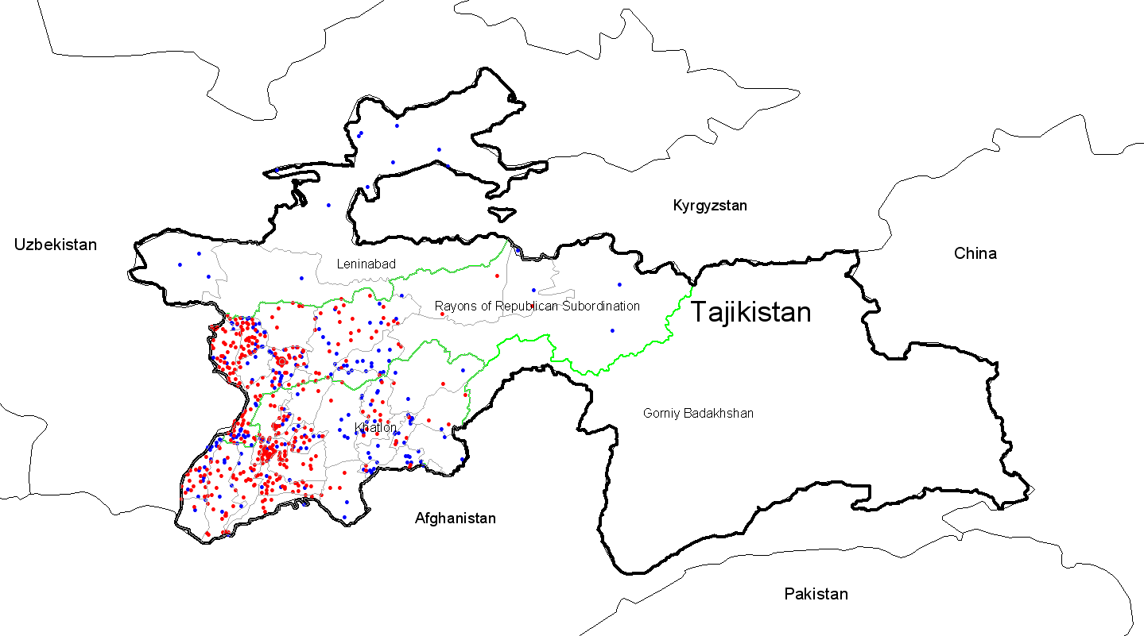
Outbreak at 2010 Tajikistan caused by poliovirus from India
Natural experiment
AFP cases (712)
Lab confirmed wild poliovirus cases (460)
Yakovenko et al., 2014

Slide 7
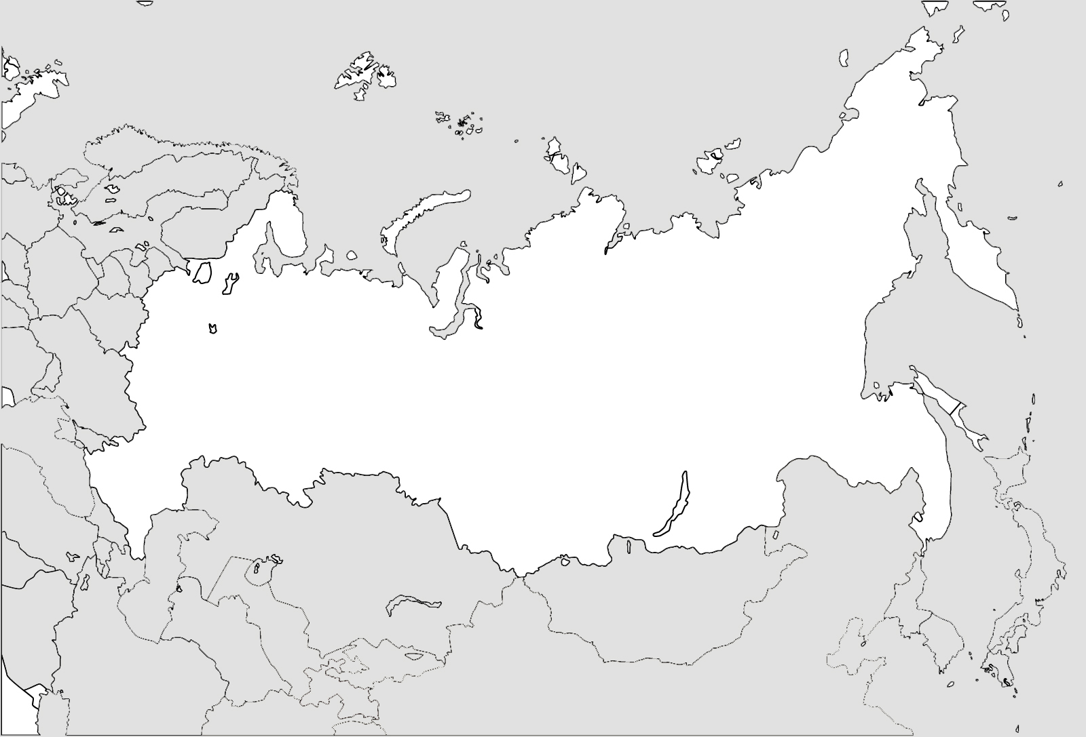
Outbreak at 2010 Tajikistan caused by poliovirus from India
Natural experiment
Moscow
(June)
Russia
Ekaterinburg
(May-June)
Magnitogorsk
(May-June)
Chelyabinsk
(May)
Khabarovsk
(July)
Chechnya
(Aug-Oct)
Dagestan (July-Nov)
Irkutsk
(May)
Kazakhstan
Uzbekistan
Mongolia
Turkmenistan
Kyrgyzstan
Tajikistan
China
Afganistan
Yakovenko et al., 2014

Slide 8
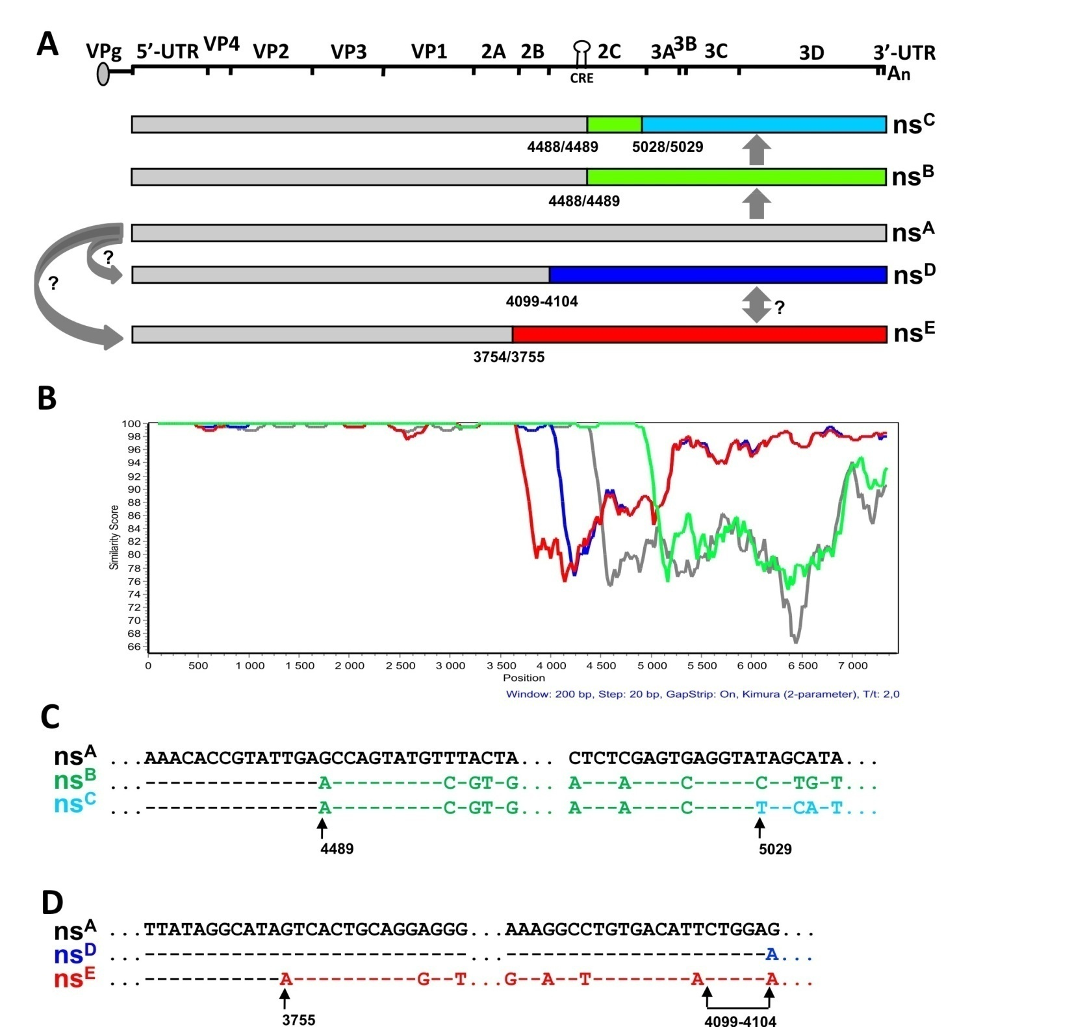
Facts:
Several recombination events – obtaining of non-structural (ns) region from unknown Enteroviruses C
At least one of recombinants (nsB) fixed and widely co-circulated with parental Indian strain (nsA)
Yakovenko et al., 2014

Slide 9
Evolutionary advantage?
Facts:
Several recombination events – obtaining of non-structural (ns) region from unknown Enteroviruses C
At least one of recombinants (nsB) fixed and widely co-circulated with parental Indian strain (nsA)
Yakovenko et al., 2014

Slide 10
Escape from immunity?
Facts:
Several recombination events – obtaining of non-structural (ns) region from unknown Enteroviruses C
At least one of recombinants (nsB) fixed and widely co-circulated with parental Indian strain (nsA)
Yakovenko et al., 2014

Slide 11
Escape from immunity?
Facts:
Several recombination events – obtaining of non-structural (ns) region from unknown Enteroviruses C
At least one of recombinants (nsB) fixed and widely co-circulated with parental Indian strain (nsA)
Yakovenko et al., 2014

Slide 12
Protein 3CD is the second highly immunogenic polioviral protein
WB: sera from infected people (nsB) with lysates of infected RD cells
 | 1 | 2 | 3 | 4 | 5 | 6 | 7 | 8 | 9 | 10 | 11 | 12 | 13 | 14 | 15 | 16
VP1 (capsid) | + | + | + | + | + | + | + | + | + | + | + | + | + | + | + | +
3CD | + | + | - | + | + | + | + | + | + | + | + | + | + | - | + | +
WB: sera from infected people (nsA) with lysates of infected RD cells
 | 1 | 2 | 3 | 4 | 5 | 6 | 7
VP1 (capsid) | + | + | + | + | + | + | +
3CD | + | - | + | + | + | - | -

Slide 13
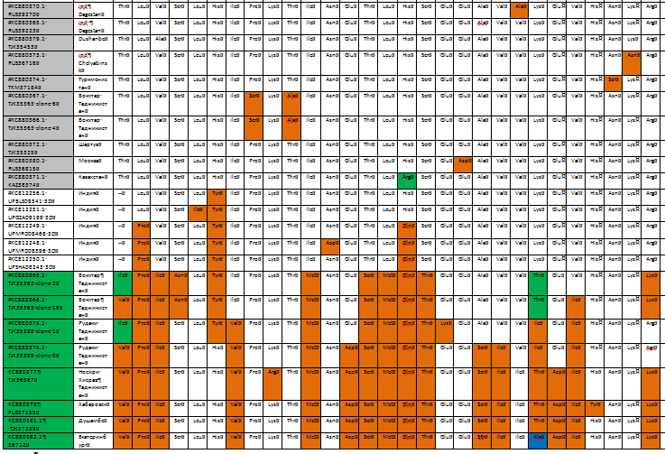
Positions of difference in amino acid sequence of 3D^{pol}
nsA
Indian
strains
nsB

Slide 14
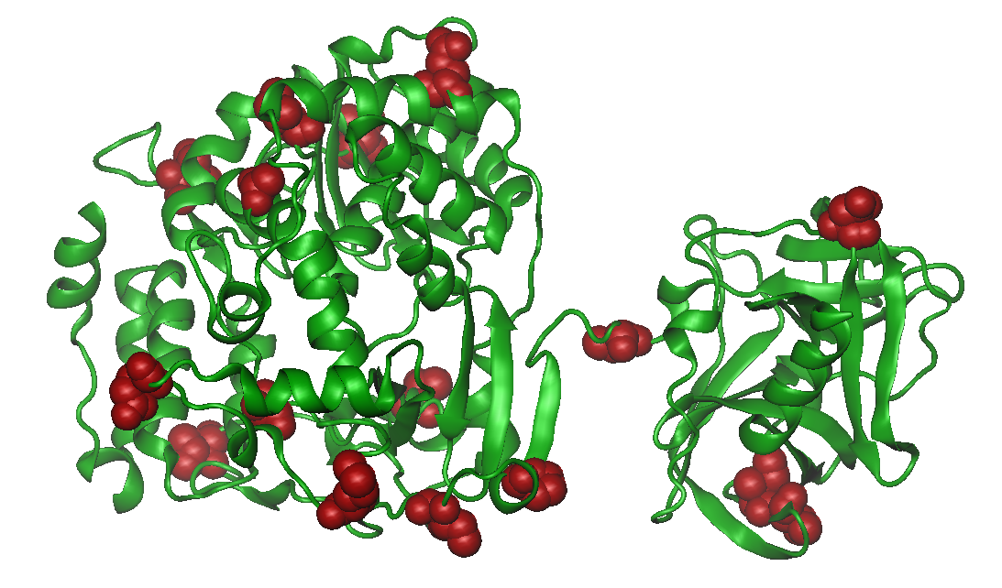
16 definitely different positions in AA 3СD sequence between nsA and nsB genomes
Epitopes?

Slide 15
No difference in immunoprecipitation assay
nsA1
PV3
Mock
MWM
^{nsC1}
^{nsB2}
nsB3
nsA2
PV1
^{nsB1}
Immunoprecipitation
with sera from patient, infected with virus with nsB type genome.
3CD
3D
Capsid protein
Western Blot with mouse polyclonal anti-3СD or anti-VP1 antibodies.

Slide 16
To do further
Virology question: Why to change NS-proteins?
its normal for attenuated vaccine strains, but why for “perfect” wild type virus?
immune pressure?
Immunology question: 3CD epitopes?
how is 3CD processed in antigen presentation system?

