Slide 1

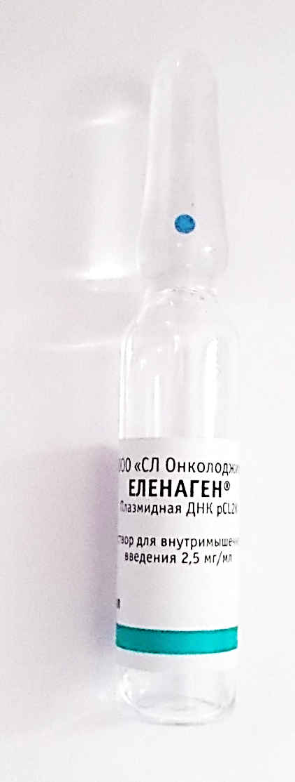
Can a DNA cancer vaccine, Elenagen®, turn out to be an anti-inflammatory gene therapy?
Every other man and every third woman will develop some type of cancer during his/her life…
(American Cancer Society’s 2013 Facts & Figures)

Slide 2

2
Safe Harbor Statement
•
Safe Harbor Statement Under the Private Securities Litigation Reform Act of 1995. In accordance with the safe harbor provisions of the Private Securities Litigation reform Act of 1995, the Company notes that statements in this web site, and elsewhere, that look forward in time, which include everything other than historical information, involve risks and uncertainties that may affect the Company's actual results of operations
•
The following important factors could cause actual results to differ materially from those set forth in the forward-looking statements: project financing; new scientific findings; our products may not be accepted by the market; and we may have difficulty in hiring and retaining key personnel
Pancreas
Confidential and Proprietary

Slide 3
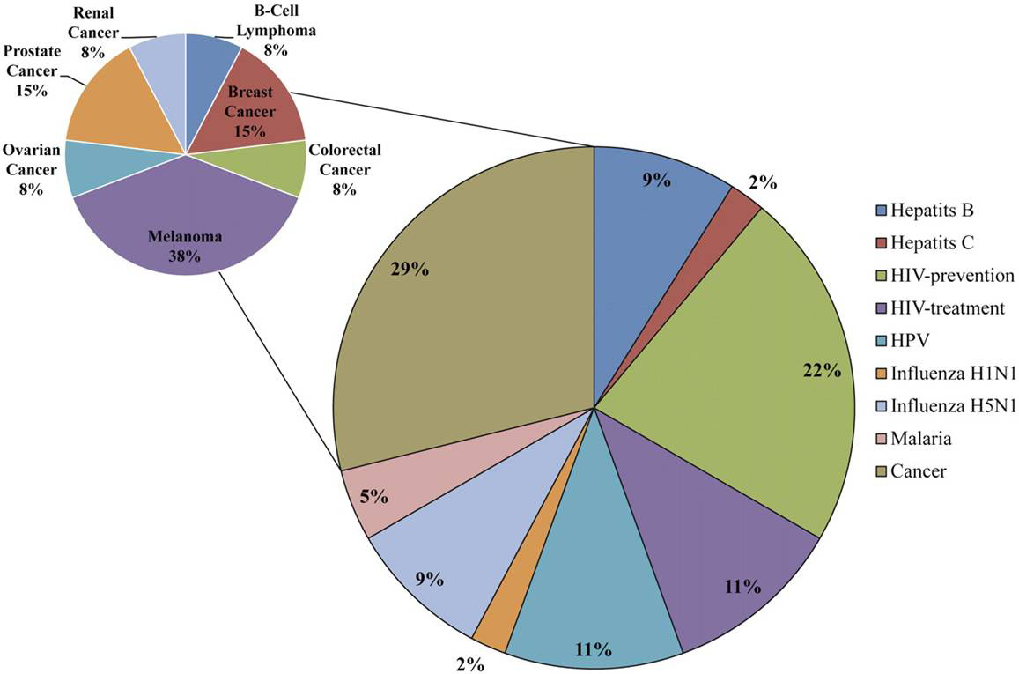
3
Current DNA Vaccine Clinical Trials
Can one therapeutic DNA vaccine protect against more than one disease?
How about therapeutic DNA vaccines against diseases of chronic inflammation?
Ferraro B et al. Clin Infect Dis. 2011; 53:296-302
Pancreas
© The Author 2011. Published by Oxford University Press on behalf of the Infectious
Diseases Society of America. All rights reserved. For Permissions, please e-mail:
journals.permissions@oup.com.
Clinical Infectious Diseases

Slide 4
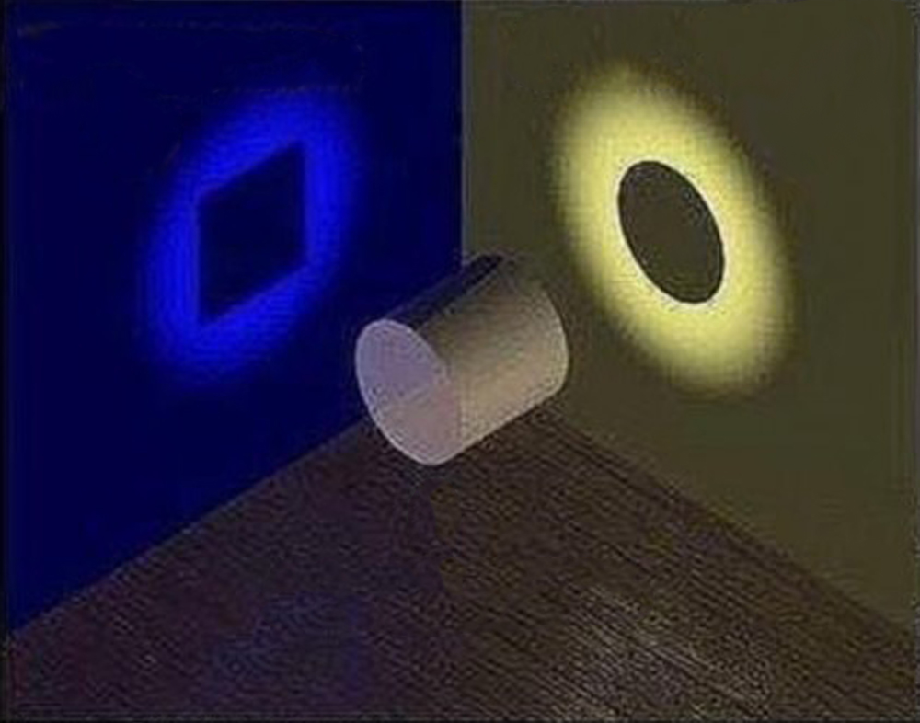
4
Can a DNA Vaccine Be a Gene Therapy at the Same Time?
Pancreas

Slide 5
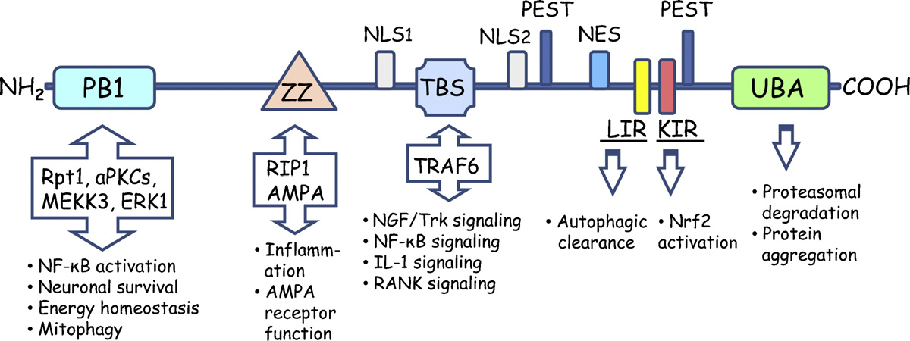
5
Structure of p62
Pancreas

Slide 6
6
Elenagen® Is a DNA Vaccine Encoding p62
•
Elenagen® is a DNA vaccine of p62, a protein complex that serves as a hub
for signal transduction through NF‐kB, TRAF6, Twist1, and MAP kinases
p62 is overexpressed in a
•
p62 is a promising target for a broad range of tumors
broad range of tumors
p62 is required for tumor development and
survival
p62 is unnecessary for normal tissue, suggesting low potential for toxicity when targeted.
Elenagen® administered intramuscularly elicits an anti‐tumor response
Tumor type
Overexpressed p62
Correlated w/
progression
Dependent on p62
•
Breast
✓
✓
✓
Colorectal
✓
✓
ND
Glioblastoma
✓
✓
✓
•
Kidney
✓
ND
✓
Liver
✓
ND
✓
Lung
✓
✓
✓
Melanoma
✓
✓
ND
Myeloma
✓
ND
✓
•
Ovary
✓
✓
ND
Pancreas
✓
ND
✓
Sources: Gabai VL and VI Shifrin. Feasibility Analysis of p62 (SQSTM1)—Encoding DNA Vaccine as a Novel Cancer Immunotherapy. Int Rev Immunol. 2014;
33:375–382. Moscat J and MT Diaz‐Meco. p62 at the crossroads of autophagy, apoptosis, and cancer. Cell. 2009; 137(6):1001‐1004.
Gewirtz DA. Cytoprotective and nonprotective autophagy in cancer therapy. Autophagy. 2013; 9:1263‐5

Slide 7
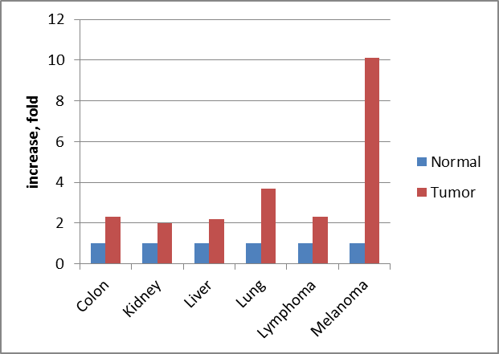
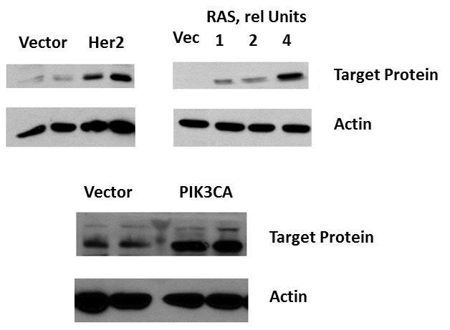
7
P62 is Overexpressed in Tumors
•
Elenagen® is a plasmid encoding p62 (SQSTM1), a major constituent of the intracellular autophagy machinery (“target protein”)
•
P62 protein is overexpressed in diverse human cancers
•
Expression of oncogenes leads to the p62 accumulation
Target mRNA expression in human cancers comparing to corresponding normal tissues. Graph was derived from microarray data of Oncomine
MCF10A human mammary epithelial cells were transduced with retroviruses (A,B) or lentiviruses C expressing corresponding oncogenes, and after brief selection levels of target protein were assessed by immunoblotting with anti-target protein antibody. Anti-actin antibody was used as loading controls

Slide 8
8
Can Tumor Cells Escape p62 Vaccine®?
Tumors often “escape” anti-cancer drugs and vaccines – why??*
  Initially a drug/vaccine targets tumor cells possessing a specific protein, and kills them
  The few remaining tumor cells commonly mutate and lose the drug/vaccine targeted protein
  Mutated cells lead to relapse of the tumor
  The drug/vaccine cannot target the newly formed tumor because it does not possess the original target protein
Cancer cells cannot mutate and “escape” p62 vaccine®!!
  If cells lose p62 they can no longer form a tumor**
  Without p62 in the autophagy machine, there is no longer any protection for the tumor against radiation and chemotherapy, as well as organism’s own defenses***
* - Dunn GP, Bruce AT, et al. Cancer immunoediting: from immunosurveillance to tumor escape. Nat Immunol. 2002; 3(11):991-998; Sergina NV, Rausch M, et al. Escape from HER-family tyrosine kinase inhibitor therapy by the kinase-inactive HER3. Nature. 2007; 445(7126):437-41
** - Duran A, Linares JF, et al. The signaling adaptor p62 is an important NF-kappaB mediator in tumorigenesis. Cancer Cell. 2008; 13(4):343-354
*** - Moscat J and Diaz-Meco MT. p62 at the crossroads of autophagy, apoptosis, and cancer. Cell. 2009; 137(6):1001-1004; Gewirtz, D. A. Cytoprotective and nonprotective autophagy in cancer therapy. Autophagy, 9: 0--1, 2013
Confidential and Proprietary

Slide 9
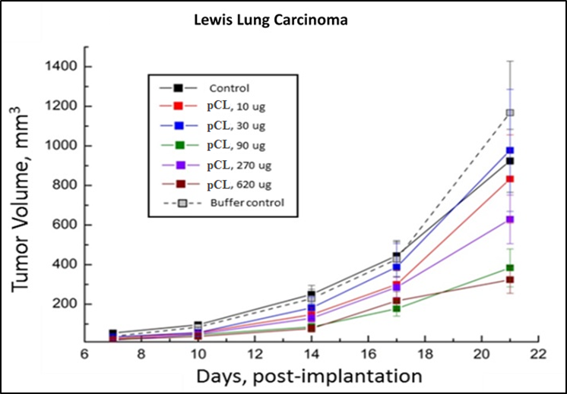
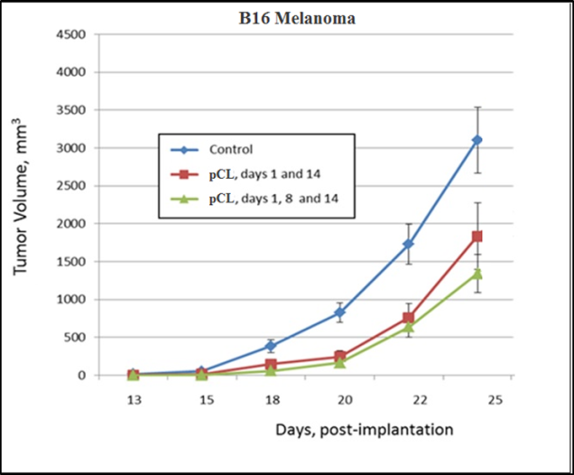
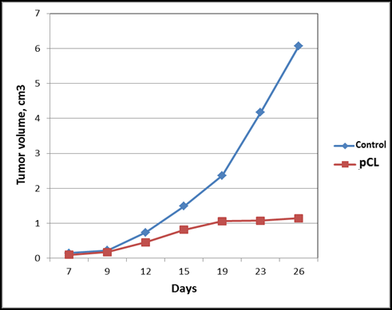
9
Elenagen (pCL): Broad Spectrum Antitumor Activity
S37 Sarcoma
•
P62 DNA (Elenagen) immunization suppresses growth of several transplantable tumors in mice: lung and breast carcinoma, melanoma, and sarcomas
Pancreas

Slide 10
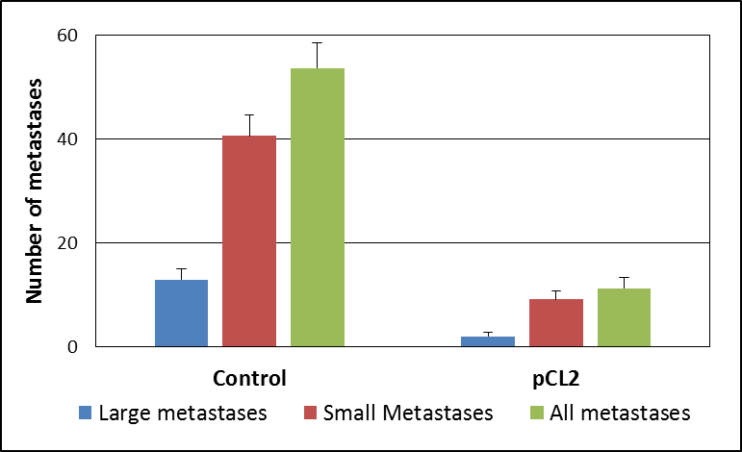
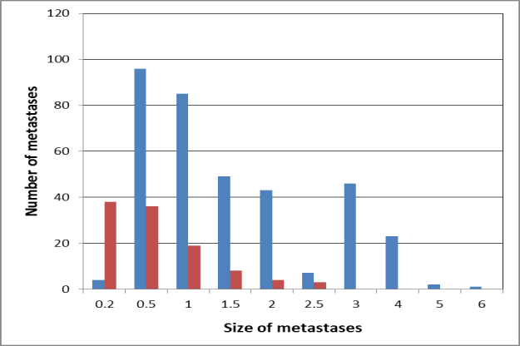
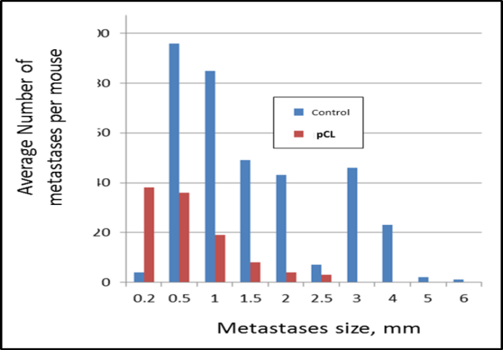
10
Anti-Metastatic Activity of Elenagen®:
  Lewis Lung Carcinoma
  B16 Melanoma
•
Elenagen® (pCL plasmid) immunization reduces both the number and the size of lung metastases in two mouse tumor models

Slide 11
11
Elenagen Increases Survival of Mice with Breast Cancer
Pancreas

Slide 12
12
Elenagen Induces Ab Response to p62
Pancreas

Slide 13
13
p62 Anti-tumor Effect Depends on Adaptive Immune System
Pancreas

Slide 14
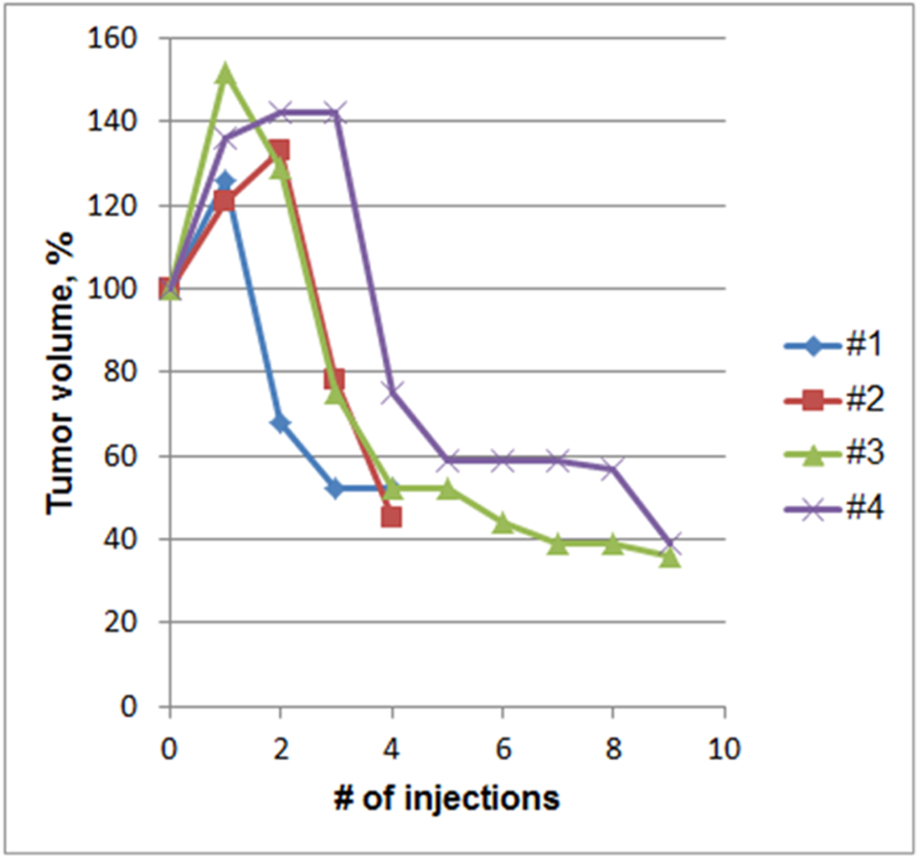
14
Change in Breast Tumor Volume in Dogs During p62 Vaccine Treatment
Pancreas

Slide 15
15
p62 Vaccine Induces Profound Immune Response (Accumulation of T-lymphocytes) in Canine Mammary Tumors
Pancreas

Slide 16
16
p62 Vaccine Evokes Encapsulation of Canine Mammary Tumors
Pancreas

Slide 17
17
Safety Studies Demonstrated No Toxicity
Acute toxicity studies in mice, rats and guinea pigs
    No significant adverse effects
    No injection site reactions, no allergic reactions
Chronic toxicity studies in rats (90 days)
    No significant adverse effects
Chronic toxicity studies in dogs (90 days)
    No significant adverse effects
Embryonic toxicity, teratogenicity
    No significant adverse effects
P62 plasmid (Elenagen) approved in Sept, 2014 by Russian Health Ministry for clinical trials. Phase I trial is currently underway
Pancreas

Slide 18
18
Phase I/II Clinical Trial of Elenagen
    Main Aim: to establish safety of Elenagen at doses of 1, 2.5 and 5 mg by CTCAE scale
    Secondary Aim: to assess tumor response by RESIST 1.1 criterion
    Approved by Russian Ministry of Health
    Enrolled 27 patients with untreatable solid tumors
    Conducted in 4 clinical centers across Russia
Pancreas

Slide 19
19
Phase I/II Trial Results:
Safety of Elenagen in patients
    In all 3 cohorts of patients treated with Elenagen in doses of 1-5 mg, no serious adverse events (SAE) or dose-limiting toxicity were found
    In cohort 3 (5 mg), transient nausea was found in 2 patients, and swelling in injection site in 1 patient (grade 1 AE)
Pancreas

Slide 20
20
Efficacy of Elenagen® in Doze Escalation Phase I Study
Stop of tumor progression in response to Elenagen monotherapy
Tumor localization | Tumor control/total tumors | Max tumor control, months
Breast | 4/8 | 6
Ovary | 5/7 | 4.5
Melanoma | 2/6 | >2*
Lung | 1/2 | 2
Renal | 1/1 | >2*
Colon | 0/3 | 0
All | 13/27 | 6
Pancreas
*A Patient is still in remission and under observation

Slide 21
21
Elenagen® Restores Tumor Sensitivity to Chemotherapy in Breast and Ovary Cancer Patients
# | Diagnosis/ patient number | Dose/ Elenagen® effect | Chemotherapy/ Effects | Patient’s conditions on Sept 1, 2016
1. | Breast 5001 | 1 mg, stabilization 2 мo | АС (Adriamycin+Cyclophosphane), stabilization 8 mo | Survived 14 mo since start the treatment
2. | Breast 5002 | 1 mg, progression | Eribulin (EB), navelbin, cisplatin, gemcitabine, bevuzicam stabilization 15 mo | Alive 17 mo In treatment
3. | Breast 5005 | 1 mg, Stabilization 6 mo | АС, stabilization (3 courses), then progression | Alive 15 mo
4. | Breast 5012 | 2.5 mg, progression | АС, then EB+trastuzumab – stabilization 6 mo | Alive 9 мo In treatment
5. | Breast 5013 | 2.5 mg progression | Anastratzol Stabilization 6 mo | Alive 9 мo In treatment
6. | Breast 5014 | 2.5 mg Stabilization 2 mo | Tamoxifen Stabilization 6 mo | Alive 9 мo In treatment
7. | Breast 5015 | 2.5 mg Stabilization 2 mo | EB Stabilization 5 mo | Alive 9 мo In treatment
8. | Ovary 5008 | 2.5 mg Stabilization 8 mo | Carboplatin, stabilization 3 mo | Alive 12 mo In treatment
9. | Ovary 5016 | 5 mg, stabilization 2 mo | Carboplatin, Stabilization 4 mo | Alive 9 мo In treatment
10. | Ovary 5018 | 1 mg, progression | Irinotecan Stabilization 4 mo | Alive 9 мo In treatment
Pancreas

Slide 22
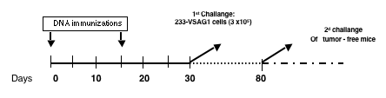
22
P62 Vaccine Induces a Long-Lasting Immunological Memory in Her-2-positive mammary tumors
TC-1
PCL
pHER2
100
pCDNA3.1
90
TC-2
80
70
60
50
% Tumor-free mice
40
30
20
10
0
0 10 15 20 25 30 50 60 70 80 90 100
Pancreas
Tumor Challenges (TC,1 and 2): 233-VSAG1 cells (3 x10⁵)
Days post challanges

Slide 23
23
Elenagen alleviates osteoporosis

Slide 24
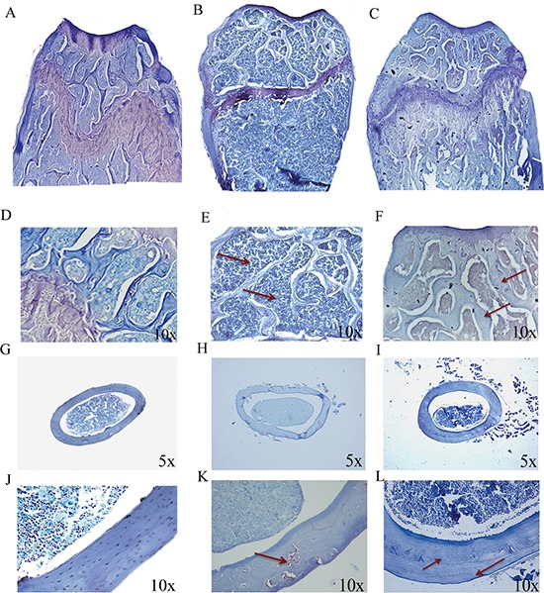
24
P62 plasmid (Elenagen) prevents osteoporosis
•
Plasmid DNA-coding p62 as a bone effective anti-inflammatory/ anabolic agent
Maria Giovanna Sabbieti1,*, Dimitrios Agas1,*, Melania Capitani1, Luigi Marchetti1, Antonio Concetti1, Cecilia Vullo1, Giuseppe Catone1, Vladimir Gabai2, Victor Shifrin2, Michael Y Sherman3, Alexander Shneider2, Franco M Venanzi1. Oncotarget 6 (6):3590-3599 (2015)

Slide 25
25
P62 plasmid (Elenagen) suppresses inflammatory signaling during osteoporosis
•
Plasmid DNA-coding p62 as a bone effective anti-inflammatory/ anabolic agent
Maria Giovanna Sabbieti1,*, Dimitrios Agas1,*, Melania Capitani1, Luigi Marchetti1, Antonio Concetti1, Cecilia Vullo1, Giuseppe Catone1, Vladimir Gabai2, Victor Shifrin2, Michael Y Sherman3, Alexander Shneider2, Franco M Venanzi1. Oncotarget 6 (6):3590-3599 (2015)

Slide 26
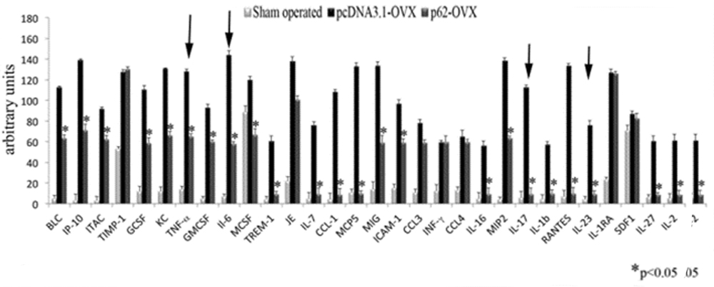
26
P62 Plasmid Suppresses Inflammatory Cytokines During Induction of Osteoporosis by Ovariectomy
•
Plasmid DNA-coding p62 as a bone effective anti-inflammatory/ anabolic agent
Maria Giovanna Sabbieti1,*, Dimitrios Agas1,*, Melania Capitani1, Luigi Marchetti1, Antonio Concetti1, Cecilia Vullo1, Giuseppe Catone1, Vladimir Gabai2, Victor Shifrin2, Michael Y Sherman3, Alexander Shneider2, Franco M Venanzi1. Oncotarget 6 (6):3590-3599 (2015)

Slide 27
27
Elenagen alleviates psoriasis

Slide 28
28
Critical Role of Inflammatory Cascades in Psoriasis

Slide 29
29
Elenagen Alleviates Imiquimod-induced Psoriasis in Mice

Slide 30
30
Elenagen alleviates high-calorie induced metabolic syndrome
Implication in obesity and type II diabetes

Slide 31
31
Elenagen Diminished Weight Gain Upon High Calorie Diet in Rats

Slide 32
32
Effect of p62 Plasmid on Body Mass Index of Rats Fed with High-calorie Diet

Slide 33
33
Elenagen Normalises Glucose and Insulin Levels in HiCal Fed Rats

Slide 34
34
Elenagen Decreases Hi-Cal Diet Induced Glycated Hemoglobin

Slide 35
35
Elenagen Suppresses Inflammatory Cytokines

Slide 36
36
Elenagen Increases Anti-inflammatory Cytokines

Slide 37
37
Effect of p62 Plasmid on Serotonin and MAO in Brain

Slide 38
38
“Vicious Circle” of HCD-induced Obesity

Slide 39
39
Elenagen alleviates
Amyotrophic lateral sclerosis (ALS)

Slide 40
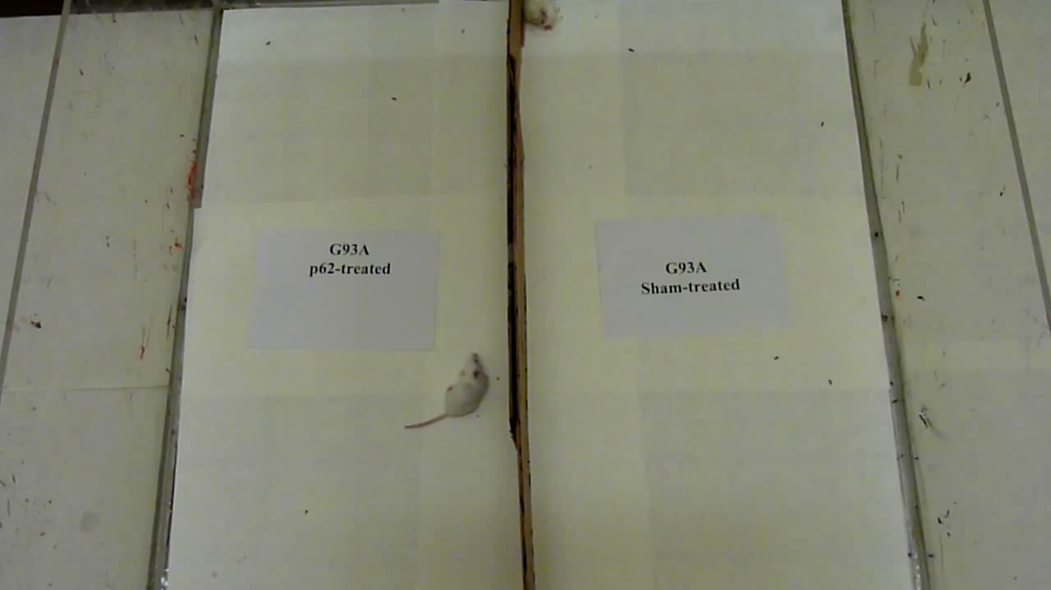
40
Mobility Test

Slide 41
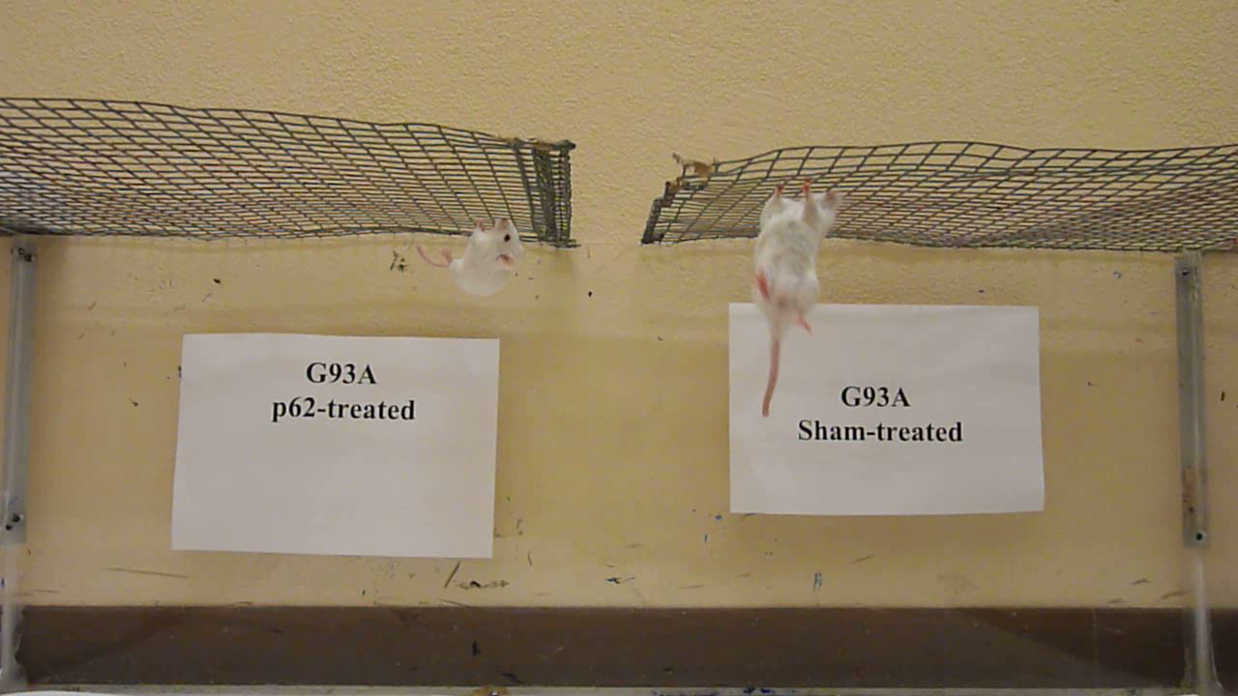
41
Mesh Test

Slide 42
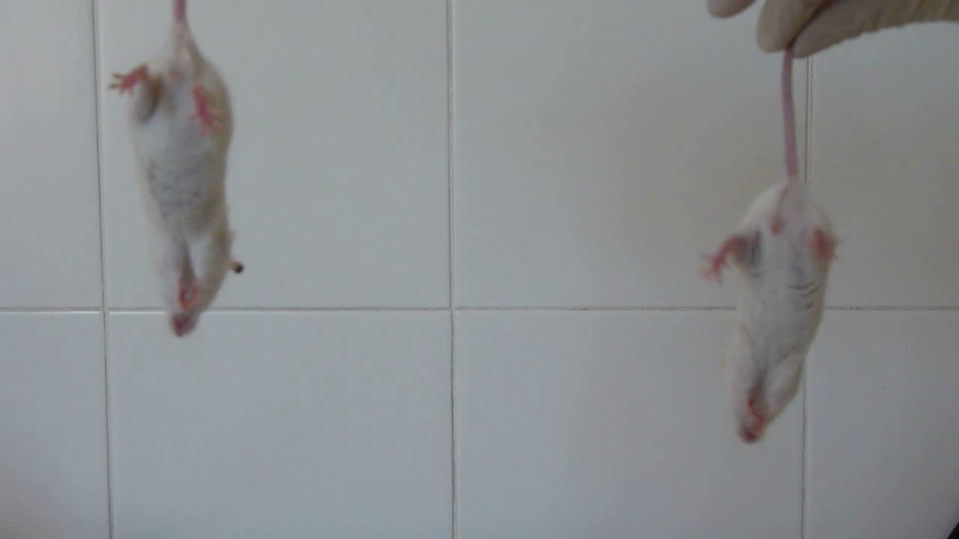
42
Tail Test

Slide 43

43
Prediction: more DNA vaccine will be discovered to have more than one mechanism and more than one application

Slide 44
41
Acknowledgement
    Preclinical studies
    Laboratory of Translational Biology, Department of Biology MCA, University of Camerino, Italy: F.Venanzi, A.Concetti, Francesca Mariotti, Cecilia Vullo, Giuseppe Catone, Nathan Friedlyand
    Research Institute of Influenza, St-Petersburg, Russia: O. Kiselev, A. Komissarov, M. Grudinin4, M. Shartukova, E. A. Romanovskaya-Romanko,
    R.E.Kavetsky Institute of Experimental Pathology, Oncology and Radiobiology of NAS of Ukraine, Kiev, Ukraine: Y. Kudryavets, N. Bezdenezhnykh, O. Lykhova, N.Semesyuk
    Medical Radiology Reseach Center, Obninsk, Russia: A. Tsyb, M. Filimonova, V. Makarchuk
    Gertzen Research Oncology Institute, Moscow, Russia: R. Yakubovsky
    Dept Biochem, Boston University School of Medicine, Boston USA: M.Sherman
    Center of Modern Veterinary Medicine, Kiev, Ukraine: E. Bagashova, N.Rud’
    T.Shevchenko Kiev National University: A.Savchuk
    CureLab Oncology: V.Sherbinina, A.Chursov, V.Gabai,
    University of Ariel, Ariel, Israel: A. Pinhasov
    Clinical trial:
    Irkutsk Oncological Dispensary
      Prof. V. Dvornichenko
      Dr. D. Ponomarenko
    St-Peterburg Oncological Dispensary
      Prof. G.Manikhas
      Prof. R.Orlova
      Dr. N.Zhukova
    Medical Centre “Medical City”
      Dr. V. Oshepkov
      Dr. L.Burkhanova
      Dr. I.Bartdinova
    St-Petersburg First Medical University
      Dr. S.Orlov

Slide 45
45
Thank you!
Confidential and Proprietary

