Slide 1

How can we increase potency of DNA vaccines?
Broad-Spectrum Influenza Vaccines
Alex Shneider, Ph.D.

Slide 2
Safe Harbor Statement
2
Safe Harbor Statement Under the Private Securities Litigation Reform Act of 1995. In accordance with the safe harbor provisions of the Private Securities Litigation reform Act of 1995, the Company notes that statements in this presentation, and elsewhere, that look forward in time, which include everything other than historical information, involve risks and uncertainties that may affect the Company's actual results of operations. The following important factors could cause actual results to differ materially from those set forth in the forward-looking statements: project financing; new scientific findings; our products may not be accepted by the market; and we may have difficulty in hiring and retaining key personnel.

Slide 3
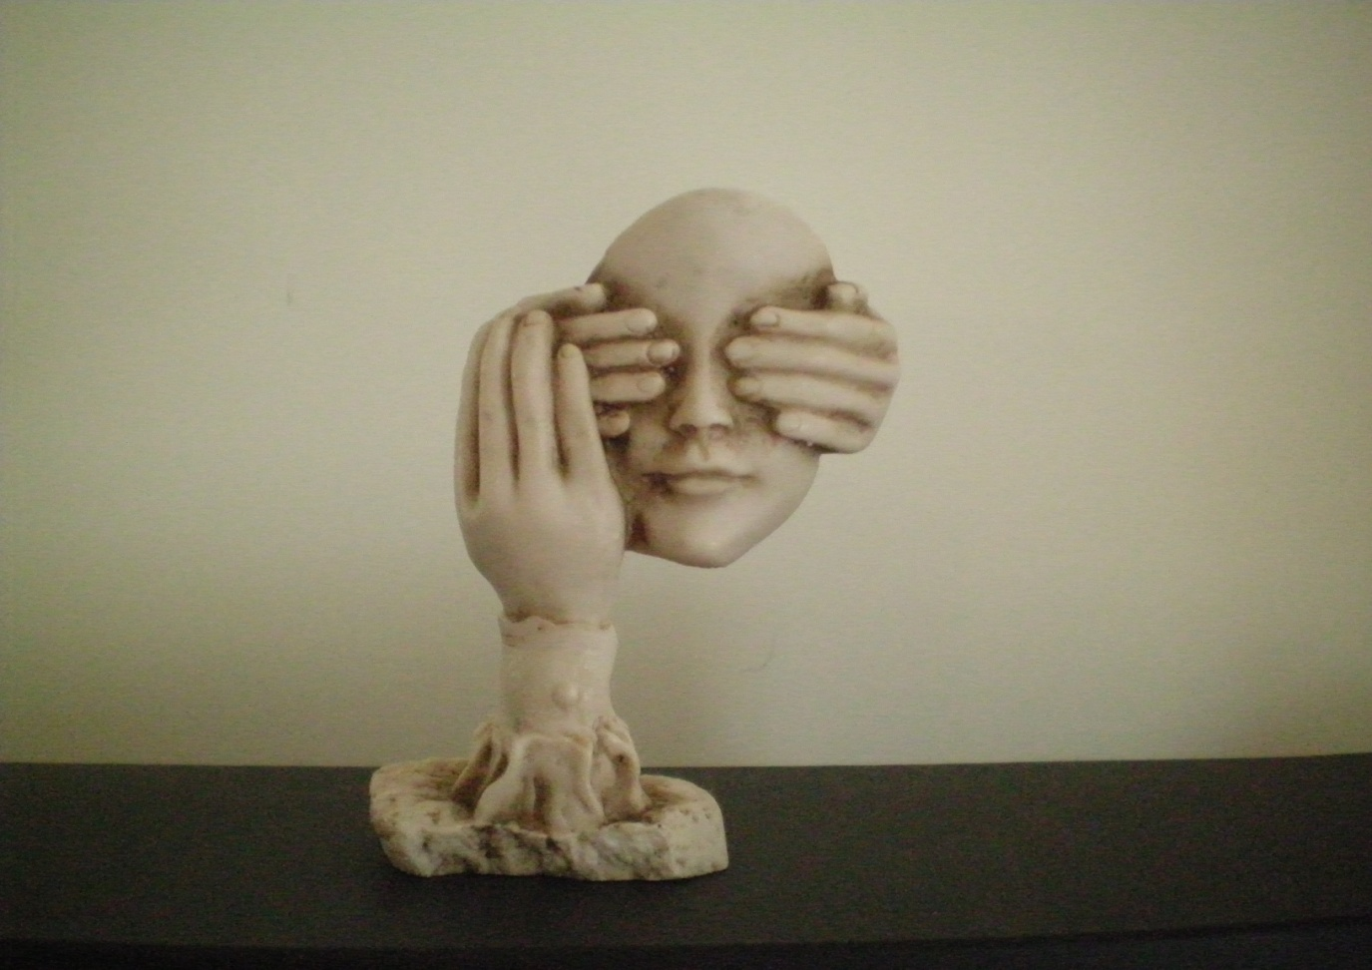
3

Slide 4
POLYGLUTAMINE DOMAINS AS NOVEL INTRA-MOLECULAR ADJUVANTS

Slide 5
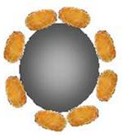
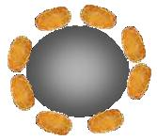
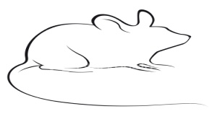
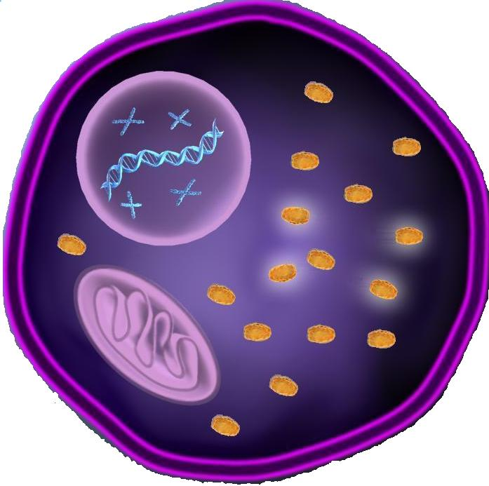
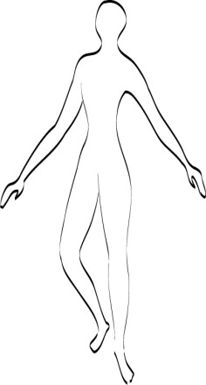
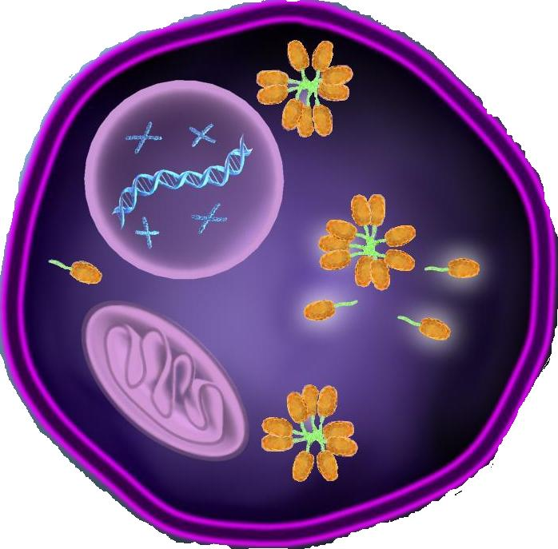
Adjuvants: Enhancing Immunogenicity via Aggregate Formation
Poor Immune
Response
Strong Immune
Response
5

Slide 6
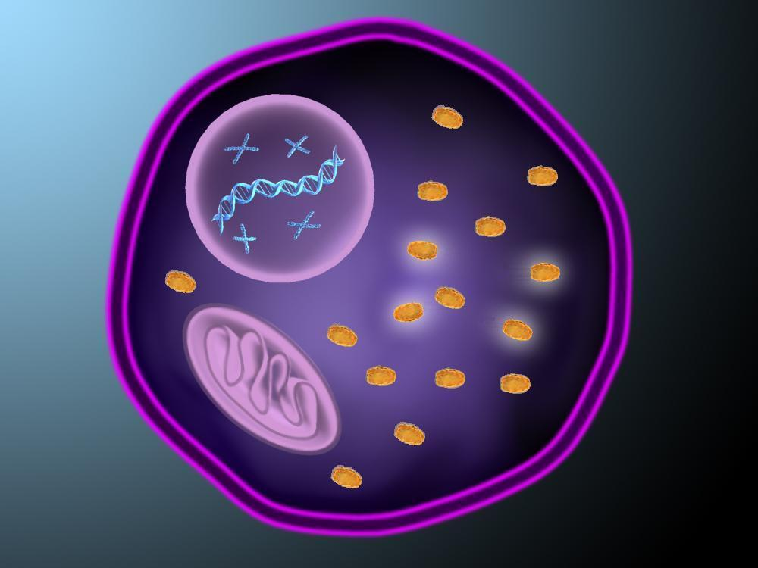
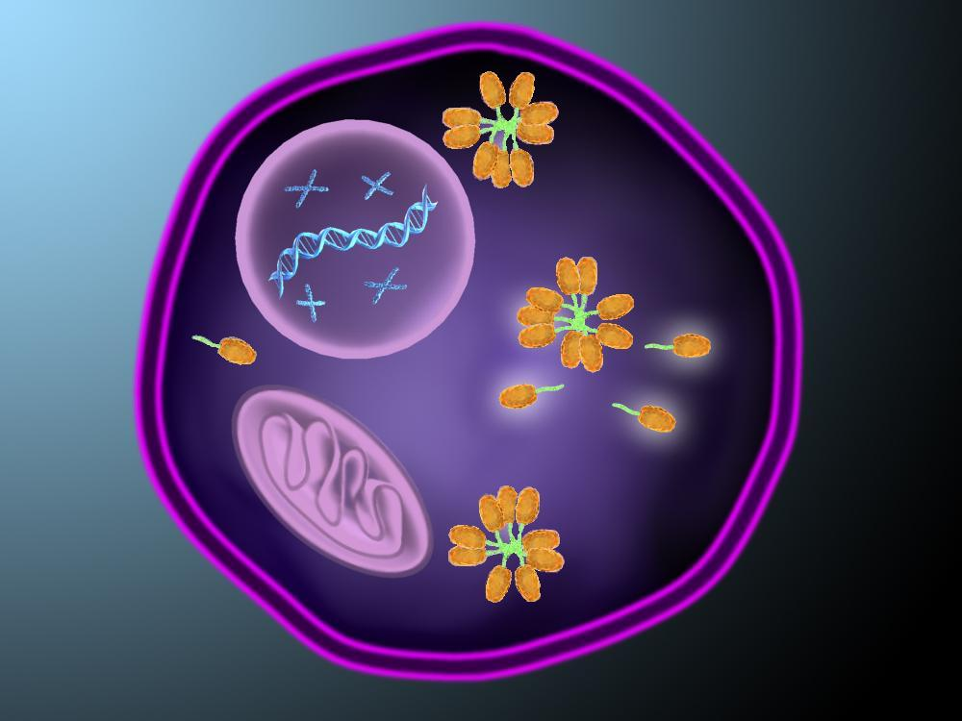
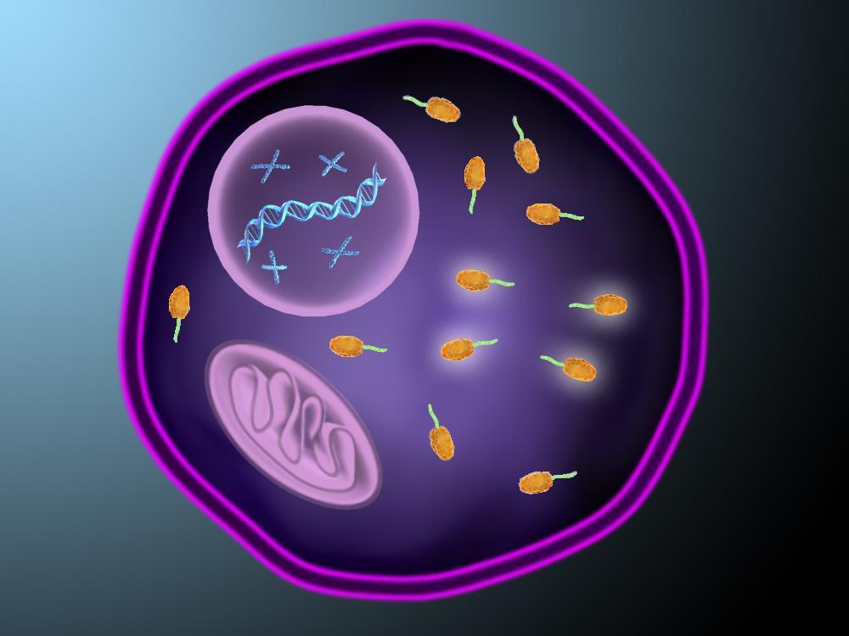
Cure Lab’s Self-Aggregating Nano-Particles
6

Slide 7
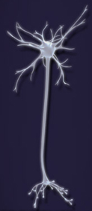
polyQ Tails in Huntington’s Disease

Slide 8
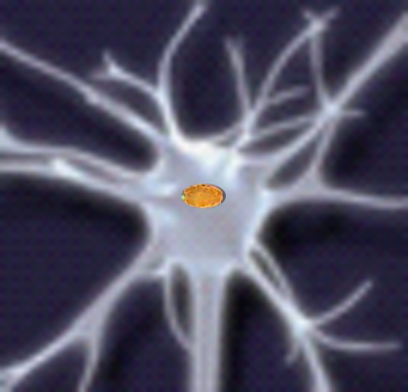
polyQ Tails in Huntington’s Disease

Slide 9
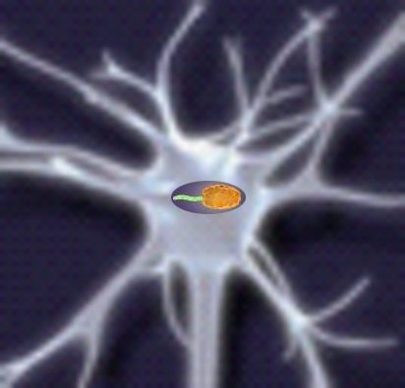
polyQ Tails in Huntington’s Disease

Slide 10
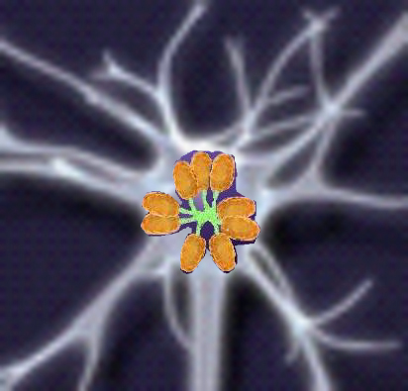
polyQ Tails in Huntington’s Disease

Slide 11

polyQ Tails in Huntington’s Disease

Slide 12
GFP Fused to Long PolyQ Domains Induces Higher Antibody Titers
12

Slide 13
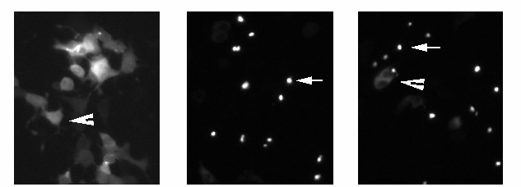
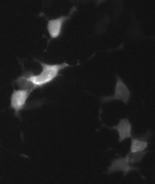
ONLY Long PolyQ Domains Trigger Formation of Intracellular GFP Aggregates
A B C D
GFP 25Q-GFP 103Q-GFP 103QP-GFP
13

Slide 14
PolyQ Domain Lacking Aggregate-Forming Activity DOES NOT Augment GFP Immunogenicity
14

Slide 15
Aggregate-Forming PolyQ Domains Augment Cellular Immunity
15

Slide 16
Summary
Fusion of GFP to aggregate-forming polyglutamine domains results in strong augmentation of humoral and cellular immunity against GFP
PolyQ-GFP caused no apparent toxicity
=> Aggregate-forming polyQ domains may serve as intra-molecular adjuvants*
* -- Ilyinskii et al., Vaccine, 2008;26:3223-3226

Slide 17
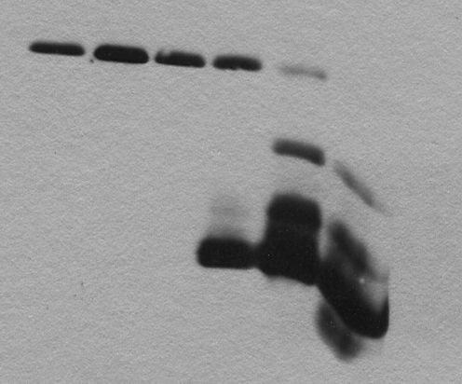
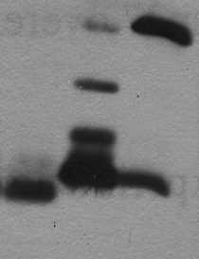
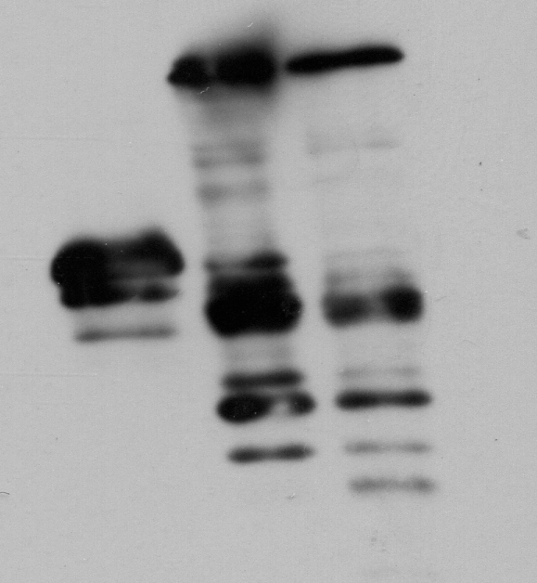
Covalently Fused PolyQ Domain is Cleaved from Recombinant Protein in Time-Dependent Manner
QM2 M2wt
16 24 40 48 48
48 h
96 h
MW, kD
GFP QGFP QGFP
MW, kD
37
37
29
29
20
20

Slide 18
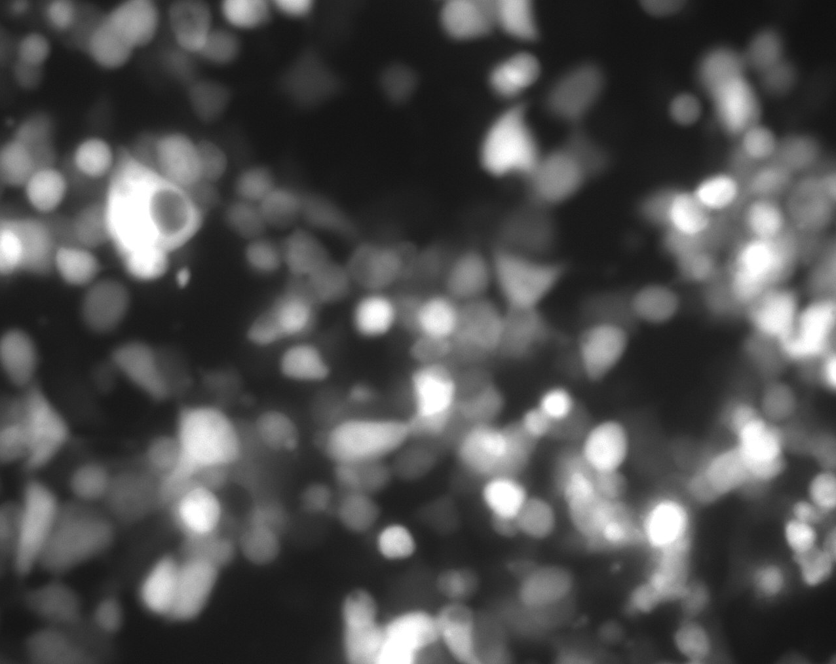

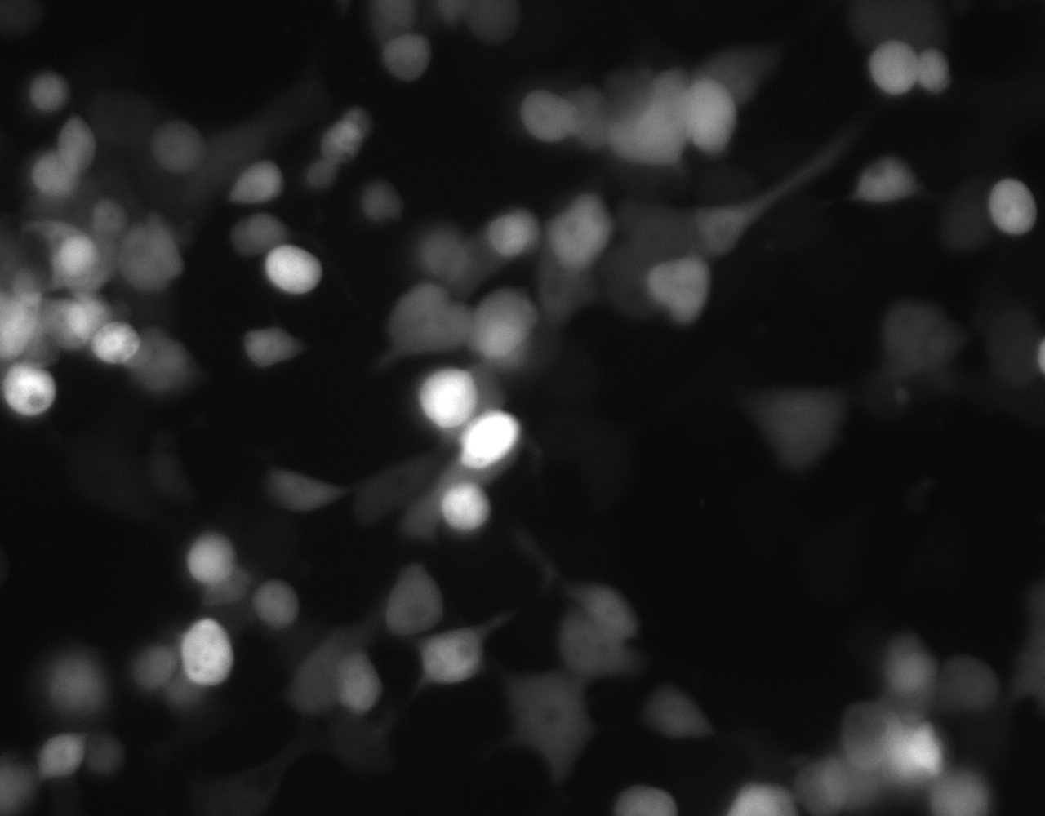
Attachment of PolyQ Domain Alleviates Influenza M2 Toxicity
GFP M2wt polyQM2
48 hours after transfection

Slide 19
Attachment of PolyQ Domain Hinders M2-Induced Cell Death

Slide 20
Summary
Fusion to polyQ delays intracellular toxicity and cell
death due to expression of cytotoxic proteins
Protein of interest is released from polyQ and
functionally active
Biotech production and high yield expression of
cytotoxic proteins may be achieved via attachment
to polyQ domains*
* -- Ilinskii et al., Journal of Biotechnology, 2008 (In Press)

Slide 21
Vaccination with a Combination of Proteosome-degradable and Non-degradable Forms
of Viral Proteins

Slide 22
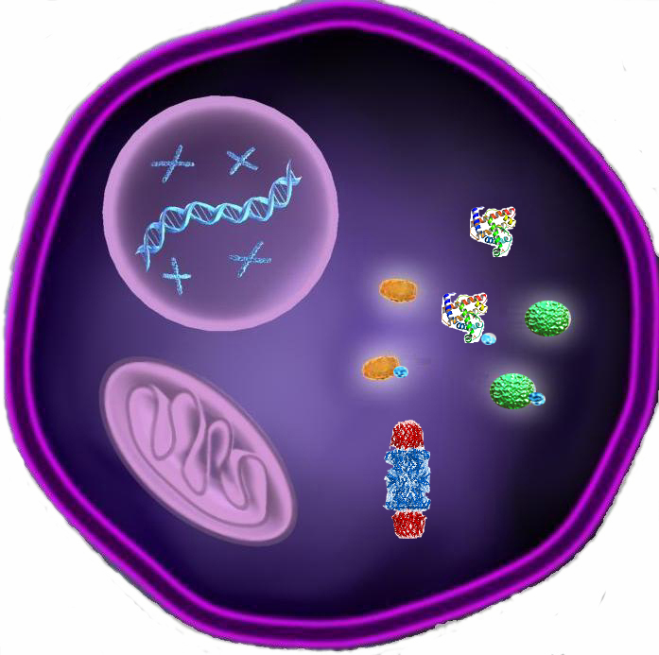
Proteosome-Dependent MHC I Presentation
Cellular Protein
Viral
Protein
Ub
8-12 aa.

Slide 23
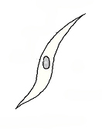




Proteosome-Resistant and -Degradable Protein Forms at Different Stages of Immune Response
Proteosome-Resistant
Antigens
Proteosome-Degradable
Antigens
Antigen Donor Cell
injected/transfected
Antigen Presenting
Cell
DNA
DNA
Peptide Transfer
HSP
Protein
Antigen
presentation
Antigen
cross-presentation

Slide 24




Disruption of NS1 3-D Structure
NS1 modification Designation
1
230
NS1wt
NS1del1
NS1del2
NS1del3
NS1del4
1
99
1
132
1
74
230
1
141
230
0 1 2 4 6 8
0 4 4 + MG132
NS1wt
NS1del2
NS1del4

Slide 25
CTL Response Following Immunization with Combinations of Wild-Type and Modified Forms of NS1

Slide 26
Summary
Combining proteosome-resistant and -degradable forms of an antigen in a vaccination regimen results in a elevated cellular immune response
Targeted disruption of 3-D structure of proteosome-resistant viral proteins results in proteosome-degradable protein forms
The new vaccination scheme should be tested with previously known and newly developed recombinant vaccines and antigens*
* -- Ilinskii et al., Vaccine 2008;26:2177-2185

Slide 27
How can we “trick” secondary RNA structures to make recombinant vaccines both safe and efficient?

Slide 28
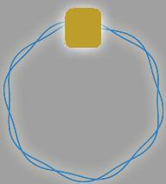
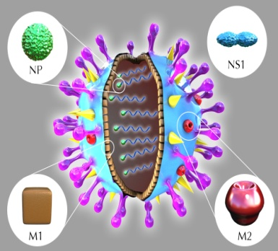
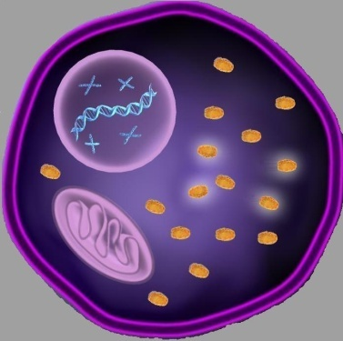
Modification vs. Expression
Antigenic properties
Immune response
Undesirable properties
Toxicity Low immune response
T
T
Modify aa of the viral protein
Low Expression Level

Slide 29
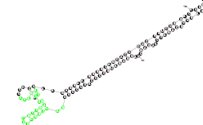
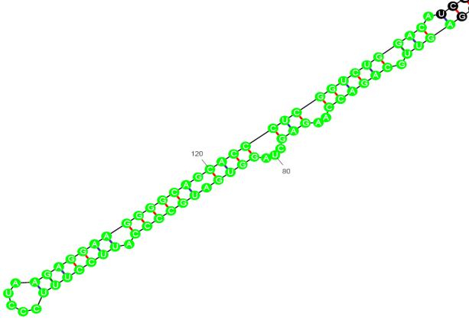
Novel Hairpin/Loop Structure in NS1 mRNA
NS1wt NS1Δ34-41

Slide 30
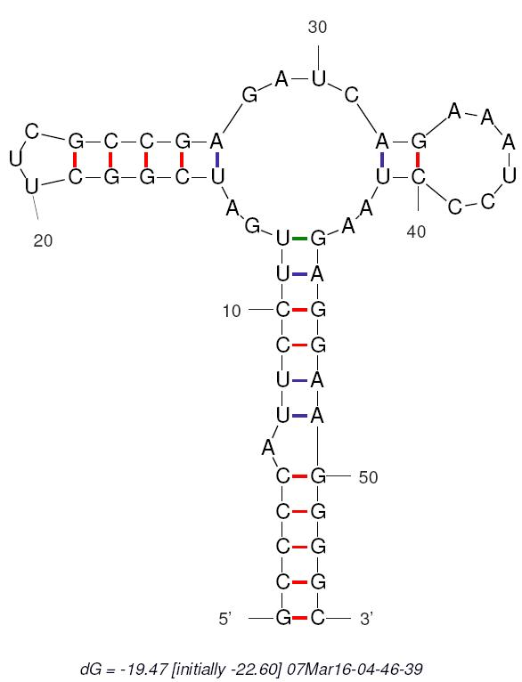
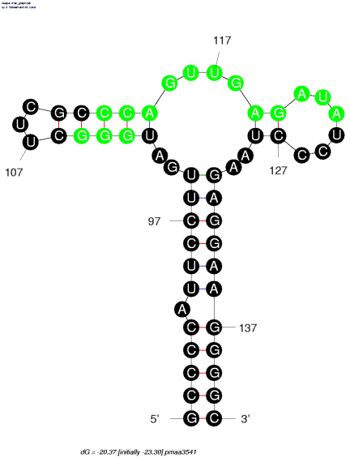
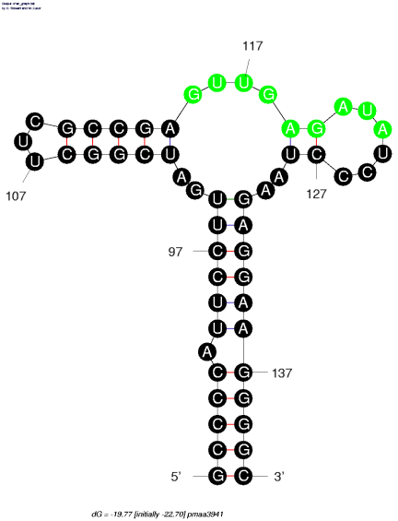
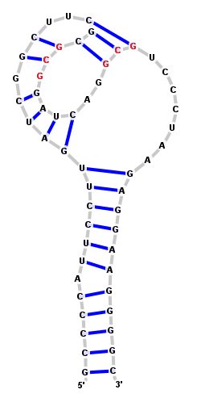
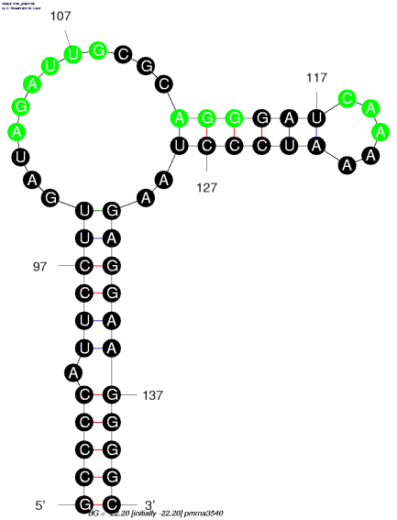
Mutations Preserving or Destroying the Hairpin/Loop
NS1wt NS1mut3541 NS1mut3941
NS1mut3540 NS1mut3841

Slide 31
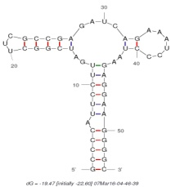

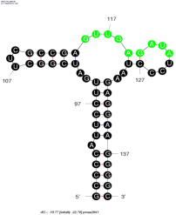

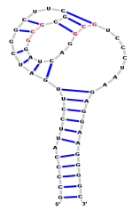
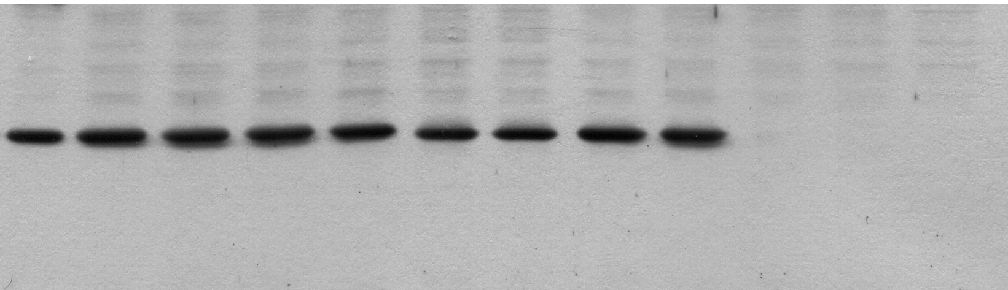
Preservation of Hairpin/Loop mRNA Structure is Essential for Recombinant NS1 Expression
4xDNA
NS1wt½ NS1wt NS1mut3540 NS1mut3541 NS1mut3941 NS1mut3841 NS1mut3841

Slide 32
Hairpin/Loop Mutations Suppress Transcription of NS1 mRNA

Slide 33
Cold-Adapted and Temperature-Sensitive Life Attenuated Influenza Vaccines
ts LAVs constitute one of the most promising class of vaccines.
FluMist is the A/Ann Arbor6/60 and Russian A/Leningrad/134/57
Few ts strains are known
Known ts strains were found empirically
ts phenotype could not be explained based on protein structure/function alteration
Methods of rational design of ts LAVs would be of a great public health benefit

Slide 34
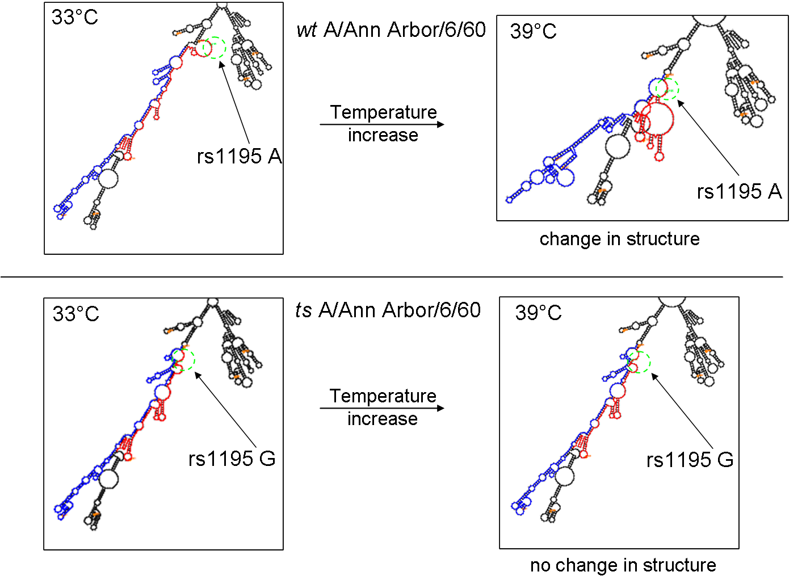
A Single Mutation in the ca/ts A/Ann Arbor/6/60 Blocks RNA Conformational Change

Slide 35
Summary
Secondary structures in mRNA/vRNA regions that encode functionally important protein elements serve as negative selection filter for mutations
Mutations within these regions lead to reduced or abolished gene expression due to lower transcription rates
Mutations within this regions should be designed to preserve secondary structures within mRNA/vRNA
Temperature sensitive LAVs can be created by altering temperature sensitivity of secondary RNA structure

Slide 36
Acknowledgments
Cure Lab, Inc. Ivanonsky Institute of Virology
Peter Ilyinskii Oleg Zhirnov
Galini Thoidis
Ignat Leschiner
Victor Shifrin
Technical University of Munich
Dmitry Frishman
Thorsten Schmidt
Northeastern University
Dmitry Lukashev
Boston University Harvard Medical School
Michael Sherman Shamil Sunyaev’s Lab
Anatoly Meriin MIT
Vlad Gabai Alex Klibaov’s Lab

Slide 37
THANK YOU!

