Slide 1
Protein against DNA, a review of vaccines against hepatitis B virus
Irina Sominskaya
Moscow 2016

Slide 2
Hepatitis B is a major global health problem, that can cause chronic liver disease and it is associated to a high risk of death from cirrhosis and hepatocellular carcinoma (HCC). Roughly 30% of the world’s population (more than 2 billion people) show serological evidence of current or past infection and among them 240 million are chronic HBV.
Reduction in the morbidity and mortality can be achieved as a result of HBV vaccination, intensive screening programs, and antiviral treatment.

Slide 4
Immunization: a procedure designed to increase concentrations of antibodies and/or effector T-cells which are reactive against infection (or cancer).
Two types of HBV immunisation:
Passive immunization
Inject the individual with ready-made HBV-specific Immunoglobulin (HBIG)
Provides immediate short-term protection
Involves large injection volumes
Can be given at birth to reduce prenatal transmission
Active immunization
The induction of immunity after exposure to an antigen

Slide 5
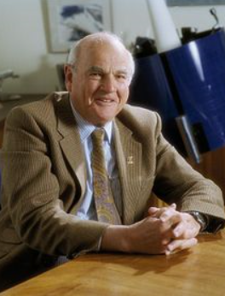
First generation vaccines
1970 Baruch Blumberg submits patent application for Australia antigen purified from plasma (later named HBsAg) as vaccine.
1970 Saul Krugman Saul Krugman was the first to report on a so-called vaccination against hepatitis B in 1971. He diluted Australia antigen positive serum from his previous human experiments 1:10, boiled it briefly to kill the virus and injected this material to mentally handicapped children as a kind of vaccine. After two injections, he injected infectious HBV containing serum as challenge to the children and found incomplete, but statistically significant protection

Slide 6
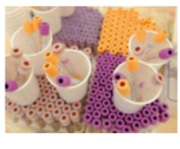
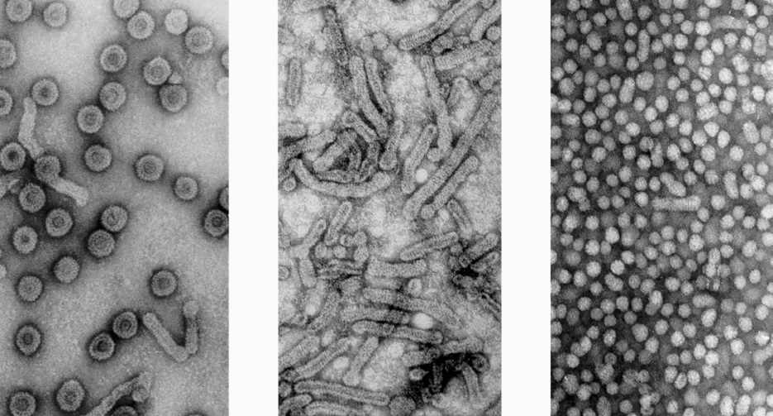
HBV particles HBsAg filaments HBsAg 20 nm particles
1975 Using chimpanzees as experimental animals, Robert Purcell and John Gerin from the NIH, and in parallel Maurice Hilleman from MSD, could prove that Blumberg’s concept of using purified 20 nm HBsAg particles from carrier plasma as HB vaccine was valid and could protect against an intravenous challenge with 3000 chimpanzee-infectious doses (MSD) immunize chimpanzees with purified HBsAg.
–Very good protection
A state of the art field study was published by Wolf Szmuness in 1980 using the plasma-derived vaccine produced at MSD. Szmuness had recognized that male homosexuals in New York had an extremely high incidence of HBV infections and performed a large placebo-controlled study with 1083 (truly voluntary) participants. The protection rate of the vaccine was 92%. After this study, the recommendation to vaccinate all kinds of high risk groups, including medical staff, was adopted in many countries.
Thereafter WHO recommends worldwide vaccination of risk groups.
–Safety concerns because of AIDS

Slide 7
Second generation vaccines
With the cloning of the HBV genome and the identification of the HBs gene in 1979 a new era of vaccine production was opened.
HBsAg could not be expressed in E. coli in spite of initial claims. Expression of glycosylated and secreted HBsAg particles in mammalian host cells was possible but the yield was relatively low and mammalian cell culture was relatively expensive. Thus, in the early 1980s Pablo Valenzuela for MSD and Michel de Wilde for Smith Kline RIT (today GSK) generated yeast cell strains which expressed the major HBs protein in very large amounts (800 mg/liter yeast culture) at low cost. The product was not completely identical to the natural HBsAg, because it did not assemble spontaneously to the 20 nm particles, was not secreted and not glycosylated. But protection experiments in chimpanzees published in 1984 by MSD were very encouraging Thus, in 1986 yeast-derived HBsAg became the standard vaccine against HBV. Rapid immunization schemes for urgent cases (e.g. 3 injections within 3 weeks) are possible but three or four injections within 6 or 12 months are optimal for induction of dependable long lasting immunity. With the advent of an inexpensive, but highly protective and well tolerated hepatitis B vaccine, WHO recommended in 1992 to implement universal childhood vaccination worldwide and meanwhile ca. 180 countries have adopted this measure

Slide 8
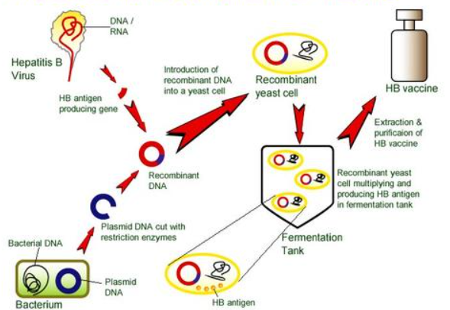
Production of recombinant vaccine

Slide 9
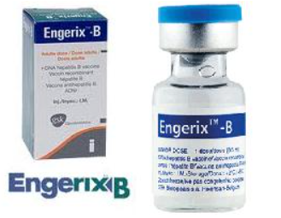
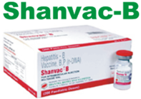
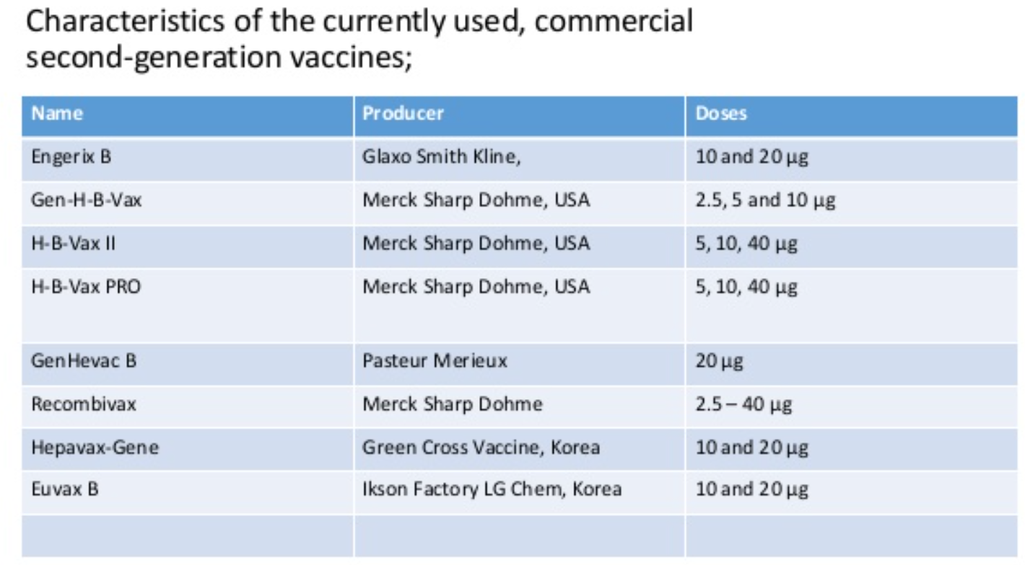
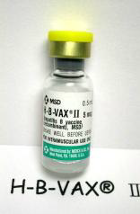

Slide 10
The success of HBV vaccination has been clearly demonstrated. The Global Alliance for Vaccines and Immunisation recognizes that the effect of HBV vaccination in reducing the incidence of liver cancer result in an impact on public health worldwide. Countries that have adopted the recommendation had a marked reduction in carrier rates as well as complications from HBV including HCC. This has been most evident in regions with a high prevalence of chronic HBV infection. At present, global HBV vaccine coverage is estimated at 75% and has reached 91% in the Western Pacific and 89% in the American, the largest decline in incidence was seen in children.
Nature of the currently predominating hepatitis B vaccines:
• Small hepatitis B surface protein SHBs
– No preS-containing surface proteins
• HBsAg subtype adw2
WHO standard only genotype A
– Worldwide genotypes B,C und D predominant
– Genotype F not detected for years with some tests
• Expressed in transformed yeast cells
– Incomplete folding, no secretion
– Neutralising conformational epitopes in vitro only partially generated
• Moderately immunogenic (3 doses of 20 μg)

Slide 11
Around 10% of the general population shows poor responses. Antibody response rates decline gradually after age 40 years, with age being a factor determining response to HB vaccine. The mechanism of nonresponse is not fully understood, but several hypotheses have been proposed. Because the existence of non-responders to HB vaccine is a serious social problem, several attempts have been made to improve the efficacy of vaccine. Persons unresponsive to a first series of three injections (i.e., anti-HBs < 10 mIU/mL) are recommended to complete a second 3-dose vaccine series, with about 50% of these individuals showing an anti-HBs response. Non-responders to the second course should be evaluated for underlying chronic HBV infection. Response in patients on hemodialysis may be improved using double-dose vaccine. However, some individuals are non-responsive to multiple series of vaccinations, suggesting the need for other strategies to induce anti-HBs production in these subjects.
Strategy to overcome nonresponsiveness:
Add preS-epitopes to HBsAg vaccine
Change vaccine carrier
More immunogenic adjuvants

Slide 12
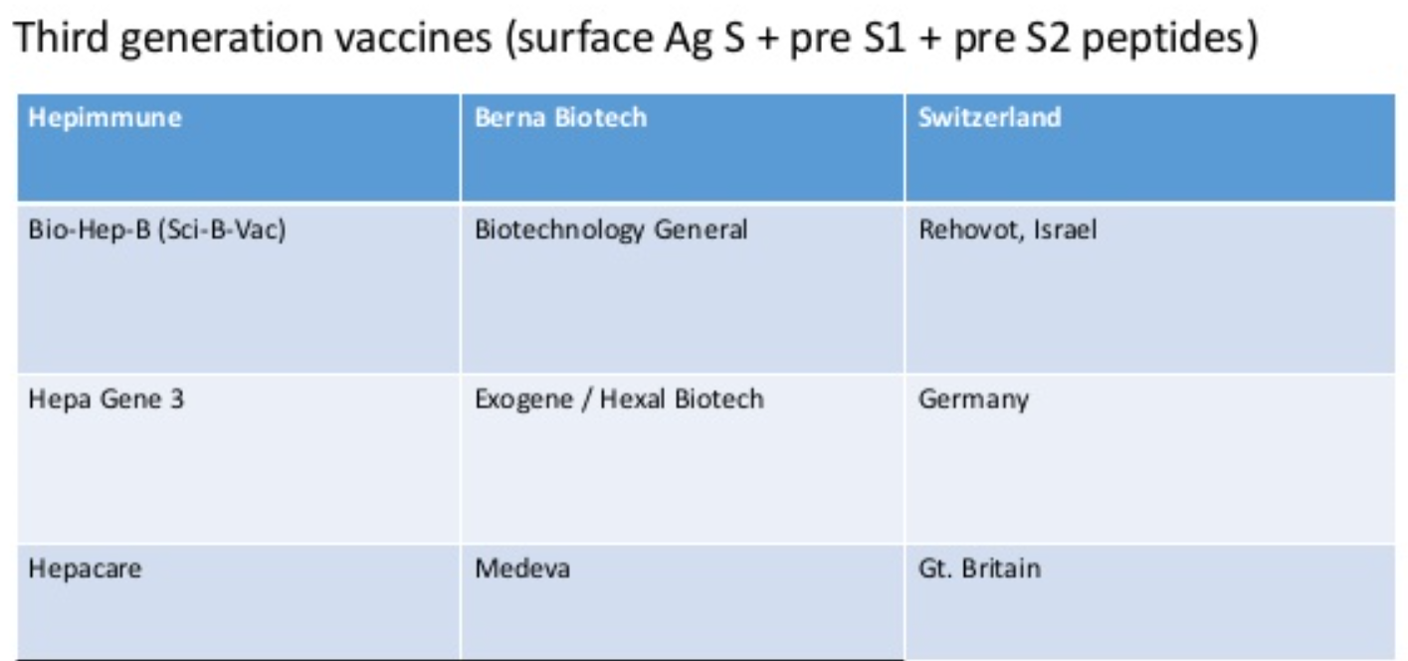
New HB vaccines have been developed to improve anti-HBs response in non-responders. Hepa geneTM, a third generation vaccine containing pre-S1 and pre-S2 proteins in addition to S protein, has been shown to induce anti-HBs in 76% of previously non-responsive individuals. Another third generation HB vaccine, Sci-B-Vac™, was recently shown to induce anti-HBs in 20 of 21 non- or low-responders, with 12 non-responders and all 6 low responders showing a high anti-HBs response (> 100 mIU/mL). Moreover, the preventive effect of Sci-B-Vac™ has been assessed in newborns.

Slide 13
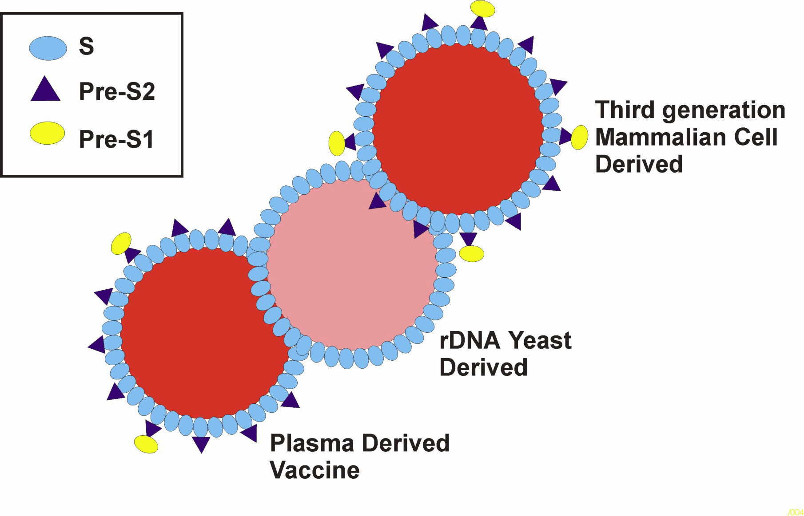

Slide 14
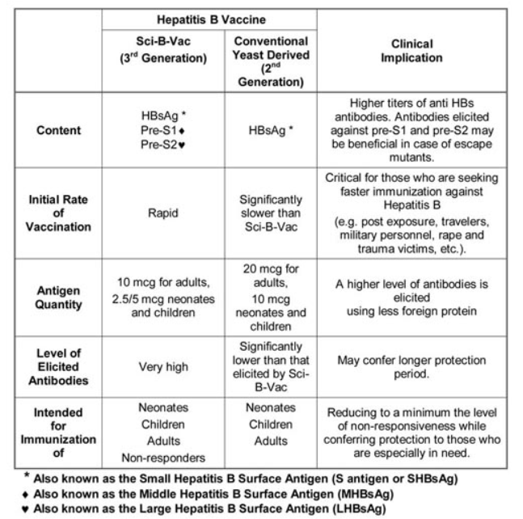
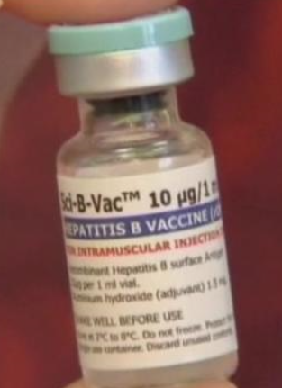

Slide 15
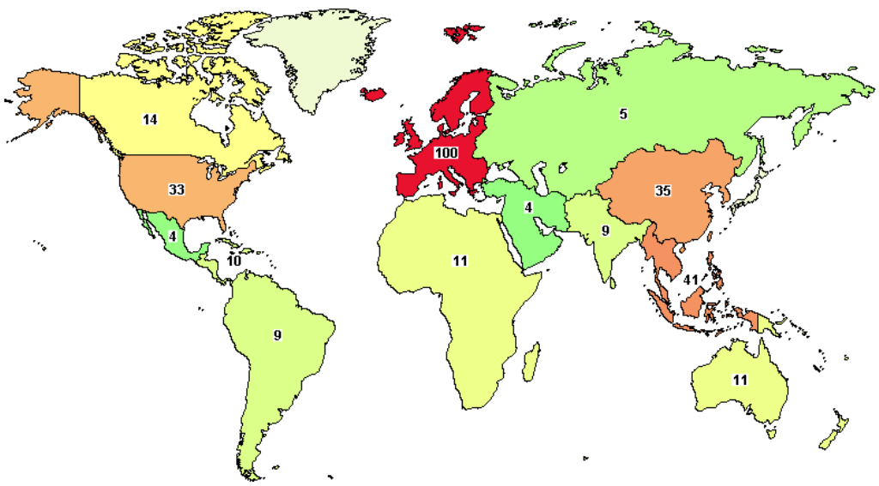
Number of clinical trials
Source:https://ClinicalTrials.gov

Slide 16
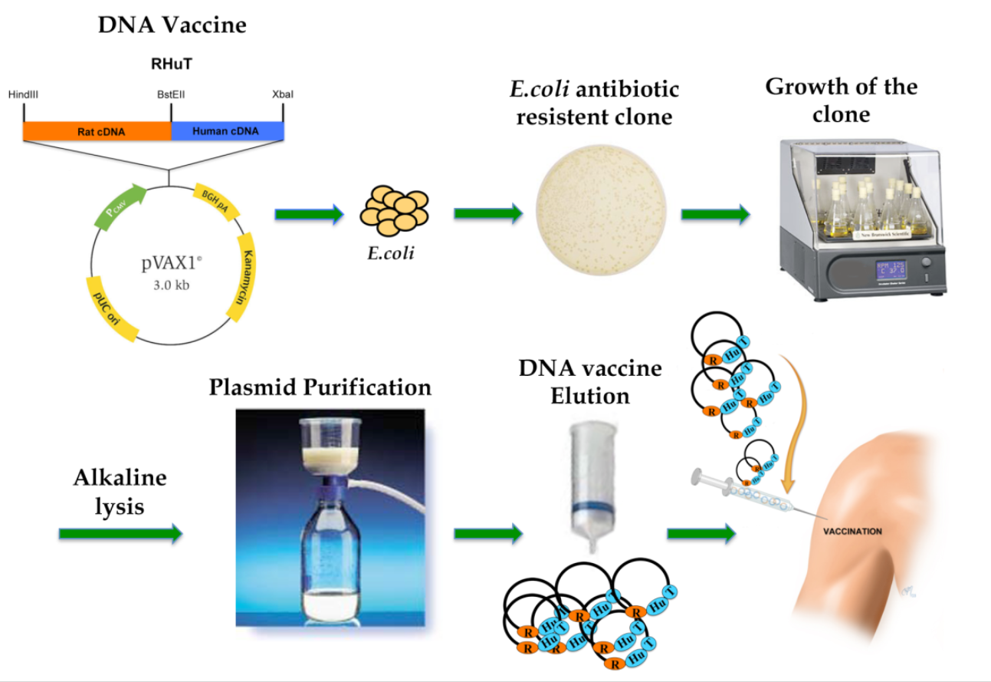
Future vaccines

Slide 17
Method of delivery | Advantage | Disadvantage
Intramuscular or Intradermal injection | No special delivery mechanism Permanent or semi-permanent expression pDNA spreads rapidly throughout the body | Inefficient site for uptake due to morphology of muscle tissue Relatively large amounts of DNA used Th1 response may not be the response required
Gene gun | DNA bombarded directly into cells Small amounts DNA | Th2 response may not be the response required Requires inert particles as carrier
Jet injection | No particles required DNA can be delivered to cells mm to cm below skin surface | Significant shearing of DNA after high-pressure expulsion 10-fold lower expression, and lower immune response Requires large amounts of DNA (up to 300 μg)
Liposome-mediated delivery | High levels of immune response can be generated Can increase transfection of intravenously delivered pDNA Intravenously delivered liposome-DNA complexes can potentially transfect all tissues Intranasally delivered liposome-DNA complexes can result in expression in distal mucosa as well as nasal muscosa and the generation of IgA antibodies | Toxicity Ineffectiveness in serum Risk of disease or immune reactions

Slide 18
Tacket CO et al. Vaccine 17(22), 2826–2829 (1999).
Roy MJ et al. Vaccine 19(7–8), 764–778 (2000).
Rottinghaus ST et al. Vaccine 21(31), 4604–4608 (2003).

Slide 19
Future vaccines
There is also a great need around the world for a therapeutic vaccine which could be used instead of the current HBV treatments using interferon.
The aim of giving therapeutic vaccines to HBV-infected patients is to increase the efficiency of the natural immune response – in particular the T-helper or cytotoxic T lymphocyte response.
Currently studied HBV therapeutic vaccines include recombinant peptide-based vaccines, DNA-based vaccines, viral vector-based vaccines, and cell-based vaccines. The challenge for the development of an efficient vaccine with relatively low side effects is still in progress.

Slide 20
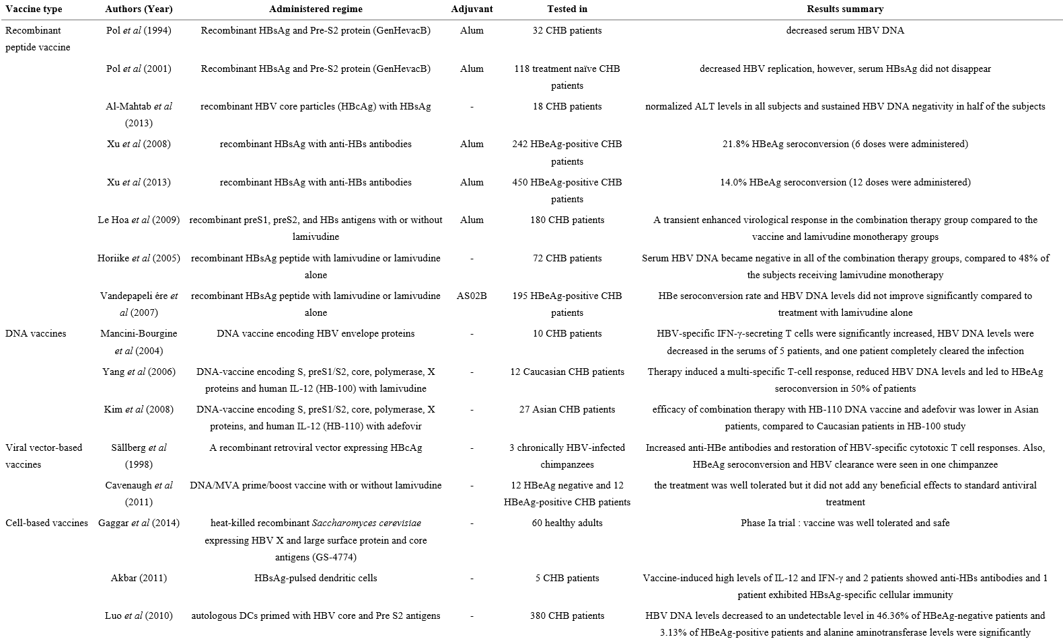

Slide 21
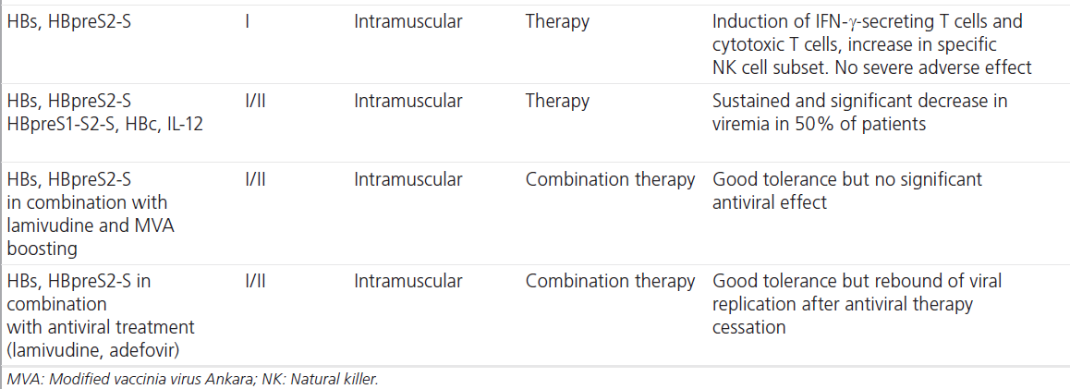
Authors
Mancini-Bourgine M et al. Hepatology 40(4), 874–882 (2004)
Scott-Algara D et al. PLoS One 5(1), E8761 (2010)
Yang SH et al. Gene Ther. 13(14), 1110–1117 (2006).
Im SJ et al. Immune Netw. 9(1), 20–26 (2009).
Cavenaugh JS et al. PLoS One 6(2), E14626 (2011).
Fontaine H et al. 46th Annual Meeting of the European Association for the Study of the Liver. Vienna, Austria, 31 March–2 April 2011.

Slide 22
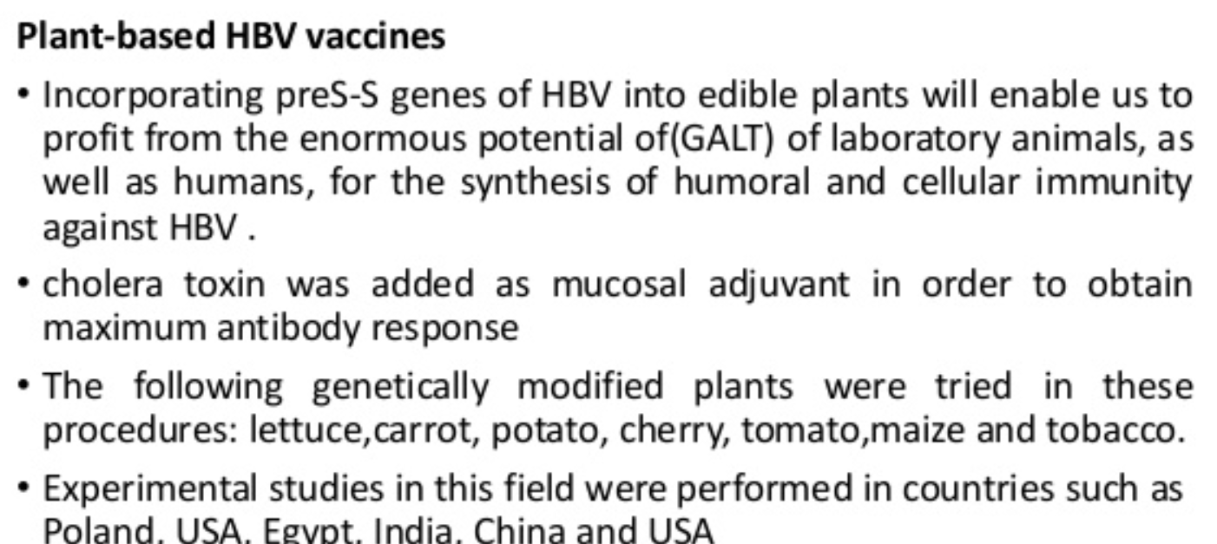
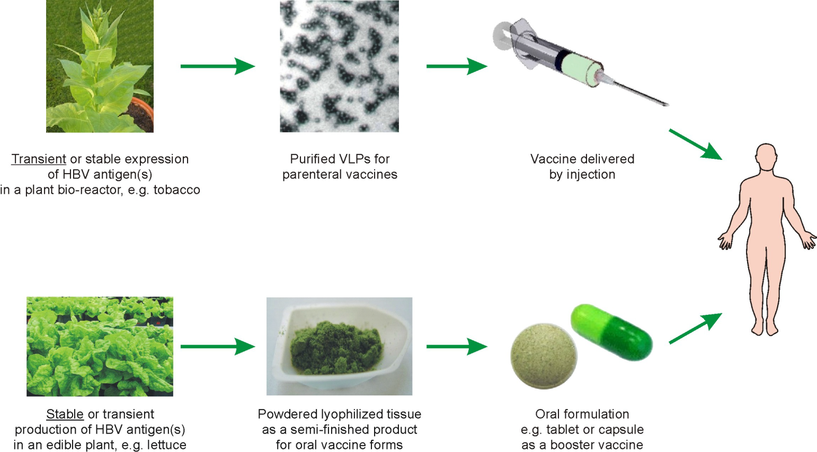
Future vaccines

