Slide 1
The impact of 11 low-penetrance allelic variants on breast cancer morbidity in population of Latvia
Ustinova M, Nakazawa-Miklaševiča M, Kalniņa L, Daneberga Z, Gardovskis J, Miklaševičs E
Riga Stradiņš University, Institute of Oncology
Funded by National Research Programme «BIOMEDICINE 2014–2017»
Supported by Horizon2020 project VACTRAIN 692293

Slide 2
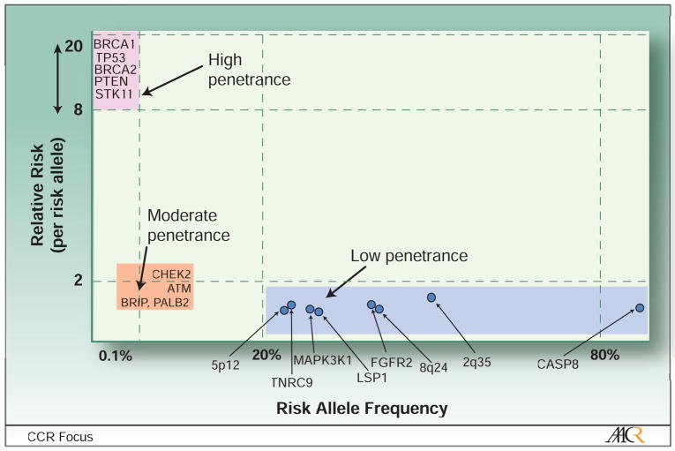
Breast cancer risk alleles
(Garcia-Closas and Chanock 2008)

Slide 3
Breast cancer risk alleles
79
(Garcia-Closas and Chanock 2008)

Slide 4
The aim
To determine the association among 11 allelic variants and breast cancer morbidity in population of Latvia.

Slide 5
Study groups
Patients
2 609 breast cancer patients with:
-no proven founder mutations in BRCA1 gene (5382 insC, 4153delA, 300T/G),
-no positive family history of the disease.
Controls
694 volunteer blood donors with:
-no oncologic illnesses detected at the time of application.

Slide 6
Methods
DNA isolation from peripheral blood leukocytes
Genotyping of 5 allelic variants using RFLP
Genotyping of 6 allelic variants using TaqMan probes
Verification of methods by Sanger sequencing
Genotyping of 11 allelic variants
Data collection and statistical analysis using R. 3.1.2.

Slide 7
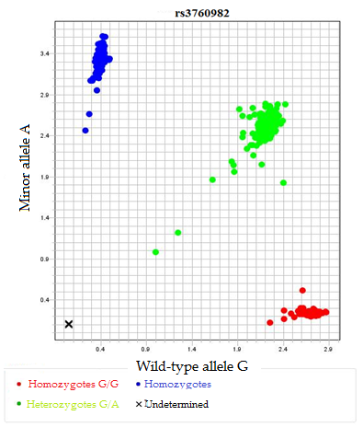
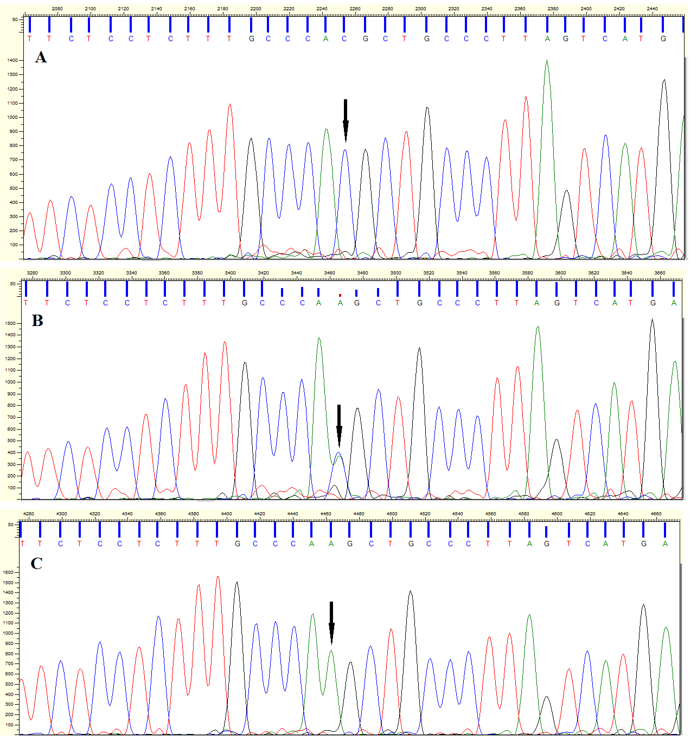
Methods
TaqMan probes - 6 allelic variants.
RFLP – 5 allelic variants.
Verification of methods – Sanger sequencing

Slide 8
Methods
DNA isolation from peripheral blood leukocytes
Genotyping of 5 allelic variants using RFLP
Genotyping of 6 allelic variants using TaqMan probes
Verification of methods by Sanger sequencing
Genotyping of 11 allelic variants
Data collection and statistical analysis using R. 3.1.2.

Slide 9
Analyzed allelic variants
rs1436904 | rs9693444 | rs17356907 | rs1550623 | rs13329835 | rs132390 | rs204247 | rs616488 | rs3760982 | rs7072776 | rs11571833
18. chr. CHST9 intron | 8. chr. RPL17P33/ LINC00589 | 12. chr. NTN4 | 2. chr. CDCA7 | 16. chr. CDYL2 intron | 22. chr. EMID1 intron | 2. chr. RANBP9 | 1. chr. PEX14 intron | 19. chr. KCNN4 intron | 10. chr. MLLT10 | 13. chr. BRCA2 intron
T/G | C/A | A/G | A/G | A/G | T/C | A/G | A/G | G/A | G/A | A/T

Slide 10
Case-control analysis

Slide 11
Case-control analysis in different age groups
 | Without stratification |  | Stratified by age
Allelic variant | OR | CI | Age group (years) | OR | CI
rs9693444 | 1,39 | 1,13 – 1,71 | 60 – 80 | 2,10 | 1,45 - 3,04
rs17356907 | 0,73 | 0,60 – 0,90 | 60 – 80 | 0,56 | 0,38 - 0,80
rs1550623 | 1,40 | 1,12 – 1,75 | 60 – 80 | 1,81 | 1,20 - 2,80
rs7072776 | 1,25 | 1,03 – 1,50 | 60 – 80 | 1,50 | 1,06 - 2,14
rs13329835 | 1,37 | 1,12 – 1,67 | ≤ 40 | 1,69 | 1,04 - 2,76
rs3760982 | 1,35 | 1,09 – 1,66 | ≤ 40 | 1,87 | 1,05 - 3,48

Slide 12
Case-control analysis in different age groups
 | Without stratification |  | Stratified by age
Allelic variant | OR | CI | Age group (years) | OR | CI
rs9693444 | 1,39 | 1,13 – 1,71 | 60 – 80 | 2,10 | 1,45 - 3,04
rs17356907 | 0,73 | 0,60 – 0,90 | 60 – 80 | 0,56 | 0,38 - 0,80
rs1550623 | 1,40 | 1,12 – 1,75 | 60 – 80 | 1,81 | 1,20 - 2,80
rs7072776 | 1,25 | 1,03 – 1,50 | 60 – 80 | 1,50 | 1,06 - 2,14
rs13329835 | 1,37 | 1,12 – 1,67 | ≤ 40 | 1,69 | 1,04 - 2,76
rs3760982 | 1,35 | 1,09 – 1,66 | ≤ 40 | 1,87 | 1,05 - 3,48

Slide 13
Case-control analysis in different age groups
 | Without stratification |  | Stratified by age
Allelic variant | OR | CI | Age group (years) | OR | CI
rs9693444 | 1,39 | 1,13 – 1,71 | 60 – 80 | 2,10 | 1,45 - 3,04
rs17356907 | 0,73 | 0,60 – 0,90 | 60 – 80 | 0,56 | 0,38 - 0,80
rs1550623 | 1,40 | 1,12 – 1,75 | 60 – 80 | 1,81 | 1,20 - 2,80
rs7072776 | 1,25 | 1,03 – 1,50 | 60 – 80 | 1,50 | 1,06 - 2,14
rs13329835 | 1,37 | 1,12 – 1,67 | ≤ 40 | 1,69 | 1,04 - 2,76
rs3760982 | 1,35 | 1,09 – 1,66 | ≤ 40 | 1,87 | 1,05 - 3,48

Slide 14
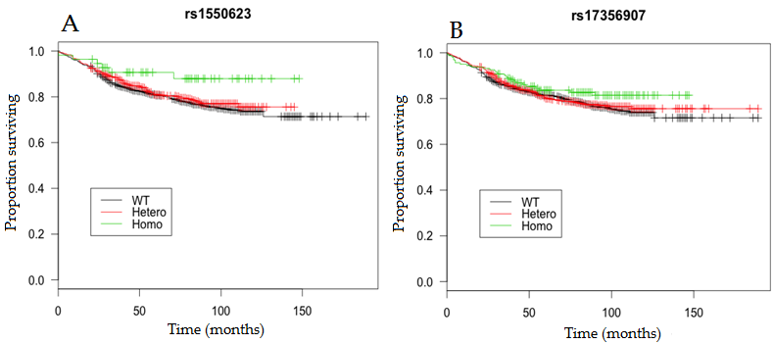
Effect on disease-specific survival

Slide 15
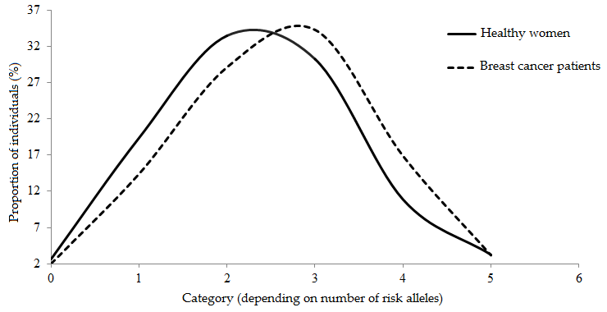
Quantitative analysis of risk alleles
0. category | All 5 loci in wild-type form
1. category | Carriers of 1 risk allele
2. category | Carriers of 2 risk alleles
3. category | Carriers of 3 risk alleles
4. category | Carriers of 4 risk alleles
5. category | Carriers of 5 risk alleles

Slide 16
Quantitative analysis of risk alleles
0. category | All 5 loci in wild-type form
1. category | Carriers of 1 risk allele
2. category | Carriers of 2 risk alleles
3. category | Carriers of 3 risk alleles
4. category | Carriers of 4 risk alleles
5. category | Carriers of 5 risk alleles
OR = 1.49; CI = 1.17 – 1.91; p-value = 0.001

Slide 17
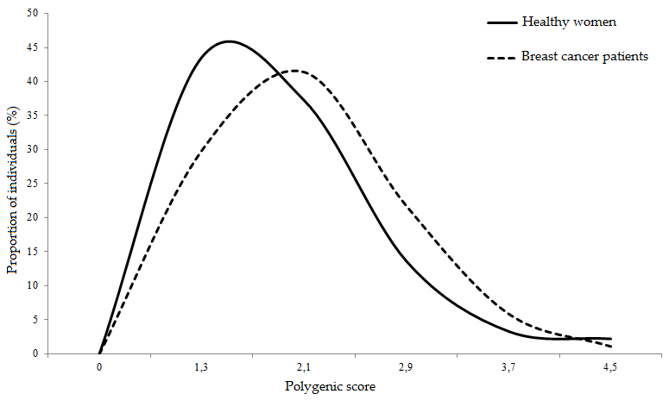
Polygenic score
OR1 × OR2 × OR3 …

Slide 18
Patient proportion depending on polygenic score
Low PS

Slide 19
Mean age at diagnosis depending on polygenic score
Low PS
59.55 ± 12.06 years
of age
59.86 ± 12.34 years of age

Slide 20
Biometrical data in high and low polygenic score groups
Patient biometrical data | High PS | Low PS
Average age at the time of diagnosis | 59,86 ± 12,34 | 59,55 ± 12,06
Hormonal contraception users | 20,00% | 39,39%
HRT users | 36,00% | 48,48%
Average number of pregnancies | 3 | 3
Breastfeeding | 90,91 | 96,77
Average age at menarche | 14,00 ± 1,50 | 13,45±1,22
Patients <14 years of age at menarche | 32,00% | 53,13%
Average age at menopause | 49,25±4,89 | 49,87±4,81
Patients > 55 years of age at menopause | 0,00% | 4,35%

Slide 21
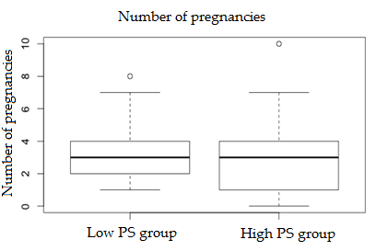
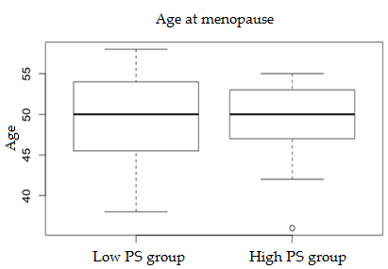
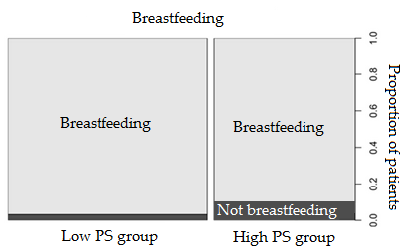
Biometrical data in high and low polygenic score groups

Slide 22
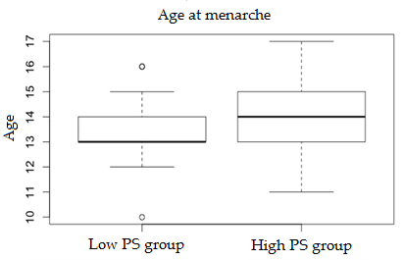
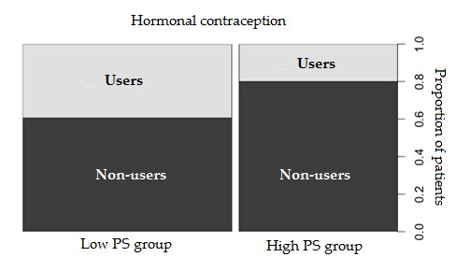
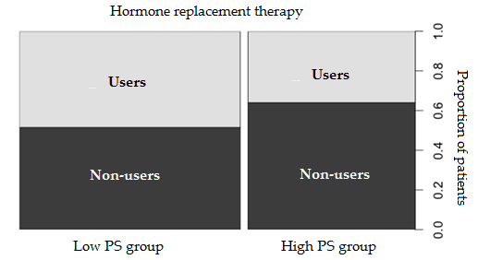
Biometrical data in high and low polygenic score groups

Slide 23
Conclusions
Rs9693444, rs1550623, rs13329835, rs3760982, rs7072776 proved an association with increased breast cancer risk, whereas rs17356907 and rs1436904 has a protective effect.
There is no significant impact of analyzed variants on patients survival.
Breast cancer predisposition comprising of multiple low-penetrance allelic variants corresponds to the polygenic model.
There are no statistically significant differencies in biometrical data between patients with high and low polygenic score.

Slide 24
Thank you!

