Slide 1
Progress in Zika virus vaccine development
Eva Žusinaite
Tartu University Institute of Technology
„Toolkits for DNA vaccine design, an update“
Moscow, 17th of November, 2016

Slide 2
ZIKV: 1947-2006
Zika virus (ZIKV) causes Zika disease: fever, rash, arthralgia, myalgia and headache
Incubation period 3-14 days, symptoms 2-7 days
Illness is mild, very low rate of hospitalization with full recovery
Few cases of death is reported in the immunocompromised patients
Only 14 clinical cases in the literature from 1951-2006.

Slide 3
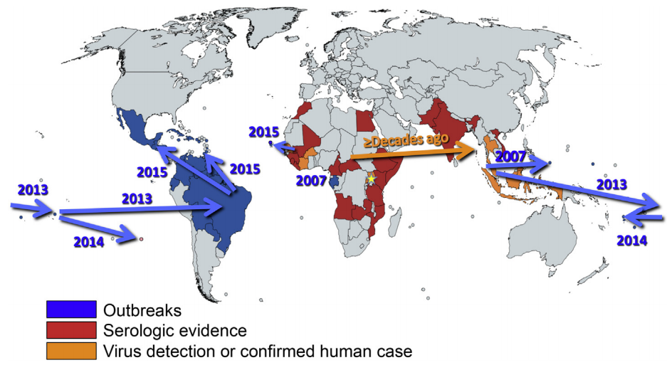
Known distribution of Zika virus
Weaver et al., 2016

Slide 4
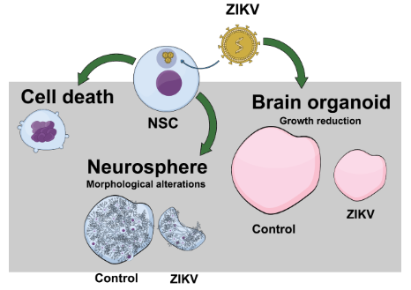
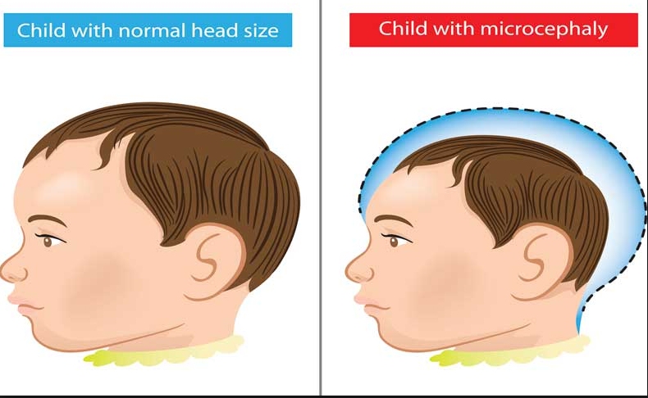
ZIKV outbreak has been associated with
Acute disseminated encephalomyelitis (ADEM)
Guillain-Barré syndrome - rapid-onset muscle weaknes caused by autoimmune destruction of the peripheral nervous system
Neurological defects and fetal malformations in children of women infected during pregnancy, including microcephaly (risk 1-15/100 pregnancies)
Causal link between ZIKV infection and microcephaly has been established by epidemiological evidence and the isolation of virus from the fetal brain

Slide 5
In response to the link between Zika virus infection during pregnancy and microcephaly, the World Health Organization declared Zika virus a Public Health Emergency of International Concern by February 1, 2016

Slide 6
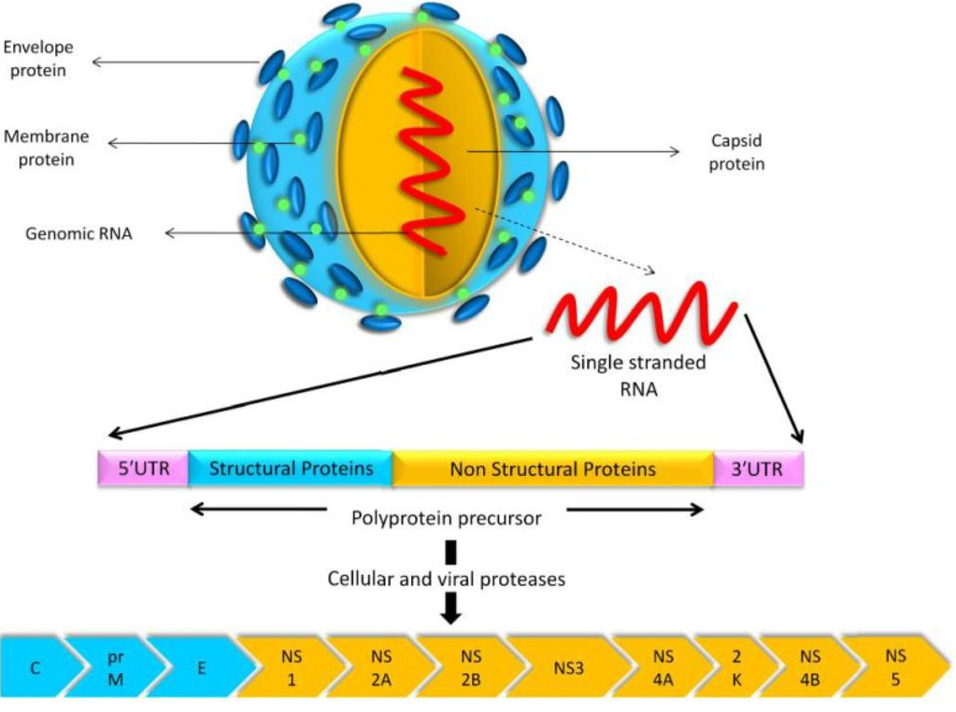
Zika virus
Family Flaviviridae; „relatives“ – YFV, DENV, TBEV, WNV, JEV
Enveloped virion, +ssRNA genome, one ORF
Cytoplasmic replication cycle
Arbovirus; vectors – Aedes mosquitoes
Transmission routes:
mosquito’s bite
sexual
blood products
vertical
Prevention:
vector control
PPE
pregnancy prevention

Slide 7
Challenges in Zika vaccine development
The virus was out of big interest for decades – relatively less is known about its biology and immune responses
Need to protect pregnant women or women planning to become pregnant makes difficulties in formulating and testing new vaccines
Although Zika virus exists as a single serotype, antibody dependent enhancement of disease cannot be excluded

Slide 8
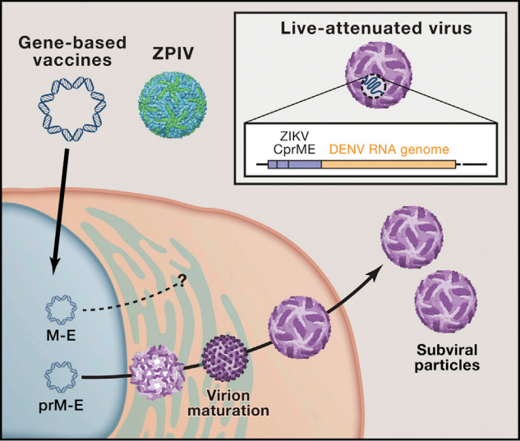
ZIKV vaccine platforms
live attenuated virus/ chimeric vaccines
whole inactivated virus
nucleic acid (DNA/RNA) vaccines
viral-vectored vaccines (measles, vaccinia, adenovirus)
subunit protein vaccines
Pierson and Graham, 2016

Slide 9
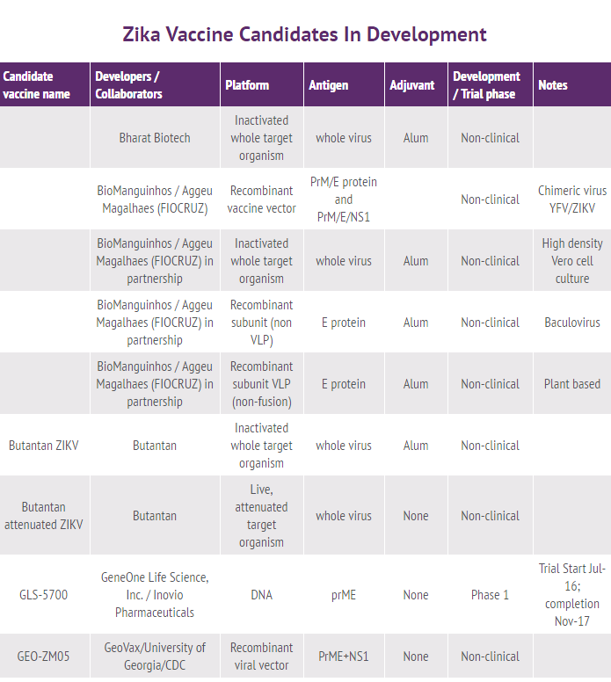
World Health Organization ZIKV vaccines pipeline, as of July 2016

Slide 10
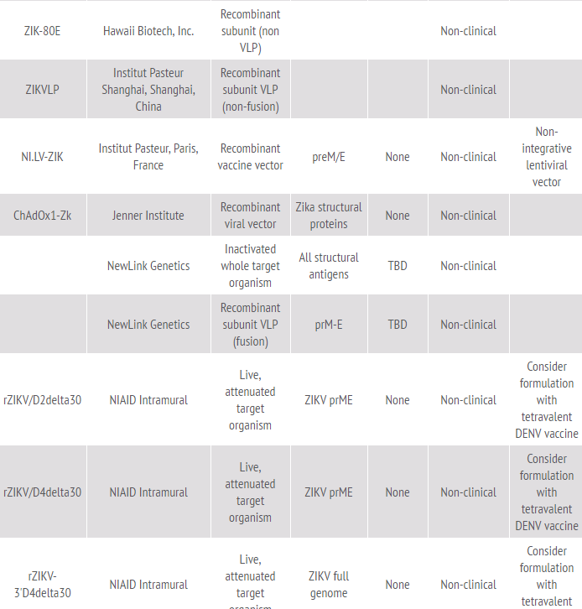
World Health Organization ZIKV vaccines pipeline, as of July 2016

Slide 11
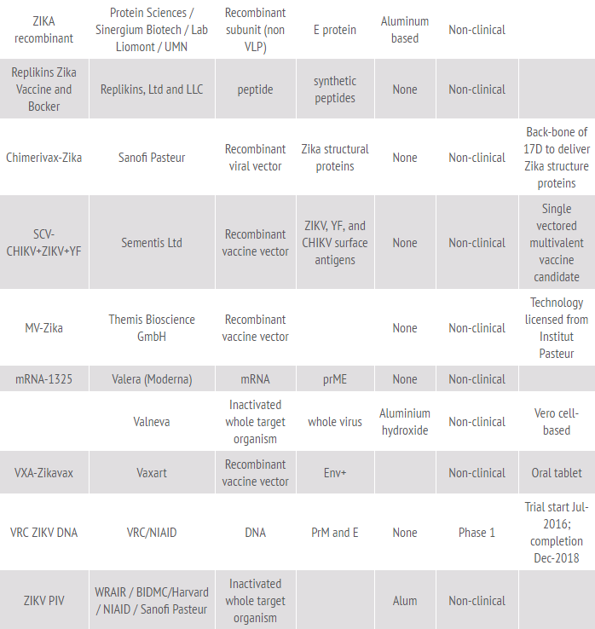
World Health Organization ZIKV vaccines pipeline, as of July 2016

Slide 12
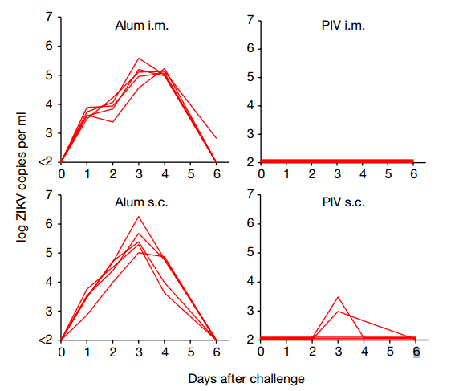
Purified inactivated virus (PIV) vaccines
Walter Reed Army Institute of Research (WRAIR)
Puerto Rican isolate (strain PRVABC59) in Vero cells
purified and inactivated with formalin (Larocca et al., 2016)
single dose (1 µg) of ZPIV with alum i/m – full protection against preventing viremia in BALB/c mice after ZIKV challenge (4 weeks after immunization)
Larocca et al., 2016

Slide 13
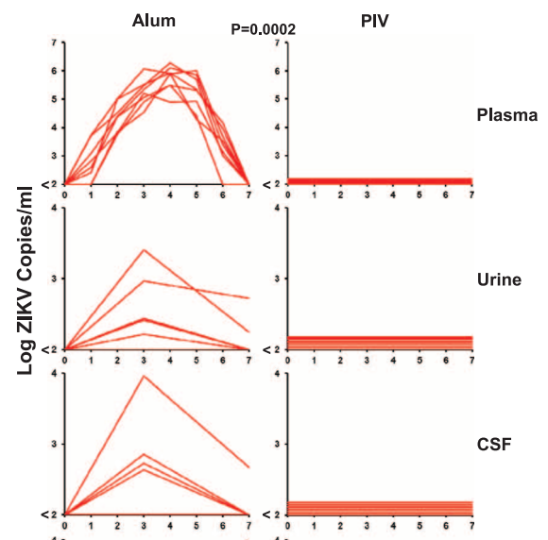
Purified inactivated virus (PIV) vaccines
ZPIV (WRAIR) challenge studies in Rhesus macaques
5 µg dose, 2 injections s/c, 4 week interval
challenge with 10*6 viral particles s/c 4 weeks later
full protection
Pahase I clinical trial were planned in Autumn 2016, not yet started
Abbink et al., 2016

Slide 14
Purified inactivated virus (PIV) vaccines in development
NIH/Butantan Institute (Brazil) and FIOCRUZ Institute
Bharat Biotech (India) – phase I planned by end of 2016
Glaxo-Smith-Klein (GB/Belgium)
NewLink Genetics (Massachusets)
PaxVax (California)
Sanofi Pasteur (France) - ChimeriVax

Slide 15
Live attenuated vaccine (LAV)
Strategies used for DENV attenuation:
historically, passaging in heterologous host organism – mouse brain
sequential passaging in mammalian cell cultures
recombinant live virus vaccines with attenuating deletions
chimeric viruses with replaced structural proteins of the attenuated vaccine candidate
Yellow fever 17D vaccine backbone with replaced prM and E proteins from four DENV serotypes
YF/ DENV1 – 4 tetravalent formulation - the first dengue vaccine, Dengvaxia (CYD-TDV), December, 2015.

Slide 16
Zika LAVs in development
NIAID/Butantan Institute
composition: prM and E proteins of ZIKV + nonstructural part of the attenuated DENV2
Phase I studies are planned for the very end of 2016/2017
Live attenuated pentavalent vaccine is under development: combined Zika + 4 dengue serotypes
Bio-Manguinhos/Fiocruz - recombinant chimeric YF 17D
UTMB/Evandro Chagas Institute/Brazil Ministry of Health - recombinant ZIKV infectious clone
Sanofi Pasteur – Chimerivax Zika – chimeric 17D vaccine

Slide 17
Flavivirus prM-E
Co-expression of flavivirus prM and E proteins in mammalian cells results in the release of subviral particles
The particles share structural, antigenic, and functional characteristics with infectious virion
This strategy was employed for many flaviviruses (WNV, JEV), including Zika virus

Slide 18
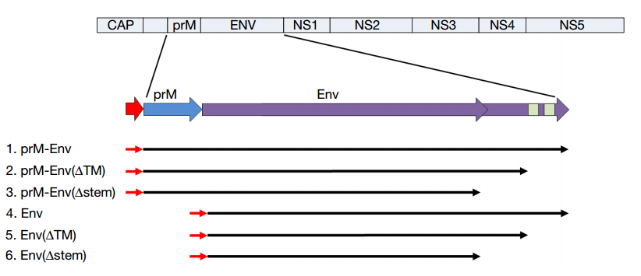
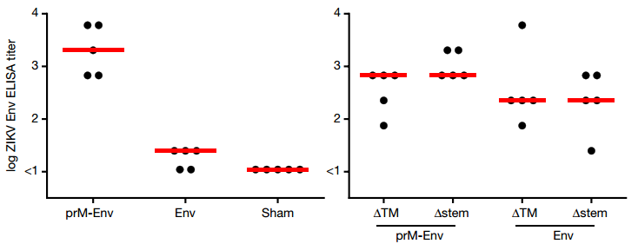
Larocca et al., 2016 „Vaccine protection against Zika virus from Brazil“

Slide 19
Larocca et al., 2016 „Vaccine protection against Zika virus from Brazil“
Challenge – 10*5 viral particles i/v 4 weeks after immunization

Slide 20
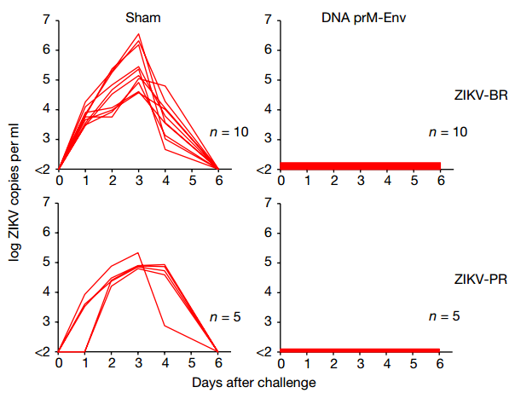
Larocca et al., 2016 „Vaccine protection against Zika virus from Brazil“
Challenge – 10*5 viral particles i/v 4 weeks after immunization

Slide 21
DNA/RNA vaccines in development
US NIH/VRC (Vaccine Research Center) - DNA plasmid expressing prM/E self-assembling into Zika VLPs; Phase I is planned on late 2016/beginning of 2017
Inovio Pharmaceuticals/GeneOne Life Science - GLS-5700 DNA; Phase I trial is planned on November 2016.
Valera (Moderna Therapeutics) – mRNA1325
Harvard Medical School, the Massachusetts Institute of Technology, the University of Sao Paulo, and the Walter Reed Institute of Research – DNA vaccine

Slide 22
Live vectored vaccines
Live vectored vaccines are chemically or genetically attenuated viral vectors expressing antigens of a heterologous pathogen
The most effective vaccines against human infectious diseases due to the broad and long-lived immune response
Examples of viruses used as vectors: pox viruses, adenoviruses, alphaviruses, measles virus, yellow fever virus and vesicular stomatitis virus

Slide 23
Measles-vectored vaccine Themis/Institute Pasteur (Austria/France)
ZIKV structural region (prM/E)
Generation of recombinant measles vaccine virus bearing Zika virus antigens (E) on the surface
Planned to enter Phase I trial at the end of 2016

Slide 24
Lentiviral-vectored vaccine Institut Pasteur
almost no information
immune response and efficacy in a mouse animal model had to be tested in March 2016
planning to enter clinical phase I studies before the end of 2016

Slide 25
MVA-VLP GeoVax/University of Georgia (USA)
Modified Vaccinia Ancara - replication deficient viral vector
MVA-VLP candidate expresses prM/E/NS1 region of ZIKV that self-assemble into VLPs in a vaccinated organism
Now in preclinical studies
Advantages of MVA-VLPs
efficient stimulation of highly durable antibody response
elicitation of antigen specific T cells
stimulation of the innate immune response without the need for an adjuvant
outstanding safety record

Slide 26
Simian adenovirus – vectored vaccine Jenner Institute (University of Oxford)
ChAdOx1-Zk - non-replicating simian adenoviral vector expressing the structural antigens of the Zika virus
Simian adenoviruses do not circulate in our population and the anti-vector immunity is weak or absent
The platform is safe – vector do not replicate inside the human body, since the replication genes are replaced by the Zika virus structural proteins
No need of adjuvants to stimulate strong immune responses, both antibodies and cytotoxic T cells
Now in preclinical studies

Slide 27
Vesicular Stomatitis virus – vectored vaccine Harvard University/NIAID
Not much information
Genetically engineered version of vesicular stomatitis virus – an animal virus that primarily affects cattle
Vaccine expresses Zika virus structural proteins on the recombinant VSV virion surface?
Early stage of development

Slide 28
Subunit vaccines
Subunit vaccines contain only purified viral antigens – proteins or their epitopes
May self-assemble into particles (e.g. B hepatitis vaccine)
Zika Envelope protein – a major target for neutralizing antibodies

Slide 29
Subunit vaccines
Hawaii Biotech – recombinant N-terminal 80% E plus adjuvant
Replikins (Canada) – synthetic Replikins peptides – promising results in animal studies
Protein Sciences/Sinergium Biotech/Mundo Sano (Argentina) – recombinant E protein – preclinical studies
VaxInnate (USA) – recombinant fusion protein E protein + bacterial flagellin (ligand of TLR5 receptor). Preclinical studies
Novavax (USA) – Zika E protein nanoparticles - preclinical studies

Slide 30
Concluding remarks
Rapid progress in understanding of ZIKV biology, pathogenesis, and immunity
Vaccine candidates are at the stage of entering clinical trials
A lot of research to be done:
characteristics of a vaccine-elicited immune response capable of preventing infection and vertical transmission
will sterilizing immunity be required, or will a reduction in viremia be sufficient to protect the fetus from disease?
the role of ADE mechanism
development of good animal model (pregnant mice model)
understanding transplacental pathology and mechanism of damaging neurvous system
vector control measures
………..

Slide 31
Thank you for your attention!

