Slide 1
p53 PROTEIN EXPRESSION AND ITS CORRELATION WITH CELL PROLIFERATION IN COLORECTAL CANCER
Drike I, Strumfa I, Vanags A, Gardovskis J
Riga Stradins University, Riga, Latvia
Notes:
Dear proffesors, dear collegues please let me introduce you with our research about p53 protein expression and its correlation with cell proliferation in colorectal cancer.

Slide 2
Introduction
Cell proliferation is one of the indicators characterising tumour progression rate. High proliferation can be associated with worse prognosis of colorectal cancer (Valera et al., 2005).
p53 protein as a cell cycle regulating factor also has an important role in pathogenesis of colorectal cancer, leading to abnormal cell division (Goergescu et al., 2007).
There are still doubts whether there is correlation between Ki-67 and p53 expression in malignancies (Lumachi et al., 2012).
Notes:
Colorectal cancer is still one of the most frequent malignancies globally and in the Western world. Cell proliferation is one of the indicators that show tumour progression rate and can be associated with worse prognosis of colorectal cancer. p53 protein as a cell cycle regulating factor also has an important role in pathogenesis of colorectal cancer, leading to abnormal cell division. But there are still doubts whether there is correlation between Ki-67 and p53 expression in malignancies.

Slide 3
Aim
The aim of our study was to evaluate p53 and Ki-67 protein expression in colorectal cancer in regard to morphological tumour characteristics
Notes:
The aim of our study was to evaluate p53 and Ki-67 protein expression in colorectal cancer in regard to morphological tumour characteristics.

Slide 4
Material and methods
The study included 61 surgically treated case of colorectal cancer, evaluated by microscopy and immunohistochemistry (p53, Ki-67).
The tumour type and grade (pTG) was assessed by World Health Organization classification (Bosman et al., 2010; Edge et al., 2010).
By immunohistochemistry (IHC), expression of Ki-67 and p53 protein was detected. Quantitative analysis comprised counting positive cells in 10 high power vision fields.
Statistical analysis was performed including descriptive tests and Spearman’s correlation.
Notes:
The study included 61 surgically treated case of colorectal cancer, evaluated by microscopy for histogenesis and immunohistochemistry with p53, Ki-67.
The tumour type and grade (pTG) was assessed by World Health Organization classification.
Quantitative analysis was done and comprised counting positive cells in 10 high power vision fields.
Statistical analysis was performed including descriptive tests and Spearman’s correlation, results where statistically significant if the p was less then 0,05.

Slide 5
Results I
26.2% [16.8–38.4]
73.8% [61.6–83.2]
Notes:
Study included 61 colorectal cancer case and regarding cancer grade, there were 45 (73.8% [95% confidence interval (CI) 61.6–83.2]) moderately differentiated (G2) adenocarcinomas, and 16 (26.2% [16.8–38.4]) high-grade (G3) adenocarcinomas.

Slide 6
Results II
19.6% [11.6–31.3]
36.1% [25.2–48.6]
Notes:
The tumours were mostly advanced, including 27 pT3 (44.3% [32.5–56.7]) and 22 pT4 (36.1% [25.2–48.6]) cancers while pT1 and pT2 cases comprised only 12 (19.6% [11.6–31.3]) tumours.

Slide 7
Results III
The mean proliferation fraction by Ki-67 was 16.6% [14.9–18.3], and the mean fraction of p53-expressing neoplastic cells: 11.9% [8.1–15.6].
Notes:
When counted positive cell amount in 10 high power vision fields in each case, we found that the mean proliferation fraction by Ki-67 was 16.6% [14.9–18.3], and the mean fraction of p53-expressiong neoplastic cells: 11.9% [8.1–15.6].

Slide 8
p53 expression
High p53 protein expression (46%)
Low p53 expression (12%)
Notes:
Here you can see intranuclear p53 protein expression in neoplastic cells in colorectal cancer- to right side low p53 expression, to left high expression. Only cells with dense color was counted as positive.

Slide 9
Proliferation fraction by Ki-67
Low proliferation fraction
High proliferation fraction
Notes:
Here you can see intranuclear ki67 protein expression in neoplastic cells in colorectal cancer- to right side high ki67 expression, to left low expression. Also for ki67 only cells with dense color was counted as positive.

Slide 10
Ki-67, p53 and pT
17.1% [13.4–20.7]
15.7% [12.9–18.6]
17.6% [14.8–20.4]
16.4% [14.9–28.0]
11.6%
[5.8–17.4]
9.9%
[3.9–15.9]
Notes:
There were no statistically significant differences between Ki-67 and p53 expression by pT parameters. The mean proliferation fraction (Ki-67) was 15.7% [12.9–18.6] in pT3 and 17.6% [14.8–20.4] in pT4 cancers. The mean fraction of p53 was 11.6% [5.8–17.4] in pT3 and 9.9% [3.9–15.9] in pT4.

Slide 11
Ki-67, p53 and tumour grade
16.7% [14.7–18.7]
16.4% [12.8–20.0]
12.2% [7.5–16.9]
10.1% [3.9–16.2]
Notes:
By tumour grade- G2 adenocarcinomas showed expression of Ki-67 in 16.7% [14.7–18.7] of neoplastic cells and p53 in 12.2% [7.5–16.9] of tumour cells, but G3 carcinomas expressed Ki-67 in 16.4% [12.8–20.0] of cells and p53 in 10.1% [3.9–16.2] of neoplastic parenchyma.

Slide 12
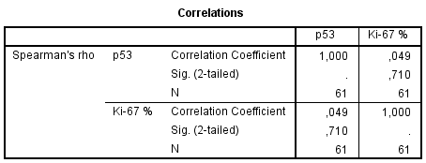
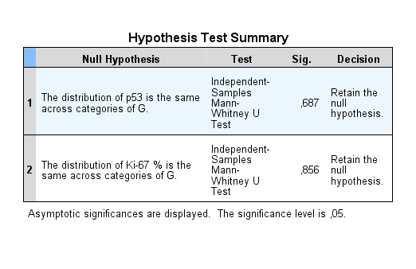
Notes:
We did compare results using Spearman rank correlation test and it showed no significant correlation between p53 and Ki-67 expression (Rs=0.049; p=0.71). By Mann-Whitney test, no statistically significant associations were found between p53 or Ki-67 and tumour grade: p=0.68 and p=0.86, respectively

Slide 13
Conclusions/ Discussion
Contrasting with older publications, our study did not confirm any differences in mean p53 and Ki-67 expression by tumour grade and pT parameters.
This grade- and stage-related homogeneity suggests uniform treatment applicability.
Cell proliferation has been associated with better response to neoadjuvant chemotherapy (Lumachi et al., 2012) while p53 expression could be targeted by cancer vaccines.
Notes:
Contrasting with older publications, our study did not confirm any differences in mean p53 and Ki-67 expression according tumour grade and pT parameters. This grade- and stage-related homogeneity suggests uniform treatment applicability. In some author works Cell proliferation has been associated with better response to neoadjuvant chemotherapy, while p53 expression could be targeted by cancer vaccines.

Slide 14
Thank you!
Notes:
Thank you.

