Slide 1


Dept. of Molecular Biosciences, Wenner-Gren Institute
Chromatin remodelling and cancer, the role of factors of chromatin remodelling in carcinogenesis.
On the human immune response to Plasmodium palciparum
anki.ostlund@su.se
Anna Rolicka
Toni Gañez Zapater
Yuan Guo
Jaclyn Quin
Ioana Buijila
Ann-Kristin Östlund Farrants
Stockholm University
anki.ostlund@su.se

Slide 2
The eukaryotic genome, DNA, is organised in chromatin
Nucleosome
Histone core
Forms a barrier for transcription factors to get access to the DNA
Protects the DNA from damage

Slide 3
The dynamic chromatin structure in cells
Inactive, heterochromatin
Me
HP1
HP1
HP1
me
RNA
At least 7 different packaging stages
Ac
Ac
mRNA/rRNA
Active, euchromatin

Slide 4
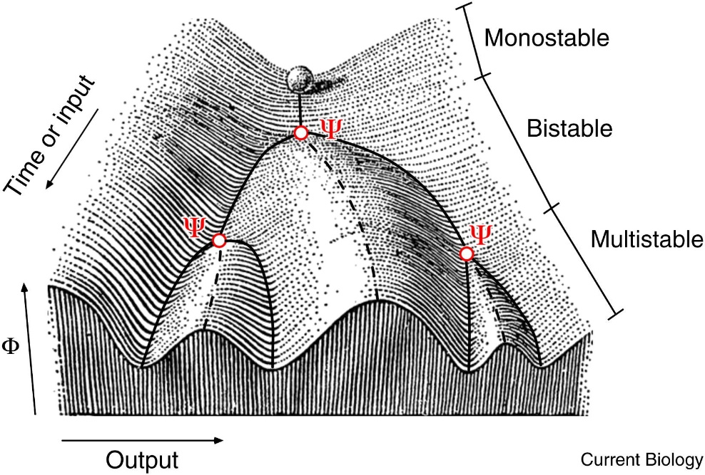
The chromatin states change in response to external cues
Waddington’s epigenetic landscape
-DNA methylation – silencing
-Histone modifications
-Nucleosome spacing
Results in changes in the expression profile,
Genes are silent and others induced
Differentiation, activation

Slide 5
The change requires enzymes
Inactive
Me
me
RNA
-ATP-dependent chromatin remodelling complexes
-DNA methylases/demethylases
-Enzymes Modifying the histones (Acetylation-methylation)
-RNA polymerases???
Ac
Ac
mRNA/rRNA
Active

Slide 6
Allows for factors to bind
Inactive
Me
me
RNA
Enzymes:
-DNA methylases/demethylases
-ATP-dependent chromatin remodelling complexes
-Enzymes Modifying the histones
-RNA polymerases???
TF
Ac
Ac
mRNA/rRNA
Active

Slide 7
Altered gene expression pattern
Inactive
Me
me
RNA
How is the change regulated:
-Pioneering transcription factors
-RNA
-Chromatin features
Enzymes:
DNA methylases/demethylases
ATP-dependent chromatin remodelling complexes
Enzymes Modifying the histones
RNA polymerases???
TF, RNA, chromatin
TF
Ac
Ac
mRNA/rRNA
Active

Slide 8
Carcinogentic transformation; nuclear reprogramming
to a more pluripotent stem cell like state
Drivers are;
Mutations (often gain of function) or overexpression of proto-oncogenes: key transcription factors c-Myc,
signal transduction effectors c-Ras, DNA repair poteins BRCA)
Loss of function of tumour supressors: RB, PTEN, p53
Viruses: papiloma, EBV
Common Characteristics:
Proliferative/self renewal
Changed gene expression profile
Resisting cell death and senescence
The genome is instable

Slide 9
The chromatin structure is changed during malignant transformation:
changed DNA-methylation pattern,
histone modifications pattern
Nucleosome arrangements changed
Altered gene expression pattern

Slide 10
The chromatin structure is changed during malignant transformation:
changed DNA-methylation pattern,
histone modifications pattern
Nucleosome arrangements changed
Chromatin remodelling and modifying enzymes are dysregulated
later in the malignant progression

Slide 11
Genomic instability
Change the gene expression pattern
The chromatin and chromatin remodelling enzymes are keepers of the integrity of DNA and proper gene expression.
Chromatin remodelling and modifying enzymes are dysregulated
later in the malignant progression

Slide 12
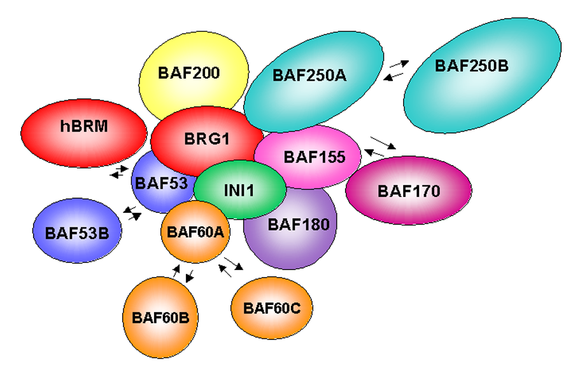
SWI/SNF complexes
Large complexes associated with transcription – recruited to specific genes by transcription factors
Mutated in 20% of cancers
Tumour supressor
C-Myc
me

Slide 13
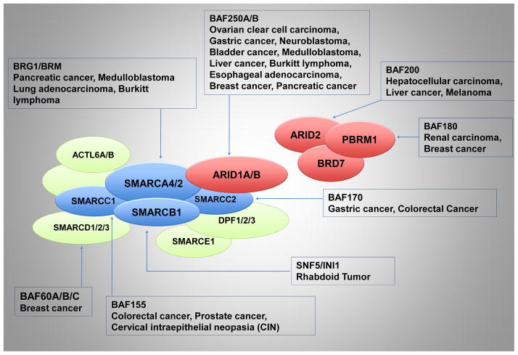
Required by a number of key pioneering factors, important during development
+
Counteracts repressing chromatin states by Pc (polycomb) and the histone demethylase Ezh2
Hohmann, 2014
Target in cancer therapy

Slide 14
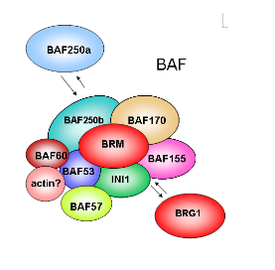
Cancer cell lines have shorter mRNA
Cancer cells express other splice variants
Can SWI/SNF affect splicing outcome, and is this contributing to cancer
exon
intron
exon
me
me
me
me
me
me

Slide 15
Genomic stability -Chromatin protects DNA and allows for repair
DNA damage occurs naturally in the cell:
Replication – stalled replication forks, DNA structure (AT-rich, Common fragile sites or in transcription units
Recombination events, repetetive sequences
Transcription – R-loops, stalled RNA pol
DNA damage – internal/external, open chromatin more sensitive

Slide 16
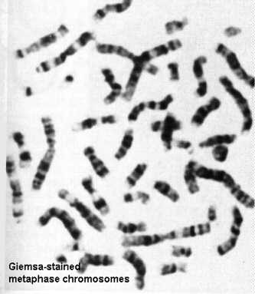
A changed chromatin landscape can result in genomic instability
Open chromatin is more sensitive to DNA-damage
Instability is manifested by:
DNA breaks – DNA damage
More mutations appear
Polyploidy, aneuploidy
Copy-number changes of chromosome segments

Slide 17
Chromatin remodelling complexes are necessary in DNA repair
INO80 clears DNA from
nucleosomes at the break
Before the break loads H2AX into active chromatin
DNA repair mashinery
INO80

Slide 18
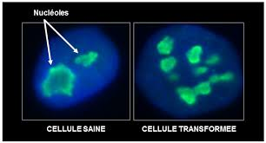
The nucleoli are affected in cancer, more nucleoli and usually differnt morphology
Used as a diagnostic tool

Slide 19
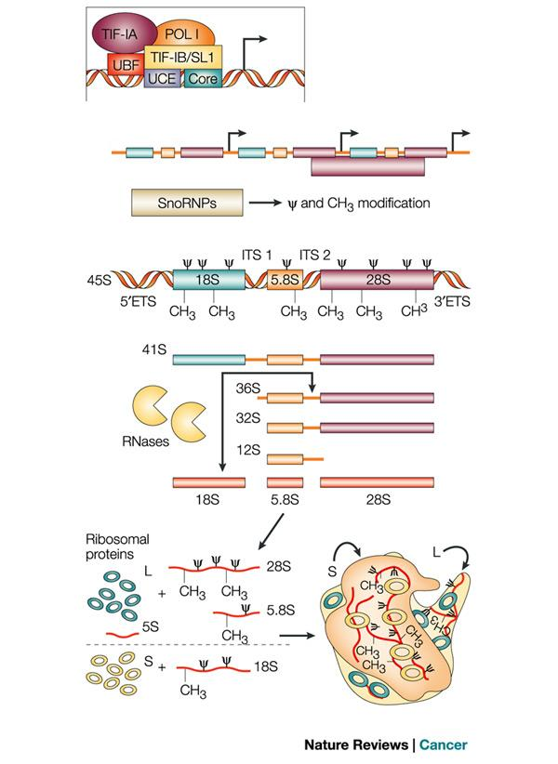
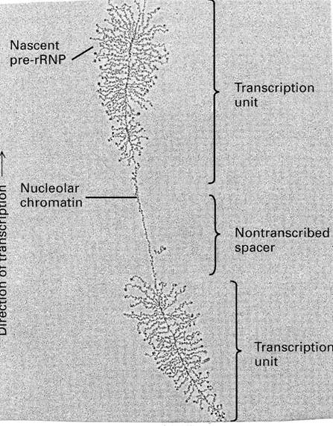
The nucleolus is the centre for ribosomal transcription and assembly
Ruggero and Pandolfi, 2003

Slide 20
Ribosomal transcription and the nucleolus
400 gene copies on 10 chromosomes
More than half in heterochromatin in differentiated cells
Ruggero and Pandolfi, 2003

Slide 21
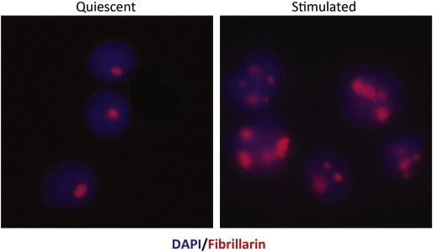
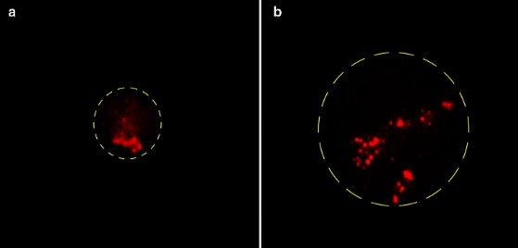
The size and the number also change during proliferative stimulation – reflects the increased needs for protein synthesis
The number of nucleoli and their size increase upon proliferative stimuli
The number of nuclei and increases and their conformation changes during differentiation
Unstimulated stimulated
Lymphocytes
Biochimica et Biophysica Acta (BBA) - Molecular Basis of Disease, Volume 1842, Issue 6, 2014, 802–816

Slide 22
The transcription is under the control of proliferative signals, nutrients, c-Myc, p53 and RB
AKT
MAPK
A
POL I
PI3K
RRN3
mTOR
TTF1
UBF
C-Myc
SL1

Slide 23
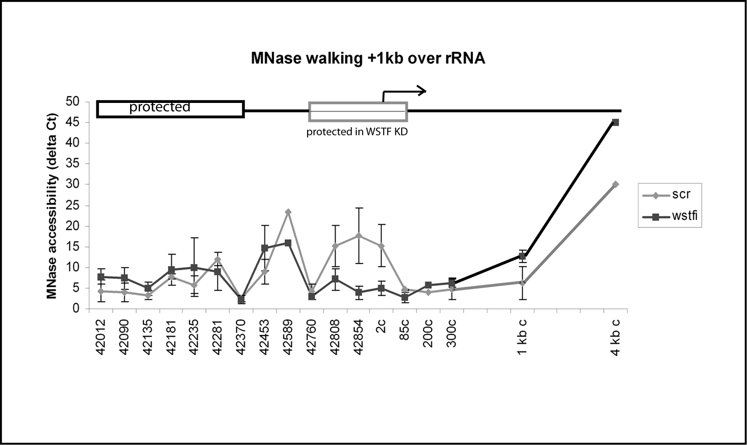
And also by chromatin and chromatin remodelling complexes – B-WICH
200 bp over the transcription start site is remodelled in the presence of WSTF- MNase walking
Pol I

Slide 24
Ribosomal transcription is often dysregulated in tumour cells
To meet the need of ribosomes
Not gain of function of RNA pol I machinery, rather the regulatory proteins – c-Myc, Rb, p-53
Chromatin?
Nucleolus and ribosomal transcription is a stress centre
DNA damage, hypoxia
Ribosomal pertubation induces cell cycle arrest G1/S
p53 dependet apoptosis

Slide 25
Not all cancer cells have larger nucleoli or have a higher rate of
ribosomal transcription
p53 or Rb minus cells – more sensitive to ribosomal disruptions
The chromatin structure is changed at the locus, more genes are in an open configuration without being transcribed

Slide 26
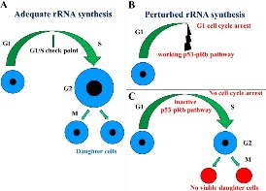
P53 or Rb minus cells – more sensitive to ribosomal disruptions
One idea is that the level of ribosome will get too low
- Leads to cell death
One idea is that more instable locus, more recombination and DNA damage
Ribosomal transcription is now targeted in cancer treatments

