Slide 1

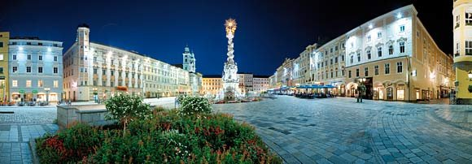
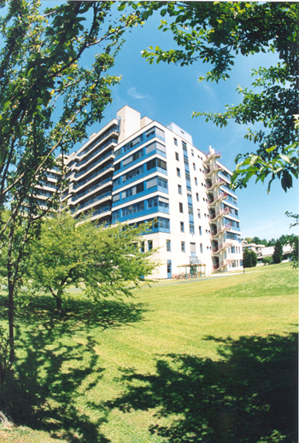
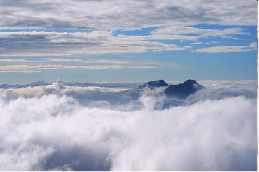

Activation of transcription factors by carcinogenic Orai mutants
Rainer Schindl
Johannes Kepler University Linz
Austria

Slide 2
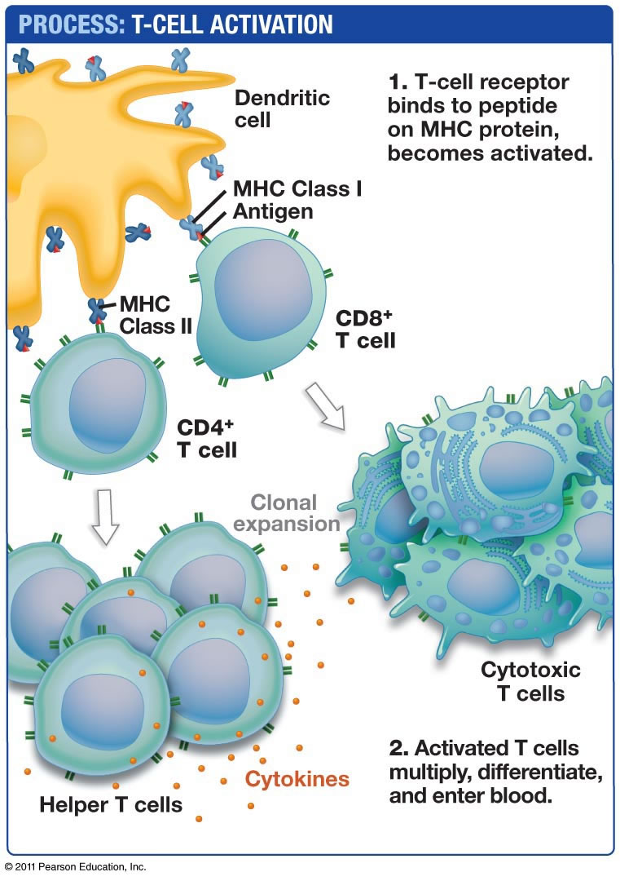
Ca²⁺ through Orai1 channels activates immune cells
Ca²⁺
Ca²⁺

Slide 3
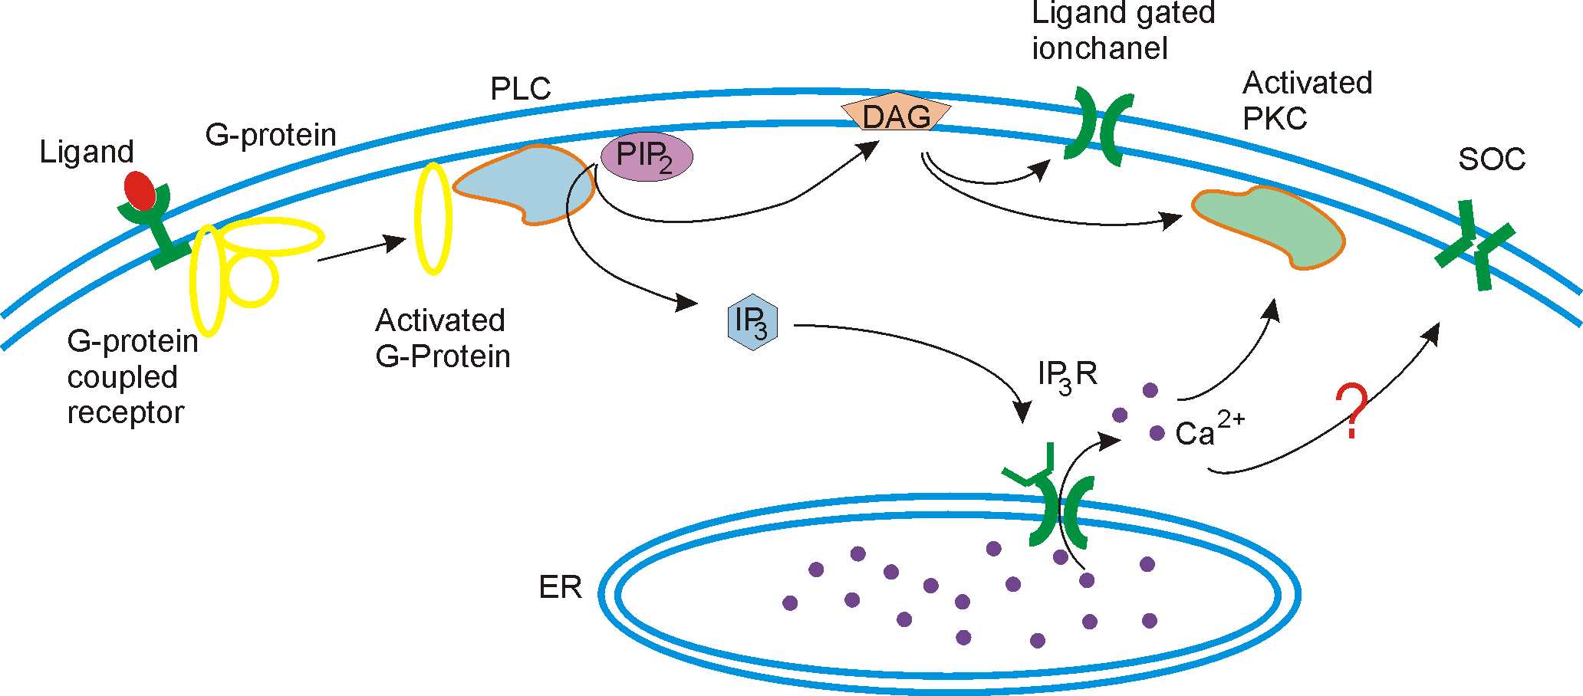
Store-operated Ca²⁺ channel
2 mM Ca²⁺
100 nM Ca²⁺
gene regulation
Vesicle release
1 mM Ca²⁺
Ca²⁺
Proposed in 1986:
store-operated channel is dependent on the [Ca²⁺] in the endoplasmic reticulum
store depletion triggers channel activation
triggers T-cell activation and mast cell degranulation

Slide 4
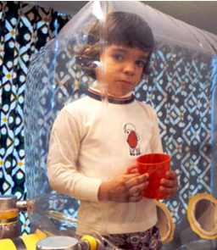
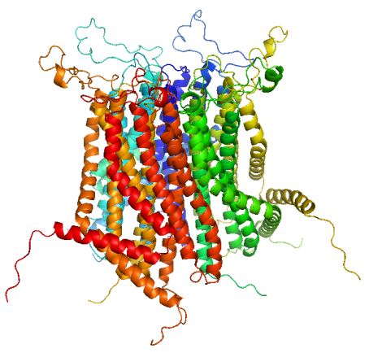

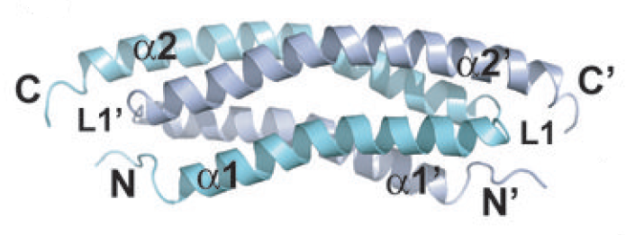
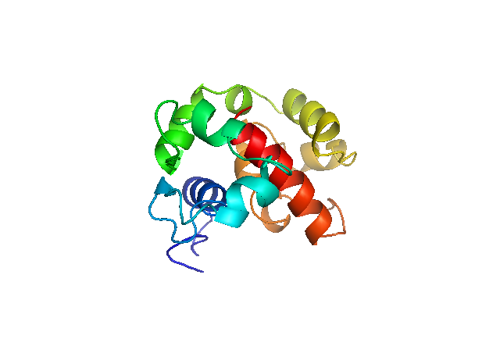
Discovery of STIM1 and Orai proteins
Orai1
Patient with Severe Combined immuno-deficiency in Orai1:
caused by a single point mutation in Orai1
STIM1
Feske, et al. (2006) Nature
Roos, et al. (2005) J Cell Biol
Liou et al. (2005) Curr Biol

Slide 5
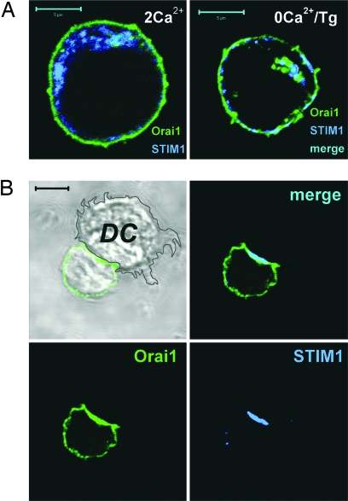
Localisation of STIM1 and Orai proteins
Orai1
plasma membrane
STIM1
endoplasmic reticulum
Lioudyno, et al. (2008) PNAS

Slide 6
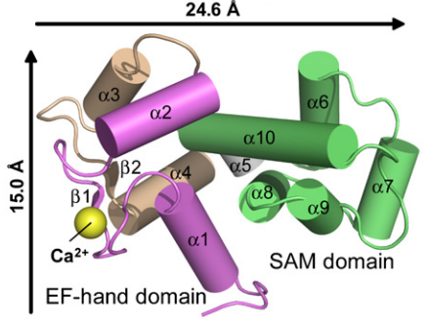
STIM1
STIM1
endoplasmic reticulum
Ca²⁺ store
Stathopoulos et al. (2008) Cell; Zheng, Stathopulos, Schindl et al. (2011) PNAS

Slide 7
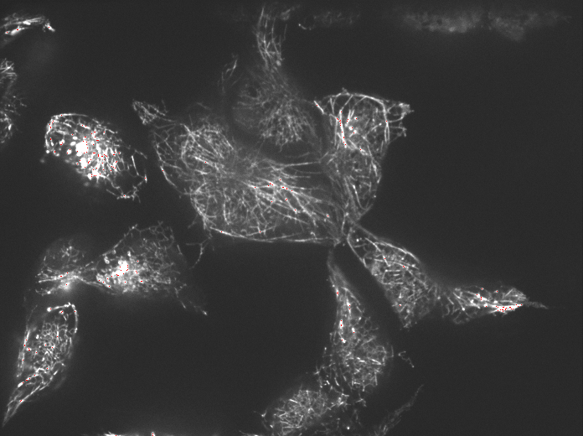

Slide 8
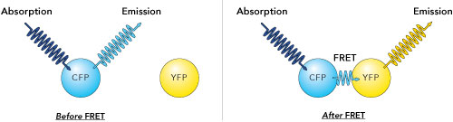


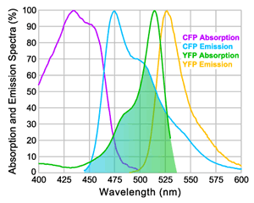
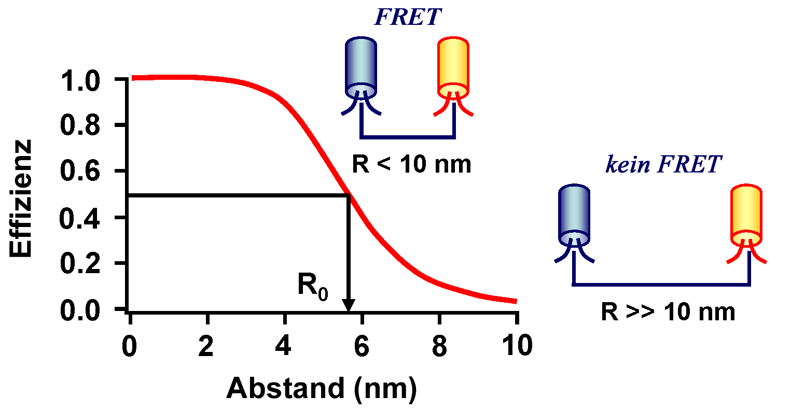
FRET technique detects close distance between proteins
Close distance of CFP and YFP results in a energy transfer to YFP
Only within 10nm

Slide 9
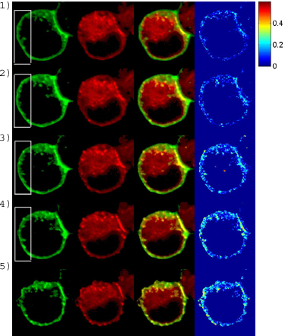
STIM1 couples to ORAI1 channel upon store-depletion
ORAI CFP
STIMYFP
Overlay
FRET
PM
STIM1
YFP
CFP
FRET
Endoplamic
Reticulum
Muik, Frischauf, Derler et al. (2008) J. Biol. Chem.

Slide 10
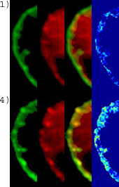
Time-dependent STIM1 coupling with ORAI1
ORAI CFP
STIMYFP
Overlay
FRET
Stim1 to Orai1 coupling is temporally as well as spatially correlated
with an increase in FRET
Muik, Frischauf, Derler et al. (2008) J. Biol. Chem.

Slide 11
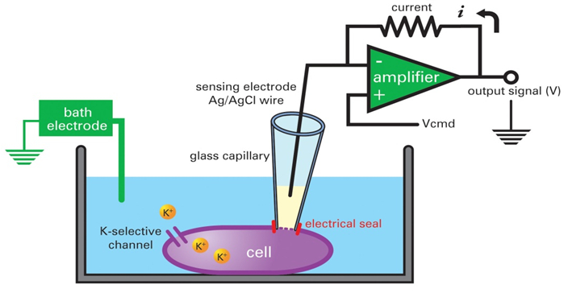

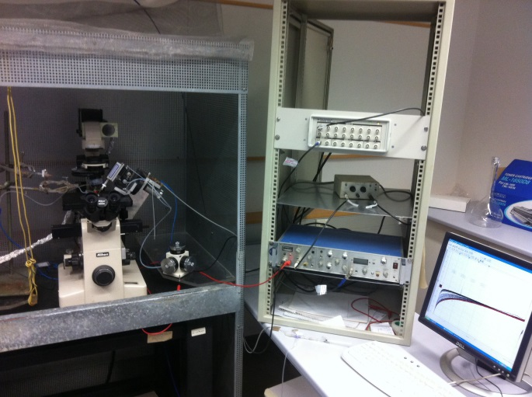
The Patch Clamp Technique
Ca²⁺
Ca²⁺
Ca²⁺
Orai channel
Ca²⁺
Ca²⁺
A tiny glass pipette is fused to a single cell to form a stable Giga-seal (~ GΩ resistance) to record single ion channels

Slide 12
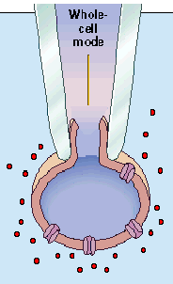
Activation of store-operated currents by overexpression of STIM1 and Orai1
10mM EGTA
10mM Ca²⁺
-95mV
-86 mV
Schindl, et al. (2008) PNAS

Slide 13
STIM1 and ORAI1 required for channel activity
Reconstitution of a store-operated current in a HEK cell
ORAI1
STIM1
calcium
current
10mM EGTA
STIM1+ORAI1
Schindl, Frischauf, Bergsmann et al. (2009) PNAS

Slide 14
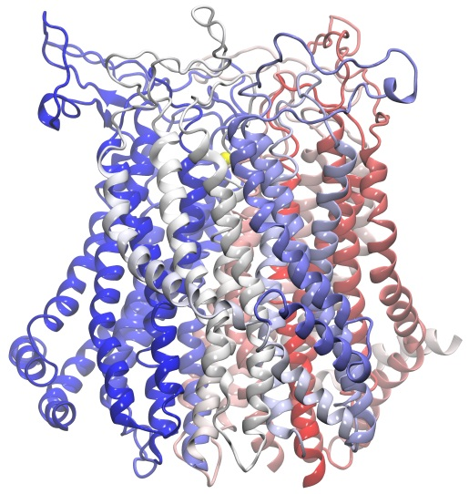
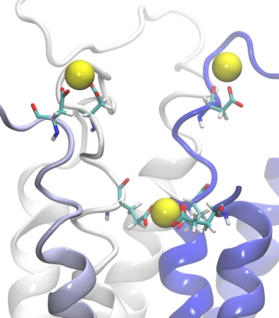
Ca²⁺ accumulation domain CAR in Orai1
a
b
Ca²⁺ accumulating region (CAR)
D110
Selectivitiy fiter
E106
Frischauf et al. (2015) Science Signal.

Slide 15
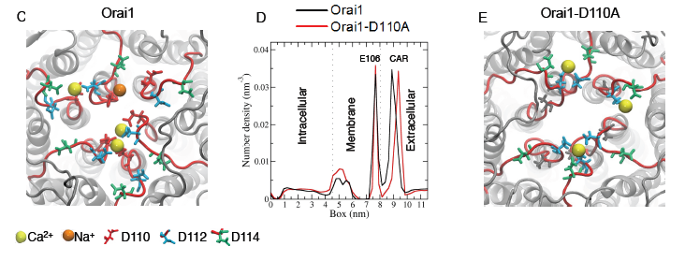
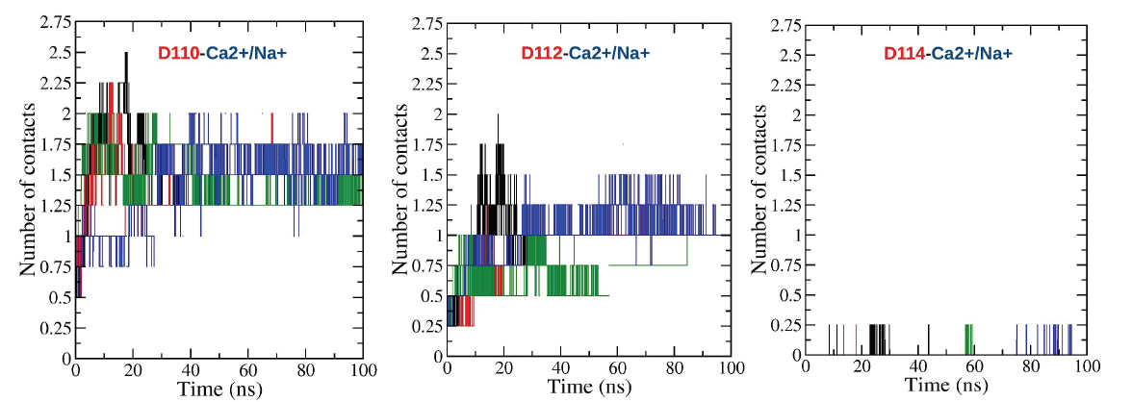
Molecular dynamics simulations predict CAR in Orai1
Frischauf et al. (2015) Science Signal.

Slide 16

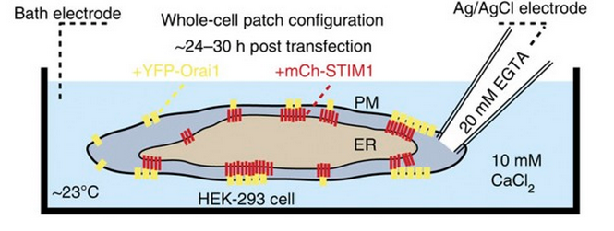
Orai1 CAR increases Ca²⁺ currents at physiological environmental Ca²⁺ levels
a
b
STIM1 + Orai1
STIM1 + Orai1-D110A
c
STIM1 + Orai1
d
STIM1 + Orai1-D110A
Frischauf et al. (2015) Science Signal.

Slide 17
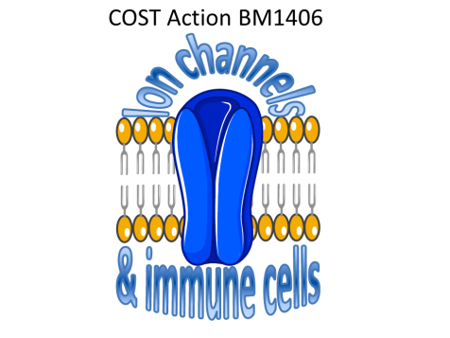

Thanks to:
Linz, Austria:
current colleagues:
Irene Frischauf, Martin Muik, Marc Fahrner, Isabella Derler, Adela Krizova, Michael Stadlbauer, Carmen Butorac, Victoria Lunz, Christoph Romanin
My team:
Monika Litviňuková, Romana Schober
Toronto, Canada:
Peter Stathopulos, Li Zeng, Mitsuiko Ikura
Nove Hrady, Czech Republic:
Vasilina Zayats, Saurabh K. Pandey, Rüdiger H. Ettrich
Homburg, Germany:
Ivan Bogeski
Supported by:

