Slide 1

HB vaccine - the first vaccine against cancer
Irina Sominskaya
Riga 2016

Slide 2
Hepatitis B is a major global health problem, that can cause chronic liver disease and it is associated to a high risk of death from cirrhosis and hepatocellular carcinoma (HCC). Hepatitis B virus (HBV) is an oncogenic virus according World Health Organization (WHO). Roughly 30% of the world’s population (more than 2 billion people) show serological evidence of current or past infection and among them 240 million are chronic HBV.
Reduction in the morbidity and mortality can be achieved as a result of HBV vaccination, intensive screening programs, and antiviral treatment.

Slide 3
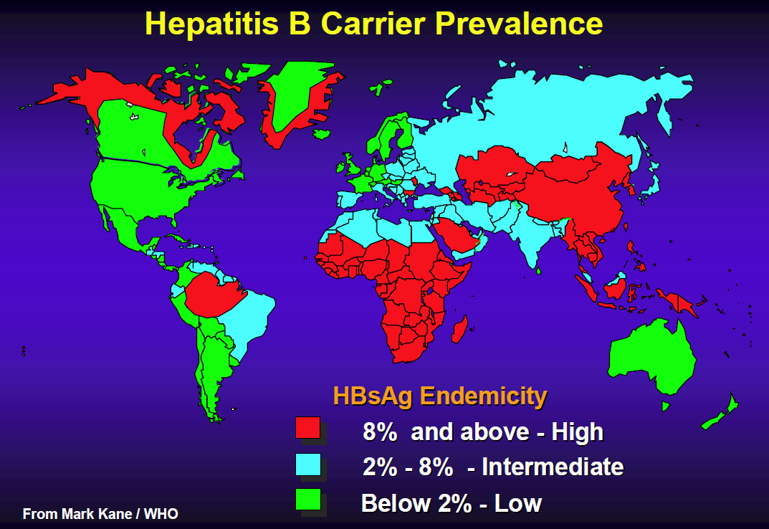

Slide 4
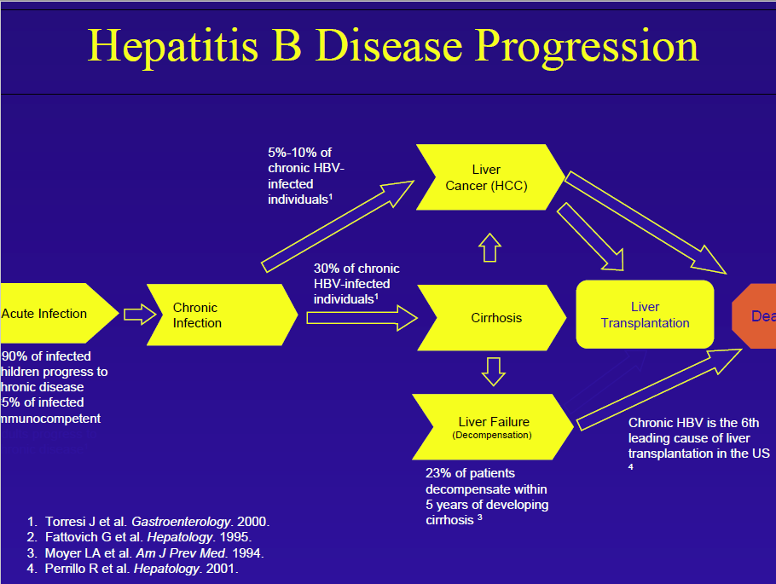

Slide 5
Immunization: a procedure designed to increase concentrations of antibodies and/or effector T-cells which are reactive against infection (or cancer).
Mechanism of Vaccination :
Establish resistance to virus/pathological organism by evoking an immune response
Give host a foreign organism/protein in non-infectious form
Antibodies are generated
Adjuvant: chemicals in the vaccine solution that enhance the immune response
Two types of HBV immunisation:
  Passive immunization
    Inject the individual with ready-made HBV-specific Immunoglobulin (HBIG)
    Provides immediate short-term protection
    Involves large injection volumes
    Can be given at birth to reduce prenatal transmission
  Active immunization
  The induction of immunity after exposure to an antigen

Slide 6
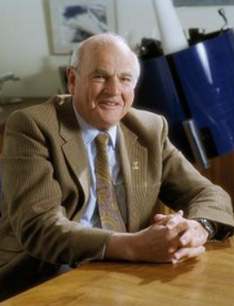
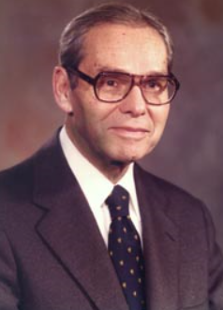
First generation vaccines
1970 Baruch Blumberg submits patent application for Australia antigen purified from plasma (later named HBsAg) as vaccine.
1970 Saul Krugman Saul Krugman was the first to report on a so-called vaccination against hepatitis B in 1971. He diluted Australia antigen positive serum from his previous human experiments 1:10, boiled it briefly to kill the virus and injected this material to mentally handicapped children as a kind of vaccine. After two injections, he injected infectious HBV containing serum as challenge to the children and found incomplete, but statistically significant protection

Slide 7
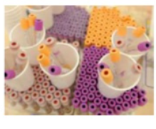
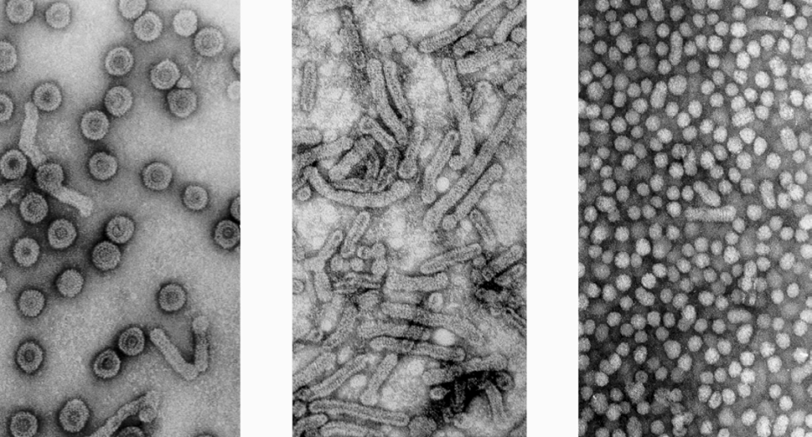
HBV particles HBsAg filaments HBsAg 20 nm particles
1975 Using chimpanzees as experimental animals, Robert Purcell and John Gerin from the NIH, and in parallel Maurice Hilleman from MSD, could prove that Blumberg’s concept of using purified 20 nm HBsAg particles from carrier plasma as HB vaccine was valid and could protect against an intravenous challenge with 3000 chimpanzee-infectious doses (MSD) immunize chimpanzees with purified HBsAg.
–Very good protection
A state of the art field study was published by Wolf Szmuness in 1980 using the plasma-derived vaccine produced at MSD. Szmuness had recognized that male homosexuals in New York had an extremely high incidence of HBV infections and performed a large placebo-controlled study with 1083 (truly voluntary) participants. The protection rate of the vaccine was 92%. After this study, the recommendation to vaccinate all kinds of high risk groups, including medical staff, was adopted in many countries.
Thereafter WHO recommends worldwide vaccination of risk groups.
–Safety concerns because of AIDS

Slide 8
Second generation vaccines
With the cloning of the HBV genome and the identification of the HBs gene in 1979 a new era of vaccine production was opened.
HBsAg could not be expressed in E. coli in spite of initial claims. Expression of glycosylated and secreted HBsAg particles in mammalian host cells was possible but the yield was relatively low and mammalian cell culture is relatively expensive. Thus, in the early 1980s Pablo Valenzuela for MSD and Michel de Wilde for Smith Kline RIT (today GSK) generated yeast cell strains which expressed the major HBs protein in very large amounts (800 mg/liter yeast culture) at low cost. The product was not completely identical to the natural HBsAg, because it did not assemble spontaneously to the 20 nm particles, was not secreted and not glycosylated. But protection experiments in chimpanzees published in 1984 by MSD were very encouraging Thus, in 1986 yeast-derived HBsAg became the standard vaccine against HBV. Rapid immunization schemes for urgent cases (e.g. 3 injections within 3 weeks) are possible but three or four injections within 6 or 12 months are optimal for induction of dependable long lasting immunity. With the advent of an inexpensive, but highly protective and well tolerated hepatitis B vaccine, WHO recommended in 1992 to implement universal childhood vaccination worldwide and meanwhile ca. 180 countries have adopted this measure

Slide 9
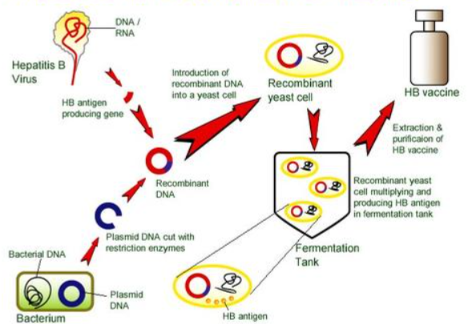
Production of recombinant vaccine

Slide 10
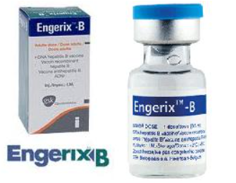
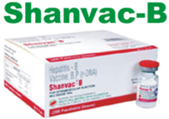
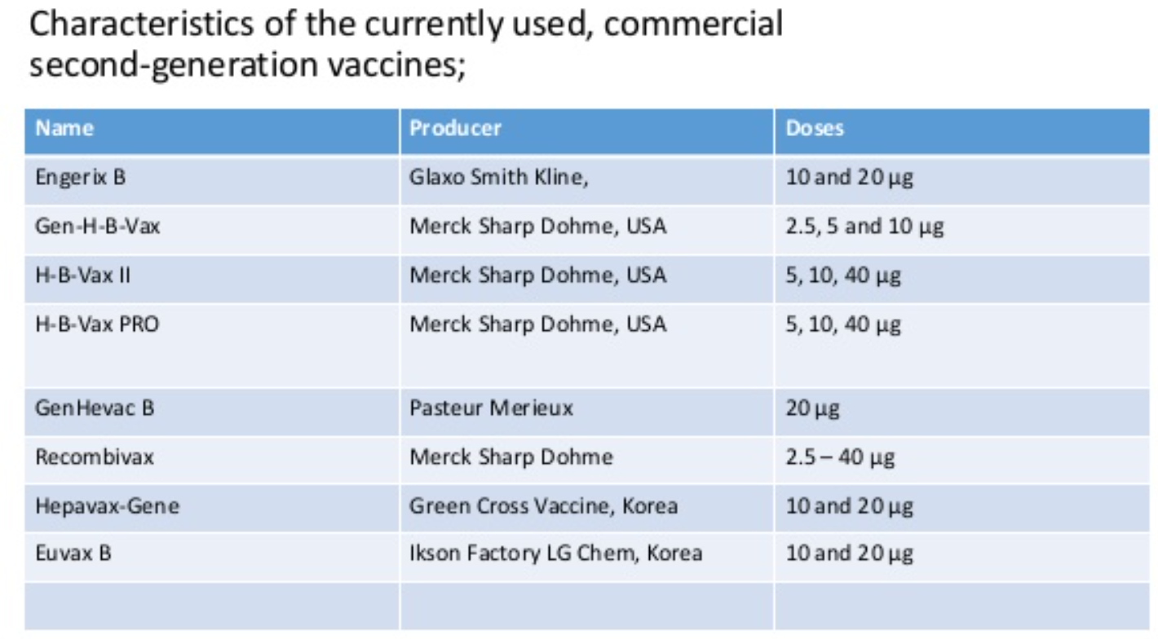
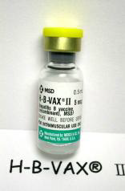

Slide 11
The success of HBV vaccination has been clearly demonstrated. The Global Alliance for Vaccines and Immunisation recognizes that the effect of HBV vaccination in reducing the incidence of liver cancer result in an impact on public health worldwide. Countries that have adopted the recommendation had a marked reduction in carrier rates as well as complications from HBV including HCC. This has been most evident in regions with a high prevalence of chronic HBV infection. At present, global HBV vaccine coverage is estimated at 75% and has reached 91% in the Western Pacific and 89% in the American, the largest decline in incidence was seen in children.
Nature of the currently predominating hepatitis B vaccines:
• Small hepatitis B surface protein SHBs
– No preS-containing surface proteins
• HBsAg subtype adw2
WHO standard only genotype A
– Worldwide genotypes B,C und D predominant
– Genotype F not detected for years with some tests
• Expressed in transformed yeast cells
– Incomplete folding, no secretion
– Neutralising conformational epitopes in vitro only partially generated
• Moderately immunogenic (3 doses of 20 μg)

Slide 12
Around 10% of the general population shows poor responses. Antibody response rates decline gradually after age 40 years, with age being a factor determining response to HB vaccine. The mechanism of nonresponse is not fully understood, but several hypotheses have been proposed. Because the existence of non-responders to HB vaccine is a serious social problem, several attempts have been made to improve the efficacy of vaccine. Persons unresponsive to a first series of three injections (i.e., anti-HBs < 10 mIU/mL) are recommended to complete a second 3-dose vaccine series, with about 50% of these individuals showing an anti-HBs response. Non-responders to the second course should be evaluated for underlying chronic HBV infection. Response in patients on hemodialysis may be improved using double-dose vaccine. However, some individuals are non-responsive to multiple series of vaccinations, suggesting the need for other strategies to induce anti-HBs production in these subjects.
Strategy to overcome nonresponsiveness:
Add preS-epitopes to HBsAg vaccine
Change vaccine carrier
More immunogenic adjuvants

Slide 13
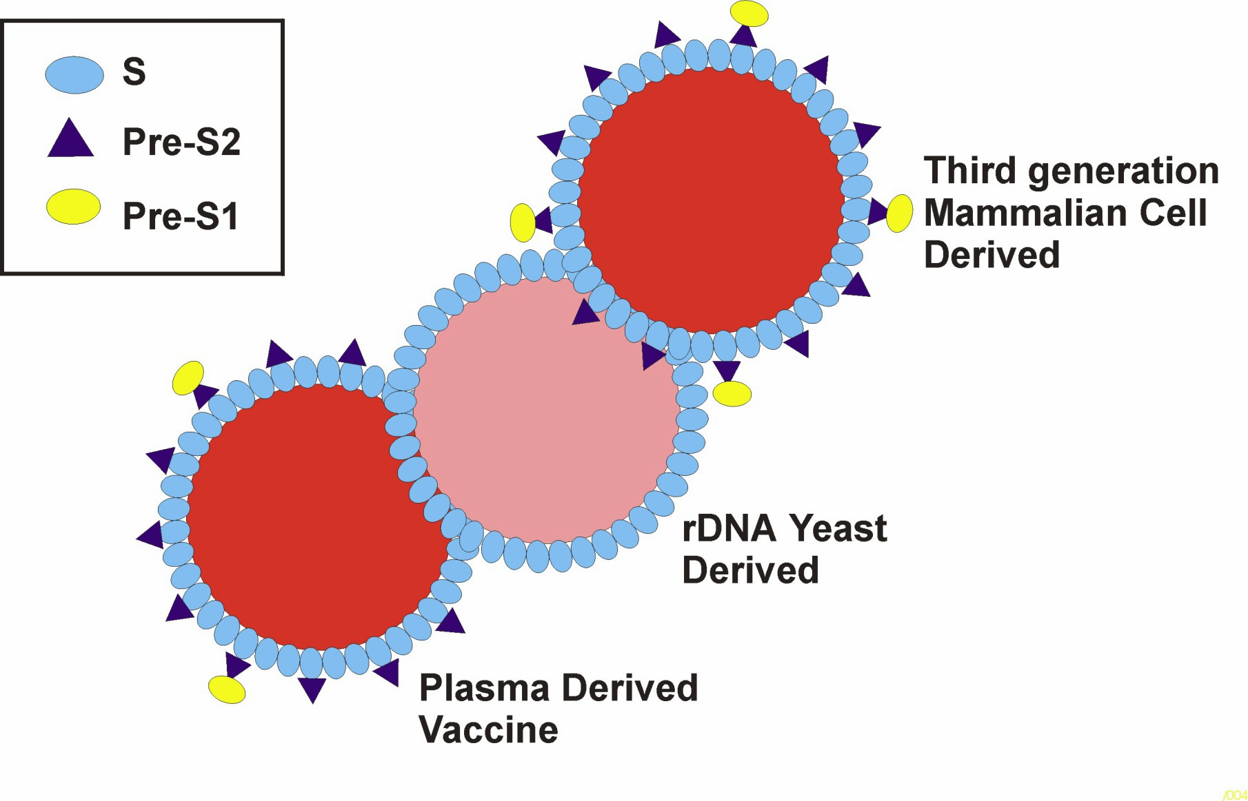

Slide 14
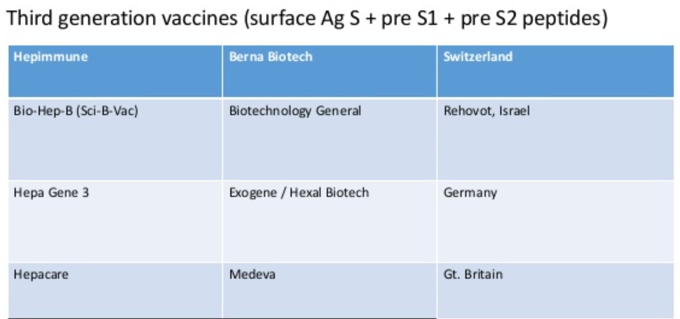
New HB vaccines have been developed to improve anti-HBs response in non-responders. Hepa geneTM, a third generation vaccine containing pre-S1 and pre-S2 proteins in addition to S protein, has been shown to induce anti-HBs in 76% of previously non-responsive individuals. Another third generation HB vaccine, Sci-B-Vac™, was recently shown to induce anti-HBs in 20 of 21 non- or low-responders, with 12 non-responders and all 6 low responders showing a high anti-HBs response (> 100 mIU/mL). Moreover, the preventive effect of Sci-B-Vac™ has been assessed in newborns.

Slide 15
Third generation vaccines
The new Pre-S/S HBV vaccines as well as some novel new adjuvants have been shown to enhance the immunogenicity of such vaccines in immunocompromised hosts and non-responders to conventional vaccines.
Other adjuvants
Interleukin (IL)-2 was not effective as an adjuvant. In contrast, levamisole used as an adjuvant in HB vaccination has shown promising results. New chemical adjuvants [AS02(v) and AS04] have also been found to increase response to HB vaccine. A European consensus statement also recommended booster vaccination if antibody concentration declines to below 10 mIU/mL, depending on the risk of exposure to HBV.

Slide 16
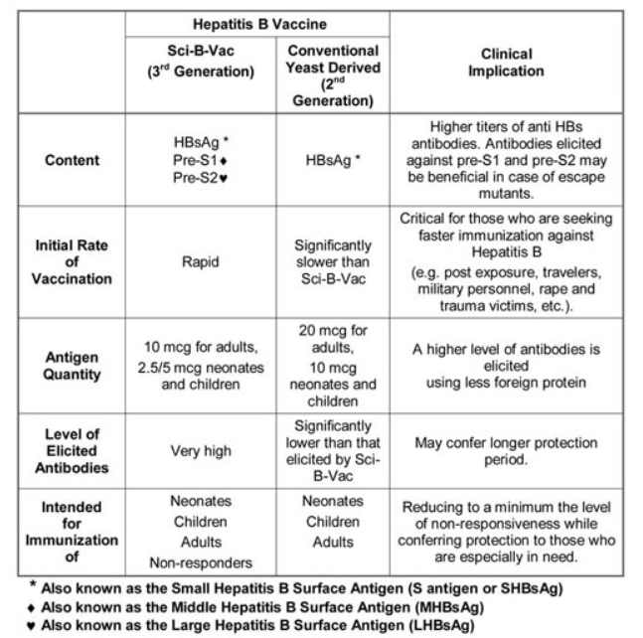
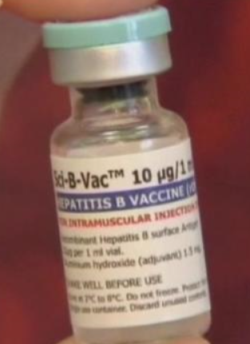

Slide 17
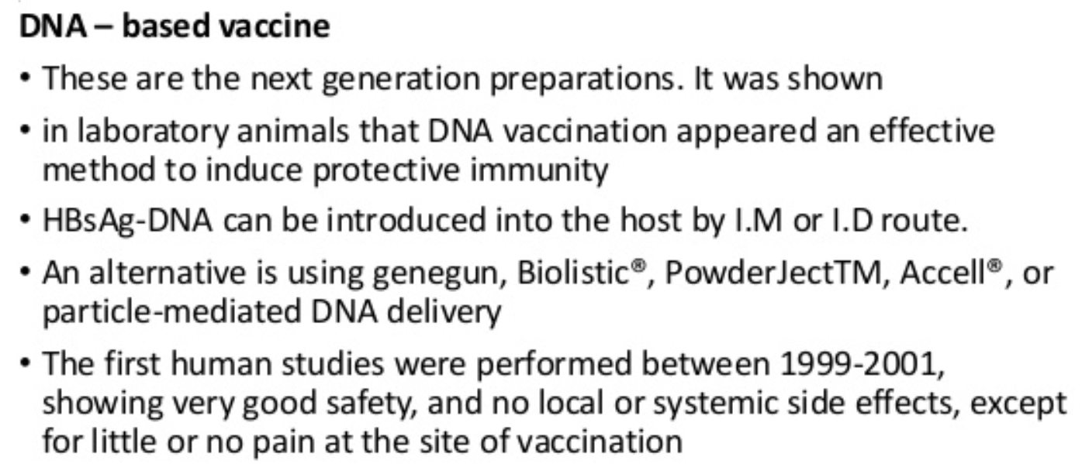
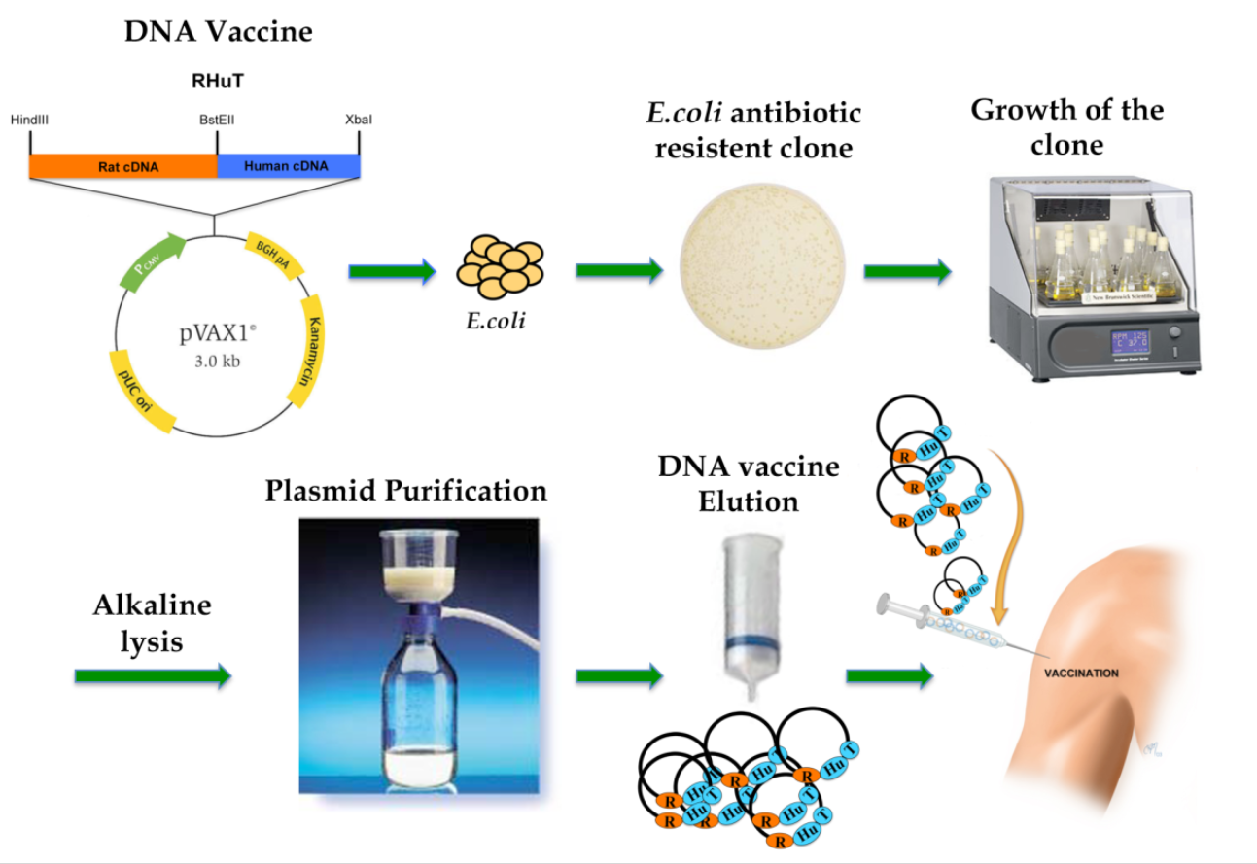
Future vaccines

Slide 18
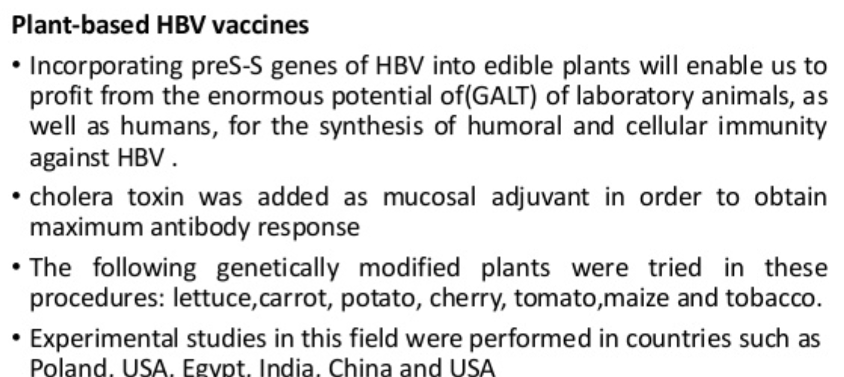
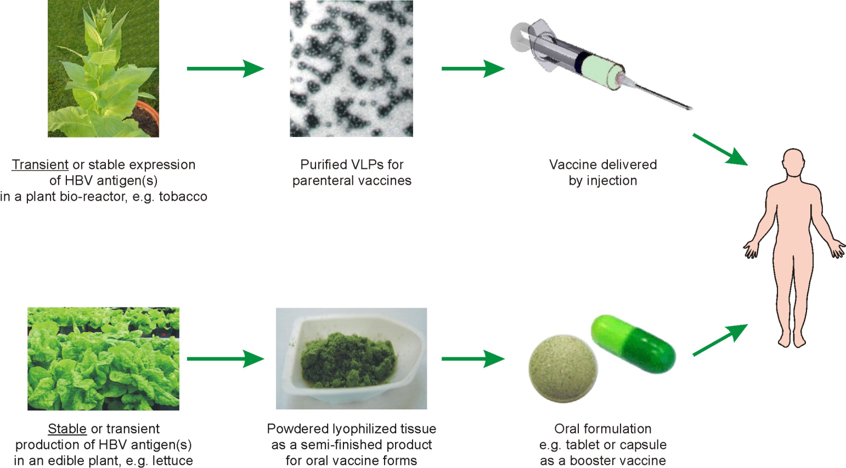
Future vaccines

Slide 19
Future vaccines
    There is also a great need around the world for a therapeutic vaccine which could be used instead of the current HBV treatments using interferon.
    The aim of giving therapeutic vaccines to HBV-infected patients is to increase the efficiency of the natural immune response – in particular the T-helper or cytotoxic T lymphocyte response.
HBcAg-based vaccines
Hepacore (HBcAg + preS1), Medeva,
Mark Page et al.

