Slide 1
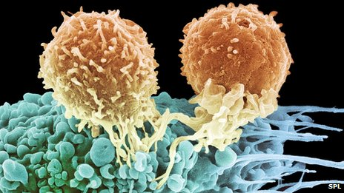
Telomerase as target for cancer immunotherapy
Jon Amund Kyte MD PhD
Dept of Oncology, Oslo University Hospital Radiumhospitalet
Riga May 25th 2014

Slide 2
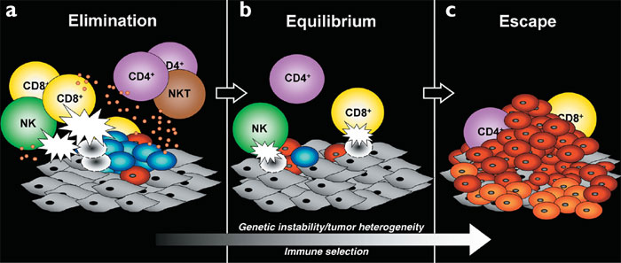
The tumor has escaped the immune system
From Dunn et al, Nature Immunology 2002
Our internal evolution:
  The tumor is educated by the immune system
  The tumor educates the immune system

Slide 3

Immunity versus tolerance
Immunity
Tolerance

Slide 4
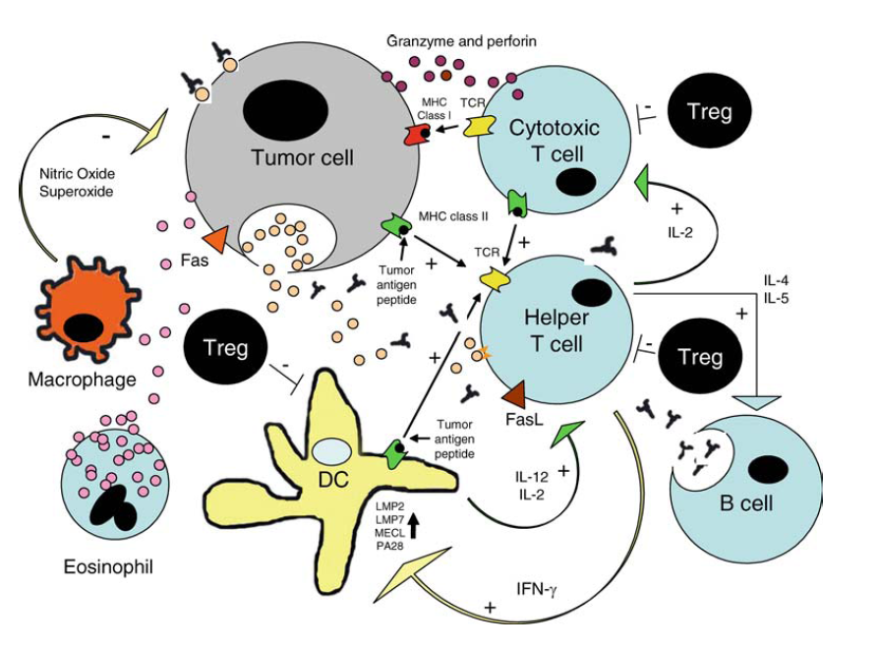
  T-helper cells may transform the tumor micro-environment
Adapted from Knutson et al, CII 2005

Slide 5
Cancer vaccination with telomerase peptide GV1001
Clinical trials in melanoma, NSCLC and pancreatic cancer

Slide 6
Tumor cells circumvent mitotic clock by expressing telomerase
Telomers
Chromosome
Mitosis
Telomerase
Somatic cells
Stem cells & tumor cells

Slide 7
GV1001 cancer vaccine:
Long peptide derived from hTERT
T helper epitopes
EARPALLTSRLRFIPK
EARPALLTS
ARPALLTSR
RPALLTSRL
PALLTSRLR
ALLTSRLRF
LLTSRLRFI
LTSRLRFIP
TSRLRFIPK
CTL epitopes
Strategy: Long peptides => combined CD4&CD8 T cell response

Slide 8
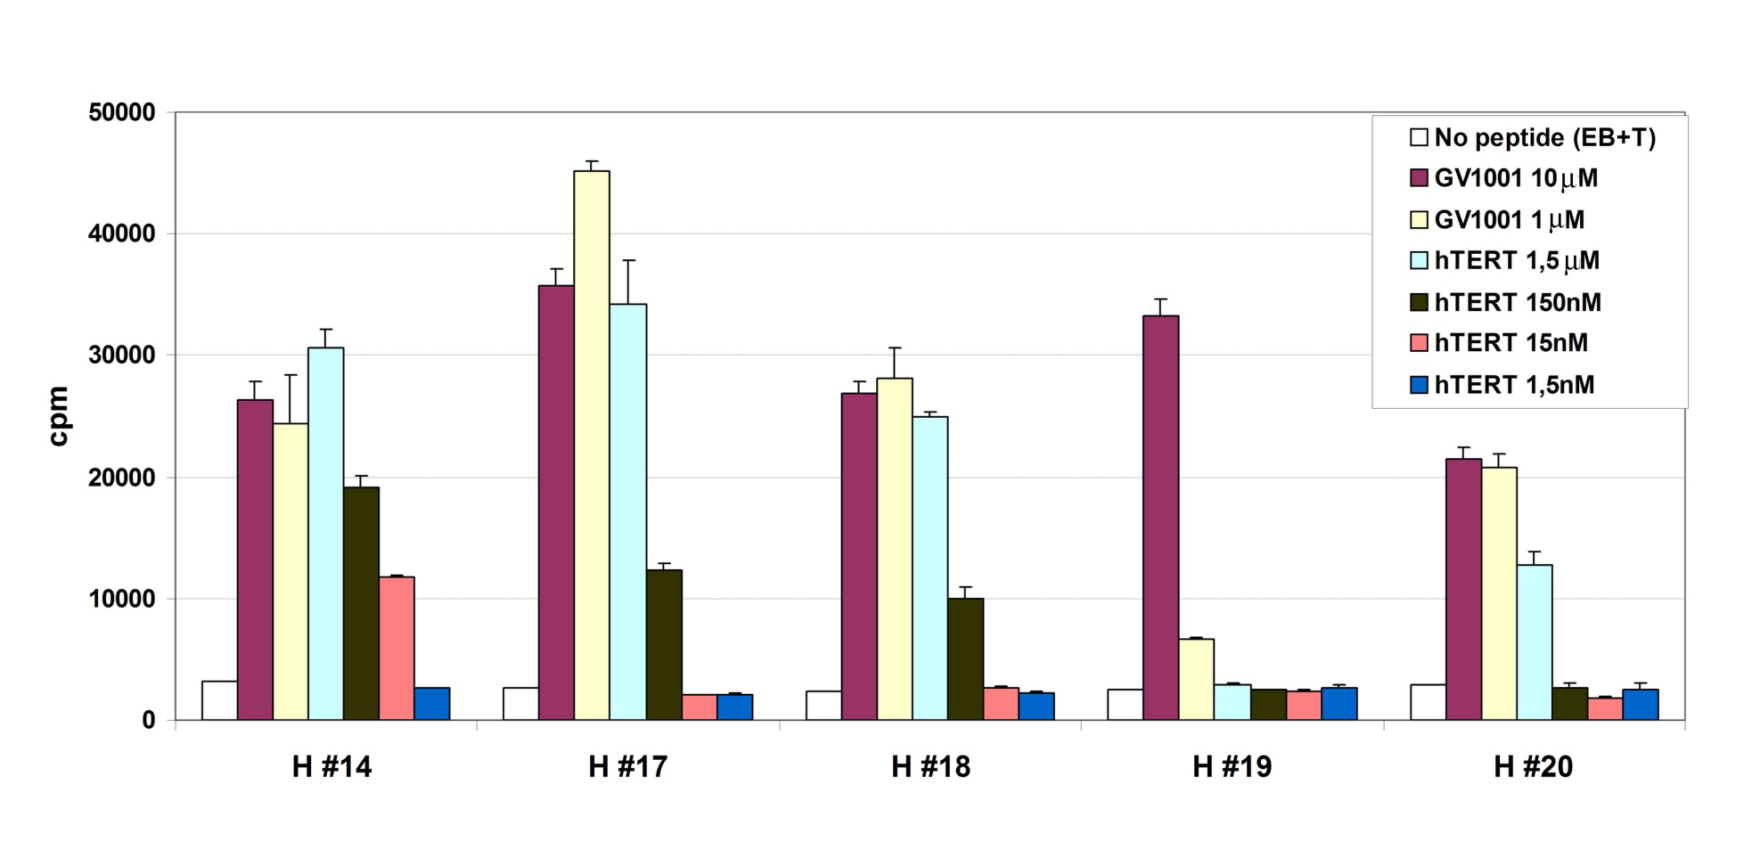
Response to hTERT protein
Proliferation of T cell clones
GV1001-specific T cell clones recognize naturally processed epitopes from hTERT protein
Kyte et al, Canc Immunol Immunother 2009

Slide 9
GV1001 NSCLC phase I/II trial
CTN-2000
Study design
  26 patients with locally advanced or metastatic NSCLC
  Two peptides: GV1001 and I540
Results
  No serious toxicity
  13/24 evaluable subjects developed GV1001-specific immune response
Brunsvig et al, Canc Immunol Immunother 2006

Slide 10
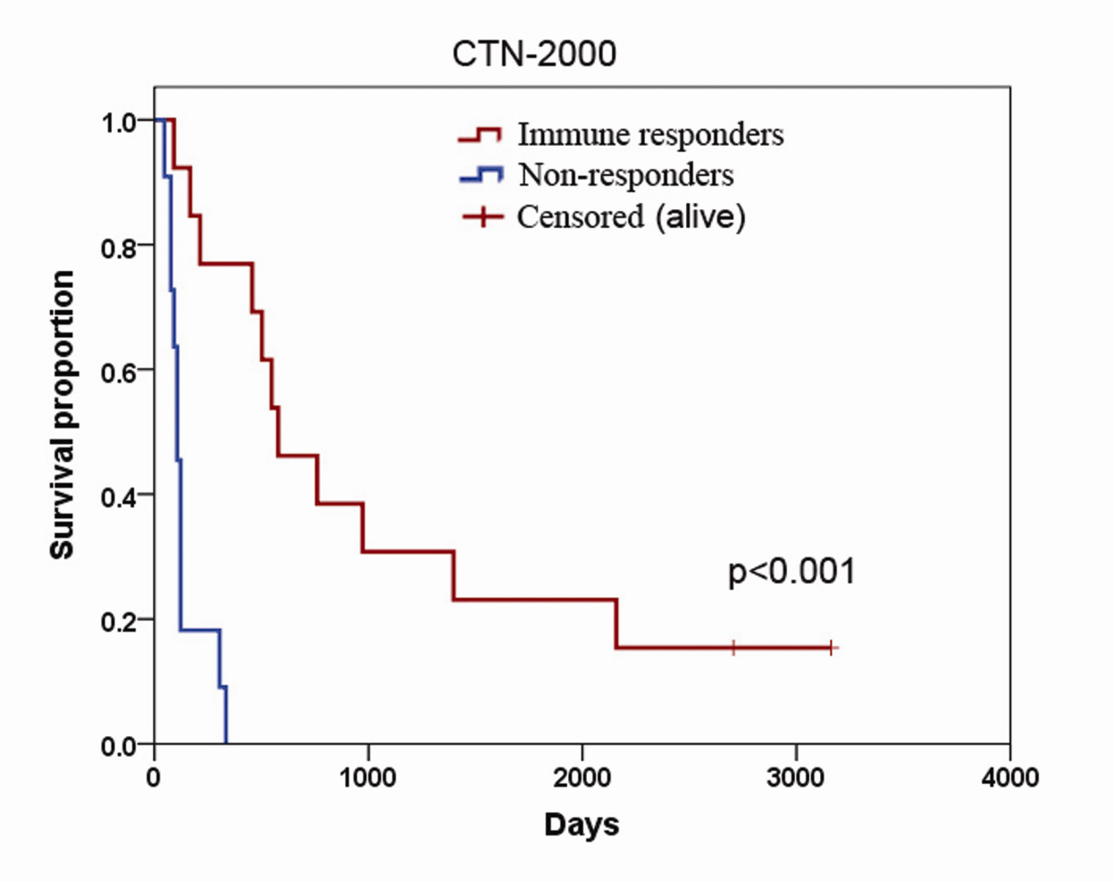
NSCLC CTN-2000
Increased survival in immune responders
Median survival 19 months versus 3.5 months (p<0.001)
Brunsvig & Kyte et al, Clinical Cancer Research 2011

Slide 11
GV1001 NSCLC phase II trial
Study design
  23 inoperable stage III patients
  Radiotherapy (2 Gy x 30) and weekly docetaxel (20mg/m2), followed by GV1001 vaccination
Results
  No serious toxicity
  Immune response in 16/23 patients (16/20 PP)
  Prolonged PFS for immune responders
Brunsvig & Kyte et al, Clinical Cancer Research 2011

Slide 12
GV1001 melanoma trial
Study design: Combine chemo & vaccine
  Temozolomide + GV1001
  Stage IV melanoma
  25 patients
    Advanced disease: 16 M1C , 9 M1B
Kyte et al, Clinical Cancer Research 2011

Slide 13
Temozolomide+GV1001 in stage IV melanoma
Immune response in 18/23 patients
  Higher immune response rate than in any GV1001 monotherapy trial

Slide 14
Tumor regression in 5/25 patients
Kyte et al, Clin Canc Res 2011

Slide 15
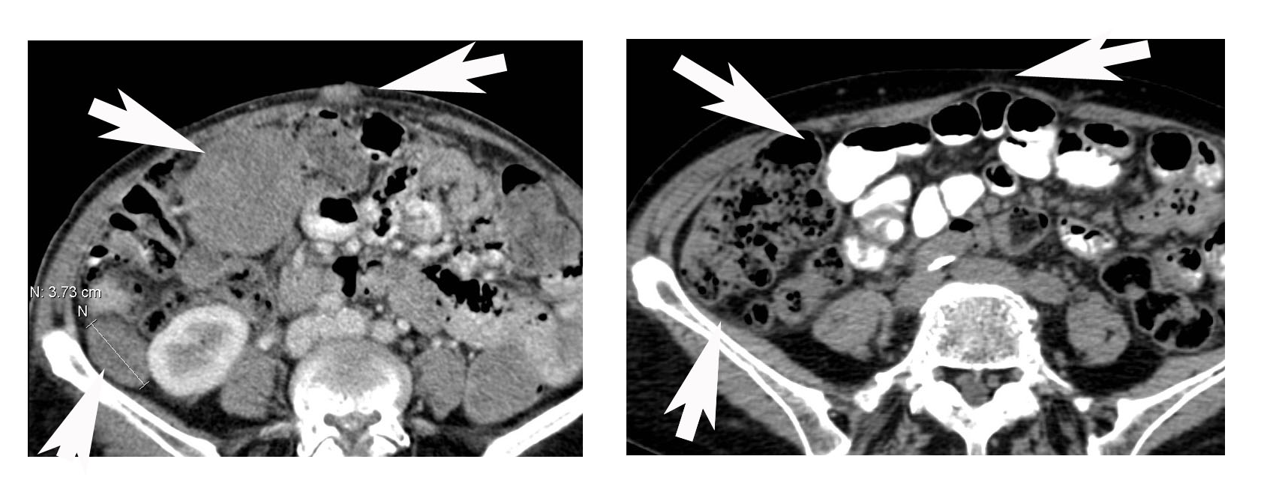
GV1001 + temozolomide
Response in advanced melanoma patient
Study entry Month 37
Kyte et al, Clin Canc Res 2011

Slide 16
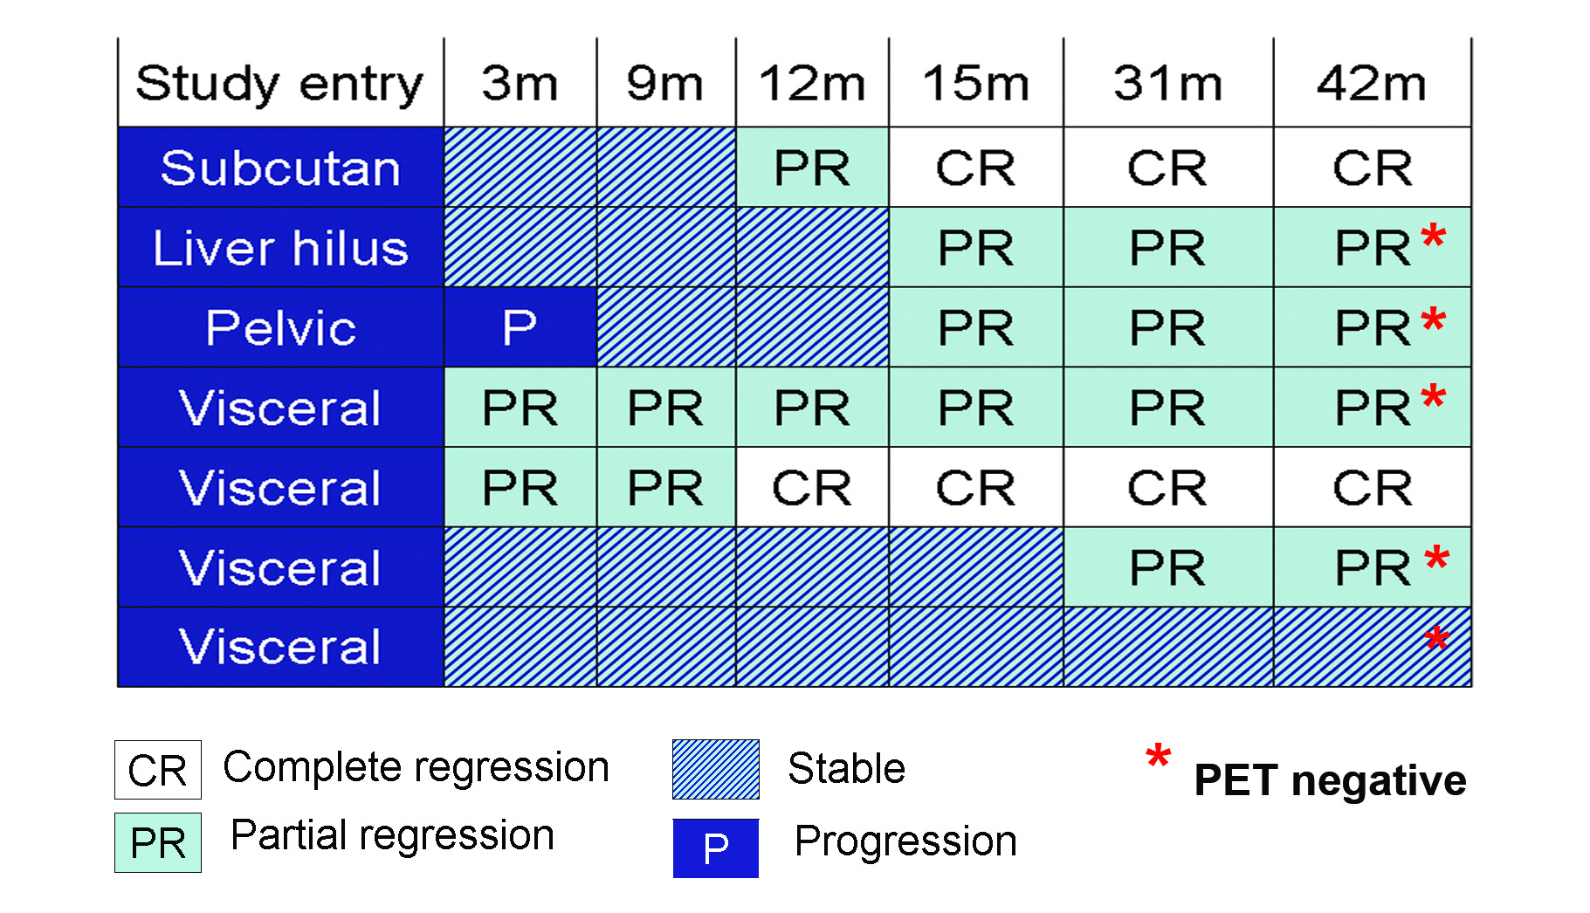
GV1001 melanoma trial (Patient 19)
Response develops over long time frame
Regression includes visceral metastases
Last scan: PET negative

Slide 17
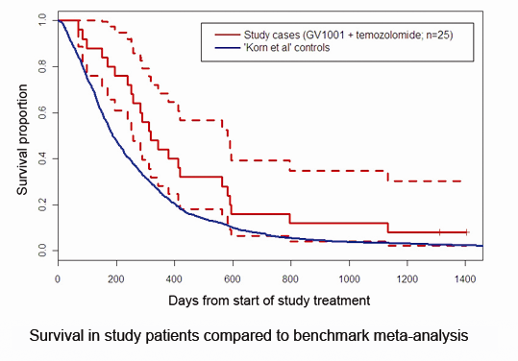
Improved survival?
GV1001 / Melanoma
Kyte et al, Clinical Cancer Research 2011

Slide 18
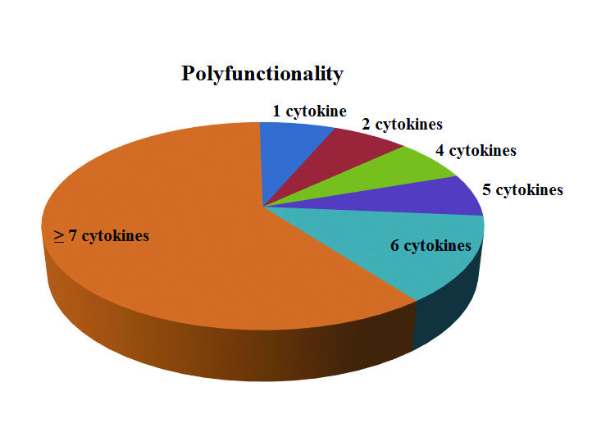
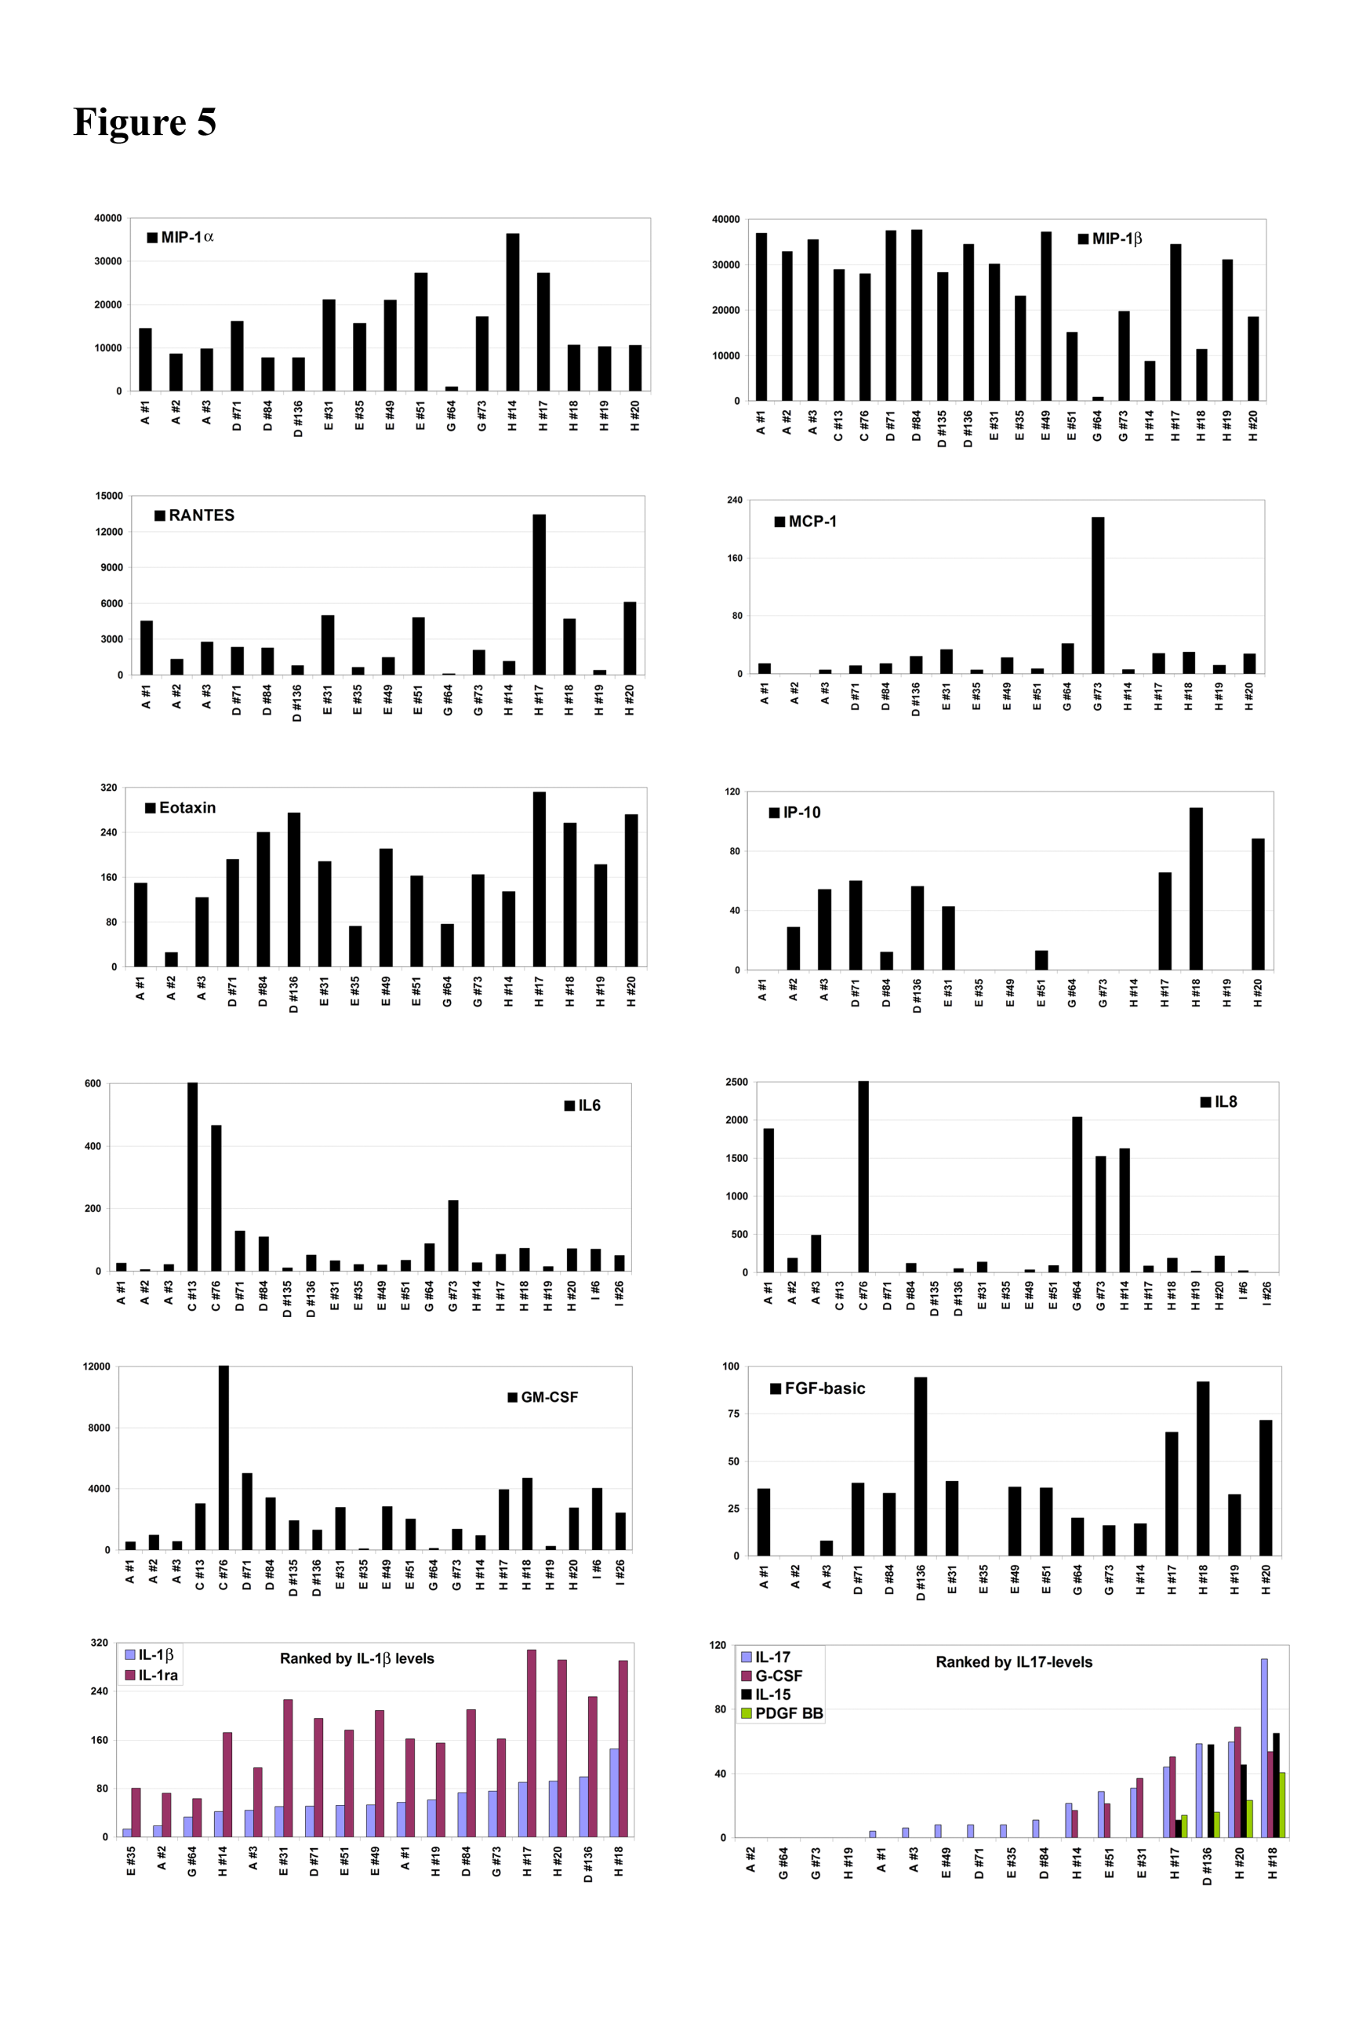
Polyfunctional cytokine profiles
Eotaxin MIP-1β MIP-1α
  Most T cell clones secreted a wide range of cytokines, incl. MIP1α, MIP1β, Rantes, IL1β, IL6, IL8, INFγ, TNFα
  Favourable in HIV and other infections
  Important for provoking inflammation and overcoming tumor tolerance?

Slide 19
The immune response in long term survivors
Cancer vaccine trials: Far more immunological than clinical responders
Immune responses, though tumor specific, are not necessarily beneficial
  Clinically effective
  Pointless
  Harmful

Slide 20
GV1001: Advanced lung cancer
Complete tumor response
Start of vaccination Month 17→
Start: Inoperable, refractory to radio- & chemotherapy
12 years: No sign of relapse & sustained T cell memory
Brunsvig & Kyte et al, Clin Canc Res 2011

Slide 21
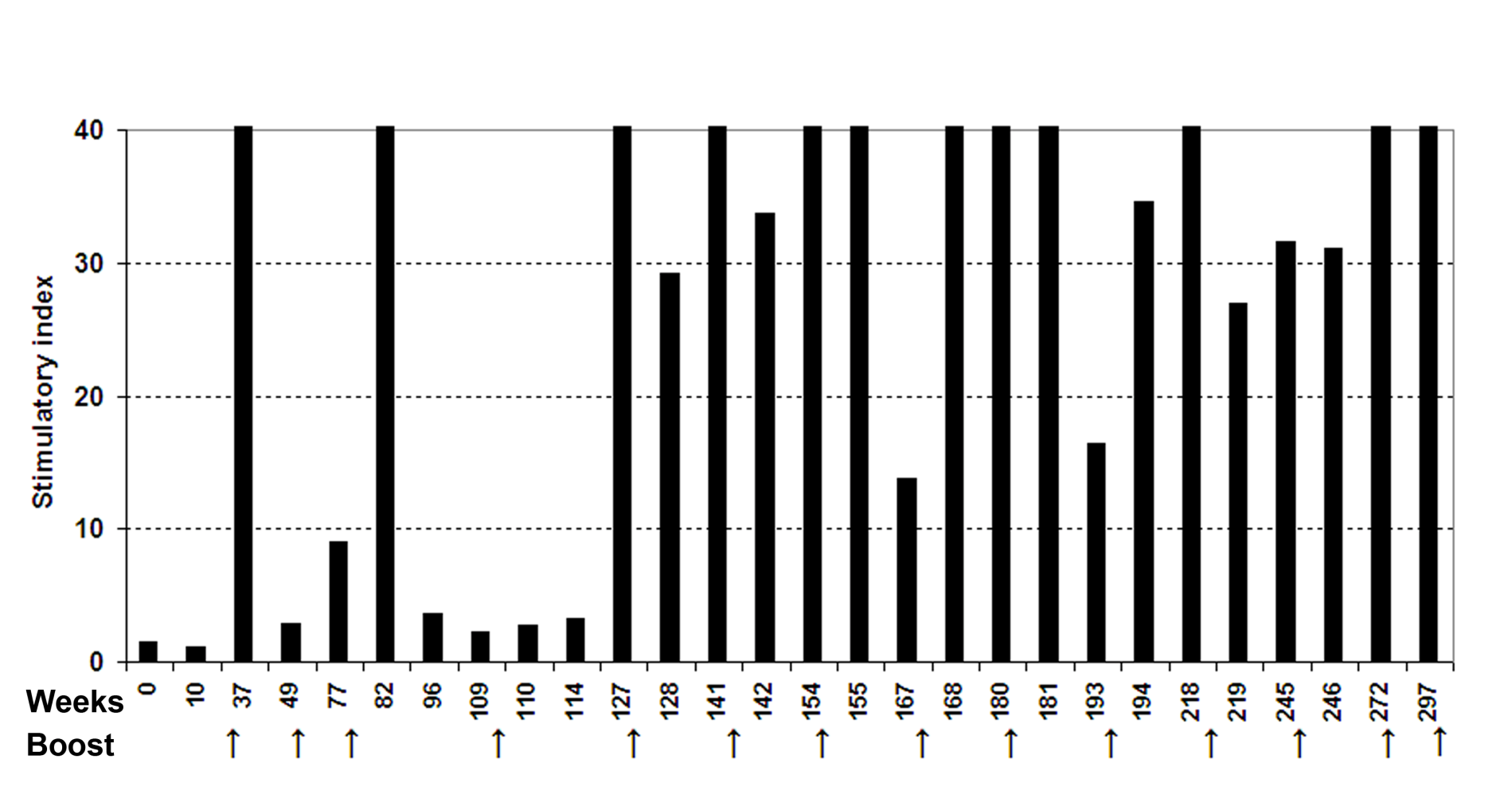
All clinical responders displayed long term immune responses
Melanoma trial: All long term immune responders survived longer than those loosing their response
Durable T cell response in clinical responders
GV1001-specific T cell proliferation
Kyte et al, Clin Canc Res 2011
Brunsvig & Kyte et al, Clin Canc Res 2011

Slide 22
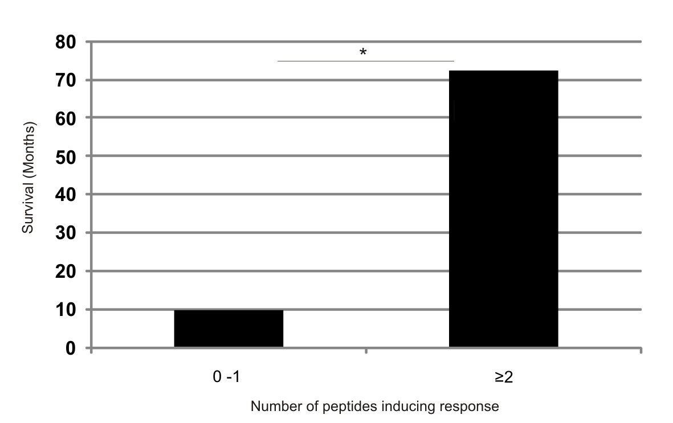
Survival correlates with recognition of additional hTERT epitopes
n=14
EPITOPE SPREADING?
Inderberg-Suso et al, 2012

Slide 23
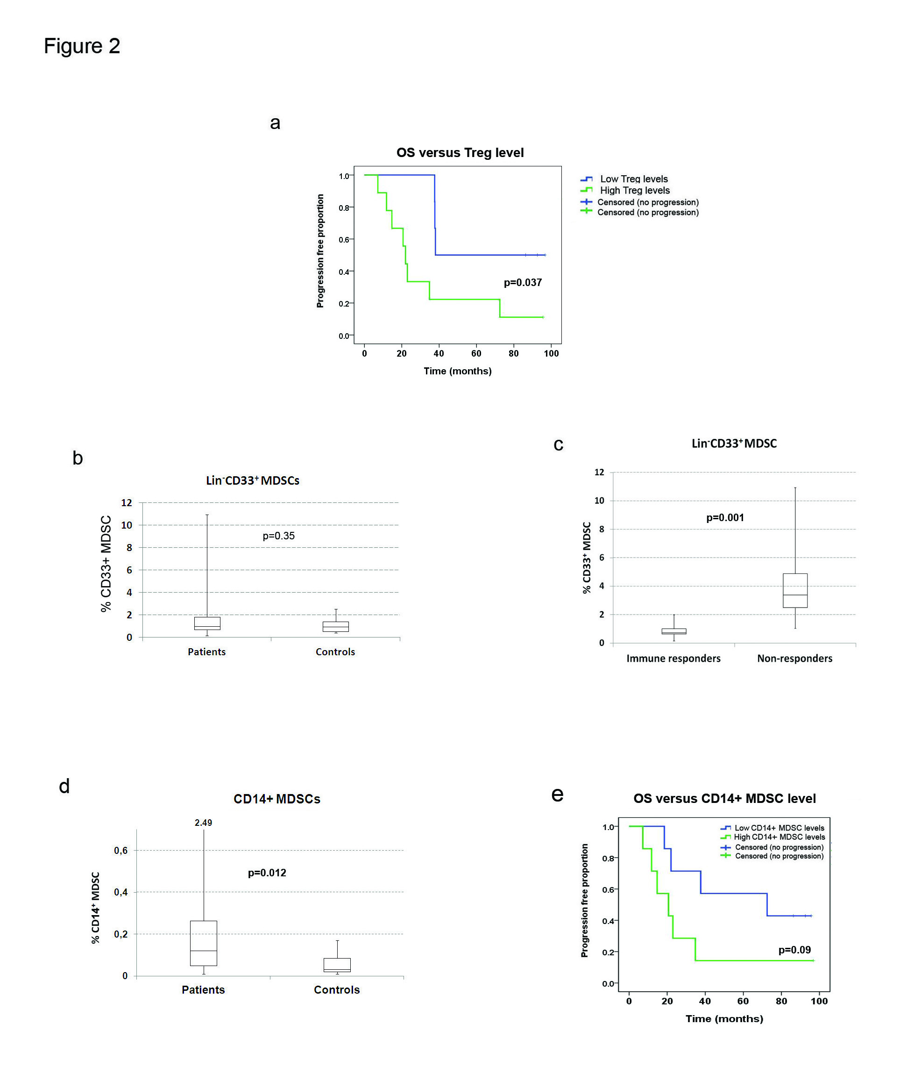
NSCLC GV1001 trial
Patients with low Treg and MDSC levels had prolonged survival
Hansen et al, Canc Immunol Immunother 2015

Slide 24
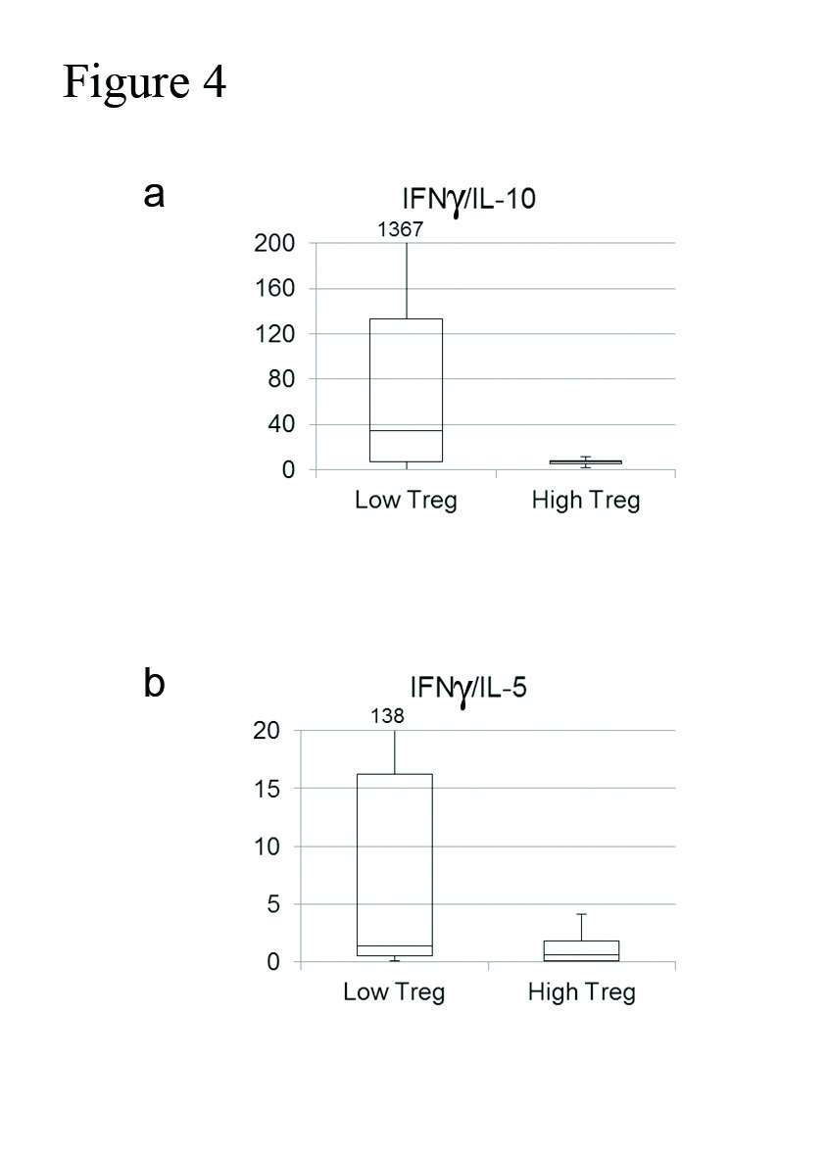
NSCLC GV1001 trial
Low Treg levels were associated with a Th1-weighted cytokine profile
Hansen et al, Canc Immunol Immunother 2015

Slide 25
Immune responders had lower MDSC levels
Hansen et al, Canc Immunol Immunother 2015

Slide 26
Main findings: GV1001 trials
No serious adverse events
GV1001-specific immune response in 50-80% of patients
  Highest response rates in trials combining GV1001 with chemo/radio-therapy
  Polyfunctional cytokine profiles
  Low Treg levels were associated with high IFNγ/IL-10 ratios
Clinical response:
  Correlation between survival and immune response
  Clinical responses develop gradually
Long term survivors: Durable T cell memory, multi-epitope responses, low Treg and MDSC levels

Slide 27



Acknowledgements
Section for Immunology
Gustav Gaudernack
Gaute L Hansen
External
Milada Cvancarova, University of Oslo
Per thor Straten, Herlev Hospital, Denmark
Clinical Trial Unit
Steinar Aamdal
Paal Brunsvig
Svein Dueland
Section for Cell Therapy
Gunnar Kvalheim
Kari Lislerud
Else Marit I Suso

