Slide 1
One step closer to a vaccine
against colorectal cancer
Britta Wahren
Karolinska Institutet 2016

Slide 2
Environmental influence
Inborn genetic, ie hereditary adenomatosis develops into tumors.
Acquired: change in somatic genes due to
radiation, toxic compounds in air (smoking) or food

Slide 3
Issues
  Foreign antigens (protective)
  HPV, HBV, EBV, Helicobacter
Endogenous antigens (therapeutic)
  Unique to tumor or overexpressed
  Breaking tolerance

Slide 4
To kill a cancer cell
1. Immune cells after vaccination
Cancer cell
Other antigens
2. Antibodies to to CEA

Slide 5
Immunization by DNA encoding CEA
CEA; Carcinoembryonic antigen in fetal gut.
Glycoprotein related to super Ig family.
Highly immunogenic in animals, less in humans.
Overexpressed in colorectal cancer.
Notes:
Immunolglobulin like domains
N-terminal domain: IgV like (variable domain)
The other domains: IgC like (constant domain)
GPI = glycosyl phosphatidyl inositol moiety
Highly glycosylated - up to 50 %
Function unknown, some possibilities

Slide 6
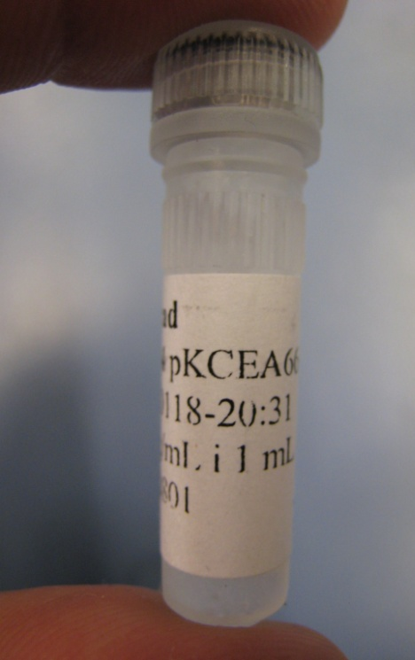
DNA vaccine CEA66
Gene for antibiotics resistence
Promoter
CEA66 gene
DNA-cirkle (~5000 bp)
N
A1
S
S
+NaCl
B1
S
S
A2
S
S
B2
S
S
A3
S
S
B3
S
S

Slide 7
Induction of innate, humoral and cell mediated immune responses
DNA vaccine
Effector mechanisms: Tumor cell killing by antibody binding, ADCC,
cytotoxicity, apoptosis.
CD8+ T-cells
Transmembrane and secreted antigens
CD4+ T-cells
B-cells
Ab
N-ter
C-ter
wtCEA
V
C
C
C
Signal peptide
Signal peptide
TetCEA
V
C
C
C
Tetanus T-helper epitope

Slide 8
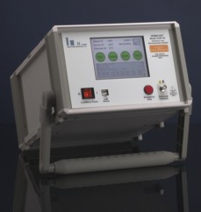
In vivo electroporation
Apply current
2x450V
Voltage
8x110V
Time
Total length of pulse-train: 0,27 seconds

Slide 9
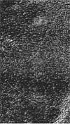
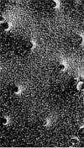
Pores formed in cell membrane
Images from Inovio
Before e.p.
Instantly after e.p.
After e.p.
Plasmids
Electrode
Electrode
Cell
+
-
Roos, CytoPulse et al

Slide 10
Results: CEA expression in transfected cells
wtCEA
ΔCEA
TetCEA

Slide 11
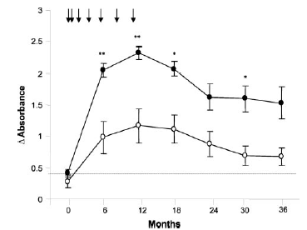
Anti-CEA IgG response in patients with(●)
and without (○) concomittant GM-CSF administration
Antibody related to better survival
Ullenhag, Frödin, Strigård et al Clin Can Res 2004

Slide 12
CMI in CEA-DNA immunized patients
Arm A
60
0,06
50
40
30
20
10
0
PT
W8
W18
W30
Staff et al Thesis Karolinska Institutet

Slide 13
Mabs against tumors
CD20: Rituxan (rituximab, IDEC/Genentech)–approved 1997
CD20: Zevalin (⁹⁰Y-ibritumomab tiuxetan, IDEC)–approved 2002
CD20: Bexxar (¹³¹I-tositumomab, Corixa/GSK)–approved 2003
CD52: CAMPATH (alemtuzumab, ILEX/Schering)–approved for CLL
CD22: Epratuzumab (Immunomedics)
CD22: ⁹⁰Y-epratuzumab (Immunomedics)
HLA-DR: Hu1D10 (apolizumab) anti-HLA-DR (PDL)
Anti-CD80 (IDEC)
Human/humanized Anti-CD20 (Abgenix, Immunomedics, GenMab)
Anti-CEA…

Slide 14

Thank you to Cancer- och Allergifonden
Collaborators
Patients

