Slide 1

Targeting the p53 tumor suppressor to fight cancer: small molecules and immunotherapy
Galina Selivanova
MTC

Slide 2
p53 is a potent tumour suppressor activated by stress
Oncogenes
DNA damage
Hypoxia
Telomere
shortening
stabilized
activated
p53
Transactivation
p21 TSP1 Bax, NOXA, PUMA
GADD45 BAL1 Fas
14-3-3s Maspin IGF-BP3
PIGs
Transrepression
Bcl-2
IGF1-R
MAP-4
PS-1
Protein-
Protein
interaction
Prevention of
metastasis and angiogenesis
Growth Arrest,
Senescence
Apoptosis

Slide 3
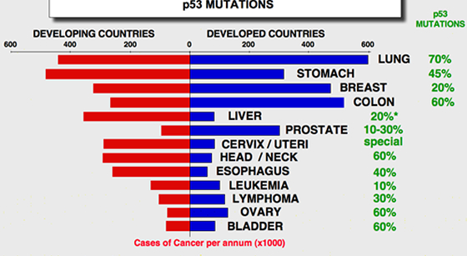
Worldwide distribution of cancers and p53 mutations
http://p53.free.fr/Database/p53_cancer/all_cancer.html

Slide 4
p53 couples the cell growth and cell death pathways p53 activated by oncogenes induces cell death
Ras
Myc
Deregulated E2F1
β-catenin
p53
Apoptosis
Inactivation of p53 by mutation, etc
allows tumor cells to escape cell death

Slide 5
Thus, reconsitution of p53 function in tumors should provide a missing link between pro-apoptotic oncogenic signaling and apoptotic machinery

Slide 6
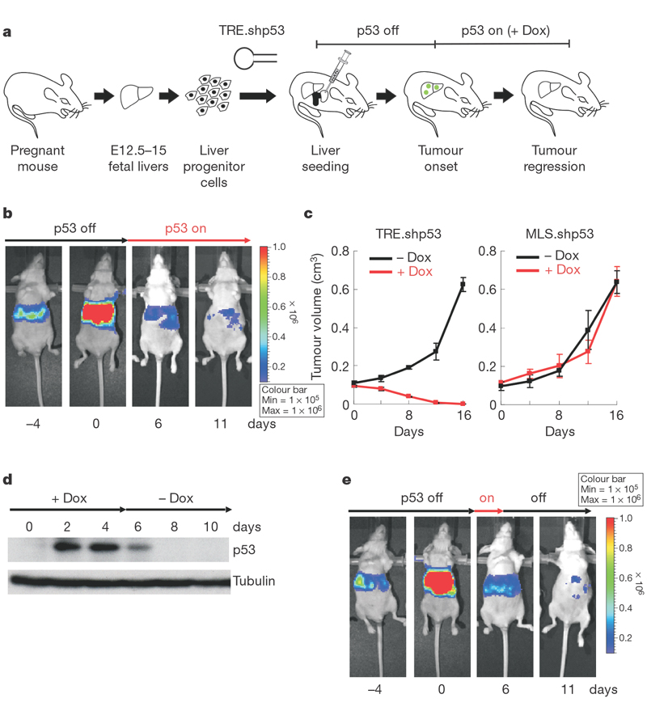
Restoration of p53 in liver carcinoma results in complete tumor regression
Xue et al Nature 2007

Slide 7
Strategies to reactivate p53
50% of tumors express
mutant p53
In 50% of tumors wtp53
is rendered non-functional
by deregulated p53 inhibitors
Mutant p53 Wild type p53
Small molecules which
stabilize the folding
of mutant p53
Small molecules which
release p53 from its inhibitor
(Mdm2)
Phenotypic screen: PRIMA-1
(Apr-246)
Biochemical screen: CP-31398
Rational design: PhiKan083
Phenotypic screen: RITA
Biochemical screen: nutlin, BDP
Rational design: MI-43

Slide 8
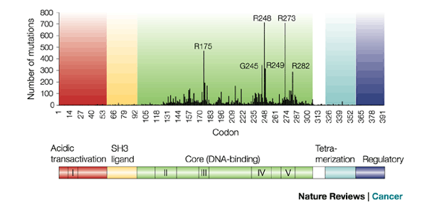
p53 mutations in tumors in the DNA binding inactivate p53
From: A.Bullock & A. Ferscht, Nat. Rev. Cancer, 2001

Slide 9
p53 is a transcriptional factor
Transcriptional complex
Transcription
p53
Specific DNA binding site
Pu Pu Pu C A/T A/T G Py Py Py
p53 responsive genes:
p21/WAF1
GADD45
MDM2
Bax
Noxa
PUMA
IGF-BP3

Slide 10
Mutant p53 accumulates in cancer due to inability to induce its own destructor Mdm2 E3 Ub ligase
p53
mutp53
activates
transcription
induces
degradation
No
transcription
activation
No
degradation
MDM-2
MDM-2

Slide 11
p53 mutations:
Occur in >50% of human tumors
The majority of p53 mutations are point missence mutations
Cluster in the core domain
Result in partial unfolding of the core domain
Mutant p53 proteins are overexpressed in tumors
Strategy:
to restore the tumor suppressor function of mutant p53 by stabilizing the folding of the core domain

Slide 12
PRIMA-1
(p53 reactivation and induction of massive apoptosis)
PRIMA-1:
Restores the DNA binding of at least
15 different mutants
Rescues p53 conformation and
trasncriptional transactivation
function of p53
Induces apoptosis in tumor cells
in vitro and in vivo in a mutant p53-
dependent manner
2,2-bis (hydroxymethyl)-1- azabicyclo[2,2,2] octan-3-one
Bykov et al, Nature Medicine 2002

Slide 13
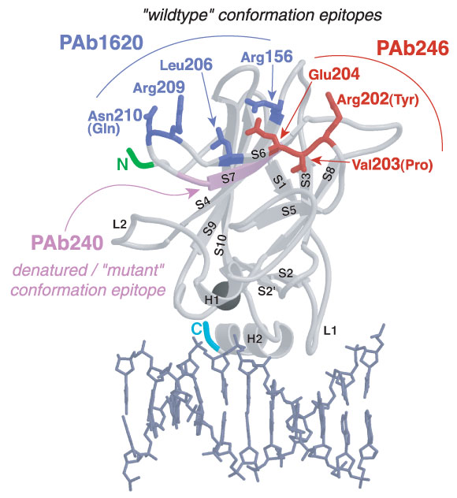

Slide 14


Restoration of tumor suppression function to mutant p53
PRIMA-1
(APR-246)
unfolded inactive p53
folded active p53

Slide 15
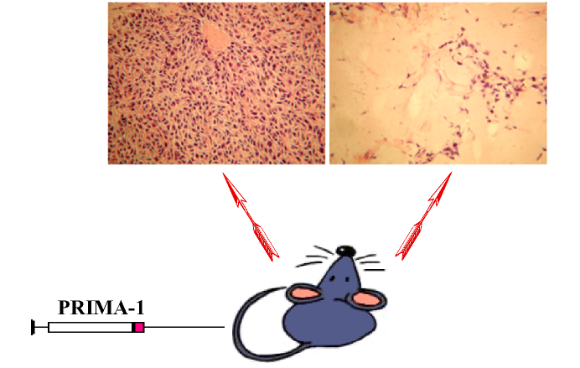
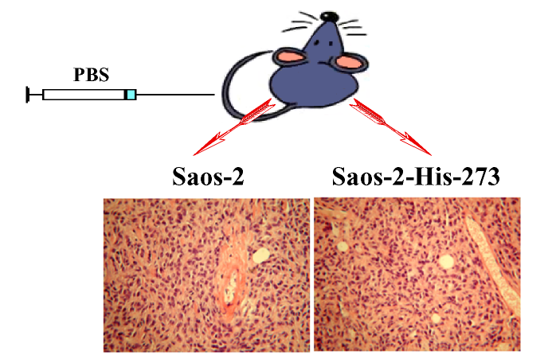
Mutant p53-dependent anti-tumor activity of PRIMA-1

Slide 16
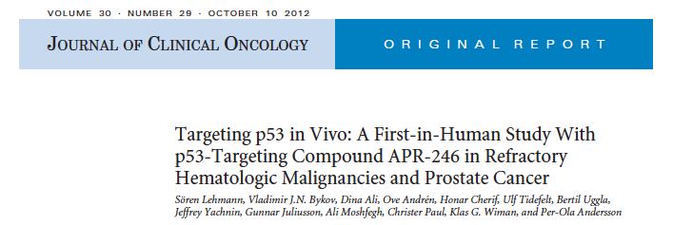
Phase I/II clinical trial with APR-246
32 patients with hematological malignancies (AML, CLL)
or hormone refractory prostate cancer
Dose escalation study, 4 days of treatment
Highest feasible dose (HFD)
Pharmacokinetics
Analysis of leukemic cells before and after treatment
Conducted by Aprea AB

Slide 17
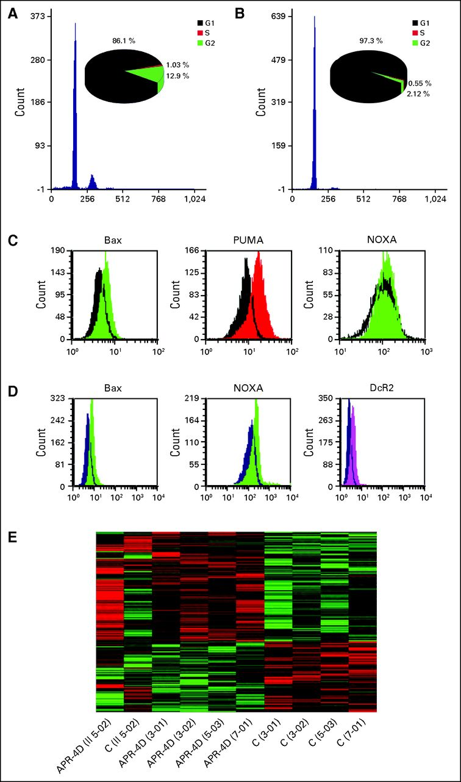
Cell cycle arrest and induction of p53 target genes Bax, PUMA, NOXA, and DcR2 by Apr-246 in tumour cells of patients
Lehmann S et al. JCO 2012;
30:3633-3639
©2012 by American Society of Clinical Oncology
Notes:
Representative flow cytometry histograms showing cell cycle analysis by the principal investigator (A) before and (B) after treatment in patient 5-02, and Bax, PUMA, NOXA1, and DcR2 plots before (black area) and after (colored area) for (C) patient 5-02 and (D) patient 5-03. (E) Heat map displaying clustering of the most differentially expressed genes (red, upregulation; green, downregulation) in circulating tumor cells in vivo by global gene expression array before (designated by “C”) and after 4 days of treatment (designated by “4D”) with APR-246, as analyzed by gene expression array. II before 5-02 indicates second treatment course.

Slide 18
Phase Ib/II proof-of-concept clinical trial of APR-246 in ovarian cancer, started 2014
The Phase Ib/II trial: to evaluate the safety, efficacy, pharmacokinetics and pharmacodynamics of APR-246 in combination with carboplatin and pegylated doxorubicin
It is a two-part study that will enroll 180 patients
Part A: to evaluate the safety and tolerability of APR-246 in combination with carboplatin and pegylated doxorubicin
Part B: to investigate the anti-tumor activity of APR-246 in combination with carboplatin and pegylated doxorubicin. Primary end point will be Progression Free Survival (PFS)
For details on the PiSARRO trial please visit: www.ClinicalTrials.gov Phase I/II clinical trial of APR-246 in ovarian cancer
www.aprea.com

Slide 19
Strategies to reactivate p53
50% of tumors express
mutant p53
In 50% of tumors wtp53
is rendered non-functional
by deregulated p53 inhibitors
Mutant p53 Wild type p53
Small molecules which
stabilize the folding
of mutant p53
Small molecules which
release p53 from its inhibitor
(Mdm2)
Phenotypic screen: PRIMA-1
(Apr-246)
Biochemical screen: CP-31398
Rational design: PhiKan083
Phenotypic screen: RITA
Biochemical screen: nutlin, BDP
Rational design: MI-43

Slide 20
A number of pathways that inactivate wtp53 in tumors converge on Mdm-2-mediated degradation of p53
overexpression of
Bmi1, TWIST, TBX2,
p14ARF negative regulators
Mdm-2:
amplifications
Inactivation of p14ARF
by gene deletions
p53
Mdm-2
Inactivation of
ATM , Chk2 and PTEN
by mutations
Activation of
Akt, HER-2/neu :
amplification or overexpression

Slide 21
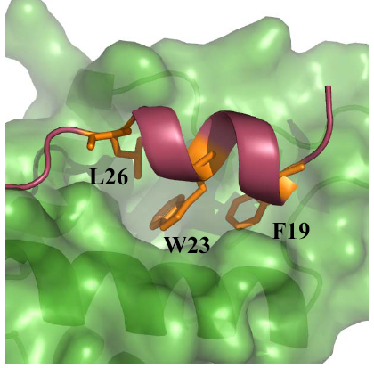
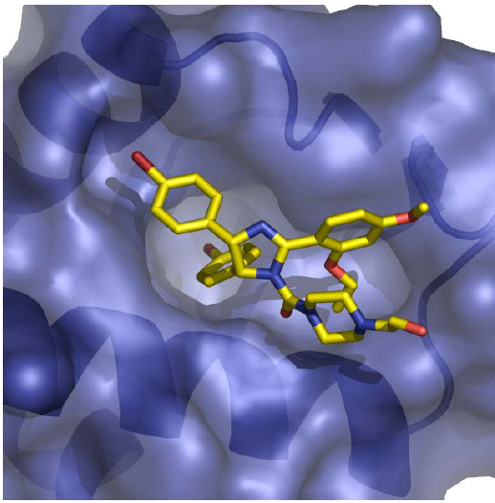
Nutlin binds to the p53 binding site of Mdm2
Hoffman-LaRoche, Vassilev et al, Science 2004
Screening: incubation of library compounds with Mdm2, analysis of binding to p53 by BiaCore
p53 N-terminal peptide in complex with Mdm2 Nutlin in complex with Mdm2

Slide 22
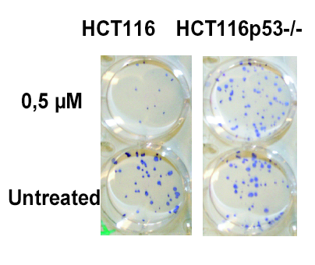
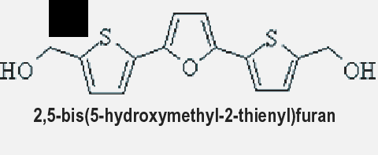
Identification of RITA
RITA
- induces apoptosis in tumor cells in a p53-
dependent manner
induces p53 level and transcriptional activity
- prevents interaction of p53 with MDM2
and other p53 inhibitors (iASPP, Parc)
- suppresses tumor growth in vivo in a p53-
dependent manner
Reactivation of p53
Induction of
Tumor cells’
Apoptosis
Issaeva et al, Nature Medicine, 2004

Slide 23

Wt p53-dependent anti-tumor activity of RITA
RITA,
1 mg/kg
HCT116
p53+/+
HCT116
p53-/-
5 days post inoculation
(tumors reached 8-16 mm3)
the animals received 7 i.p. injections
of RITA or PBS
RITA,
10 mg/kg
PBS

Slide 24
Wt p53 reactivation: from lab bench to clinic
Disruption of nucleoli
ActD, BMH-21, CX5461
CDK inhibitor roscovitine
Blocking p53 binding site
Nutlins SJ-172550
MI series XI-006
LCA,RO5963
ATSP-7041
L5, L11
Inhibitors of nuclear export
i.e., Leptomycin B
Mdm2
MdmX
Inhibitors of E3 ligase activity
HLI373, Sempervirine.
MEL23
Crm1
p53-binding molecules
i.e., RITA, CDB3
p53
Quanacrine,
curaxins
FACT
SIRT1
Tenovins,
inauhzin

Slide 25
A precisely tuned level of p53 activity is required for a long cancer-free life
p53 mouse models:
p53 KO p53-/- spontaneous tumors
Super p53 p53+/+/+ tumor-free,
increased protection from
carcinogen-
induced tumors
”m” allele p53 tumor-free,
but: premature aging
Mdm-2 KO p53 embryonic lethality
or destruction of tissues
in adult mice upon
switching on p53
(normal level, but greatly
enhanced in response to stress)
(constitutively activated)
(uncontrolled activity
in the absence of Mdm-2)

Slide 26

Manipulation of p53 for a longer cancer-free life
Model: different outcome upon pharmacological reactivation of p53 by small molecules APR-246, RITA, nutlin
?
DNA repair
Tumor
prevention
Tumor
survival
Growth arrest
?
?
Tumor
eradication
Apoptosis

Slide 27
Combination therapy: small molecules and immunotherapy?

Slide 28
Mutant p53 accumulates in cancer due to inability to induce its own destructor Mdm2 E3 Ub ligase
p53
mutp53
activates
transcription
induces
degradation
No
transcription
activation
No
degradation
MDM-2
MDM-2

Slide 29
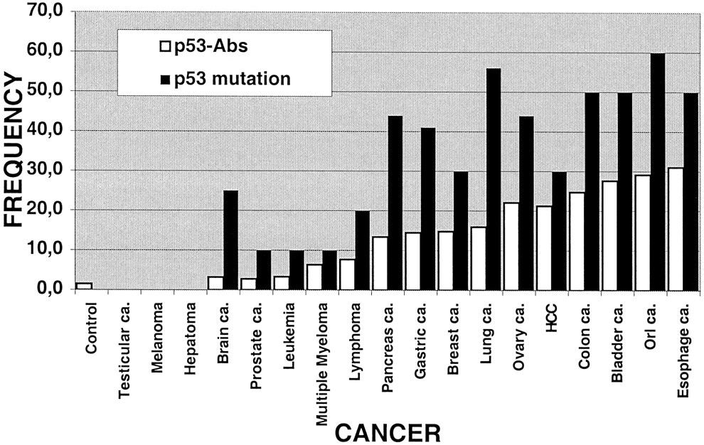

Relationship between the frequency of p53 mutation and p53 antibodies in various types of cancer.
p53-specific serum auto-antibodies (p53-Aab) can be detected in patients with many types of cancer,
indicating the presence of p53-specific T-helper (Th) cells
Dying tumour cells taken up by professional APCs can serve as potent immunogens for B-cell and Th-cell activity
Thierry Soussi Cancer Res 2000;60:1777-1788
©2000 by American Association for Cancer Research
Notes:
Relationship between the frequency of p53 mutation and p53 antibodies in various types of cancer. The frequency of p53 mutations is taken from the literature, and the frequency of p53-Abs is taken from Table 1 <$REFLINK> .

Slide 30
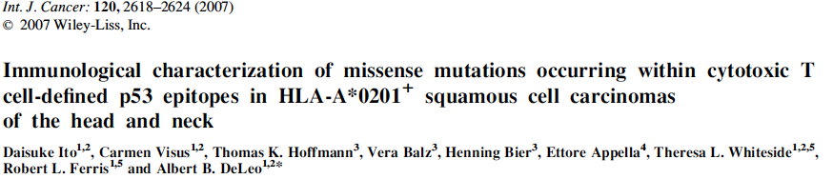
Vaccine to mutant p53
Anti-p53 Y220C effector cells were specific for mutant p53 peptide, but not wtp53
The frequency of Y220C mutation is 1.5%
Vaccine targeting this mutation could be applicable to a number of patients

Slide 31
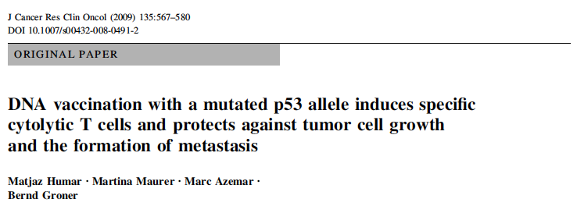
Vaccine to mutant p53 cont-d
In vivo DNA vaccination using mutant p53 expressing plasmid induced ant-p53 CTLs
and
mutant-p53 specific protection from tumor growth and metastasis

Slide 32
Wild type p53 as a target
for immunotherapy?

Slide 33
DNA damage checkpoint activation: induction of p53 in response to oncogenic stimuli
Activated oncogenes
Telomere
erosion
Unscheduled replication
Aberrant replication
structures
DNA damage
ATR/Chk1
γ-H2AX
ATM/Chk2
p53
Growth arrest or cell death
Selection pressure
against early tumour progression
Halazonets and co-authors,
Bartek and co-authors
Nature, 434, 2005

Slide 34
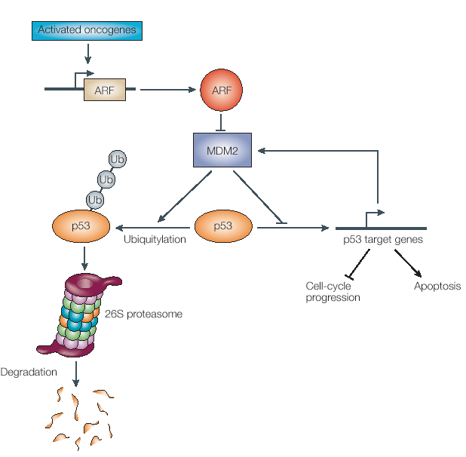
Induction of p53 upon oncogene activation
Checkpoint kinases
p14ARF:
Inhibits Ub-nation by Mdm-2
Sequesters Mdm-2 to the nucleolus
ATM, ATR, DNA-PK, Chk2
Phosphorylate the N-terminus of p53
ATM:
Phosphorylates Mdm-2
Acetylation?

Slide 35
In the absence of stress p53 level is low due to the negative feed-back loops
ARF
represses
transcription
prevents
degradation
p53
activates
transcription
induces
degradation
MDM-2

Slide 36
Upon DNA damage or oncogene activation these feedback loops are disrupted
Oncogenes
ARF
represses
transcription
prevents
degradation
p53
activates
transcription
induces
degradation
Chekpoint
kinases
MDM-2

Slide 37
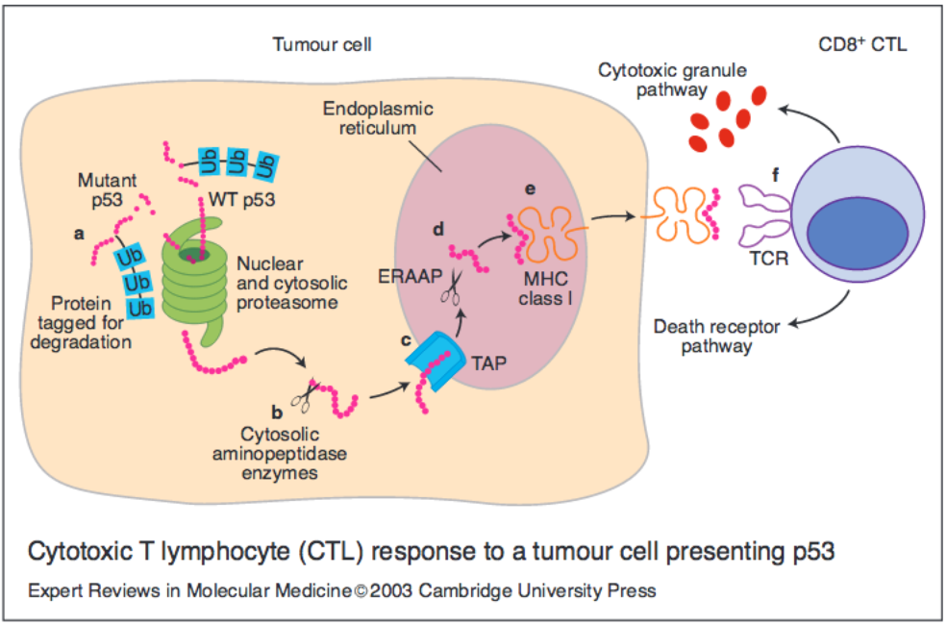
p53-derived peptides can be presented by MHC class I molecules
- p53 degradation generates a repertoire of wtp53-derived peptides available for binding to nascent class I MHC molecules
- Tumor cells presenting such epitopes can be recognized by wtp53-specific CTLs in vitro.
- Anti-p53 CTLs are able to eradicate tumors efficiently in vivo without damage to normal tissues -> these CTLs were truly tumor-specific

Slide 38
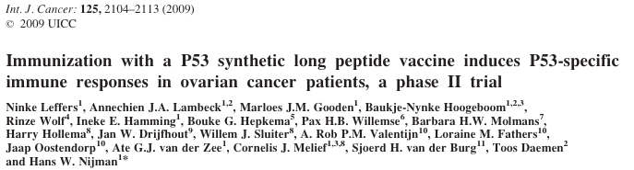
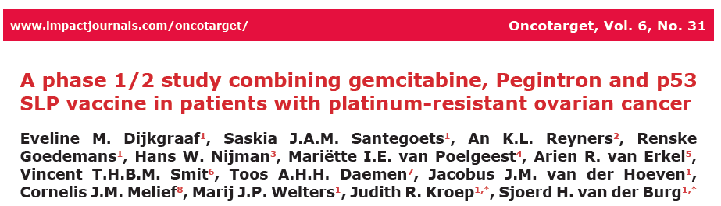
Clinical trials
p53 SLP vaccine : 3 mg/peptide, 9 peptides 25-30 residues long spanning 70-235 a-a residues of p53
All vaccinated patients showed strong vaccine-induced
p53-specific T-cell responses.

Slide 39
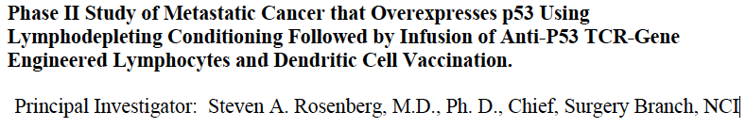
Clinical trials-2
Adoptive transfer of lymphocytes expressing murine T-cell receptors specific for p53 (264-272) and infusion of high dose IL-2.
Among 10 patients enrolled, 1 had objective partial tumor regression.
TCR-modified cells were detectable in patient’s blood 1 months after adoptive transfer

Slide 40
Conclusions
p53-specific CTLs are highly desirable tool for targeted immunotherapy for a wide range of cancers
TCR gene transfer into CD8+ T cells could be a good strategy
DNA vaccine?

Slide 41




Thanks to
Yao Shi
Hai Li
Gema Sanz
Fedor Nikulenkov
Vera Grinkevich
Elisabeth Hedström
Martin Enge
Clemens Spinnler
Natalia Issaeva
Alexander Shilov
Collaborators:
Karolinska Institutet, Stockholm:
Elias Arner
Klas Wiman
Sören Lehmann
Jussi Taipale
Olle Sangfeldt
Alexander Kel, geneXplain, Germany
Katerina Gurova, Roswell Park Cancer Institute, USA

