Slide 1
NK-MEDIATED CYTOLYSIS IN GLIOBLASTOMA, TRIGGERED BY VIRAL THERAPY
E. Marion Schneider, Haouraa Mostafa, Andrej Pala, Arno Thaller,
Michael Georgieff, C. Rainer Wirtz

Slide 2
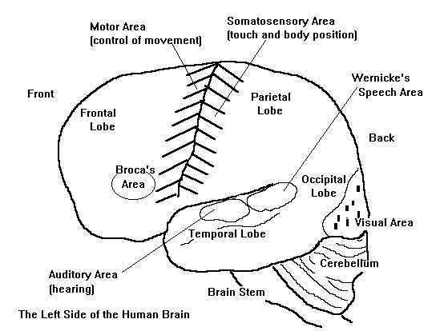
Patients
 |  | Patients | Controls
Sex | male | 32 | 14
 | female | 19 | 23
Ages | ≤ 50 | 15 | 30
 | > 50 | 36 | 7
Resection | total | 26 | -
 | subtotal | 25 | -
IDH | positive | 13 | -
 | negative | 35 | -
16
6
5
3
3
2
5
11
IDH= Isocitrate dehydrogenase 1
www.ib-psychology.wikispaces.com

Slide 3
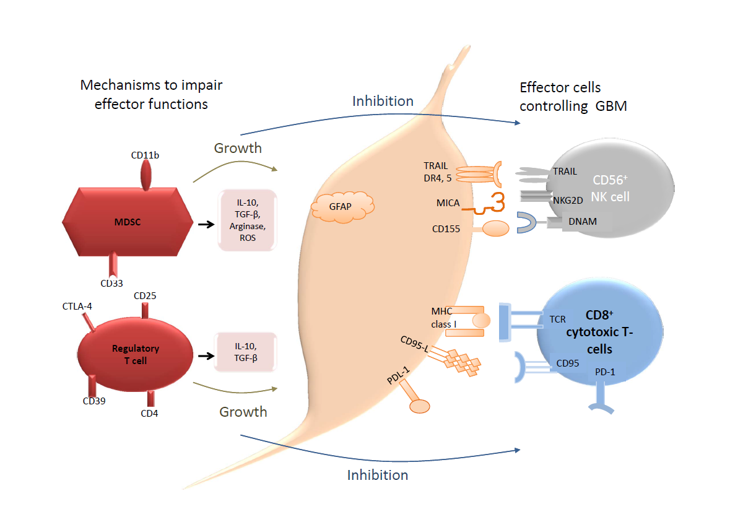

Slide 4
Median overall survival of GBM patients
CD95
CD56⁺
NK cell
TRAIL
NKG2D
DNAM
Median OS: 19 months

Slide 5
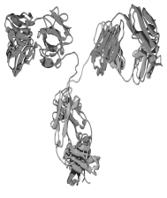

Antibody binding to GBM antigens
GBM
CD95-ligand
TRAIL receptors DR4, DR5
CD95
FcR
CD56⁺
NK cell
MICA
TRAIL
CD155
NKG2D
HLA class I
DNAM
Median OS: 19 months

Slide 6
CD8 in GBM patients.
Results
CD8⁺ CTL
TCR
CD95
PD-1
CD8 is significantly diminished in GBM patients and correlates with prolonged survival.

Slide 7
Results
Increased CD56/CD16 expression in DC-treated GBM patients plus NDV

Slide 8
Results
p=0.0079

Slide 9
Xenogeneic Virotherapy increases the relative amount of NK cells (CD56+) inGBM patients after radio-chemotherapy
Conclusion
The relative amounts of CD16+ (activated) NK cells are not upregulated by virotherapy
Upregulation of CD16 and DNAM-1 appears to require dendritic cell therapy in addition to xenogeneic viruses

Slide 10
Results
Cell lines | sex | age [y] | PDL-1 [%] | TRAIL DR5 [%] | CD155 [%] | CD95 [MFI] | MICA [MFI] | HLA class I [MFI] | HLA DR [MFI]
#12537 | m | 63 | 30 | 63 | 100 | 5733 | 617 | 4500 | 496
#15520 | f | 62 | 12 | 72 | 95 | 11652 | 3975 | 8233 | 357
#15537 | m | 58 | 9 | 89 | 100 | 11481 | 6219 | 6526 | 62
#15604 | m | 70 | 62 | 85 | 100 | 10347 | 2378 | 4282 | 0
#15677 | m | 62 | 2 | 81 | 100 | 8077 | 4157 | 5395 | 59
#15734* | m | 58 | 1 | 44 | 68 | 6862 | 1972 | 1990 | 0
#16112* | f | 24 | 2 | 49 | 95 | 8572 | 3911 | 4599 | 0
#16143 | f | 64 | 2 | 59 | 95 | 10823 | 8526 | 3068 | 0
GBM cell lines express NK recognition receptors, but differ regarding their expression densities

Slide 11
GBM cells differ in their susceptibilty for NK-mediated killing.
Results
Cell lines | sex | age [y] | PDL-1 [%] | TRAIL DR5 [%] | CD155 [%] | CD95 [MFI] | MICA [MFI] | HLA class I [MFI] | HLA DR [MFI]
#12537 | m | 63 | 30 | 63 | 100 | 5733 | 617 | 4500 | 496
#15520 | f | 62 | 12 | 72 | 95 | 11652 | 3975 | 8233 | 357
#15604 | m | 70 | 62 | 85 | 100 | 10347 | 2378 | 4282 | 0
Susceptibility to NK-mediated cytolysis corrrelates with high MICA and PD-L1 expression and low HLA- classI and class II antigens

Slide 12
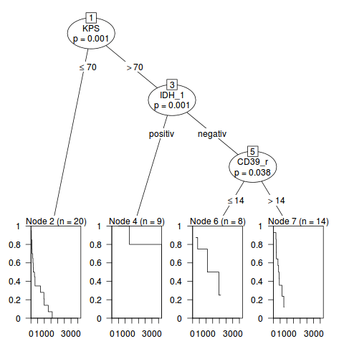
Regulatory T cells in GBM.
Results
CD25
Regulatory
T cell
CD39
CD4
CD39 is significantly elevated in GBM patients and correlates with poor survival.

Slide 13
Summary
DC therapy combined with virotherapy may stimulate the population of
NK effectors in GBM patients with relapse after radio chemotherapy
The effect on CD39 positive regulatoy T cells needs further investigations
A coiDC therapy combined with virotherapy may stimulate the population of
NK effectors in GBM patients with relapse after radio chemotherapy

Slide 14
Glioblastoma Biology Group
Anesthesiology (Georgieff)
Haouraa Mostafa
Elvira Dietrich
Philip Sander
Ayman Soboh
Neurosurgery (Wirtz)
Andrej Pala
IOZK (Stücker)
Stefaan van Gool
Electron Microscopy
Paul Walther
Pathology
Peter Möller
Angelika Scheuerle
Pediatrics (Debatin)
Andrew M. Westhoff
Lisa Nonnenmacher

