Slide 1
MODIFIED KLINTRUP-MAKINEN INFLAMMATION SCORE IN RELATION TO INVASIVE PROPERTIES OF COLORECTAL CANCER
Drike I, Strumfa I, Vanags A, Gardovskis J
Department of Pathology, Riga Stradins University, Riga, Latvia
Notes:
Good afternoon dear proffesors, dear collegues. I’m Inese Drike from Riga Stradins University and please let me introduce you with our research MODIFIED KLINTRUP-MAKINEN INFLAMMATION SCORE IN RELATION TO INVASIVE PROPERTIES OF COLORECTAL CANCER .

Slide 2
Introduction
The progression of colorectal cancer and patient’s survival depends on many factors, including the characteristics of peri- and intra-tumoural inflammation (Klintrup et al., 2005; Roxburgh et al., 2009).
Inflammatory infiltration into invasive margin of tumour has been associated with increased survival (Richards et al., 2012).
Notes:
Colorectal cancer is one of the most frequent malignancies in western world. The progression of colorectal cancer and patient’s survival depends on many factors, including the characteristics of peri- and intra-tumoural inflammation. Inflammatory infiltration into invasive margin of tumour in some researches has been associated with increased survival.

Slide 3
Aim
The aim of our study was to evaluate inflammation in colorectal cancer in relation to the manifestations of invasive tumour growth.
Notes:
The aim of our study was to evaluate inflammation in colorectal cancer in relation to the manifestations of invasive tumour growth.

Slide 4
Material and methods
The study included 262 consecutive retrospective cases of colorectal cancer, subjected to microscopic evaluation and statistical analysis.
Microscopically peritumoural inflammation was evaluated using Klintrup-Makinen inflammation score
The invasive potential was evaluated by the presence of lymphatic (LY), perineural (PN) and intraneural (IN) invasion.
Notes:
The study included 262 consecutive retrospective cases of colorectal cancer. Microscopically peritumoral inflammation was evaluated using previosly published Klintrup-Makinen inflammation score. The tumour invasive potential was evaluted by the presence of lymphatic, perineural and intraneural invasion.

Slide 5
Material and methods II
After qualitative assessment of Klintrup-Makinen overall peritumoural inflammation score, the identified groups (no inflammation versus mild versus moderate versus severe inflammation) were distributed into two classes:
  low-grade (no or mild inflammation) versus high-grade (moderate or severe) inflammation.
Descriptive statistical analysis was performed including calculation of 95% confidence interval (CI) by CIA software (Altman et al., 2000).
Chi-square test was also applied. Any differences were considered significant if p < 0.05.
Notes:
After qualitative assessment of Klintrup-Makinen overall peritumoural inflammation score, the identified four groups (no inflammation versus mild versus moderate versus severe inflammation) were distributed into two classes:
low-grade (no or mild inflammation) and high-grade (moderate or severe) inflammation.
Descriptive statistical analysis was performed .

Slide 6
Results
The study included 262 cases of colorectal cancer
15.3%
[11.4 – 20.1]
32.4%
[27.1 – 38.3]
50.4%
[44.4 – 56.4]
Notes:
The study included 262 cases of colorectal cancer
There were 132 cases of pT3 tumours, 85 pT4 cancers and 40 pT2 cases

Slide 7
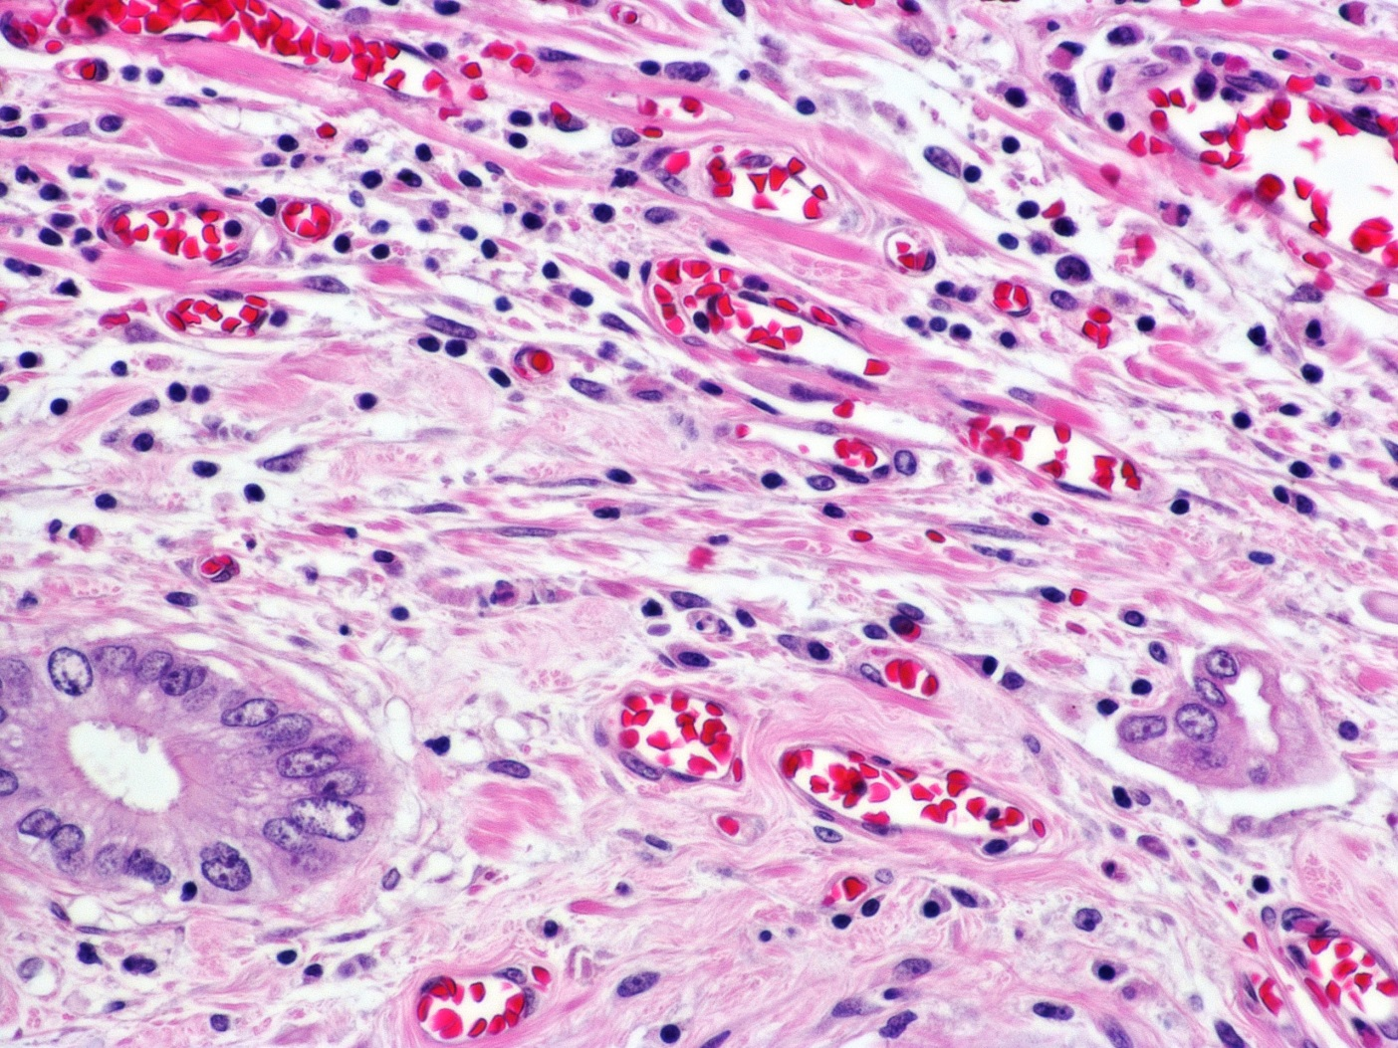
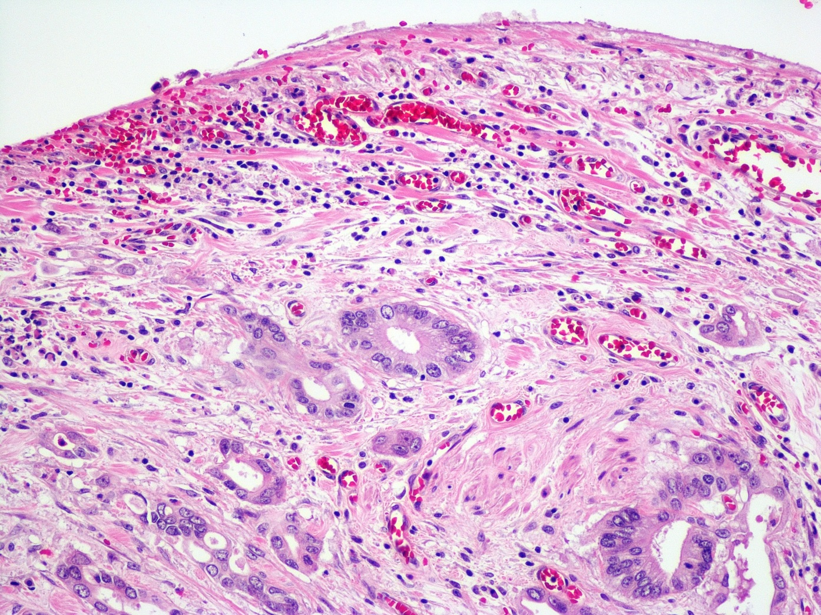
Klintrup-Makinen overall peritumoural inflammation score
Low-grade inflammation:
  62 (46.9% [38.7 – 55.4]) pT3
  51 (60.0% [49.4 – 69.8]) pT4
Notes:
Low-grade inflammation was seen in 62 (46.9% [38.7 – 55.4]) pT3 and 51 (60.0% [49.4 – 69.8]) pT4 cancers
And here in this picture we can see low to mild inflammation in invasive front of cancer.
In higher magnification we can see low amount of lymphocytes, no neutrophils, no no eosinophil leucocytes, some monocytes in invasive border

Slide 8
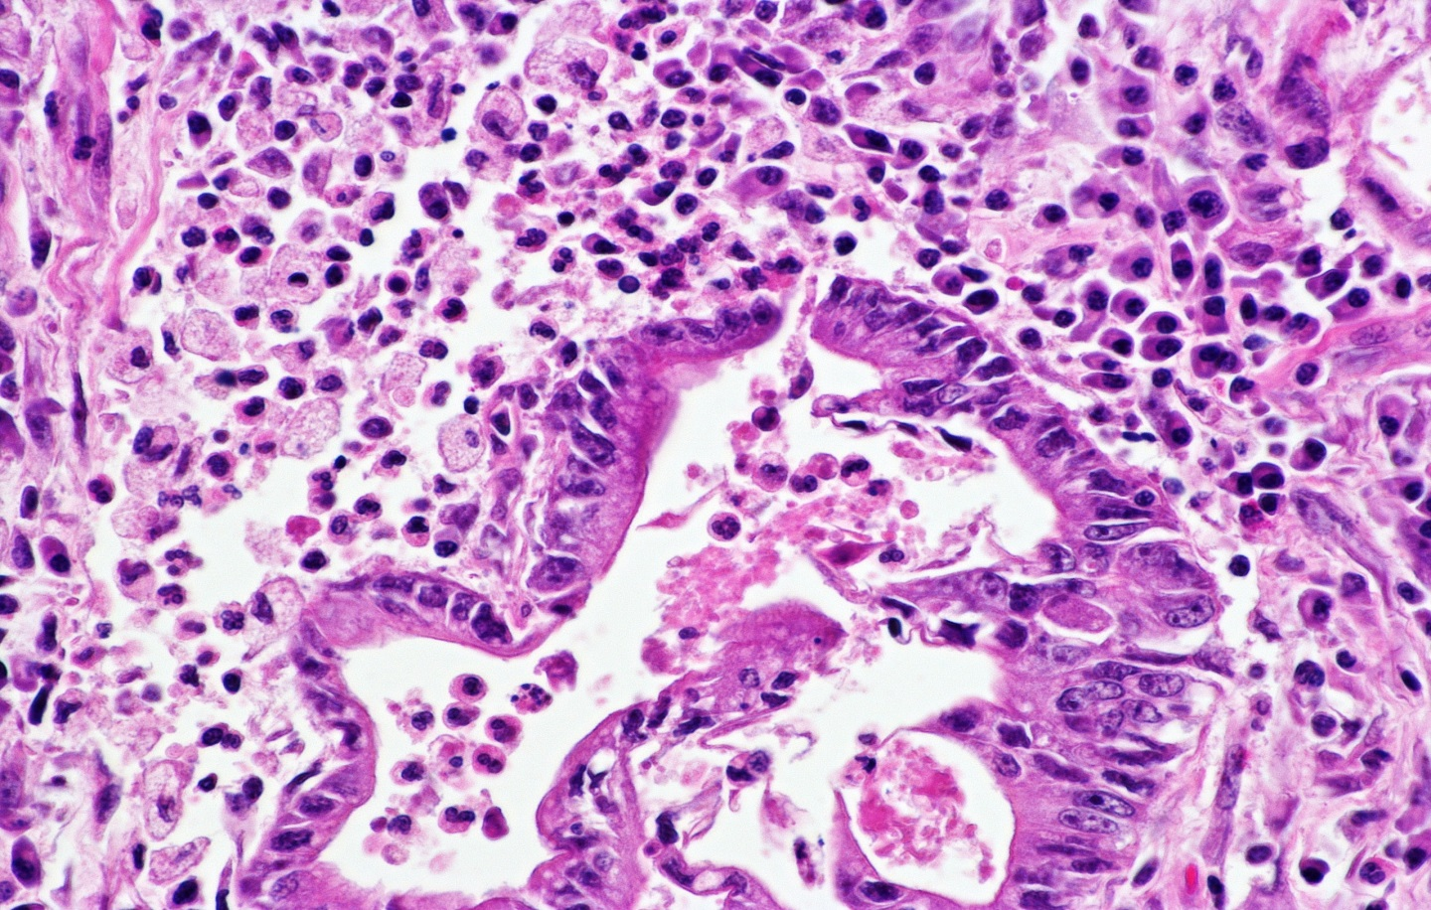
Klintrup-Makinen overall peritumoural inflammation score
High-grade inflammation
  25 (62.5% [47.0 – 75.8]) pT2;
  70 (53.0% [44.5 – 61.3]) pT3;
  34 (40.0% [30.2 – 50.6]) pT4
Inflammatory cells infiltrating cancer complexes
Notes:
High-grade inflammation was found in 25 (62.5% [47.0 – 75.8]) pT2; 70 (53.0% [44.5 – 61.3]) pT3 and 34 (40.0% [30.2 – 50.6]) pT4 tumours.
And here in this picture In difference you can see higher amount and diverse cell component what infiltrates tumour complexes.

Slide 9
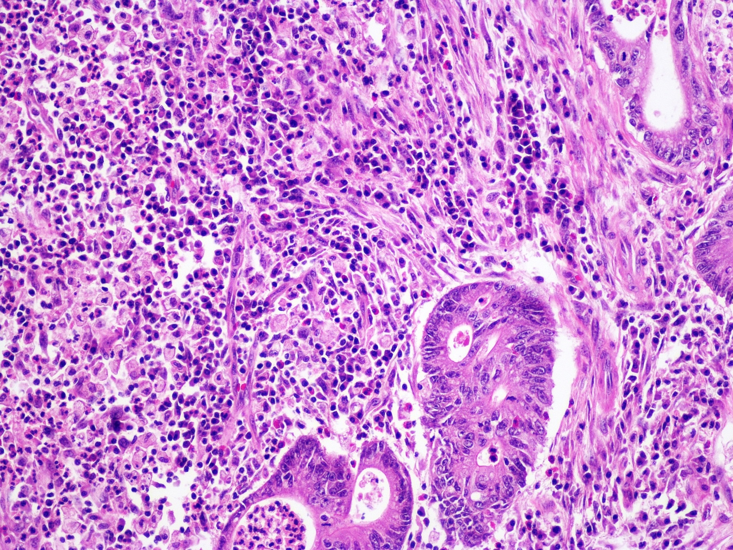
Increased density of inflammatory cells
Notes:
Also here we can see increased density of inflammatory cells around and between tumour complexes

Slide 10
Tumour invasion according to inflammation grade
66.1%
[57.5 – 73.8]
51.8%
[43.5 – 60.1]
40.7%
[32.8 – 49.2]
55.9%
[47.2 – 64.2]
Chi-square test revealed statistically significant difference between tumours exhibiting low-grade versus high-grade inflammation regarding lymphatic (p = 0.019) and perineural invasion (p = 0.014), but there was no statistically significant difference in case of intraneural (p = 0.201) invasion.
Notes:
When we analysed tumour invasivness potential we found that:
In cancers characterised by low-grade inflammation what you can see with light blue colour, lymphatic invasion was identified in 66.1% [57.5 – 73.8], intraneural invasion in 29.9% [22.6 – 38.4], and perineural invasion in 55.9% [47.2 – 64.2] of cases. In tumours showing high-grade inflammation, lymphatic invasion was seen in 51.8% [43.5 – 60.1], intraneural invasion in 22.9% [16.7 – 30.7], and perineural invasion in 40.7% [32.8 – 49.2] of cases. Chi-square test revealed statistically significant (defined as p < 0.05) difference between tumours exhibiting low-grade versus high-grade inflammation regarding lymphatic (p = 0.019) and perineural invasion (p = 0.014), but there was no statistically significant difference in case of intraneural (p = 0.201) invasion

Slide 11
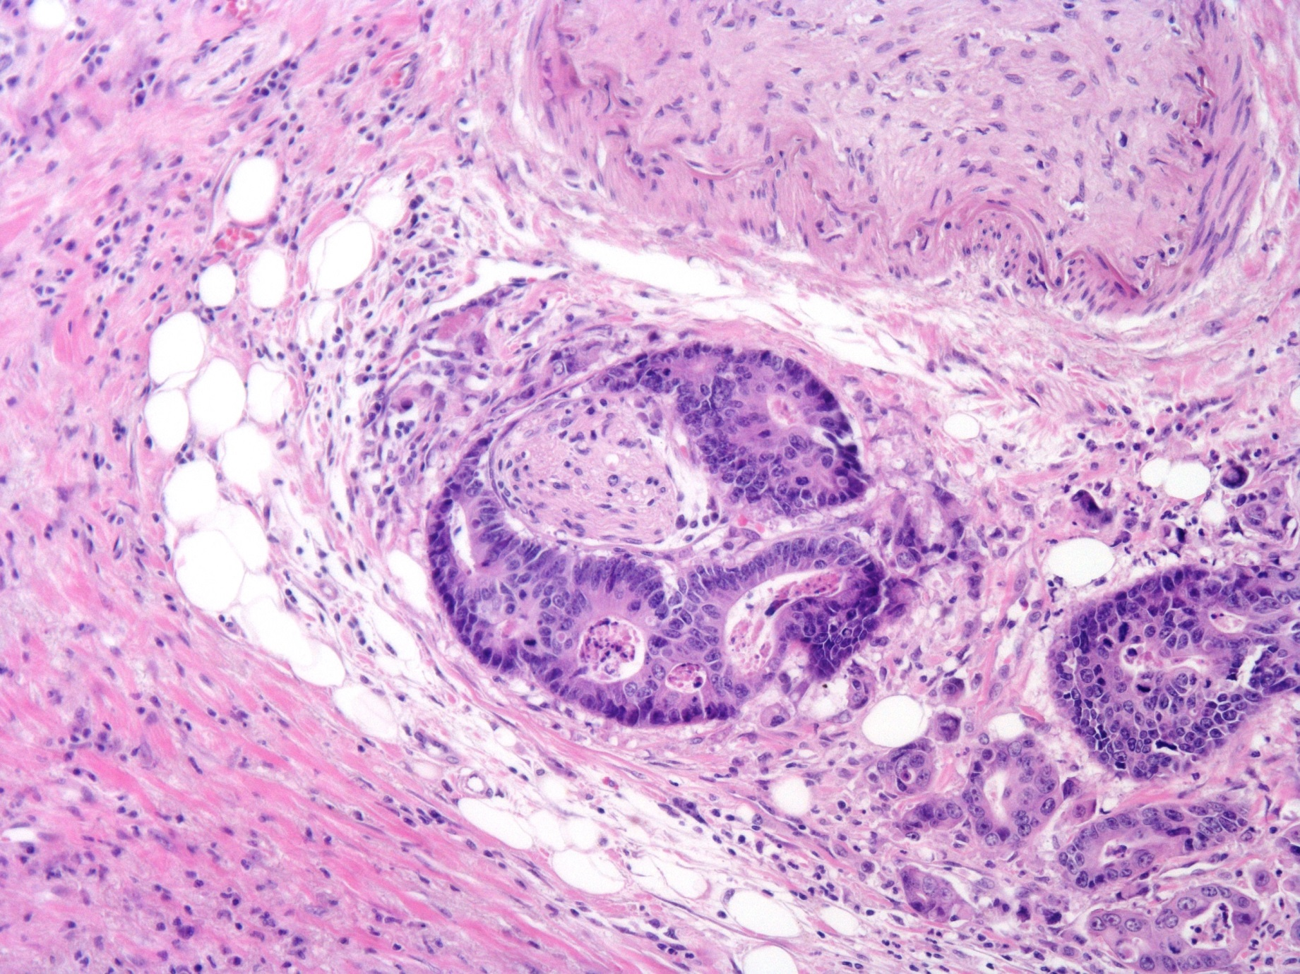
Adenocarcinomatous complexes around the nerve
Low grade inflammation
Notes:
In this picture you can see low grade inflammation around tumour complexes who are surrounding nerve structure.

Slide 12
Conclusions/ Discussion
In colorectal cancer, high-grade peritumoural inflammation is statistically significantly related to less frequent manifestations of invasive growth including lymphatic and perineural invasion.
Hypothetically, enhancement of inflammatory reaction by anti-cancer vaccination also could be favourable. The trend to less frequent occurrence of pT4 tumours in the class of colorectal cancer showing high-grade inflammation tends to reject hypothetic link between the assessed peritumoural inflammation and more advanced local tumour spread causing bowel obstruction.
Notes:
In conclusion I can say that:
In colorectal cancer, high-grade peritumoural inflammation is statistically significantly related to less frequent manifestations of invasive growth including lymphatic and perineural invasion. Thus, assessment of these parameters indirectly indicates that inflammation could be a beneficial prognostic factor.
Hypothetically, enhancement of inflammatory reaction by anti-cancer vaccination also could be favourable. The trend to less frequent occurrence of pT4 tumours in the class of colorectal cancer showing high-grade inflammation tends to reject hypothetic link between the assessed peritumoural inflammation and more advanced local tumour spread causing bowel obstruction.

Slide 13
Thank you!

